Slide 1

Forensic Psychiatry 1
Introduction to the Criminal Justice System

Slide 2
Psychiatry and the CJS
Aims and Objectives
To develop an understanding of
The structure and organisation of the criminal justice system
The mental health of prisoners and understand the complexities of their treatment
The structure and organisation of secure psychiatric services and the different levels of security
The framework around the management of mentally-disordered offenders
Part III Mental Health Act

Slide 3
Psychiatry and the CJS
To achieve this
Case Presentation
Journal Club
555 Presentation
Expert-Led Session
MCQs
Please sign the register and complete the feedback

Slide 4
Psychiatry and the CJS
Expert Led Session
An Introduction to the Criminal Justice System
Author: Dr Victoria Sullivan

Slide 5
Criminal Justice System
Police
Crown Prosecution Service (CPS)
National Offender Management Service (NOMS)
National probation service
HM Prison service
Youth Justice Board and Youth Offending Teams (YOT)
Notes:
NOMS
An executive agency of MOJ that brings together the administrative organisation of HM Prison service and National Probation Service
Aims to deliver end to end management of offenders through the offender pathway
Offender Management process involves
Aspire
Sentencing planning
Implementation
Review
Evaluation

Slide 6
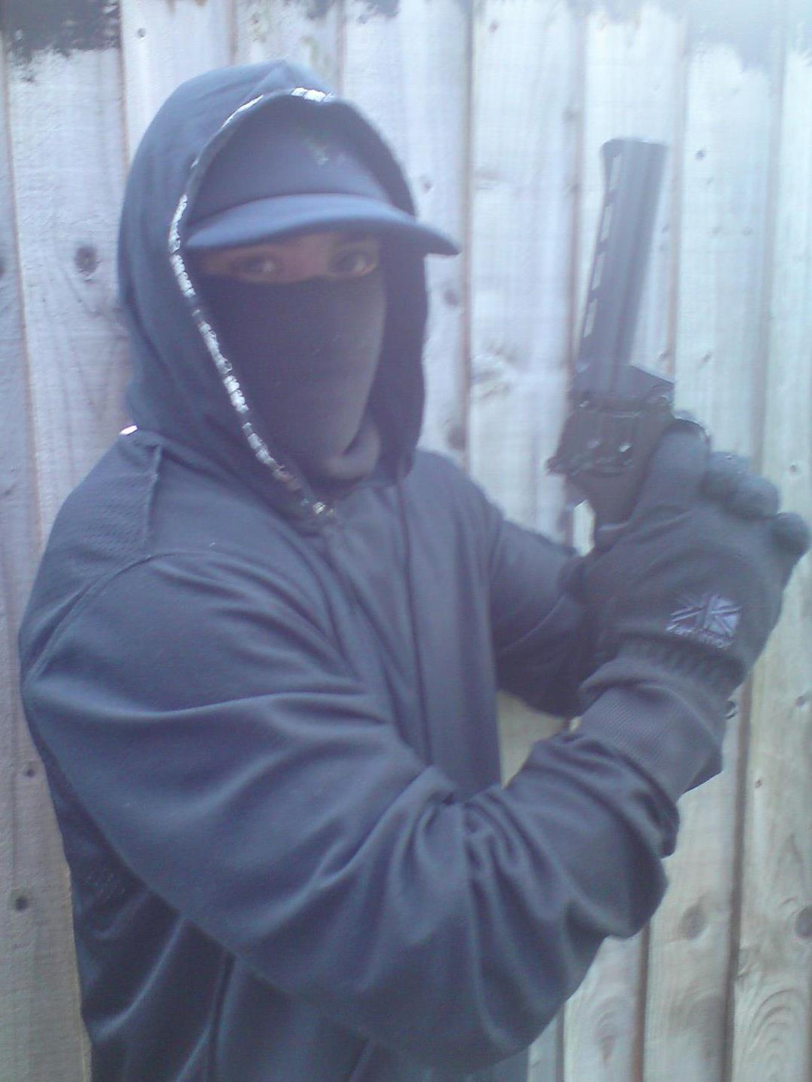
Meet Bob
22
Previously under EIT – psychosis NOS
No medication
Under arrest for armed robbery
Notes:
Bob is going to take us through the CJS
Previously under EIT – diagnosis of psychosis NOS. Some concern that he had presented with drug-induced psychosis. Using cannabis daily, some ‘dabbling’ of cocaine. Previous symptoms included persecutory beliefs that he had a chip implanted in a dental filling and that he was being monitored by ‘the feds’. Typical prodromal symptoms – something not quite right, dropped out of school, using substances to control symptoms
Had been started on olanzapine 10 mg/day but stopped taking after 6 weeks.
Lost to follow up
Forensic history – possession substances, assault, property damage etc
Not employed

Slide 7
Police detention

Slide 8


Slide 9
Appropriate Adult
Introduced to provide protection for vulnerable people at police station – witness / suspect
Required for anyone who is
Mentally disordered
Mentally vulnerable
Under the age of 17
Role is
To advise the person being questioned
To observe that the interview is conducted properly and fairly
To assist in communication (may explain words or procedures)
Notes:
Introduced by PACE to provide protection for vulnerable people at a police station – whether a suspect or witness
AA is required when dealing with anyone who is
Mentally disordered (as defined in MHA- code C PACE)
Mentally vulnerable (has difficulty understanding significance of the questions or their replies for whatever reason, including problems with physical health or mental health, drugs or alcohol)
Under the age of 17
Low threshold for calling an AA – when the custody officer has any doubt about the mental state or capacity of a detainee
AA may be
The guardian, relative or other person responsible for the person’s care
Someone who has experience of dealing with mentally-disordered or vulnerable people (often a MH social worker) – not employed by the police
Some other responsible person aged 18 or over, who is not employed by the police
Not anyone involved in the offence or investigation
So may preclude a the person’s CMHT social worker if the person has made admissions to them in relation to the offence
No statutory duties placed on local authorities to provide AA and no comprehensive duties.
Rights include
Private consultation
To have information about the grounds for detention and to see the custody record
To request legal advice (for the detainee)
Reading of rights and interviewing must be done in presence of AA, and the suspect should be charged and cautioned in their presence again
At interview, the police officers must explain that the role of the AA is
To advise the person being questioned
To observe that the interview is conducted properly and fairly
To assist in communication (may explain words or procedures)

Slide 10
Psychiatrist in Police Station
Issues that may be encountered:
Fitness for detention
Fitness for interview
Risk assessment
Observation
Need for appropriate adult
Medication
Further psychiatric treatment / placement
Notes:
Important, when conducting assessments in police station to
Have a sound knowledge of relevant legal rights and procedures including PACE, MHA and MCA
Understand roles and authority of other individuals present
Be clear about the boundaries as your role as a psychiatrist and understand on which issues your decision is authoritative and on which you are only giving advice
Ensure that you have effective clinical supervision
Issues that you may encounter
Fitness for detention (no statutory definition – are unfit if they need immediate medical investigation or treatment in hospital and the consequences of not receiving this are serious)
Fitness for interview (will be discussed in a later LEP session)
Risk assessment – DSH / suicide / harm to others (Need to document this in custody record, inform custody sergeant and keep own notes)
Medical advice to be given to detainee / custody staff
Any requirements for changes to standard observation procedures
Whether there is a need for an AA
Information about required medication
Decision about appropriate setting for any further psychiatric treatment – including MHA assessment and appropriate placement
You should not be asked about fitness to be charged – this is a passive process and requires no capacity on the individual being charged. A police interview is not a prerequisite for being charged.
You need to consider what information you pass onto the police officers responsible for detention. You MUST always take your notes away with you. If you leave them they become part of the custody record and therefore will not longer be confidential.
PACE
Police and Criminal Evidence Act 1984
Custody Officer – statutory duties
Deciding to detain
Welfare of detained persons
Calling an appropriate adult
Risk assessment
Rights
Liaise with health-care professionals
PACE provides and regulates the majority of police powers
There are a number of codes of practices.
Custody officer is at centre of PACE procedures.
Independent of the investigation
Is at least the rank of sergeant
Has undergone specific training
Is responsible for ensuring all detainees are head and dealt with in accordance with PACE.
Responsible for statutory functions
Deciding whether to detain following arrest
Welfare of detained persons – including mental / physical health and language difficulties
Calling an appropriate adult when appropriate to do so
Conducting a risk assessment
Informing detained person of their rights
Compiling and maintaining a custody record
Calling and liaising with health-care professionals and solicitors
Rights of an individual detained in police custody
To have someone of their choice informed of their arrest
To have free and private legal advice from a solicitor
To examine the custody record, which can be requested for up to 12 months after the period of detention, and to have the code of practice
To an appropriate adult where appropriate
To have at least 8 hours on uninterrupted rest in any 24 hour period, not disturbed by interviews or travel (starts from time of arrest)

Slide 11
Bob in police custody
Interviewed with appropriate adult
Seen by psychiatrist – fit to be interviewed
‘No comment’ interview
Charged with armed robbery and possession imitation firearm
Remanded to prison
Notes:
Serious Crime Act 2007 (s21)

Slide 12
Prisons and prisoners

Slide 13
Category of Prisons
Male Prisons
May be closed, open, local and training
A – for prisoners whose escape would be considered highly dangerous / threat to national security
B – for prisoners whose escape must be made very difficult
C – for prisoners who cannot be trusted in open conditions
D – for prisoners who can be reasonably trusted in open conditions
Female Prisons
May be closed, semi-open or open
There is only one separate category (A) and ‘all other prisoners’
Notes:
Bob likely to have been remanded to a local prison. Given the nature of his crime (armed robbery, firearms etc) what category would Bob fit?
139 Prisons in England and Wales. MALE Prisons may be
Closed – security measures prevent escape
Open – prisons have more freedom within prison and may go out into the community
Local – usually for unsentenced prisoners or those with short sentences – are all closed prisons
Training – more availability of programmes to reduce offending – may be open or closed
Categories of MALE prisoner
A – those whose escape would be considered highly dangerous to the public or a threat to national security
B – those for whom escape must be made very difficult (all unconvicted adult prisoners will be classed as B until sentenced)
C – Prisoners who cannot be trusted in open conditions
D – prisoners can be reasonably trusted in open conditions
Unless you’re a category A prisoner, automatically B on reception into prison
Female prisoners are not classified in same way – only A is a separate category
Women’s prisons may be
Closed, semi-open and open
Unconvicted adult female prisoners will be held in closed conditions

Slide 14
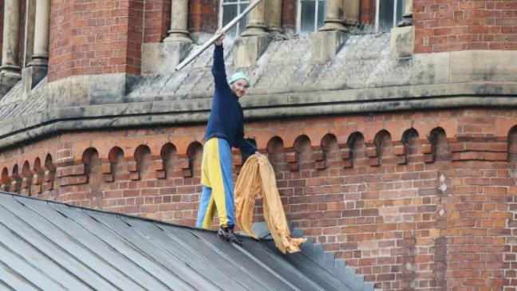
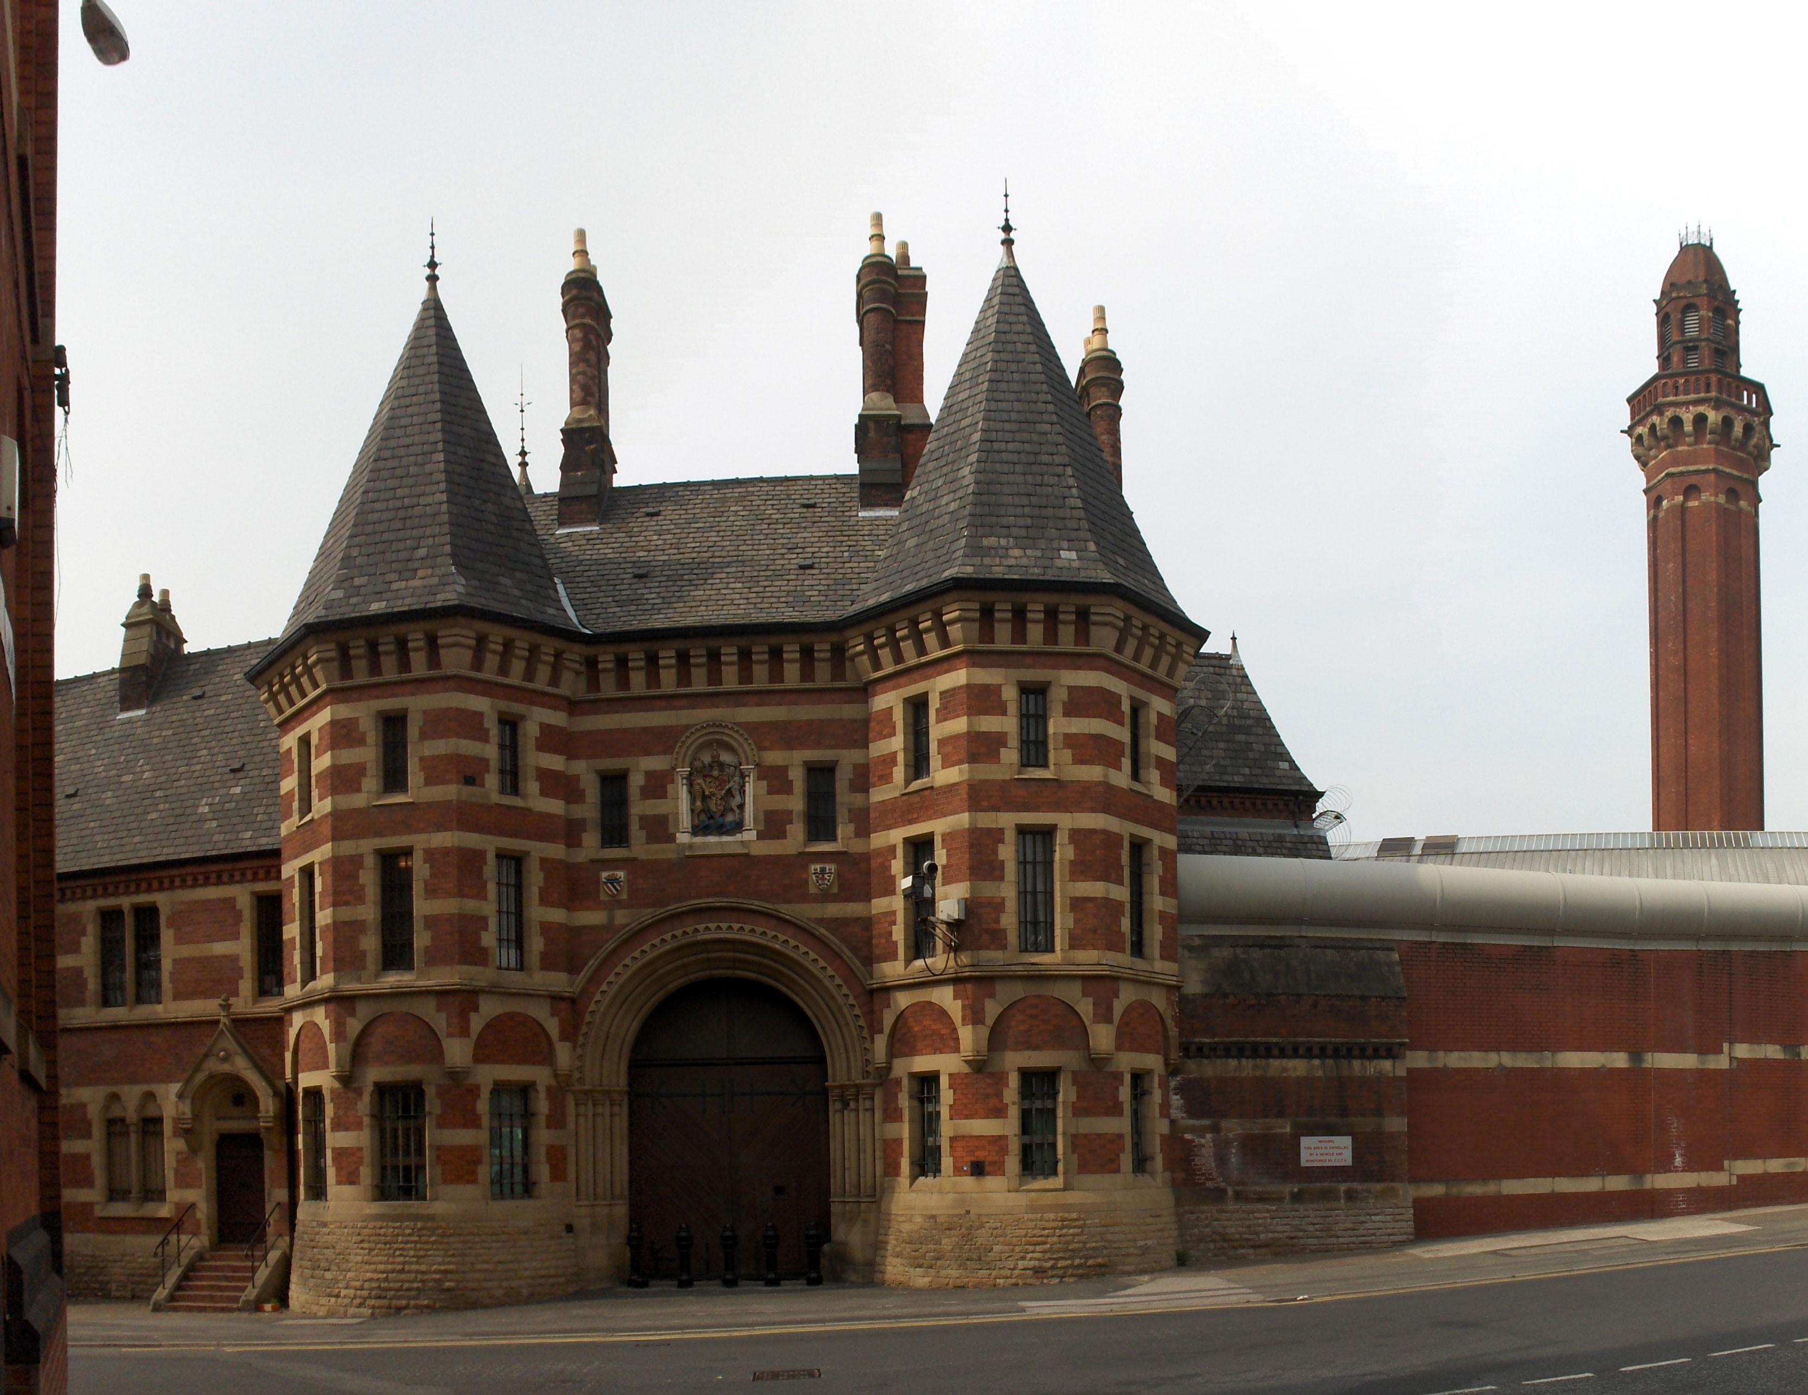
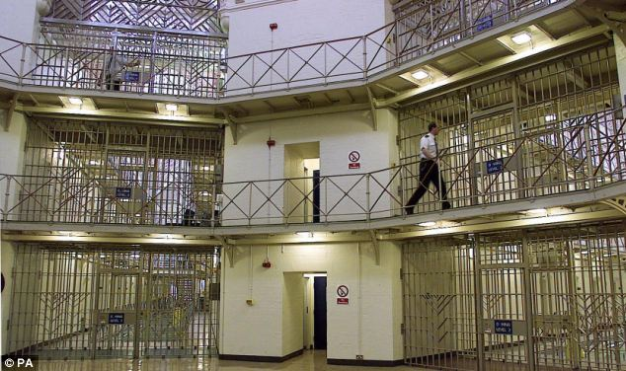
Category A Prisons
Notes:
Comment on features of Cat A Prison
Prisoner in high visibility clothing so should be spotted if were to escapte
V strict visiting procedures / searches etc
HMP Belmarsh in London has exceptionally high risk cat A prisoners – e.g. Abu Hamza was there, Lee Rigby’s killer Michael Adebolajo was there (recently moved to Wakefield) and Michael Adebolawe, Ian Huntley
Troublesome prisoners get moved around prison estate

Slide 15
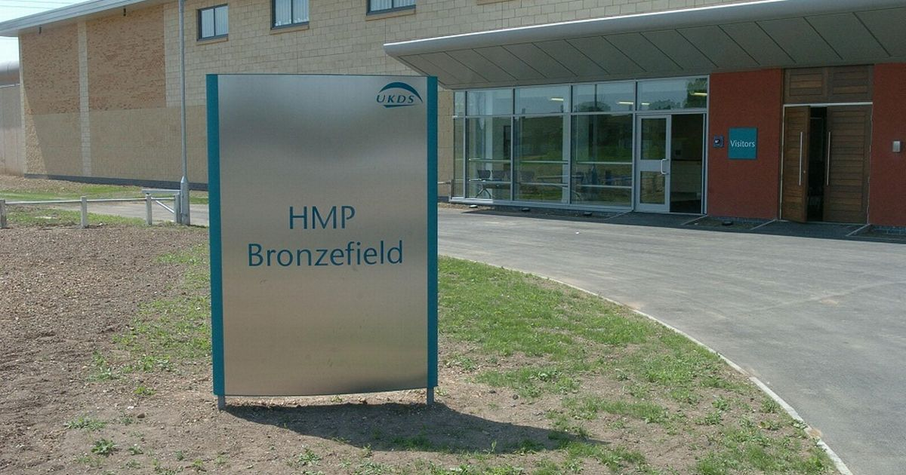
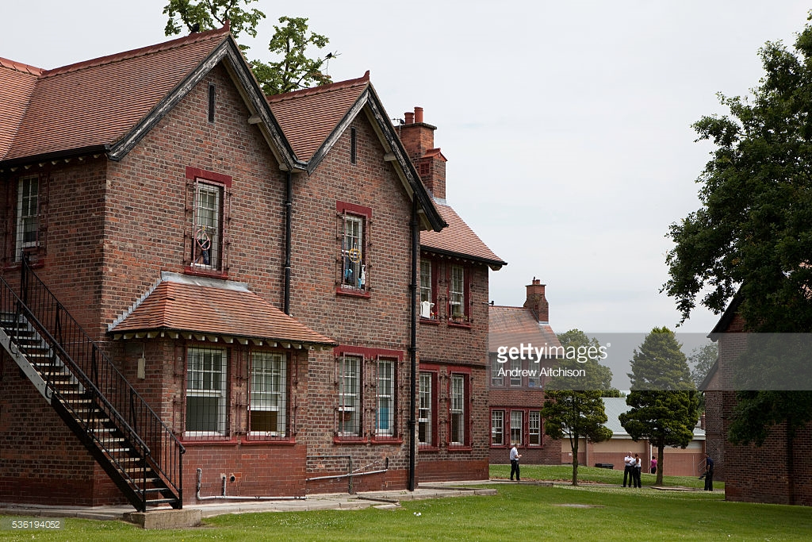
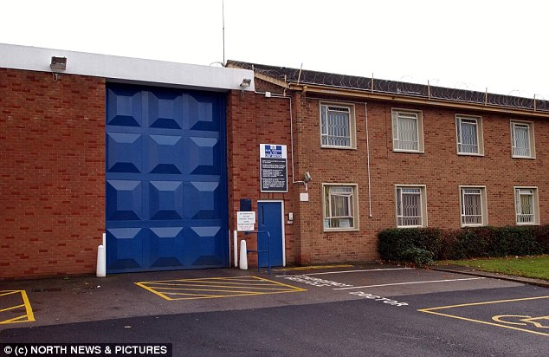
Female Prisons
Notes:
Mother and baby units – up to 18m
Left = Styal – does have 2 wings, but most women cared for on houses.
Right bottom = HMP Low Newton, Primrose Unit ( only women’s DSPD) – Rose West
Right top = HMP Bronzefield, biggest female prison in country, has category A unit – Johanna Dennehy

Slide 16
Prisoners
Prison population 110%
> 50% Young (20 – 34 yrs)
95% Male
84% sentenced
BME overrepresented
Low IQ common
Socio-economic deprivation
Poor physical health
Notes:
Prison population in 2010 – 84,000
This represented 110% uncrowded prison capacity
95% men
84% sentenced
5% convicted but unsentenced
10% untried
Average cost is £39,000 per prisoner per year
Prison population is increasing
>50% prisoners are aged 20 – 34 years
Black and minority ethnic (BME)groups over-represented
BME 26% prison population vs 7.9% general population
Black 15% prison vs 2% general
Asian 7% prison vs 4% general
Mixed 3% prison vs 1.2% general
Chinese / other 2% prison vs 0.8% general
Rate of imprisonment based on ethnicity
1.3 / 1000 white
3.7 / 1000 mixed
6.8 / 1000 black
1.8 / 1000 Asian
0.5 / 1000 Chinese / other
Prisoners and low IQ
25% adult prisoners have IQ less than 80
7% have an IQ less than 70
In young offenders – number with low IQ is higher
Socio-economic factors
Prisoners are more likely to have come from chaotic home environments with a history of
Running away from home (5x more likely than general population)
Being taken into care as a child (nearly 14x more likely)
Poor literacy and numeracy skills
Exclusion from school
Homelessness
Unemployment
Single
No qualifications
Physical health
Higher rates of HTN, diabetes, asthma and arthritis
Higher death rates

Slide 17
Bob in prison
After 4 weeks in prison Bob referred to in-reach team
Food refusal – believes poisoned
Fights with other prisoners
Flooding cell
Observed responding
Refuses to accept antipsychotics

Slide 18
Mental Health of prisoners
Higher rates of mental disorder*
*JCP related to mental disorder in prisoners
Higher rates of psychosis, mood disorder and PD than general population
High prevalence of substance and alcohol abuse
Notes:
Studies have consistently shown much higher rates of mental disorder in prisoners than in the general population
Higher rates of psychosis, mood disorder & personality disorder than general population (Note – not gone into much detail as the JCP presentation is related to the mental health of prisoners and presents the key figures. FYI….
Systematic review of 62 surveys across 12 countries by Fazel and Danesh in 2002, covered 23,000 prisoners and showed the prevalence of psychiatric disorder…
Male Female
Psychosis 3.7% 4%
Major depression 10% 12%
PD 65% 42%
Antisocial PD 47% 21%)
Substance misuse
High prevalence of substance misuse in prisoners
Nearly 75% have used an illegal substance in 12 months prior to imprisonment (in general population is nearly 10%)
Nearly 50% have used heroin or cocaine
Most frequently used drugs are cannabis and heroin
High rates of alcohol abuse / dependence

Slide 19
Mental Health Care in prisons
Reception screen
Physical / Mental disorders
Substance Use
Risk of suicide and / or self-harm
Facilities vary between prisons
Same as for all other settings
Analogous to CMHTs
Psychiatric Assessment
Mental Health In-Reach Teams
NHS responsible
Notes:
NHS now has responsibility for health care in prisons (since April 2006) – previously was run by the Home Office (as it was then)
‘Equivalence of care’ (1997) – prisoners should have the same access to the same quality and range of healthcare service as the general public receives from the NHS.
Spending on healthcare for prisoners is between 3.9 and 7.3 times greater than in the community
Psychiatric morbidity of prisoners is 20 times greater than in the community
Facilities vary between prison – some have 24 hr healthcare centres with nurse cover.
Mental Health In-Reach Teams
Analogous to CMHTs
Enables prisoners to remain on ordinary location and receive treatment
Some prisons have primary care mental health teams – models of care vary between prisoners, but general principle is that prisoners can access them directly and focus on common mild and neurotic disorders. Therefore in-reach teams can concentrate on treating ‘severe and enduring mental illness’
Royal College recommends minimum psychiatric staffing cover for prisons dependent on category of prison and size
Psychiatric Assessment in Prisons
Same as for other settings
More emphasis on suicide risk assessment
Prisoners screened on reception (entry) into prison for
Immediate physical health problems
Immediate mental health problems
Significant drug and alcohol problems
Risk of suicide and / or self-harm
Prison is stressful
Sudden and complete interruption of prisoner’s life
Separated from family and support structures
Uncertainty about future
Concerns about fidelity of spouse, loss of job, financial instability, loss of house / accommodation / possessions
May find prison an unfamiliar, hostile and threatening environment
Experience discrimination / bullying
Difficulties coming to terms with offences
Withdrawal from drugs / alcohol
Remand prisoners may have stress of on-going court case

Slide 20
Mental Health Treatment in prisons
No different to community / hospital
Prison health-care centres are NOT hospitals
No compulsory treatment
May use MCA but consider transfer to hospital
Prescribing in prisons – need to consider
Medication times
Medication in possession
Drugs of abuse
CPA applies
Notes:
Psychiatric Treatment in prisons
No different to elsewhere
Prison is an inadequate environment for treatment of SMI and psychosis
Prisons on healthcare wings are often isolated in single cells with less opportunity for exercise, association and activity than prisoners on normal location – may have unintended effect of exacerbating psychosis
Prison healthcare centres are NOT hospitals for the purposes of MHA
Cannot receive compulsory treatment under MHA in prison
May use MCA for treatment of prisoners who lack capacity
But where the prisoner is suffering from mental disorder and lacks capacity / refuses consent – transfer to hospital is preferred
Prescribing in prisons
Be aware of local policies and procedures related to
Medication times (some prisons only administer meds twice daily)
Medication in possession
Medication not to be prescribed (potential for abuse)
CPA applies in prison
For patients known to CMHT already, CMHT retains responsibility for CPA

Slide 21
Bob in prison
Increasing concern about presentation
Psychotic
Refusing treatment
Food refusal persists
Smearing faeces
Tied 4 ligatures
Referred to hospital for admission

Slide 22
Difficult behaviours in prisoners
Food refusal
Most common protest behaviour
Management depends on aetiology
Dirty protests
Psychiatric assessment often required
Self-harm
17% male sentence prisoners have lifetime history
Alcohol dependence
May be extreme and persistent
Notes:
Food refusal
Most common protest behaviour in prison
Management depends on aetiology of food refusal
SUFFERING FROM ACUTE MENTAL ILLNESS
Usually depression or non-affective psychosis
Accurate diagnosis and treatment of mental illness is priority
If psychotic – may be useful to provide sealed food
PARANOID PERSONALITY TRAITS / DISORDER
Oppositional struggle with authority and may make demands
Stubborn, self-important prisoners clashing with a rigid and controlling prison regime
Usually cease food refusal of own accord
GENUINE DEMAND
To move to another prison / have a special privilege
Require support and counselling to encourage them to pursue their demand in a more appropriate way
Tend to be short-lived
POLICITCAL POINT
Usually willing to starve themselves to death to make some point
Uncommon
Usually have an established history of activism
Dirty Protest
Usually a strategy to achieve some gain
Defecates and / or urinates in cell, smearing faeces on walls and often on their body and clothing
Well-established prison procedures for managing this
Psychiatric assessment often necessary as often associated with florid psychosis
Self-harm
Common to relieve distress and tension
17% male sentenced prisoners reported self-harm on at least one occasion in their life
More common among white prisoners
Associated with alcohol dependence but not drug addiction
EXTREME AND PERSISTENT SELF-HARM
Small group – difficult to manage
High levels of impulsivity and emotional instability, features of borderline PD, history of trauma, disturbed early attachments, early onset of conduct disorder & drug / alcohol use to cope with stress
Mental health in-reach teams often provide intense input
Management as in non-prison settings – need for consistency in support

Slide 23
Suicide in prison
 | Young prisoners with poor coping skills | Older prisoners facing long sentences | Those with psychiatric illness
Proportion of total suicides % | 30 – 45 | 5 – 10 | 10 – 22
Motivation | Fear Helplessness Distress Isolation | Guilt Hopelessness | Alienation Loss of self-control Fear Helplessness
Importance of their situation | Acute | Chronic | Varied
History of previous suicidal behaviour | Common | Less Common | Varied
Liebling 1995
Notes:
Suicide
THIS IS BEING COVERED BY JCP PAPERS AS WELL
Rate of suicide higher in prisons than general population
Prison – 133 / 100000
Remand prisoners – 339 / 100000
General population – 9.4 / 100000
Shaw et al (2004) found that
Nearly 50% prison suicides were remand prisoners
32% occurred within 7 days of entry into prison
92% were by hanging or self-strangulation
72% had a history of mental disorder (commonest was drug dependence)
57% had symptoms suggestive of mental disorder at time of reception into prison
There are significant differences between those prisoners who attempt suicide (Liebling 1995)
Protective factors:
Involvement in physical exercise
Job in prison
Active in cell
Risk factors:
Bullied at school
Childhood sexual abuse
Previous self-injury
Difficulties with other prisoners
Receiving few letters
No release plans
High hopelessness score
Persistent sleeping problems

Slide 24
Diversion from CJS

Slide 25
Diversion from CJS
Removal of mentally-disordered offender (MDO) from CJS to hospital for treatment
An MDO may be diverted from
Police custody
Magistrates’ Court
Prison
Notes:
Diversion from custody encourages the removal of people with MD from the CJS to a suitable hospital or community placement so that they can receive treatment. This reflects a social consensus that people with illness should be treated rather than punished.
The Reed report (1992) recommended nationwide provision of court diversion schemes and alternative community placements for MDOs. This led to an increase in the number of prison transfers to hospital.
The Bradley report (2009) recommended court diversion schemes and the establishment of Criminal Justice Mental Health Teams to ensure continuity of care for individuals in contact with CJS and to identify and divert MDOs as early as possible.
A MDO may be diverted from
Police station (at point of arrest)
Magistrates’ Court
Prison

Slide 26
Diversion from CJS
Advantages of diversion
Vulnerable offenders don’t receive convictions for minor offences
Police can focus on more serious crime
Disadvantages
MDOs may evade prosecution for serious offences
MDOs may cause disruption in local services
Offender given help and support
Future management may be more difficult → further offending
Notes:
Advantages of diverting people out of CJS
Vulnerable individuals who have committed minor offences due to their disorder to not receive a criminal conviction
More time is spent by police processing more serious crime
The individual is given help and support to reduce further reoffending, rather than punishment
Disadvantages
People with MD may evade prosecution for serious offences
MDOs may cause disruption to local MH services
May be more difficult to manage in future → further offending
Potential effects of a court diversion scheme include
Reduced re-offending and improved mental health outcomes
Reduced delay in receiving treatment
Increased admissions → increased demand for beds
Liaison between mental health services and court / solicitors
Most patients diverted from court do not require a secure bed – generally can be admitted to locked wards (Joseph & Potter 1990, 1993) This study also identified of those who went through the diversion process –
75% had previously been detained in hospital
77% had a criminal record (>50% of whom had previously been in prison)
Schizophrenia was the most common diagnosis (39%)
34% were unfit to plead
32% were admitted to hospital (1.5% of whom were admitted to an RSU – the rest went to unlocked wards were 46% absconded)
Diversion schemes require active participation of at least one psychiatrist and an AMHP
Liaison schemes are generally nurse-led and will identify offenders who require diversion and liaise with secondary mental health professionals for further assessment

Slide 27
Managing suicide risk in prison
Assessment, Care in Custody and Teamwork (ACCT)
Monitors and protects prisoners at risk of serious self-harm or suicide
Collaborative working
Peer support – Listeners Scheme
Personal officer
Chaplaincy
Mental Health In-Reach Teams
Notes:
ACCT – Assessment, Care in Custody and Teamwork
System for monitoring and protecting prisoners at risk of serious self-harm or suicide
Approach aims
To encourage staff to work as a team to recognise and manage suicide risk
To alter the balance from watching and preventing self-harm to engaging the prisoner to work collaboratively
Any member of staff can open an ACCT document
There will be an assessment within 24 hours
Other sources of support
Peer support – Listeners Scheme is most established. Prisoners receive training and supervision from the Samaritans. Are available on wings to support and counsel fellow prisoners
Personal officer
Chaplaincy
Mental health in-reach teams

Slide 28
Prison transfer
Improved psychiatric care in prison, but prisoners with SMI may require admission
Increase in prison transfers
Increasing prison population
Better identification of MDOs
Limited bed availability
Notes:
There have been improvements to MH care and treatment in prisons, but many prisoners with SMI generally require transfer to a hospital setting.
No compulsory treatment in prison
There has been an increase in prison transfers, may be due to
Increasing prison population
More psychiatric input into prisons – better identification of MDOs
Limited bed availability – making it easier to secure beds from prison rather than from Court diversion
Therefore waiting times for admission have increased
Transfer late in sentence – increased tendency for admission close to prison release date
Prospect of release sensitises professionals to risk
Pre-release assessments identify previously undetected problem
Deterioration in mental health due to stressor of release
In general hospitals do not admit prisoners late in sentence unless there is good evidence that hospital treatment will be of benefit to the prisoner and there are good reasons why transfer could not have been done earlier in sentence (recent deterioration in prisoner’s mental health). These patients should be dealt with by civil section on release from prison.

Slide 29
Secure mental health services

Slide 30
Development of forensic psychiatric services
1850 – 1989 – development of criminal asylums / special hospitals
1960s – forensic psychiatry conceptualised
1975 – Butler Report
1980 – First MSU
Notes:
1800 – James Hadfield attempted to kill King George III and was found NGRI. He was transferred to Bethlem Hospital from prison but escaped and was returned to prison. There was criticism that admitting ‘criminal lunatics’ was a common goals, there was inadequate security in asylums and uncertainties about funding the care of prisoners in asylums.
Criminal wings were introduced to Bethlem in 1816; patients with less serious offences were dealt with in county asylums.
Following on from this, further criminal asylums were opened
Dundrum central criminal asylum in Ireland – 1850
Broadmoor criminal lunatic asylum in Berkshire – 1863 (500 beds)
Rampton criminal lunatic asylum in Nottinghamshire – 1912
Moss side hospital in 1914 and Park lane hospital in 1974 – combined in 1989 to for Ashworth Hospital.
These were referred to as ‘special hospitals’ and more recently as part of ‘high secure services’
Forensic psychiatry seen as a separate speciality in 1960s and there were a number of reports about how to bring services together.
By the early 1970s there was serious overcrowding in the special hospitals, an awareness of difficulties managing mentally ill offenders in prison and downgrading of security of general psychiatric hospitals. The Butler Committee was established in 1972, following the conviction of Graham Young who had poisoned a large number of people, killing 3, after discharge from Broadmoor Hospital. The committed considered the criminal law in relation to MDOs and made recommendations about facilities and treatment. The report identified a lack of secure beds and recommended the development of regional secure units to allow for psychiatric care and treatment outside of custodial settings.
Following Butler report interim secure units were set up in grounds of general psychiatric hospitals. The first RSU opened in Middlesbrough in 1980. Regional forensic psychiatry services have built up since them and provide a broad range of services:
Psychiatric input to prisons
Court liaison and diversion schemes
Providing management advice to general psychiatry
Community follow-up
By 1999 there were approximately 2000 RSU / MSU beds – 500 of which were provided outside of the NHS (independent sector)
Forensic population (high / medium / low) was nearly 4000 in July 2007. In 2009 nearly 3500 of these were provided for by the NHS.

Slide 31
Entry into secure care
Referrals may come from
CJS (court, prison, police stations)
Movement between levels of security
Up / down / sideways
Gate-keeping for specialist services outside of NHS
Second opinion on diagnosis / risk / management

Slide 32
High Secure | Medium Secure | Low Secure / PICU
Grave offence, especially sadistic or sexual | Serious offence of past failed placements at lower level | History of non-violent offending behaviour
Immediate danger to others if in community | Danger to others would be less immediate
Risk predominately to others |  | Mix of risk to others / challenging behaviour / DSH
Capacity to coordinate escape / absconsion would undermine confidence in CJS | Risk of escape / absconsion Pre-sentence for serious charge | Low risk of absconsion
Unpredictable relationship between risk and mental state | Recovery likely to be prolonged, some risks remain when well | Acute illness, likely to respond to treatment
Previously unmanageable in medium security | Previously unmanageable in low security / PICU | Previously unmanageable on open ward
Clark T & Rooprai DS. Practical forensic psychiatry (2011) Table 2.1
Notes:
High Secure:
Three high secure hospitals
Ashworth Hospital
Rampton Hospital (incl HSS for women, LD and deaf)
Broadmoor Hospital
‘Grave and immediate danger’
Grave offence
Immediacy of risk if at large
Capacity to escape / subvert security
Admission to HSS is when the patient is considered to pose a ‘grave and immediate danger’ to the public. This decision may be based on
Having being charged with or convicted of a grave offence
Immediacy of risk to others if set at large
Evidence of a capacity of coordinate an organised escape attempts, or engage in subversive behaviour.
Also, cases with a high national profile are likely to be admitted to high security on the basis that an absconsion from hospital would likely seriously undermine confidence in the CJS.
There have been a number of inquiries that have been highly critical of the high secure hospitals. For example at Ashworth Hospital, the Blom-Cooper Report in 1992 criticised the culture and found abusive practices – there was evidence of systematic maltreatment and abuse of patients and failures of management. The Fallon Inquiry in 1994 identified shortcomings in the running of the PD service as patients were discovered to have been dealing drugs, alcohol and pornography and security had been compromised to a large extent.
Since then the management of the high secure hospitals has been brought into that of the local NHS provider and services have retracted as rehabilitation through medium and low secure services has been seen as appropriate.
Medium Secure
3500 national beds
Often mainstay of forensic psychiatric inpatient care
Regional centres
Prison in-reach
Court diversion and liaison
Forensic outreach / community
Specialised services for women, forensic CAMHs, older adults, LD
Low Secure
Services delivering “intensive.. multidisciplinary treatment…for patients who demonstrate disturbed behaviour…and who require the provision of security.”
Active rehabilitation and long-term facilities
Step-down from medium security
Community rehabilitation
Longer-term care
Developed with little formal guidance / specification over the past 10 – 15 years
No reliable data on provisions / numbers and the range of services is diverse
In 2002 the DoH developed national minimum standards for LSS and PICUs – described as services delivering “intensive, comprehensive and multidisciplinary treatment and care by qualified staff for patients who demonstrate disturbed behaviour in the context of a serious mental disorder and who require the provision of security.”
LSS have evolved into a combination of active rehabilitation and long-term facilities that provide
A step-down from medium security into the community and allowing for extended community rehabilitation
Long-term care for those in medium security who are unlikely to be successfully discharged into the community due to the nature of their illness and ongoing risks
A sideways move from PICUs for those who require longer term care in such conditions.
Forensic Community Services
No uniform service
No forensic community follow up
Parallel model
Integrated model
Consultation and liaison model
No agreed standards for forensic community teams → variation in service models
Some services have no forensic community follow-up and all patients are transferred to the care of general psychiatric teams on discharge from secure hospitals
Parallel model where the forensic community team caries CPA responsibility for a case-load of patients
Integrated model where the forensic community team works with the CMHT to support them in managing ‘forensic’ patients. This encourages development of skills in the CMHT and reduces stigma.
Consultation and liaison models where forensic services provide support to general psychiatry colleagues on a traditional medical referral basis or via a specially commissioned forensic liaison service.

Slide 33


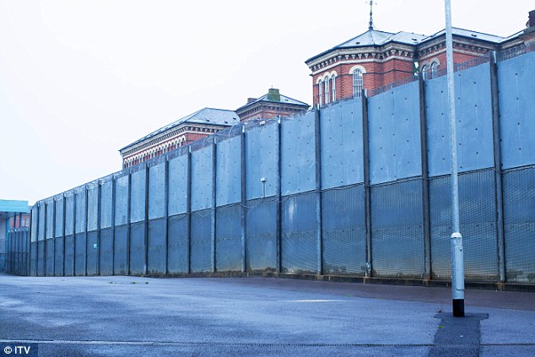
High Secure Hospitals
Notes:
Top left = Ashworth
Bottom left = Broadmoor
Right = Rampton
Comments on fences, procedures – searching , restricted practices etc

Slide 34
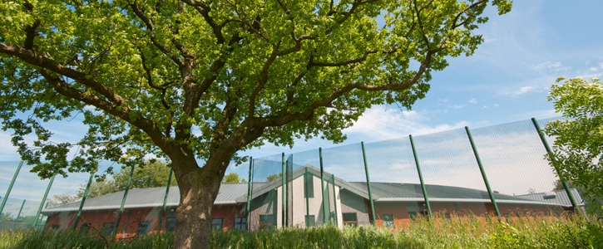
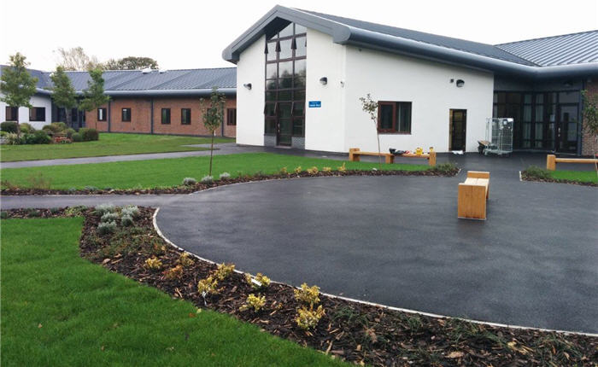
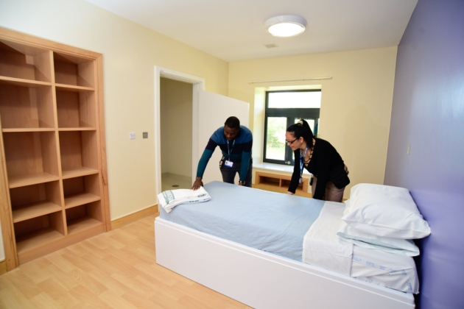
Medium Secure Hospitals
Notes:
Talk about fences
Procedures, security etc
Fixtures and fittings – no ligature points etc etc

Slide 35
Types of Security
Physical
Buildings
Equipment
Procedural
Policies and practices
Relational
Interpersonal interactions
Relational explorer
Notes:
Physical
Provision, maintenance and correct use of appropriate buildings and equipment by properly trained staff
Includes: perimeter fence, building security, observation and alarm systems
Procedural
Policies and practices
Management of violent incidents, de-escalation, breakaway, PMVA, seclusion, visits, money etc
Relational
Related to quality of care and is closely linked to resources
Includes: staffing, staff to patient ratios, multi-disciplinary teams with the right range of skills.
Also related to the development of therapeutic alliances between staff and patients

Slide 36
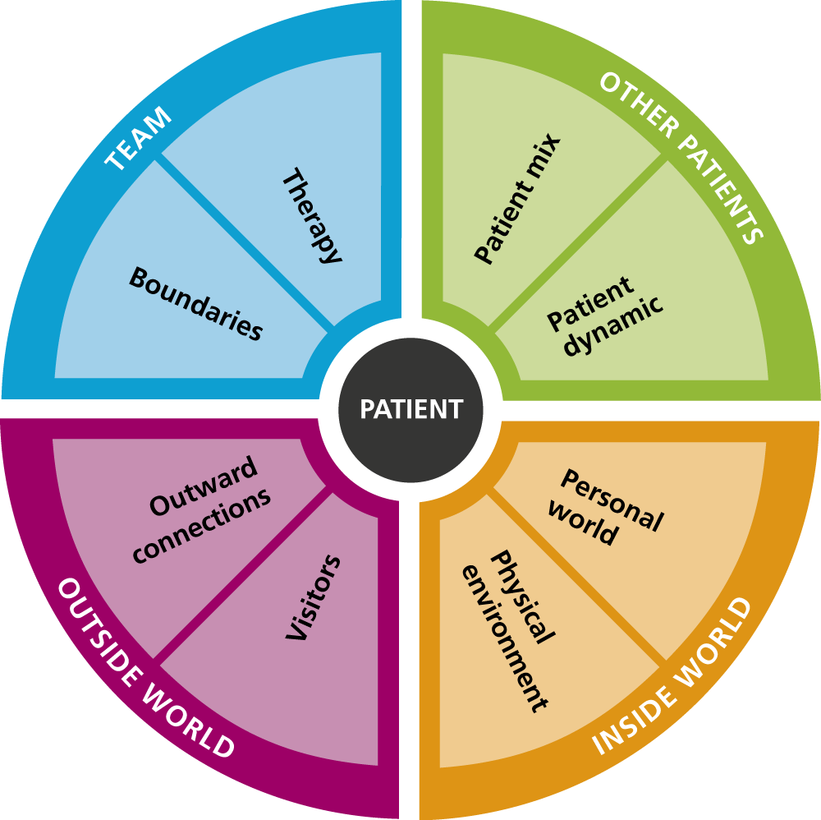
Notes:
Relational Security Explorer
TEAM
Are we positive role models?
How do patients feel about their treatment and recovery?
Are we engaging with patients enough?
Are we confident to speak up if someone is compromised?
Do we know what the boundaries are?
Do we have core values for the ward?
OTHER PATIENTS
Do we know our patient mix?
How does the ward dynamic feel for us and patients?
Do we know what’s really going on on the ward?
Do we feel in control?
Are we tackling discrimination, bullying and harassment?
Do we talk enough about this?
OUTSIDE WORLD
Do we know what to do if something is going wrong?
Would we be able to spot plans to abscond / escape?
Do patients understand the consequences of absconding / escaping?
Do we have a plan for escorted leave?
Do we talk enough to visitors before and after their visit?
Do visitors know the rules?
INSIDE WORLD
Do we know everything we need to know about our patients?
Do we know that the triggers are for all our patients?
Can we spot when something is wrong?
Do we talk enough to patients about how they’re feeling?
Does the ward environment help us to engage patients?
Is our ward tidy and well cared for?

Slide 37
Bob in hospital
Bob is transferred to the local MSU
Under section 48/49 MHA
Commenced on depot antipsychotic medication
Mental state improves
Case sent for trial at Crown Court
?????

Slide 38
Criminal justice system

Slide 39
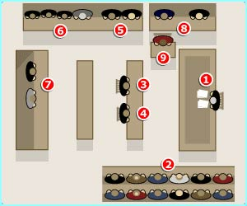
Crown Court
news.bbc.co.uk
Notes:
It’s often useful to use a diagram to explore some of the Pritchard criteria with a defendant – instructing counsel / course of proceedings / juror challenge etc.
1. Judge
The judge is in charge of the trial.
He makes sure that the trial is presented in a fair and a clear way. The judge settles any arguments between the barristers about what the law is.
If the defendant is found guilty the judge will get to say what the sentence should be.
The judge will also advise the jury on anything that they do not understand about the law.
2. Jury
They decide if the defendant is guilty.
Twelve ordinary men and women are chosen at random. Their names come from the list of people who can vote in elections.
A jury must listen to all the evidence before they choose their verdict (say if the defendant is guilty or not).
Unanimous verdict This means that all 12 jury members agree with the decision.
Majority verdict If a jury cannot agree on a verdict then the judge might say that he will accept a majority decision. That means a verdict that 10 or 11 of the 12 jury members agree with. This normally happens after the Jury have spent a couple of days thinking about the verdict.
Hung Jury If the jury is split into two fairly even groups and people will not change their minds, then there can be no verdict. The jury is said to be hung.
Foreman The jury pick one member to be their spokesperson, they are called the foreman. The judge asks the foreman to tell the court the verdict.
3. Prosecution barrister
The prosecution barrister explains to the court what the defendant is accused of.
The prosecution must show the jury enough evidence to make them feel really sure that the defendant is guilty.
If the jury are not sure then they must give a "not guilty" verdict.
A barrister is a lawyer who specialises in appearing in court. Solicitors can also put forward the case in court.
4. Defence barrister
The defence barrister represents the person accused of the crime.
The defence do not have to prove that the accused is innocent, just that the prosecution's arguments are not good enough.
The barrister points out to the jury what they think is wrong with the prosecution's evidence. They will try to show that there are other possible explanations. Their arguments are called the case for the defence.
5. Press
Reporters from newspapers, TV and radio.
Reporters come from local and national papers, TV and radio. The reporters are not allowed to take cameras into the court. That's why you might see pictures on the TV news which have been drawn by a courtroom artist.
6. General public
Ordinary people who have come to see the court case.
They are allowed into the public gallery to watch the trial. At a trial that has been in the news or involves famous people there can be large queues of people who want to get in. More people will turn up than can be allowed into the gallery.
7. Defendant
The person accused of the crime.
When two or more people are on trial together are called co-defendants. They are innocent until proven guilty. That means they don't have to prove they are innocent. It's up to the prosecution to show that they are guilty.
8. Ushers
The usher takes oaths from witnesses and jury members.
The oath or affirmation is a promise. Witnesses promise to tell the truth and members of the jury promise to give the defendant a fair trial. This is what they say.
Jury members: I swear that I will faithfully try the defendant and give a true verdict according to the evidence
2. Witnesses I swear that the evidence I am about to give is the truth, the whole truth and nothing but the truth.
The Usher also carries written questions from the jury to the judge.
9. Witness stand
Witnesses give evidence at a trial.
They can include the police as well as people who saw, or know something, to do with the crime. They must take an oath saying that they will tell the truth.
Defence witness Anyone who was called to be a witness by the defendants legal team, because their evidence appears to show that the defendant didn't commit the crime.
Prosecution witness Anyone who was called to be a witness by the prosecution, because their evidence appears to show that the defendant did commit the crime.
Character witness Helps the jury understand what sort of person the defendant is.
Expert witness Somebody who has expert knowledge that is called upon to explain things to the jury.

Slide 40
Bob at Trial
Bob found guilty of armed robbery and possession of imitation firearm
Psychiatric reports → hospital order not recommended
Due to be remitted back to prison
Sentenced to 8 years imprisonment
Returned to HMP

Slide 41
leaving prison

Slide 42
Parole Board
Main focus is protecting the public and managing risk
Parole Hearings
May require psychiatric risk assessment
Satisfied that it is no longer necessary for the protection of public that the prisoner should be confined
Risk = dangerousness and must be substantial
Notes:
Parole intended to promote rehabilitation, while maintaining the deterrent of recall to custody for transgressions
NOW – protecting public and managing risk are preferred focus
Independent, executive, non-departmental public body – sponsored by MOJ since 2007
Board considers whether or not to release
Indeterminate sentence prisoners who are post-tariff or who have been recalled to prison
Discretionary conditional release prisoners or extended sentence prisoners who have completed their minimum term of imprisonment
Recalled determinate sentence prisoners
The statutory test for release of indeterminate sentence prisoners –
Board is satisfied that is it no longer necessary for the protection of the public that the prisoner should be confined.
If prisoner is not to be released
Risk must mean dangerousness
Risk must be substantial
Parole Board hearings
Sits as 1, 2 or 3 member panel, reviewing suitability for release in paper or oral hearings
Oral hearings normally take place in prisons and consider suitability for release from indeterminate sentences
Chaired by a sitting or retired judge for life sentence prisoners, and an experienced independent member for IPP prisoners
Psychiatric reports for parole hearings
Task is to provide an assessment of risk – risk of serious harm in particular

Slide 43
MAPPA
Key functions
Identification of MAPPA offenders
Risk assessment & Risk management
Sharing information
Categories of MAPPA offender
Category 1 – registered sex offender
Category 2 – violent or other sex offender
Category 3 – other offenders
Possible 4th category – potentially dangerous offenders
Notes:
Multi Agency Public Protection Arrangements
Statutory duty on police and probation to establish arrangements for assessing and managing risks posed by violent and sexual offenders in their area.
A number of agencies have a ‘duty to cooperate’ with the Responsible Authority
Social care
Housing
Education
Health
Each of the MAPPA areas has a strategic management board responsible for monitoring and developing MAPPA and a MAPPA coordinator with responsibility for oversight of local arrangements
Key functions of MAPPA
Identification of MAPPA offenders
Assessing the risks posed by offenders
Managing the risks posed by offenders
Sharing information about offenders
Desired outcome of MAPPA is effective risk management
Zero risk can never be achieved
There are 3 formal categories of MAPPA offender
Category 1 – registered sex offenders
Category 2 – violent or other sex offenders
Sentenced to 12 months imprisonment or longer, or
Sentenced to a hospital or guardianship order under MHA
Category 3 – other offenders, ‘who, by reason of offences committed by them….are considered by the Responsible Authority to be persons who may cause serious harm to the public’
Many police forces have a 4th category of ‘potentially dangerous offenders’
Those without a criminal conviction or caution to place them in another category, but whose behaviour gives reasonable grounds for believing that there is a present likelihood of them committing an offence that will cause serious harm.
Information sharing and confidentiality
There is a requirement for information-sharing between agencies
It must be proportionate and done in ways that are accountable and ensures the safety and security of the information

Slide 44
MCQs

Slide 45
Psychiatry and the CJS
MCQs
1. What is the relative risk of psychosis in prisons compared to the general population?
A. 5
B. 10
C. 20
D. 100
E. 2

Slide 46
Psychiatry and the CJS
MCQs
1. What is the relative risk of psychosis in prisons compared to the general population?
A. 5
B. 10
C. 20
D. 100
E. 2
Notes:
Prisoners are nearly 20 times more likely to suffer psychosis or major depression, and about 10 times more likely to have an antisocial personality disorder than the general population. Fazel & Danesh (2002)

Slide 47
Psychiatry and the CJS
MCQs
2. How many homicide offenders have active psychiatric symptoms at the time of committing the homicide?
A. 1 in 10
B. 1 in 5
C. 1 in 3
D. 1 in 2
E. 1 in 4

Slide 48
Psychiatry and the CJS
MCQs
2. How many homicide offenders have active psychiatric symptoms at the time of committing the homicide?
A. 1 in 10
B. 1 in 5
C. 1 in 3
D. 1 in 2
E. 1 in 4
Notes:
10% homicide offenders have active symptoms at the time of the offence Shaw et al (2006)

Slide 49
Psychiatry and the CJS
MCQs
3. The rate of suicide is highest in:
A. Service users in the community
B. Sentenced prisoners
C. Service users in general psychiatric wards
D. Older prisoners facing long sentences
E. Remand prisoners

Slide 50
Psychiatry and the CJS
MCQs
3. The rate of suicide is highest in:
A. Service users in the community
B. Sentenced prisoners
C. Service users in general psychiatric wards
D. Older prisoners facing long sentences
E. Remand prisoners
Notes:
The rate of suicide:
Prison population – 133 / 100,000
Remand prison population – 339 / 100,000
General population – 9.4 / 100,000
Remand prisoners account for 49% prison suicides.
92% prison suicides occur by hanging or self-strangulation
Shaw et al (2004)

Slide 51
Psychiatry and the CJS
MCQs
4. Which is the most common psychiatric condition in prisoners?
A. Depression
B. Personality disorder
C. Psychopathy
D. Psychosis
E. Neurosis

Slide 52
Psychiatry and the CJS
MCQs
4. Which is the most common psychiatric condition in prisoners?
A. Depression
B. Personality disorder
C. Psychopathy
D. Psychosis
E. Neurosis
Notes:
Prevalence of psychiatric morbidity in prisons worldwide - Fazel & Danesh (2002)
Psychotic illnesses
Male - 3.7%
Female - 4%
Major depression
Male - 10%
Female - 12%
Personality disorder
Male - 65%
Female - 42%
Antisocial PD
Male - 47%
Female - 21%

Slide 53
Psychiatry and the CJS
MCQs
5. What is the prevalence of major depression in male prisoners?
A. 10%
B. 12%
C. 25%
D. 3.7%
E. 50%

Slide 54
Psychiatry and the CJS
MCQs
5. What is the prevalence of major depression in male prisoners?
A. 10%
B. 12%
C. 25%
D. 3.7%
E. 50%

Slide 55
Psychiatry and the CJS
Any Questions?
Thank you.

