Slide 1

MRCPsych General Adult Module
Self Harm and Suicide

Slide 2
GA Module: Self Harm and Suicide
Aims and Objectives
Aims
  The overall aim is to give an overview of suicide and self harm
Objectives:
  By the end of the session, trainees should have
  Developed an understanding of various facets of self-harm and suicide (aetiology, epidemiology, neurobiology, genetics)
  Developed an understanding of surveys and develop skills for critically appraising surveys.

Slide 3
GA Module: Self Harm and Suicide
To achieve this
Case Presentation
Journal Club
555 Presentation
Expert-Led Session
MCQs
Please sign the register and complete the feedback

Slide 4
GA Module: Self Harm and Suicide
Expert Led Session
Self harm and Suicide:
Aetiology and Epidemiology

Slide 5
Contents
Definitions; and problems with suicide research
Epidemiology of suicide
National Confidential Inquiry in to Suicide (and Homicide)
Epidemiology of Self-Harm
Psychological theories of suicide
Neurobiological theories of suicide
Reference and further reading
MCQs
NB- assessment and management are covered in Semester 3

Slide 6
Definitions
Suicide
Dictionary definition
The action of killing oneself intentionally
Suicide
In coroner’s court
A coroner can now issue a conclusion of suicide on the balance of probabilities. Other options are an open verdict or narrative verdict.
Self-harm
Dictionary definition
The practice of deliberately wounding oneself (usually without the intent to kill oneself)
Parasuicide
Non Suicidal Self Injury
Self-Injury
Self-mutilation
Notes:
While it may be fairly easy to explain what we mean by suicide, it is often considerably harder to determine an outcome of suicide in the coroner’s court. One has to infer the intention of the deceased. Previously, suicide needed to be proved ‘beyond reasonable doubt’, but the burden of proof has changed to ‘on the balance of probabilities’ ie a lower bar has been set.
Where evidence is lacking, the coroner may provide an open verdict, or provide a description of events known as a narrative verdict.
The definition of self-harm is a bit more difficult and has had many names over the last few years, but they essentially mean the same thing: deliberately harming oneself without the intent to end life

Slide 7
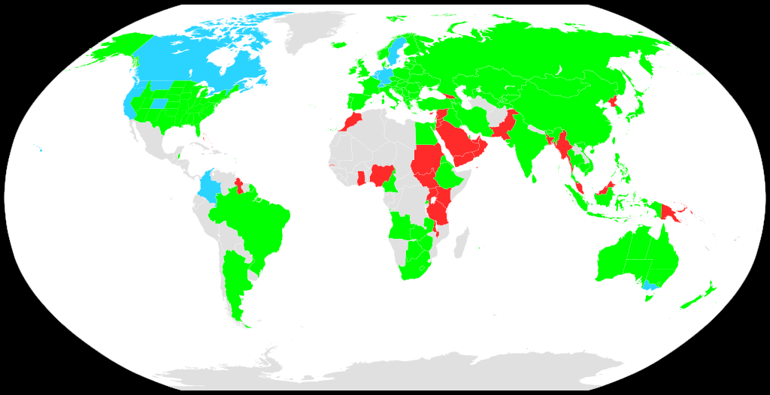
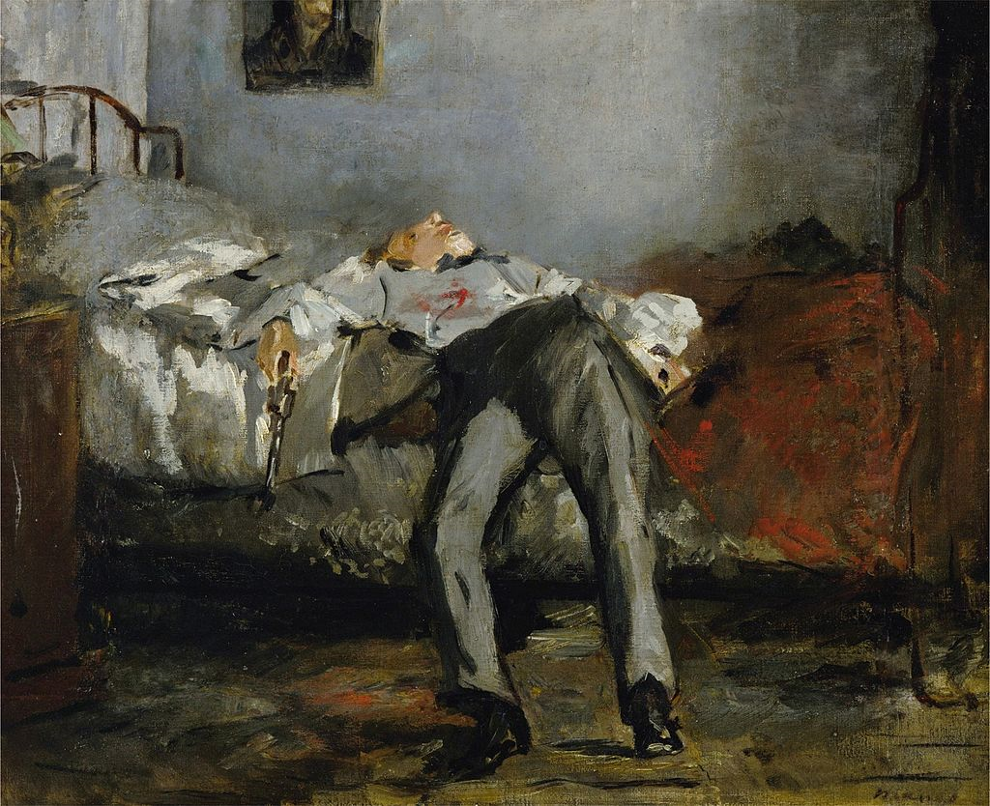
Troubling Terminology
Historically suicide believed to be a sin in religious context
Laws developed to criminalise suicide
In many countries it remains illegal
Suicide + assisted suicide illegal / Suicide legal, assisted suicide illegal
Suicide + assisted suicide legal
Suicide decriminalised in the UK in 1961
Phrase ‘commit suicide’ relates to previous illegality of the act
Has various negative moral and historical implications
Phrase now used: ‘completed suicide’
The Suicide by Edouard Manet
Notes:
Suicide has historically been seen as a sin by many cultures, affiliated to various religious beliefs. It subsequently came into law that this was an illegal act. By the 19th century it was better understood as often being the result of mental illness/madness.
Suicide is a crime in several countries of the world (eg Ghana, Kenya, Sudan, Uganda, Bangladesh, Pakistan, UAE, etc)
Western countries have largely decriminalised suicide
English common law criminalised suicide until the passing of the Suicide Act in 1961.
The phrase ‘commit’ suicide persists in common parlance… its roots come from when suicide was a criminal act.
People are encouraged to use the phrase ‘completed suicide’ rather than ‘commit’. There are strict reporting guidelines for journalists, that they are not to use the phrase ‘commit suicide’ unless it is a direct quote from someone in authority.

Slide 8
Epidemiology of Suicide

Slide 9
The problem with stats
The deceased can never testify as to their intent
Coroner’s verdicts previously had a ‘high bar’ for suicide
Definitions of suicide vary
Countries where it is illegal may report lower rates
It is therefore highly likely that suicide rates are an underestimation
WHO Suicide Prevention
https://www.who.int/mental_health/prevention/suicide/suicideprevent/en/
The WHO source data globally to provide estimates of suicide statistics. They are probably the most accurate source of data regarding suicide internationally.
National Confidential Enquiry into
Suicide and Safety in Mental Health
https://sites.manchester.ac.uk/ncish/
The NCISH report compiled through the University of Manchester provides the most accurate data on UK suicides and is updated regularly.
Notes:
Identifying whether someone has committed suicide can be extremely difficult
It is based on previous history, review of their situation, autopsy, mode of death etc. However the intent of the person at that time can never truly be known.
Previously the bar for suicide was high in coroner’s court (beyond reasonable doubt), leading some possible suicides to be returned as narrative or open verdicts, which may have skewed the data.
Definitions of suicide vary between countries.
How they are reported also varies and therefore it is difficult to compare statistics globally.
Where suicide is illegal, it is likely that the number of suicides are under-reported.
The WHO have the best global database for gathering suicide statistics, but even with this, they admit it is likely to be a gross underestimation.

Slide 10
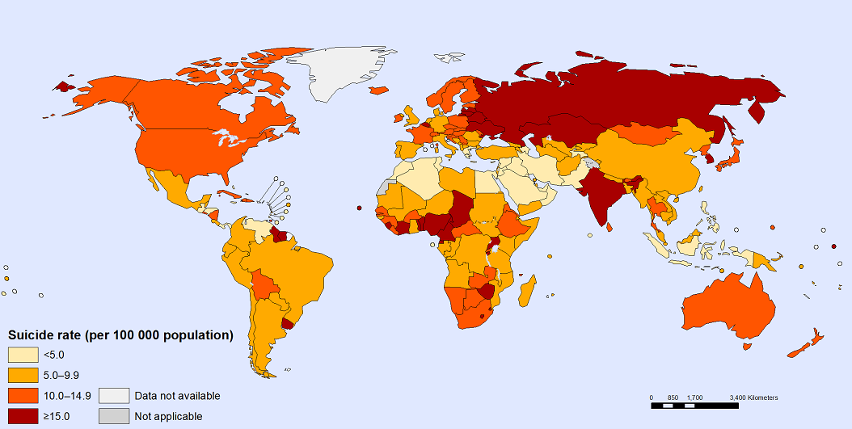
Global Suicide Rates
800,000
Suicide rate per 100,000 population
People die by suicide every year
Every 40 secs
Another person dies by suicide
1.4%
Of all deaths
79%
10.7
Global average suicides per 100,000 population
Europe + South East Asia
Of all suicides occur in middle- and low-income countries
Highest suicide rates per 100,000 population
https://www.who.int/mental_health/prevention/suicide/estimates/en/
Notes:
These figures represent global suicide rates.
It should be noted that there are vast differences in rates between countries/regions and these figures constitute the global average
Data is correct as of last recording in 2016

Slide 11
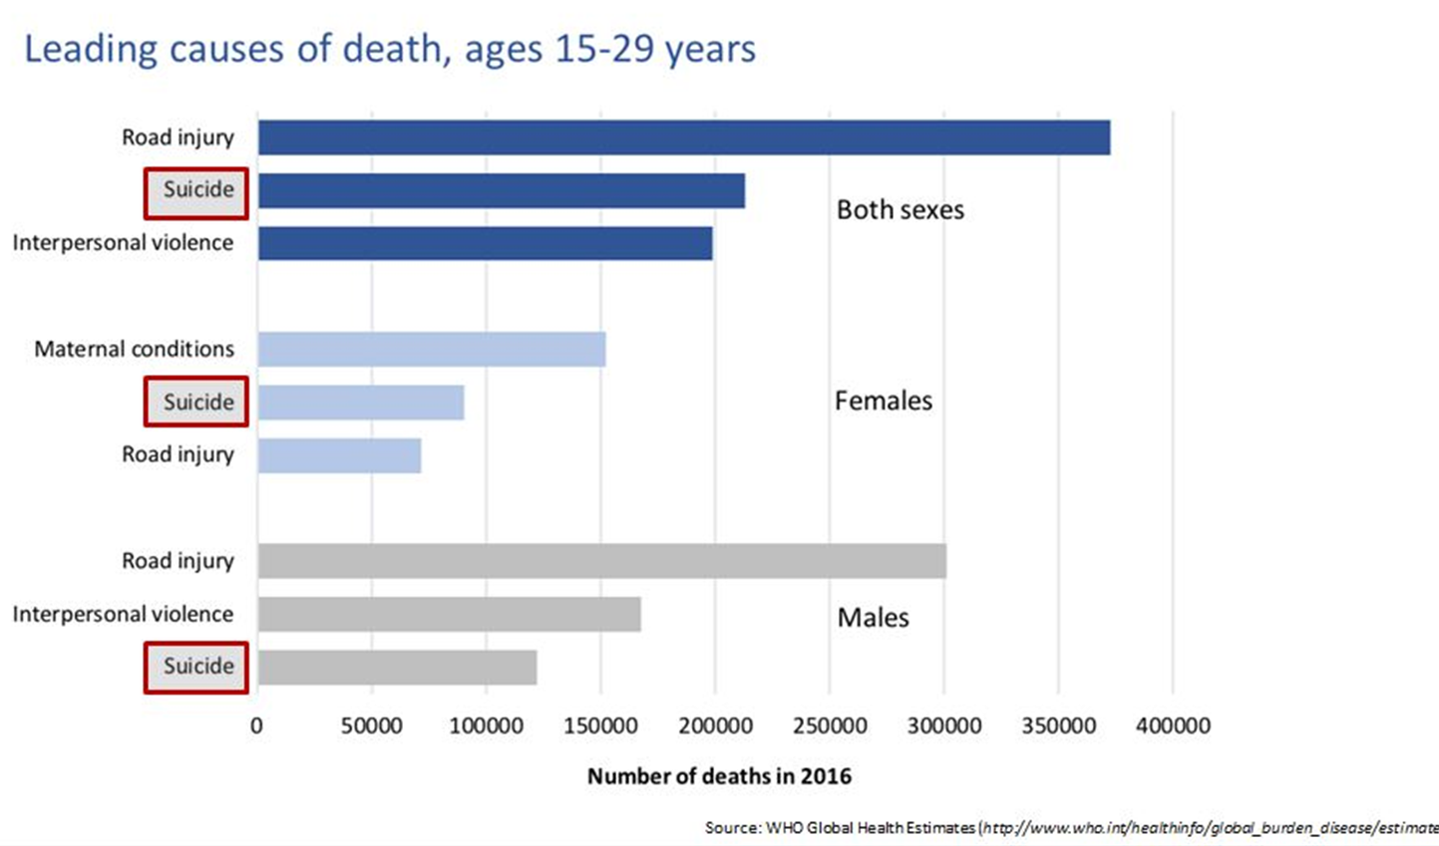
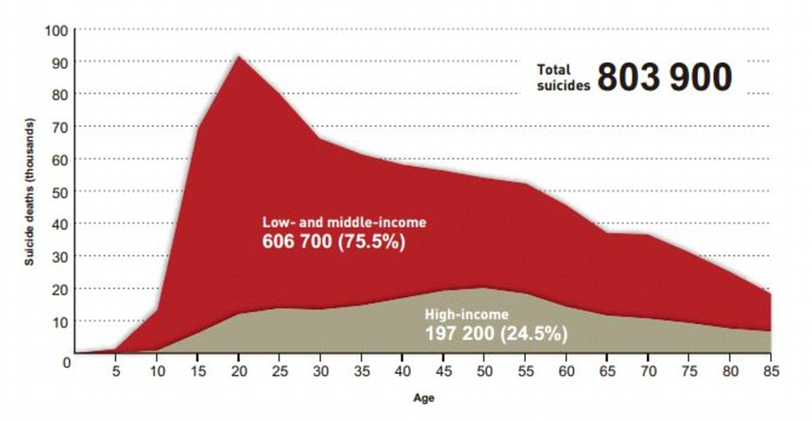
Global Suicide in Youth
Suicide is the second leading cause of death in 15-29 year olds
https://www.who.int/mental_health/prevention/suicide/estimates/en/
Notes:
Suicide is the second leading cause of death in 15-29 year olds globally
There is a significant spike in youth suicides in low and middle income countries

Slide 12
Global Suicide Facts
Most common methods: hanging, self-poisoning with pesticides, firearms
More common in: police, firefighters, first-line responders, army, prisoners, high-security hospital patients
Most significant risk factor: previous suicide attempt
Bachmann S (2018) Epidemiology of suicide and the psychiatric perspective. Int J Environ Res Public Health
https://www.who.int/mental_health/prevention/suicide/estimates/en/
Notes:
Globally the most common methods are hanging, self-poisoning with pesticides and use of firearms
However, there are significant regional variations – in the UK hanging is most chosen by males, and mixed overdoses by females
There is a trend in risk factors globally – suicides are more common in first-line responders, army, prisoners and high-security hospital patients
The most significant risk factor globally is a previous suicide attempt.

Slide 13
Suicide and Mental Illness
Rates of suicide in mental health patients 10 x higher than general population
53.7% of all MH patient suicides were diagnosed with depression
45.3% of inpatient MH patient suicides were diagnosed with schizophrenia and organic mental disorders
32% of outpatient MH patient suicides were diagnosed with depression
5-14%
12-19%
2.5-6%
3-9%
1.2%
Suicide rate in all patients with schizophrenia
Suicide rate in inpatients with depression
Suicide rate in all patients with anxiety disorders
Suicide rate in all patients with borderline personality disorder
Suicide rate in all patients with anorexia nervosa
Bachmann S (2018) Epidemiology of suicide and the psychiatric perspective. Int J Environ Res Public Health
Bertolote JM et al (2003) Suicide and mental disorders: do we know enough? BJPsych
Kostro K et al (2014) The current status of suicide and self-injury in eating disorders: a narrative review. Journal of Eating Disorders
https://www.who.int/mental_health/prevention/suicide/estimates/en/
Notes:
Globally, there is a significant link between suicide and mental illness.
The risk of suicide is 10 x higher in mental health patients compared to general population.
The majority of all mental health patient suicides are diagnosed with depression – however there are differences between inpatient and outpatient suicides:
The most prevalent illness in inpatient mental health suicides is schizophrenia and other organic mental disorders
The most prevalent illness in outpatient mental health suicides is depression
These are rough suicide rates for patients with particular mental health diagnoses. However, as you can see the rates vary and there is conflicting evidence regarding these.

Slide 14
National Confidential Inquiry into Suicide and Safety in Mental Health
Data from United Kingdom 2006-16
https://sites.manchester.ac.uk/ncish/
Notes:
The National Confidential Inquiry into Suicide and Safety in Mental Health
Uses national data to identify those who die by suicide or are convicted of homicide
Clinical information is obtained via questionnaires issued to clinicians
Response rate is ~95%
Produced data specific to the UK
Annual reports are produced

Slide 15

Notes:
This video gives a brief overview into the findings of the most recent report (2016)
The video lasts 2 mins 50 s
The video is embedded from YouTube and therefore requires connection to the internet. On arriving at the slide, PowerPoint will automatically connect to YouTube.
When the play icon appears on the image, press this to play the video
If you choose not to use the video, you can skip past by clicking one of the arrow keys on the keyboard.

Slide 16
Key Findings
Total Suicides: 2006-2016 UK
Methods: 2016 England
Diagnosis: 2006-16 England
64,570 suicides
2,406 hanging/strangulation
4,802 depressive illness
17,931 MH patients suicide
824 self-poisoning
2,245 schizophrenia
1,371 MH inpatient suicide
425 Jumping
1,275 personality disorder
526 Other
1,224 bipolar disorder
https://sites.manchester.ac.uk/ncish/
Notes:
Overall there is a downward trend in the rates of suicide in the UK, although this is not the case for Northern Ireland
In the decade between 2006-2016 there were over 64,000 suicides across the UK
28% of suicides had contact with mental health services within 12 months of suicide
2016 Data for England shows hanging/strangulation as the most common method by some distance, followed by self-poisoning and jumping from a height. Other methods include drowning, gas inhalation, stabbing and firearms in that order
Self poisoning was most commonly through use of opiates
Depressive illness was the most common method for all patient suicides, followed by schizophrenia, personality disorder and bipolar disorder. The remaining 3654 suicides were ascribed to alcohol dependence, adjustment disorder, anxiety disorder, drug dependence and ‘other’

Slide 17
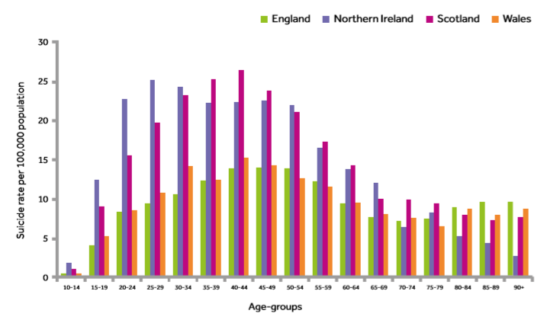
Key Findings
Suicide rates per age group 2006-2016
https://sites.manchester.ac.uk/ncish/
Notes:
The peak of suicides is at age 35-50 in all countries except Northern Ireland, where the peak is between 25-30

Slide 18
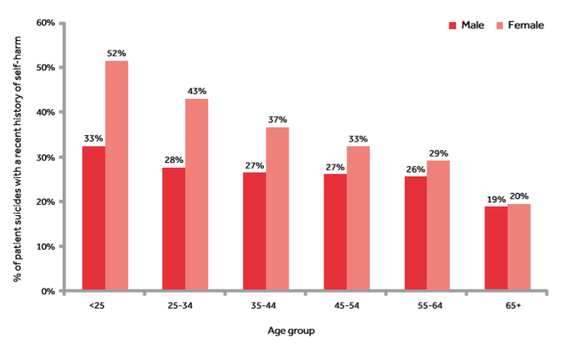
Key Findings
Proportion of suicides with recent (<3 month) history of DSH
https://sites.manchester.ac.uk/ncish/
Notes:
A higher proportion of young females who engage in DSH will go on to complete suicide
½ of all patients who completed suicide with a recent history of DSH were female and aged under 25

Slide 19
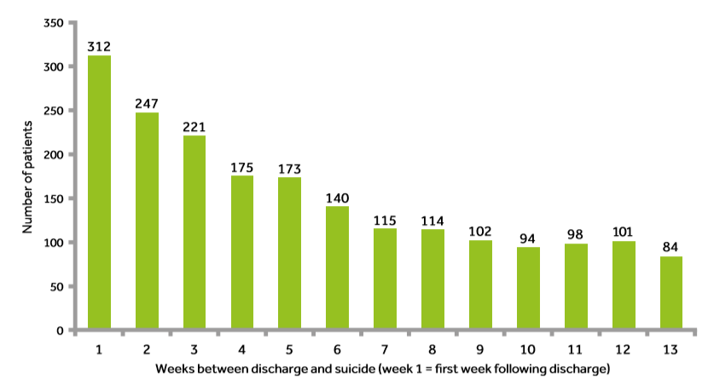
Key Findings
Number of suicides per week following inpatient discharge (2006-16 England)
21%
11%
Complete suicide on day 3 post-discharge
Complete suicide before follow-up appointment
https://sites.manchester.ac.uk/ncish/
Notes:
Suicide risk increases upon discharge
The highest risk of suicide was on day 3 post-discharge (21%)
11% died before their first follow-up appointment
Of those who complete suicide following discharge, there is a disproportionate number of patients with personality disorder diagnosis

Slide 20
Key Findings
Female patients have specific risk profile
39%
74%
15%
Contact with MH services
Self-harm
Personality Disorder
Young people have common antecedents
25%
19%
30%
Bereaved (9% by suicide)
Bullied
Physical health conditions
56% of completed suicides have comorbid alcohol/substance misuse
https://sites.manchester.ac.uk/ncish/
Notes:
10 years – 6000 female suicides
Higher rate of contact with services
39% under mental health services, more likely to have seen MH service in the last week
Risk factors – less alcohol/drugs, higher rates of self harm
Comorbidity important – combo of PD, self harm, drugs and alcohol together = highest risk
Self harm – antecedent of suicide, esp in females and young people
In young people, there are common antecedents including bullying and bereavement, with 60% having had contact with CAMHS, 41% of which was recent contact
The majority of completed suicides have comorbid alcohol or substance misuse

Slide 21
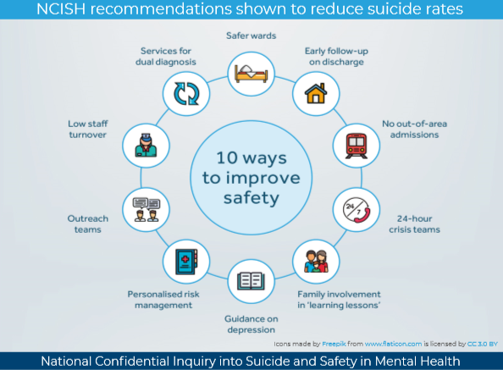
Notes:
National Confidential Enquiry - Annual report 2018: England, Northern Ireland, Scotland and Wales
10 key elements for safer care for patients

Slide 22
Epidemiology of Deliberate Self-Harm

Slide 23
Self Harm Epidemiology
Suicide attempts are 30 x more common than suicides
Incidence of adolescent self harm is increasing
Estimated 14-39% of general population engage in DSH
Prevalence data difficult to calculate as 59.4% do not have contact with services following DSH
Adolescence (2011-14)
Primary Care (2001-13)
Emergence Dept (2000-07)
37.4
12.3
17.9
12.3
36-44
/10,000
Incidence in females
/10,000
Incidence in males
/10,000
Incidence in females
/10,000
Incidence in males
/10,000
Incidence (non-gender specific)
Bachmann S (2018) Epidemiology of suicide and the psychiatric perspective. Int J Environ Res Public Health
Carr MJ, et al (2016) The epidemiology of self-harm in a UK-wide primary care patient cohort, 2001-2013. BMC Psychiatry. 16: 53
Bergen H, et al (2010) Epidemiology and trends in non-fatal self-harm in three centres in England: 2000-2007. BJPsych 197(6): 493-8
McManus S, et al (2019) Prevalence of non-suicidal self-harm and service contact in England, 2000-14: repeated cross-sectional surveys of the general population. The Lancet; 6(7): 573-81
Notes:
Suicide attempts are significantly more common that completed suicides.
There has been a 68% rise in the incidence of DSH in adolescent girls between 2011-14
There is a clear gender difference in that females, particularly young females, are more likely to self-harm
This data may be skewed by the fact that females are more likely to present to services following an incident at a young age, whereas men are more likely to present to services with increasing age
Overall estimates for DSH rates are skewed by lack of presentations to services, but a number of studies have shown an incidence of approximately 40% in an emergency department population with significantly fewer reported through studies of general practice.
Prevalence is higher in those from socioeconomically deprived backgrounds

Slide 24
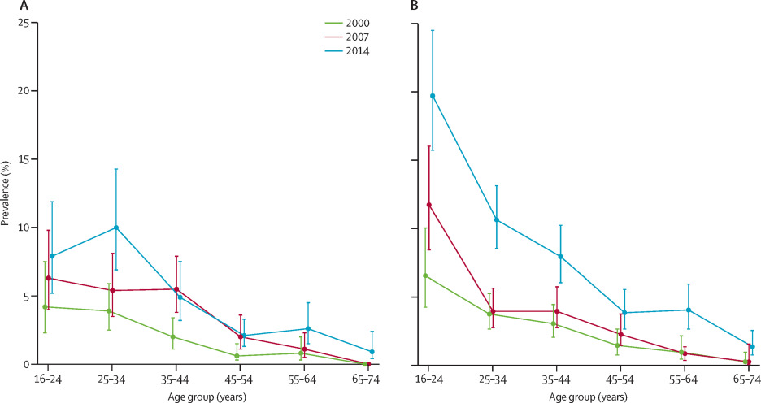
Self Harm Epidemiology
Prevalence of DSH decreases over the lifespan
Male
Female
McManus S, et al (2019) Prevalence of non-suicidal self-harm and service contact in England, 2000-14: repeated cross-sectional surveys of the general population. The Lancet Psychiatry; 6(7): 573-81
Notes:
A cross-sectional study of UK general population demonstrated the significantly higher rates of DSH in the female (and younger) population. Prevalence of DSH decreases over time with increasing age.
75% of patients who self-harm are under the age of 30, and 60% of those who self harm are between age 16-25

Slide 25
Self Harm Epidemiology
Risk of repetition:
1 in 6
1 in 4
Repeats within
1 year
Repeats within
4 years
Risk of suicide:
1 in 200 to 1 in 40
Complete suicide within 1 year
1 in 15
Completes suicide within 9 years or more
Owens, et al (2002) Fatal and non-fatal repetition of self harm: Systematic review. BJPsych 181(3): 193-9
Notes:
Patients who self-harm once are extremely likely to self harm again. A quarter of patients will repeat DSH within the next four years.
Deliberate self-harm is a strong predictor for completed suicide. Rates vary but up to 1 in 40 may complete suicide within the year of DSH incident, and 1 in 15 will complete suicide within 9 years

Slide 26
The Psychology of DSH
Reasons given for DSH
Factors associated with repetition of DSH
To die
Escape from unbearable anguish
To obtain relief
To change behaviour of others
To escape from a situation
To show desperation to others
To elicit help
To get back at others/make them guilty
Previous attempt(s)
Personality disorder diagnosis
Alcohol/substance abuse
Previous psychiatric treatment
Unemployment
Lower socioeconomic status
Criminal record
History of violence
Age 25-54
Single, divorced or separated
Cowen P, et al (2012) Shorter Oxford Textbook of Psychiatry, 6th Ed
Notes:
Many reasons are given for DSH, ranging from an intent to end their life to the classical ‘cry for help’

Slide 27
The psychology of suicide

Slide 28
The Psychology of Suicide
Suicidal ideation is common (9.2% lifetime prevalence)
But only 1/3 of those with SI go on to make a suicide attempt
What is it that makes a person move from ideation to action?
A number of risk factors for suicide have been identified
But the vast majority of people with those risk factors do not go on to make a suicide attempt
Why do risk factors lead to suicide attempts in some but not others?
Most psychological models in current research based on stress-diathesis:
Pre-existing vulnerability (diathesis) + Stress → Suicidal behaviour
O’Connor RC & Nock MK (2014) The psychology of suicidal behaviour. The Lancet Psychiatry 1(1): 73-85
Notes:
While we have seen that suicide is thankfully a fairly rare event, suicidal ideation is much more common.
But of those who have SI, only a third go on to make a suicide attempt.
While a number of risk factors are associated with suicide, the vast majority of those with those risk factors do not complete suicide.
Why is this?
Psychological theories can provide some possible answers, but ultimately the answers are extremely complex

Slide 29
Psychological Theories (1)
Theory |  | Premise
Cubic model of suicide | Shneidman (1985) | Combination of press (stress), pain (psychache) and perturbation result in suicide risk
Diathesis-stress-hopelessness model of suicidal behaviour | Schotte & Clum (1987) | Cognitive vulnerability (eg social problem-solving) accounts for the association between stress and suicide risk
Suicide as an escape from self | Baumeister (1990) | Main motivation of suicide is to escape from painful self-awareness
Clinical model of suicidal behaviour | Mann, et al (1999) | Stress-diathesis model, wherein suicide risk is caused by psychiatric disorder (stressor) and diathesis (tendency to experience more suicidal ideation/impulsivity)
Suicidal mode as cognitive behavioural model of suicidality | Rudd, et al (2001) | Based on ten principles of cognitive theory, the model describes the cognitive, affective, behavioural and physiological system characteristics associated with the development of suicide risk
Arrested flight model | Williams (2001) | Suicide risk is increased when feelings of defeat and entrapment are high and the potential for rescue (eg social support) is low
O’Connor RC & Nock MK (2014) The psychology of suicidal behaviour. The Lancet Psychiatry 1(1): 73-85
Notes:
This table shows various psychological theories that have been developed since 1985.
We will look at some of them in more detail later.

Slide 30
Psychological Theories (2)
Theory |  | Premise
Interpersonal-psychological model | Joiner (2005) | Suicidal desire is caused by high levels of burdonsomeness, and thwarted belongingness; desire is probably translated into suicidal behaviour when capability is high
Schematic appraisal model of suicide | Johnson, et al (2008) | Appraisal model which proposes risk is caused by the interplay between biases in information processing, schema and appraisal systems
Cognitive model of suicidal behaviour | Wenzel & Beck (2008) | Diathesis-stress model with three constructs: dispositional vulnerability factors, cognitive processes associated with psychiatric disturbance, and cognitive processes associated with suicidal acts
Differential activation theory of suicidality | Williams, et al (2008) | Associative network model, in which the experience of suicidal ideation or behaviour during a depressive episode increases the likelihood that it will re-emerge during subsequent episodes
Integrated motivational-volitional model of suicidal behaviour | O’Connor (2011) | Diathesis-stress model, specifying components of the premotivational, motivational (ideation and intent formation) and volitional (behavioural enaction) phases of suicidality
O’Connor RC & Nock MK (2014) The psychology of suicidal behaviour. The Lancet Psychiatry 1(1): 73-85
Notes:
This table shows various psychological theories that have been developed since 1985.
We will look at some of them in more detail later.

Slide 31
Interpersonal Theory
Two factors (burdonsomeness and thwarted belongingness) lead to desire for suicide. When capability of suicide is added this leads to suicide attempt
Thwarted
Belongingness
‘I am alone’
Desire for suicide
Perceived
Burdonsomeness
‘I am a burden’
Suicide
attempt
Capability for suicide
O’Connor RC & Nock MK (2014) The psychology of suicidal behaviour. The Lancet Psychiatry 1(1): 73-85
Notes:
In 2005, Joiner posited the interpersonal theory of suicide.
This combined two significant factors in the development of suicidal ideation – thwarted belongingness (ie feeling alone) and perceived burdonsomeness (feeling a burden to others)
When these are present at the same time, the desire for suicide is developed
When the capability for suicide is added (ie availability of means, tolerance of the physical pain aspect of DSH, ), this leads to the suicidal act

Slide 32
Stress-Diathesis Model
Susceptibility (diathesis) to stress and exposure to stressors leads to suicidal action
Genetics;
childhood traumatic events
Psychiatric disorders; psychosocial adverse events
Diathesis
Sensitivity to social stress
Impulsivity
Pessimism
Hopelessness
Stress
Financial or marital problems
Exacerbation of psychiatric disorder
Emotional pain
Suicidal behaviour
Van Heerigen K & Mann JJ (2014) The neurobiology of suicide. Lancet Psychiatry 1(1): 63-72
Notes:
Most modern psychological theories regarding suicidal action revolve around a stress-diathesis model.
Put simply, a patient may be predisposed to sensitivity to stress due to biological and psychological factors (genetics, childhood trauma, etc).
This leads them to have a sensitivity to social stress, be impulsive, be pessimistic and hopeless
When this is combined by stressors (mental illness, adverse life events) they are extremely stressed and become triggered to engage in suicidal behaviour.
However, this does not explain how people with similar stress and diathesis can experience suicidal thoughts but not engage in a suicidal action.

Slide 33
Integrated motivational-volitional model
This uses the stress-diathesis model but separates into pre-motivational, motivational and volitional (action) phases
Pre-motivational phase
Background factors and triggering events
Motivational phase
Ideation/intent formation
Volitional phase
Behavioural enaction
Diathesis
Defeat and humiliation
Entrapment
Suicidal ideation & intent
Suicidal Behaviour
Environment
‘Threat to self’
moderators
‘Motivational’
moderators
‘Volitional’
moderators
Examples:
Ruminations
Memory biases
Coping
Social problem- solving
Examples:
Thwarted belongingness, burdonsomeness, goals, social support
Examples:
Capability, impulsivity,
access to means, imitation,
planning
Life Events
O’Connor RC & Nock MK (2014) The psychology of suicidal behaviour. The Lancet Psychiatry 1(1): 73-85
Notes:
O’Connor (2014) took the stress-diathesis model one step further.
It goes some way to explaining how people can move from suicidal thoughts to suicidal action.
It looks at three distinct phases in the development of suicidal action – pre-motivational phase, motivational phase and volitional (action) phase.
The pre-motivational phase includes the factors which predispose someone to develop suicidal thoughts, similar to what we saw on the previous slide. These may be genetic factors, environmental stressors, adverse life events, childhood adversity, etc.
The motivational phase is where suicidal thoughts develop.
The first step is feelings of defeat and humiliation are triggered by an event.
The person’s innate coping strategies (or maladaptive coping strategies) then impact on the evaluation of these defeat thoughts.
If this then leads to a feeling of being trapped, the patient will often see no way out from these feelings other than suicide.
Entrapment may be felt when there is a lack of social support, a lack of life goals, feelings of loneliness, feeling a burden, etc.
Suicidal thoughts then may start.
Only when something triggers the move from motivational to volitional phase does someone act on their suicidal thought.
What might trigger this is the person’s capability to harm themselves, access to means, planning of suicidal act, impulsivity, etc.

Slide 34
Key Psychological factors
Personality and individual differences
Hopelessness
Impulsivity
Perfectionism
Neuroticism & Extraversion
Optimism
Resilience
Cognitive factors
Cognitive rigidity
Rumination
Thought suppression
Memory biases
Belongingness / burdonsomeness
Fearlessness about injury / death
Pain insensitivity
Problem-solving and coping
Agitation
Implicit associations
Attentional biases
Future thinking
Goal adjustments
Reasons for living
Defeat and entrapment
Social factors
Social transmission
Modelling
Contagion
Assortative mixing
Exposure to deaths by suicide of others
Social isolation
Negative life events
Childhood adversity
Traumatic adult life events
Physical illness
Interpersonal stressors
Psychophysiological stress response
O’Connor RC & Nock MK (2014) The psychology of suicidal behaviour. The Lancet Psychiatry 1(1): 73-85
Notes:
As part of their work on the integrated motivational-volitional model, O’Connor identified key psychological factors that can act as moderators (both positive and negative) within the model

Slide 35
Neurobiology of Suicide
Neurobiology of suicide relates to the stress-diathesis model
Specifically, what accounts for the vulnerability (diathesis)
It is thought genetic predisposition and/or epigenetic modifications play a part
50% of risk for suicide/suicide attempts is heritable
Childhood adversity is strongly linked to suicide
It is thought these early life experiences cause epigenetic modifications to the brain
Gene
Adverse life event
Neurotransmitter
Brain circuit
Mood regulation
Decision making
Van Heeringen K, Mann JJ (2014) The neurobiology of suicide. The Lancet Psychiatry 1(1): 63-72
Salloum, NC (2017) Suicidal behaviour: A distinct psychobiology? American Journal of Psychiatry 12(1): 2-4
Notes:
In this example, a gene codes for a neurotransmitter
This neurotransmitter is involved in the brain circuitary controlling for mood regulation and decision making
When an early adverse life event occurs, it causes an epigenetic modification to the gene
This affects how the neurotransmitter is expressed
This has a downstream impact on the brain circuit
And thus leads to impaired mood regulation and decision making

Slide 36
Neurobiology of Suicide
Theories:
Impact:
Defective transmission of Serotonin
Cognitive control of mood
Pessimism
Reactive aggressive traits
Problem-solving
Excessive emotional pain
Over-reactivity to negative social signs
Suicidal ideation
Hypothalamic-pituitary-adrenal axis (stress response system)
Elevated or blunted cortisol levels implicated
Neuroinflammation
Evidence of elevated pro-inflammatory IL-6 and other signs of inflammation on post-mortem
Kynurenine Pathway
High levels of neurotoxic Quinolinic acid formed from the main metabolic pathway for degradation of tryptophan
Neuroplasticity
Increased neuronal loss and decreased neurogenesis
Van Heeringen K, Mann JJ (2014) The neurobiology of suicide. The Lancet Psychiatry 1(1): 63-72
Salloum, NC (2017) Suicidal behaviour: A distinct psychobiology? American Journal of Psychiatry 12(1): 2-4
Notes:
There are several key pathways which are implicated in physiological changes in the suicidal brain.
There is no one unifying theory to link them all.
The HPA axis, serotonin transmission, neuroinflammation and defects in neuroplasticity have all been implicated.
Other more unusual pathways such as the kynurenine pathway which breaks down tryptophan have been shown to be defective in post-mortems following suicide.
It is thought that the impact of some of these defects leads to impaired control of mood, pessimism, impaired problem solving, excess emotional pain, suicidal thoughts and over-reactivity to negative social signs

Slide 37
Neurobiology of Suicide
But how does impairment of those cognitive processes lead to suicide?
Susceptible individual
Overvalue sign of social rejection
Susceptibility resembles sensitivity to signals of defeat
Brain circuitry determines which process individuals use to cognitively control emotions generated and decide how to deal with them
Experience intense mental pain that is difficult to control
Impaired decision-making restricts choices available –
Suicide feels like the only way to stop the intense, unrelenting emotional pain
Van Heeringen K, Mann JJ (2014) The neurobiology of suicide. The Lancet Psychiatry 1(1): 63-72
Salloum, NC (2017) Suicidal behaviour: A distinct psychobiology? American Journal of Psychiatry 12(1): 2-4
Notes:
There are several key pathways which are implicated in physiological changes in the suicidal brain.
There is no one unifying theory to link them all.
The HPA axis, serotonin transmission, neuroinflammation and defects in neuroplasticity have all been implicated.
Other more unusual pathways such as the kynurenine pathway which breaks down tryptophan have been shown to be defective in post-mortems following suicide.
It is thought that the impact of some of these defects leads to impaired control of mood, pessimism, impaired problem solving, excess emotional pain, suicidal thoughts and over-reactivity to negative social signs

Slide 38
References
World Health Organisation Suicide Data:
https://www.who.int/mental_health/prevention/suicide/estimates/en/
National Confidential Enquiry (UK Data):
https://sites.manchester.ac.uk/ncish/
Epidemiology:
Bertolote JM et al (2003) Suicide and mental disorders: do we know enough? BJPsych
Kostro K et al (2014) The current status of suicide and self-injury in eating disorders: a narrative review. Journal of Eating Disorders
Bachmann S (2018) Epidemiology of suicide and the psychiatric perspective. Int J Environ Res Public Health
Carr MJ, et al (2016) The epidemiology of self-harm in a UK-wide primary care patient cohort, 2001-2013. BMC Psychiatry. 16: 53
Bergen H, et al (2010) Epidemiology and trends in non-fatal self-harm in three centres in England: 2000-2007. BJPsych 197(6): 493-8
McManus S, et al (2019) Prevalence of non-suicidal self-harm and service contact in England, 2000-14: repeated cross-sectional surveys of the general population. The Lancet Psychiatry; 6(7): 573-81
Owens, et al (2002) Fatal and non-fatal repetition of self harm: Systematic review. BJPsych 181(3): 193-9
Psychology and Neurobiology of Suicide:
Cowen P, et al (2012) Shorter Oxford Textbook of Psychiatry, 6th Ed
O’Connor RC & Nock MK (2014) The psychology of suicidal behaviour. The Lancet Psychiatry 1(1): 73-85
Van Heeringen K, Mann JJ (2014) The neurobiology of suicide. The Lancet Psychiatry 1(1): 63-72
Salloum, NC (2017) Suicidal behaviour: A distinct psychobiology? American Journal of Psychiatry 12(1): 2-4

Slide 39
GA Module: Self Harm and Suicide
Questions
Discussion

Slide 40
GA Module: Self Harm and Suicide
MCQs
1. What is the single strongest predictor of completed suicide?
Mental illness
Previous self-harm
Recent bereavement
Having a neurodegenerative physical illness
Family history of suicide
Notes:
Answer: B

Slide 41
GA Module: Self Harm and Suicide
MCQs
2. A patient is refusing life-saving treatment for severe blood loss after cutting her wrists. Under the law in England and Wales, whose responsibility is it to assess capacity to make a decision to refuse treatment?
A consultant psychiatrist
A clinical psychologist
Any psychiatrist who is approved under Section 12(2) of the Mental Health Act
The clinician proposing the treatment
The duty AMHP (Approved Mental Health Professional)
Notes:
Answer: D

Slide 42
GA Module: Self Harm and Suicide
MCQs
3. What proportion of completed suicides have alcohol or substance comorbidity?
A. 9%
B. 32%
C. 56%
D. 70%
E. 87%
Notes:
Answer: C

Slide 43
GA Module: Self Harm and Suicide
MCQs
4. There is RCT evidence for reduction in suicide risk with which of the following medications?
Aripiprazole
Sodium valproate
Buspirone
Topiramate
Lithium
Notes:
Answer: E

Slide 44
GA Module: Self Harm and Suicide
MCQs
5. Completed suicides in the UK are most likely to use which method?
Firearms
Jump from a height
Self-poisoning
Hanging/strangulation
Self-immolation
Notes:
Answer: D

Slide 45
GA Module: Self Harm and Suicide
Thank you

