Slide 1

MRCPsych Old Age Module
Alzheimer’s Disease

Slide 2
OA Module: Alzheimer’s disease
Aims and Objectives
The overall aim is for the trainee to gain an overview of Alzheimer’s disease
  By the end of the session trainees should:
  Understand the epidemiology of Alzheimer’s disease.
  Understand the risk factors, genetics, neuropathology, neurotransmitters and neuroimaging associated with Alzheimer’s disease.
  Understand the clinical features of Alzheimer’s disease, the assessment process and the principles of management.
  Understand the carer burden related to Alzheimer’s disease.

Slide 3
OA Module: Alzheimer’s disease
To achieve this
Case Presentation
Journal Club
555 Presentation
Expert-Led Session
MCQs
Please sign the register and complete the feedback

Slide 4
OA Module: Alzheimer’s disease
Expert Led Session
Alzheimer’s disease
Dr Salman Karim
Consultant Psychiatrist/Honorary Senior Lecturer
Lancashire Care NHS Foundation Trust
University of Manchester
Peer reviewed Dr Richard Atkinson and Dr Anthony Peter, 2020

Slide 5
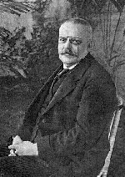

Slide 6
Epidemiology
850,000 people in the UK with dementia
Projected rise of 40% over next decade
1 in 3 people born in the UK this year will develop dementia in their lifetime
50 million people have dementia worldwide
10 million new cases each year
63% of these live in low and middle- income countries, this is projected to increase to 71% by 2050
Alzheimer’s accounts for 62% of all cases

Slide 7
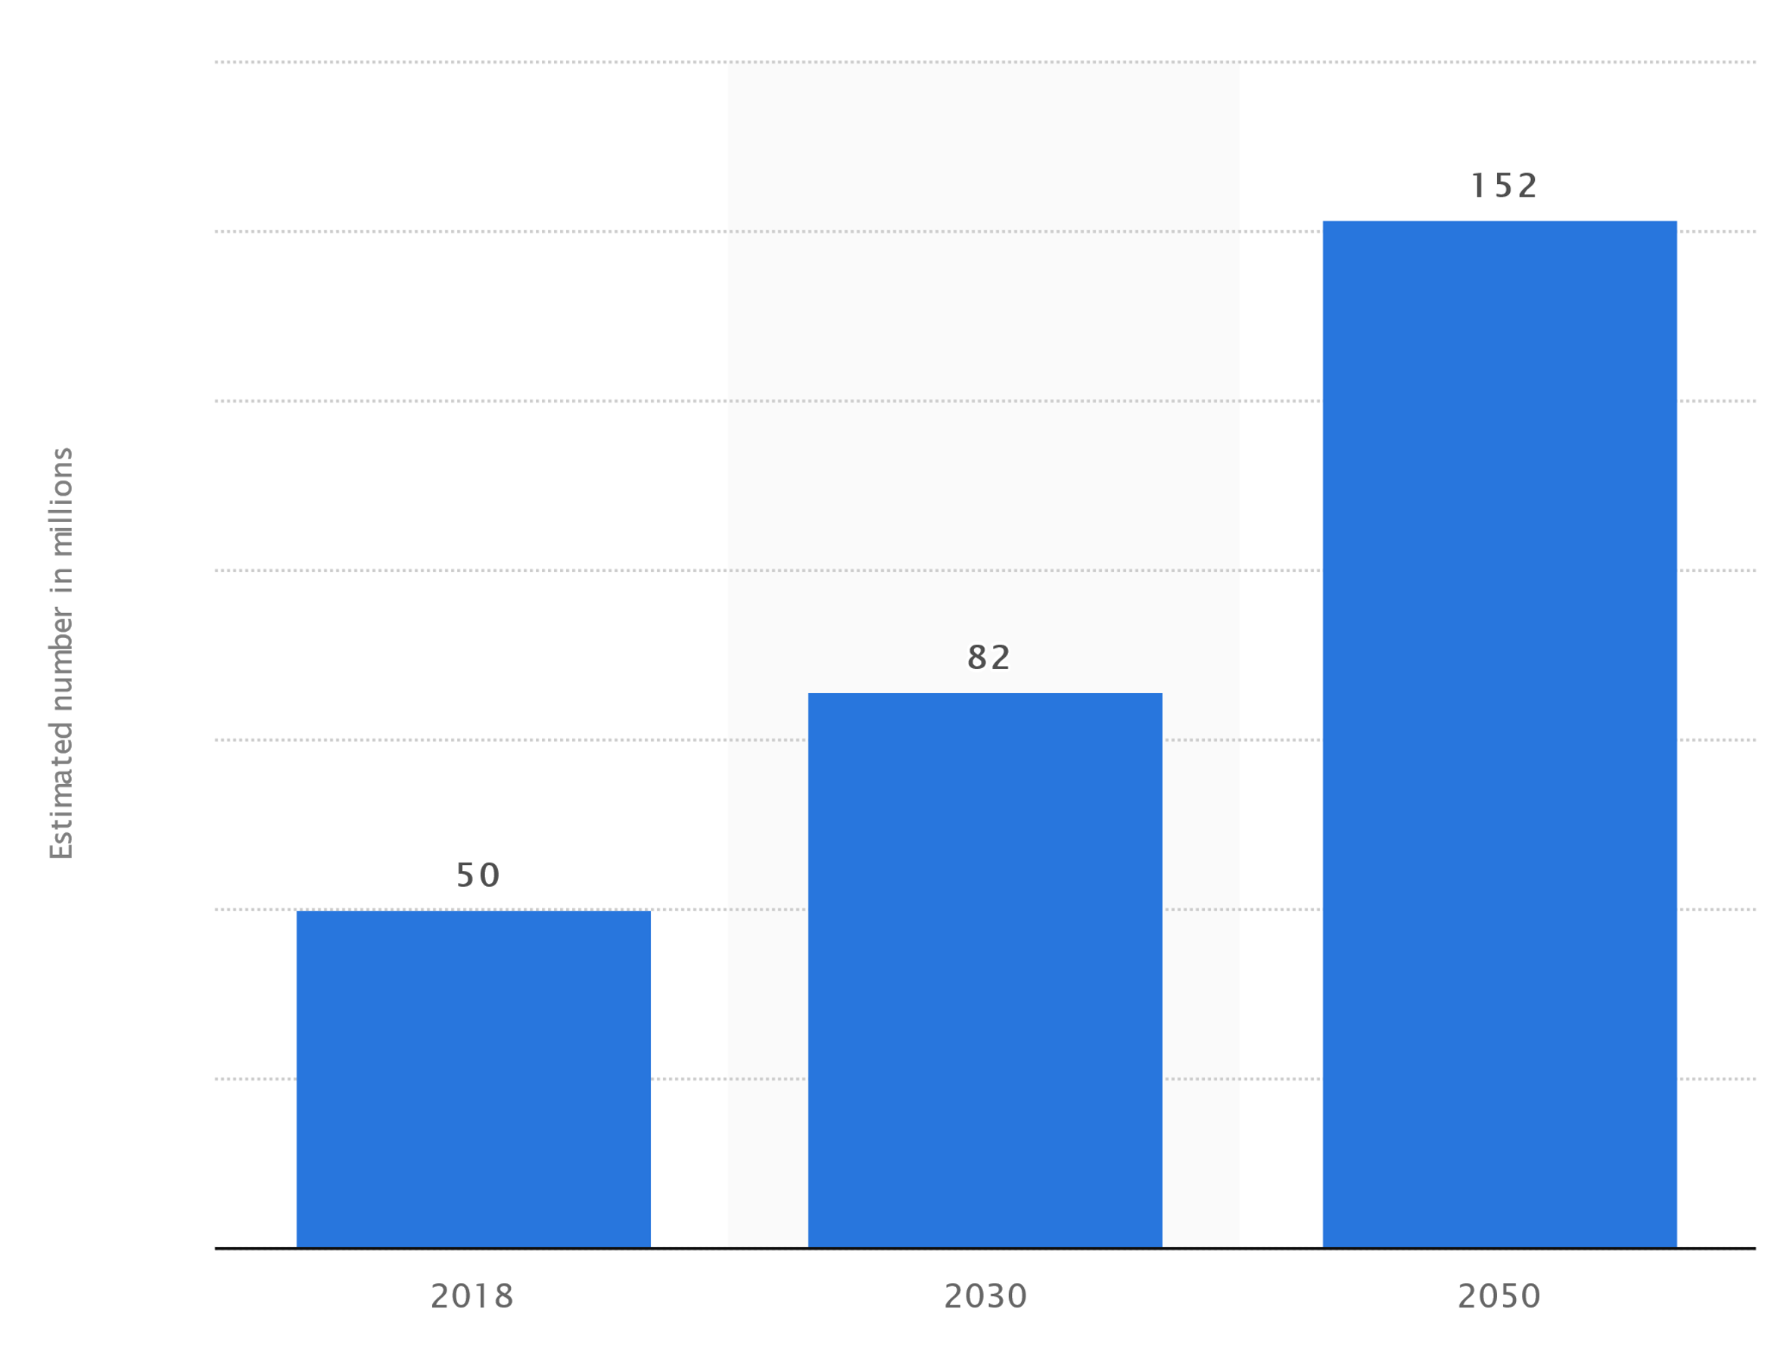
Estimated number of people with dementia worldwide in 2018, 2030 and 2050

Slide 8
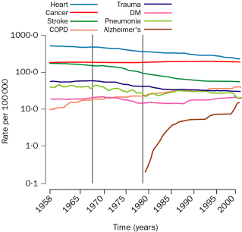

Slide 9
Epidemiology
Total cost of care in the UK is £26.3 billion
The NHS picks up £4.3 billion of the costs and social care £10.3
This is set to rise sharply in next two decades to £94.1 billion in 2040
Costs include healthcare, social care and unpaid care (that provided by family members)
This does not include carer burden

Slide 10
NEUROPATHOLOGY
Senile Plaques :
Extra-cellular amyloid beta-peptide
Neurofibrillary Tangles :
Intra-cellular fibrillary proteins
Tau deposits
Reduction of neurons and synapses
Reduction in cellular energy metabolism
Neuronal dysfunction/ death

Slide 11
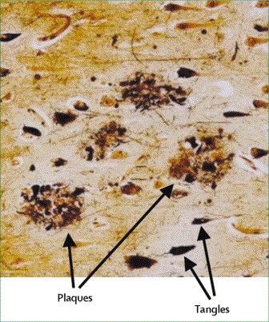

Slide 12
Neurotoxic action of Beta amyloid
Oxidative stress
Impaired cellular metabolism
Mitrochondial dysfunction
Impaired calcium metabolism
Impairment of long term potentiation
Increased neuro-fibrillary tangle formation

Slide 13
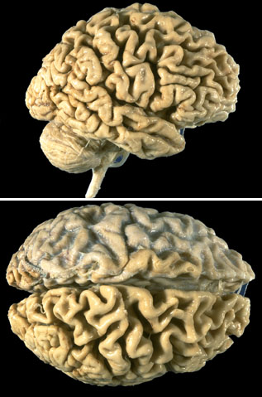

Slide 14
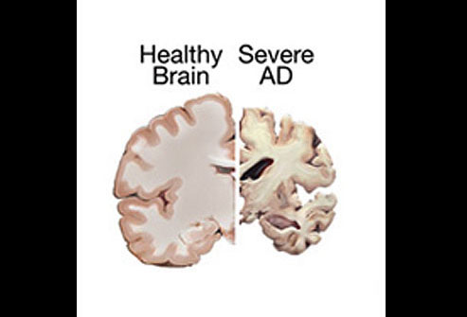

Slide 15
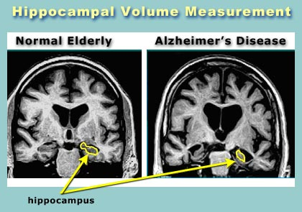

Slide 16
Aetiology
Late-Onset AD (LOAD)
  Not directly caused by gene
  APOE variant on chromosome 19 increases risk
  APOE = gene involved in making protein which carries cholesterol
  Different forms of APOE (E2,3,4)
  APOE4 allele – 3x increased risk of disease
  1 in 4 inherit APOE4

Slide 17
Aetiology
Early-Onset AD (EOAD)
1 in 20 AD patients have EOAD
  50% risk if have gene mutation below
  3 faulty genes linked to EOAD
  Mutation causes build up of amyloid
    Amyloid precursor protein on chromosome 21
    Presenilin 1 on chromosome 14
    Presenilin 2 on chromosome 1
Notes:
Mutations in the genes associated with early onset causes the production of amyloid plaques

Slide 18
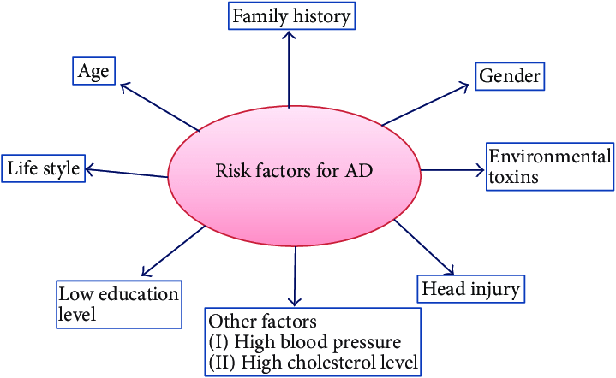
Risk Factors

Slide 19

Genetic Testing
Offered by NHS if risk of FTD or EOAD
Genetic counselling before and after
Test for which APOE allele you have
Poor predictive value for disease but shows increased risk

Slide 20
MECHANISM OF BETA AMYLOID DEPOSITION
Faulty processing of amyloid precursor protein (APP)
Increased accumulation of Beta-amyloid :
Toxic effect
Vulnerability to oxidative stress
Metabolic stress
Excitotoxicity
Disruption of calcium homeostasis

Slide 21
Accumulation of Aβ in cerebral cortex
Microglial & astrocyte activation
Oxidative injury; altered neuronal ionic homeostasis
Neuronal & synaptic dysfunction
Neuronal death
Dementia

Slide 22
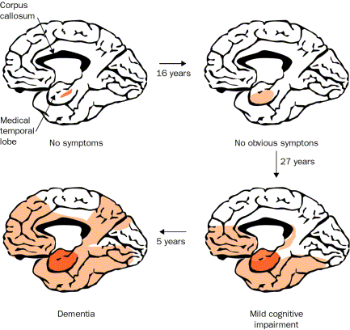

Slide 23
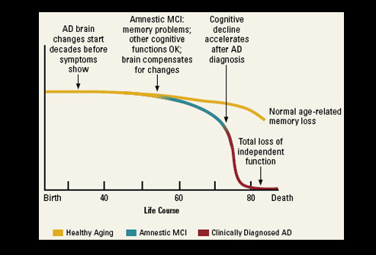

Slide 24
Neurochemistry of Alzheimer’s disease
Acetylcholine:
Perception, Attention, Learning, attention, Cognition and judgement
Noradrenaline:
Alertness, Memory and Attention
Serotonin:
Regulation of appetite and emotions
Glutamate (excitatory neurotransmitter ):
Neuronal cell death in many conditions is mediated by the effects of glutamate

Slide 25
CLINICAL FEATURES
Cognitive Symptoms :
Amnesia
Aphasia
Apraxia
Agnosia
Frontal executive dysfunction

Slide 26
CLINICAL FEATURES
Non-cognitive symptoms
Psychotic symptoms:
Delusions
Hallucinations
Misidentifications
Affective Symptoms:
Depression
Anxiety
Euphoria

Slide 27
CLINICAL FEATURES
Behavioural symptoms :
Apathy
Agitation
Wandering
Physical aggression
Verbal aggression

Slide 28
CLINICAL FEATURES
Neuro-vegetative symptoms :
Sleep disturbance
Eating difficulty
Sexual disinhibition
Incontinence
Personality changes – apathy, loss of inhibition
LPPA – an atypical form of Alzheimer’s

Slide 29
Atypical Alzheimer’s
Logopenic primary progressive aphasia (lvPPA): word-finding pauses; impaired repetition of phrases, spared object and word comprehension
Posterior cortical atrophy (PCA)
Frontal variant (fv-Alz)
Down’s syndrome variant

Slide 30
DIAGNOSIS
Clinical diagnosis: 90% accuracy
History : insidious, gradual progression
Physical examination : no focal neurological signs / no evidence of systemic disease
CT scan : ventricular dilatation, cortical/temporal lobe atrophy
EEG : Diffuse slow wave activity

Slide 31
Neuroimaging in AD
Global Cortical Atrophy scale (0-3, 3 is severe)
Medial Temporal Lobe Atrophy (MTA) (0-4)
  < 75 years: score 2 or more is abnormal.
  > 75 years: score 3 or more is abnormal
Fazekas Scale for white matter hyperintensities
  Score 0-3, 3 is large confluent lesions
  2/3 are pathologic
Koedam Score for Parietal Atrophy (0-3)

Slide 32
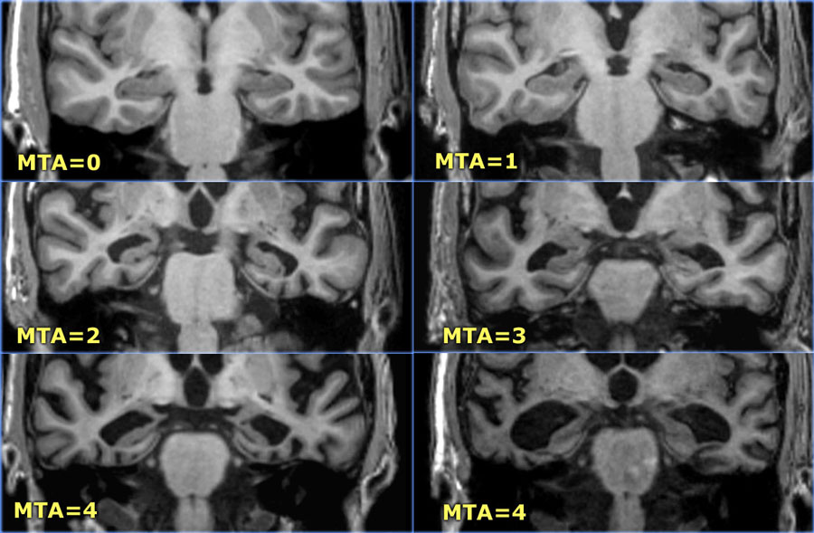
MTA Score
https://radiologyassistant.nl/neuroradiology/brain-dementia-role-of-mri

Slide 33
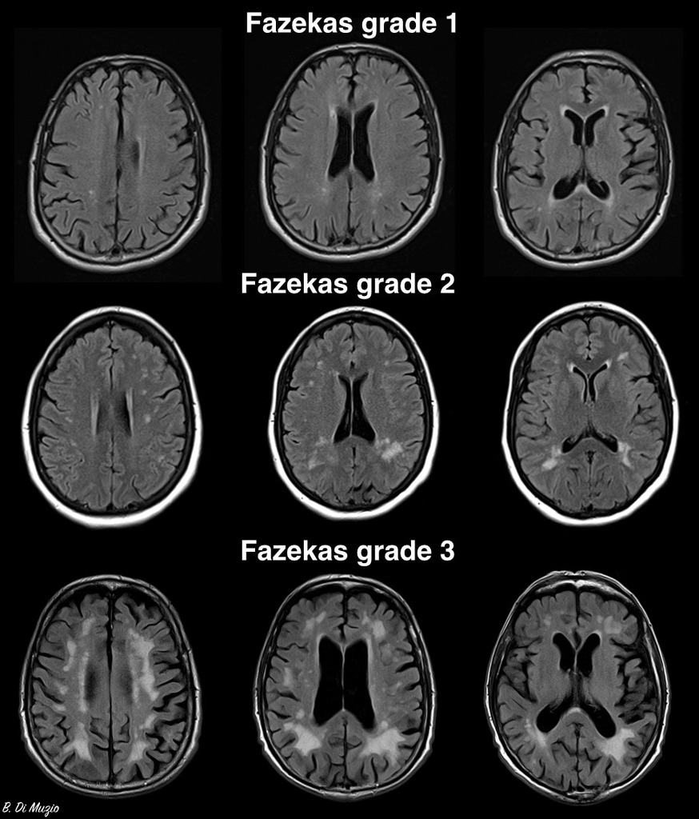
Fazekas Score
https://radiopaedia.org/cases/fazekas-scale-for-white-matter-lesions

Slide 34
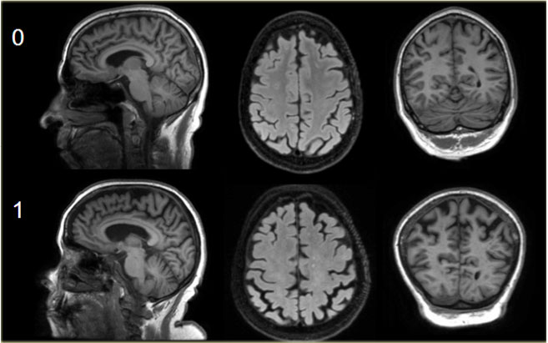
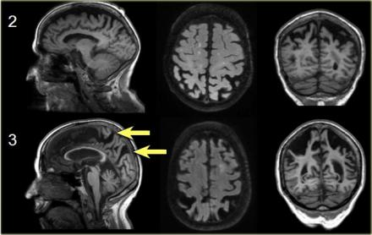
Koedam Score
https://radiologyassistant.nl/neuroradiology/brain-dementia-role-of-mri

Slide 35
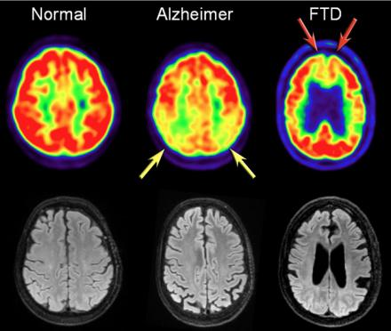
PET Imaging
Hypometabolism in temporoparietal regions
Helps differentiate AD from FTD which shows frontal hypometabolism

Slide 36
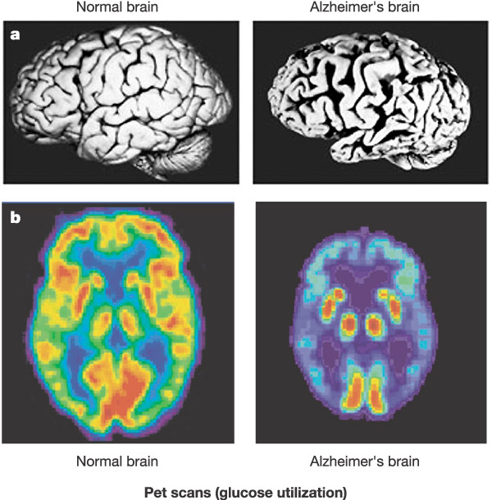

Slide 37
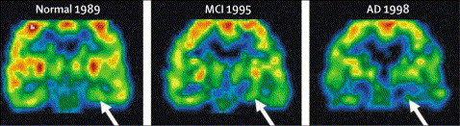
PET FDG in AD

Slide 38
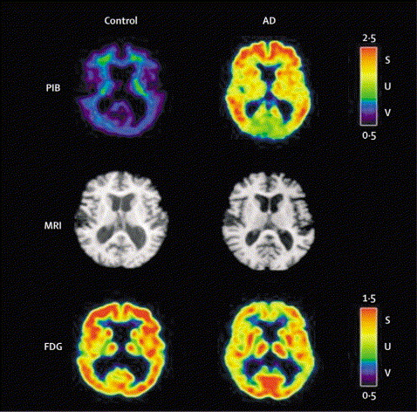

Slide 39
National Institute on Ageing-Alzheimer’s Association Research Framework 2018 update: Biomarker grouping

Slide 40
National Institute on Ageing-Alzheimer’s Association Research Framework 2018 update: biomarker profiles and categories

Slide 41
National Institute on Ageing-Alzheimer’s Association Research Framework 2018 update: cognitive staging combined with biomarkers

Slide 42
MANAGEMENT
Medications:
Cholinestrase inhibitors
Memantine
Ginkobiloba?
Vitamin E?
Non pharmacological interventions

Slide 43
Cholinesterase Inhibitors
Statistically superior to placebo in improving cognition
Corner stone of AD treatment
Higher doses more effective than lower doses
Treatment efficacy is similar for the three drugs available
GI side effects: nausea, vomiting, diarrhoea
Cardiac side effects: bradyarrythmia and syncope

Slide 44
Donepezil (Aricept)
Introduced in UK in 1997
5–10mg daily dose
Long plasma half life of 70 hours
Oral bioavailability unaffected by food
10mg dose more effective
Specific side effects: headache, anaemia, thrombocytopenia, insomnia, agitation

Slide 45
Rivastigmine (Exelon)
6–12mg daily dose
Effect on aceytlcholinesterase and butyrylcholinesterase
Short half life, transdermal patch available
Patch reduces GI side effects
Requires slower titration
Also licensed for Parkinson disease dementia

Slide 46
Galantamine (Reminyl)
8–24mg daily dose (optimal dose 16-24mg/day)
Dual action: CHEI and modulating effect on nicotinic receptors
Can be given once or twice daily
Bioavailability not affected by food
Similar side effect profile to other CHEIs

Slide 47
Memantine (Ebixa)
10–20mg daily dose
Partial glutamate receptor antagonist
Can be titrated quickly
Better tolerated than CHEIs
Problematic side effects: dizziness, fatigue,restlessness and hyper-excitation
Alternative to CHEIs: cardiac conduction problems, severe asthma, GI ulcers

Slide 48
Management Strategies
Early diagnosis
Family education
Early treatment intervention
Effective management of concurrent conditions
Ongoing caregiver support

Slide 49
Behavioral symptoms as progresses
100
80
Agitation
Diurnal
Rhythm
60
Depression
Prevalence (% of patients)
Irritability
40
Social
Withdrawal
Wandering
Aggression
Anxiety
Mood
Change
Paranoia
Hallucinations
20
Socially Unacceptable
Suicidal
Ideation
Accusatory
Delusions
0
Sexually Inappropriate
–40
–30
–20
–10
0
10
20
30
Months Before Diagnosis Months After Diagnosis
Jost BC, Grossberg GT. J Am Geriatr Soc. 1996;44:1078-1081.
Notes:
This graph illustrates that behavioral symptoms appear at all stages of Alzheimer’s disease, sometimes as early as 2 years prior to diagnosis. Peak frequencies of disturbances are indicated on a time line of disease progression.
Social withdrawal occurred an average of 33 months before diagnosis and was the earliest recognizable psychiatric symptom observed in this study. Suicidal ideation, depression, paranoia, and diurnal rhythm disturbances also occurred early in the course of the disease, whereas agitation, hallucinations, and aggression were documented an average of 1 to 2 years after diagnosis.

Slide 50
Behavior Management Principles
Non-drug management generally provides better results
How pharmacotherapy can be beneficial
Target medication to specific behavior
Avoid caregiver interpretation of PRN orders
Consider the patient's physical health status
Consider drug pharmacokinetic and pharmacodynamic properties

Slide 51
Managing Aggression
Identify the cause (noise, fear, etc.)
Simplify the environment to limit distractions
Music, exercise, etc. as a soothing activity
Shifting the focus to another activity

Slide 52
OUTCOME
Depends on the severity
Rate of institutionalization :
mild cases 12% after 1 year
severe cases 40% after 1 year
Median survival : 5-6 years

Slide 53
PREVENTION
Protective factors:
Anti-inflammatory drugs
Statins
Oestrogen
Alcohol
Life style:
Physical activity
Mental activity
Social Integration

Slide 54
RISK FACTORS
Age: Risk doubles every 5 years after 60
Diabetes
IHD
Hypertension
Low intelligence/ education
Smoking
Head injury

Slide 55
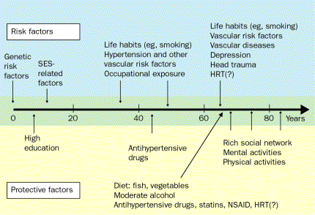

Slide 56
Please provide feedback/suggestions on this presentation to the module lead mark.worthington@lancashirecare.nhs.uk

Slide 57
OA Module: Alzheimer’s
Any Questions?
Thank you…. MCQs are next...

Slide 58
OA Module: Alzheimer’s
MCQs
1. The prevalence of dementia in the general UK population older than 65 is approximately:
A. 0.5-1%
B. 2-4%
C. 7%
D. 15%
E. 20%

Slide 59
OA Module: Alzheimer’s
MCQs
1. The prevalence of dementia in the general UK population older than 65 is approximately:
A. 0.5-1%
B. 2-4%
C. 7%
D. 15%
E. 20%

Slide 60
OA Module: Alzheimer’s
MCQs
In Alzheimer’s Disease, the gene for Amyloid Precursor Protein (APP) is found on the long arm of chromosome:
  1
  14
  21
  19
  27

Slide 61
OA Module: Alzheimer’s
MCQs
In Alzheimer’s Disease, the gene for Amyloid Precursor Protein (APP) is found on the long arm of chromosome:
  1
  14
  21
  19
  27

Slide 62
OA Module: Alzheimer’s
MCQs
As regards biomarkers in Alzheimer’s disease:
  The first biomarker change in Alzheimer’s disease is reflected by a decrease in CSF tau levels
  β amyloidosis can only be detected in venous plasma samples
  Amyloid-β accumulation is not sufficient to cause disease progression
  PET imaging is estimated to be able to predict changes 25 years prior to symptoms
  All individuals that have positive biomarker results progress at the same rate

Slide 63
OA Module: Alzheimer’s
MCQs
As regards biomarkers in Alzheimer’s disease:
  The first biomarker change in Alzheimer’s disease is reflected by a decrease in CSF tau levels
  β amyloidosis can only be detected in venous plasma samples
  Amyloid-β accumulation is not sufficient to cause disease progression
  PET imaging is estimated to be able to predict changes 25 years prior to symptoms
  All individuals that have positive biomarker results progress at the same rate

Slide 64
OA Module: Alzheimer’s
MCQs
4. A frail elderly gentleman is diagnosed with Alzheimer’s dementia in the clinic. He has a history of moderate COPD and 1st degree heart block. He also has a history of peptic ulcers.
Which would be the most appropriate first line drug to prescribe to slow cognitive decline and alleviate the behavioural and psychological symptoms of the dementia?
  A. Rivastigmine patch.
  B. Galantamine
  C. Memantine
  D. Donepezil
  E. Risperidone

Slide 65
OA Module: Alzheimer’s
MCQs
4. A frail elderly gentleman is diagnosed with Alzheimer’s dementia in the clinic. He has a history of moderate COPD and 1st degree heart block. He also has a history of peptic ulcers.
Which would be the most appropriate first line drug to prescribe to slow cognitive decline and alleviate the behavioural and psychological symptoms of the dementia?
  A. Rivastigmine patch.
  B. Galantamine
  C. Memantine
  D. Donepezil
  E. Risperidone

Slide 66
OA Module: Alzheimer’s
MCQs
Which of the following combination of APOE alleles confers the highest risk of developing AD?
  4:2
  2:3
  3:3
  3:4
  4:4

Slide 67
OA Module: Alzheimer’s
MCQs
Which of the following combination of APOE alleles confers the highest risk of developing AD?
  4:2
  2:3
  3:3
  3:4
  4:4

Slide 68
OA Module: Alzheimer’s
Any Questions?
Thank you

