Slide 1

Psychotherapy
Referring to Psychotherapy

Slide 2
Referring to Psychotherapy
Aims and Objectives (from handbook)
Identify relevance to psychotherapy of particular aspects of the psychiatric history.
Account for psychiatric presentation in psychological terms.
Know when to refer patients appropriately to specialist services

Slide 3
Referring to Psychotherapy
To achieve this
Case Presentation
Journal Club
555 Presentation
Expert-Led Session
MCQs
Please sign the register and complete the feedback

Slide 4
Referring to Psychotherapy
Expert Led Session
Psychotherapy Assessment
Author: Dr. Adam Dierckx
Consultant Medical Psychotherapist

Slide 5
What will we cover?
What therapy for whom?
Where to refer.
What can your patient expect from assessment?
Mop up from afternoon

Slide 6
What Therapy For Whom?
By Diagnosis
By NICE Guidance
‘Real life’

Slide 7
Therapy by diagnosis
ICD-10
Organic: supportive and systemic for carers
Substance misuse: MI, groups (e.g. AA, TC)
Psychosis: Cognitive Tx, Family Tx
Affective Disorders: CBT, psychotherapy
Anxiety Disorders: CBT
Behavioural Disorders: CBT
Personality Disorders: Adapted dynamic therapies
Notes:
Although these are clearly generalizations, the point is to convey to trainees that they can start to think of certain conditions as having a ‘first line’ of therapy choice.

Slide 8
By NICE Guidance
Follows broad outline in previous slide
Significant limitations for psychological therapy guidance.
Not all conditions have guidance
Most guidance is not exhaustive – what next?
Notes:
By ‘not exhaustive’ I mean that some guidance advises on treatment for a certain number of steps into the treatment algorithm but then does not advise further. For example, the depression guidance advises on medication then CBT then more medication but then does not offer an opinion on further psychological therapy. However, in real practice, this is exactly when clinicians often refer to specialist psychotherapy services.

Slide 9
Practical Guide: Where to refer?
Cognitive & Behavioural Therapies
Primary Care – IAPT
Mainly mild – moderate
Affective and anxiety disorders
Mainly shorter term presentations
No previous therapy
Secondary Care – Clinical Psychology
More complex and/or severe cases
Lack of effect from previous therapy
Longer presentations
Notes:
In this slide, and the next, the presenter can begin to introduce some more pragmatic reality to the idea of referral. The limitations (by design) of simple short term interventions like IAPT can be mentioned here, as can the differences between Clinical Psychology services and Psychotherapy

Slide 10
Practical Guide: Where to refer? (2)
Psychotherapy
Chronicity
Complexity
Comorbidity
Counter-transference
Notes:
Chronicity – Patients are often referred when symptoms remain unresolved despite seemingly adequate care
Complexity – Often this complexity takes the form of comorbid PD, making ‘simpler’ treatments less effective
Comorbidity – The presence of other conditions can often lead to exclusion from other services
Counter-transference – A common reason for referral is difficulties that have arisen in the relationship between the patient and the professionals involved. To some extent this also informs the previous 3

Slide 11
What happens in an assessment?
Diagnosis / Formulation
Engagement
Therapeutic change
Consent
Treatment planning
Notes:
For these and the following slides, please feel free to add / amend as fits your clinical assessment practice.

Slide 12
Formulation
Synthesis of historical information
Current presentation
Past History
Exploration of coping mechanisms
Emphasis on interpersonal events
An attempt to explain why the patient’s illness looks like it does.

Slide 13
History of Presenting Complaint
What is the problem the patient wants addressing?
What is the problem the referrer wants addressing (if different)?
When did it start and how?
What is the interpersonal context?
Has it happened before? Any patterns?
Notes:
Presenters can go into more depth here about what historical detail is useful and why.
The difference between the patient’s ideas about why they want therapy (or not) and why the referrer wants the patient to do therapy are important. These may well be influential in both accepting a patient for assessment and the therapy recommended at the end of assessment. For example, a patient who sees themselves a needing to change and that this change is necessary to resolve their mental health problem will likely be an ideal candidate for therapy. However, a patient who does not want therapy is unlikely to benefit, however much their psychiatrist wishes for them to have treatment. However, such a patient’s psychiatrist may well derive huge benefit from a therapeutic consultation where new ideas about the patient shape and influence the care plan.

Slide 14
Triangle of Conflict
Information from HPC
Notes:
(I’ve assumed here that the presenter is familiar with Malan’s ‘Two Triangles’ method for constructing formulations and interpretations – anyone wanting translation, please contact me.)
During this slide, the presenter should illustrate how (and where) items form the history in the previous slide can be used to populate Malan’s Triangle of Conflict.

Slide 15
Past History
What is the story of the patient’s life?
Brief and in general terms
Family structure and relationships with family
Attachment disruption e.g. CSA, loss, LAC
How do they get on with people?
Adolescent and adult relationships – stability/chaos
What do they do with their life now?
Notes:
Presenters can go into more depth here about what historical detail is useful and why.
Attachment disruptions need not be huge or traumatic but they usually give an idea about the patient’s attachment style. This is extremely relevant to the predicted relationship with a future therapist.

Slide 16
Triangle of Person
Information from PH and other history
Notes:
During this slide, the presenter should illustrate how (and where) items from the past history in the previous slide can be used to populate Malan’s Triangle of Person.

Slide 17
Full Formulation
Combine both Triangles
Notes:
This slide draws on Malan’s later concept of ‘Two Triangles become Four’, in which he illustrates that the same dynamics in the Triangle of Conflict apply for each of the three areas of the Triangle of Person – Past, Other and Therapist. When this can be described, the formulation becomes more coherent and focused.
The picture illustrates this as three small, identical Triangles of Conflict at each angle of the larger Triangle of Person

Slide 18
Engagement
Motivation & Readiness
Attachment Style
Aims and focus for therapy

Slide 19
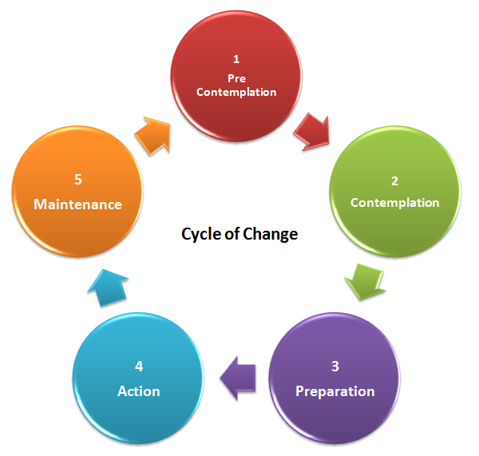
Motivation & Readiness
Notes:
Here the presenter can talk about the Cycle of Change and its relevance to all therapies (drug & talking). The point to be conveyed is that the patient needs to be in the correct place in the cycle of change to use an intervention. Supplementary work can be done to move the patient around the cycle e.g. motivational interviewing.

Slide 20
Attachment Style: Adaptations
Secure
Attaches easily with appropriate boundaries
Insecure: Ambivalent
Alternately help seeking and rejecting
Needs consistency & gently firm boundaries
Insecure: Avoidant
Hard to engage, avoids care
Needs encouragement and not mistaking avoidance for not wanting help
Disorganized
Chaotic
Needs stabilization first
Notes:
This slide is to illustrate (and expand upon) adaptations that the assessor might make to test whether insecurely attached or disorganized individuals can engage with a therapist.

Slide 21
Therapeutic Change
Movement in motivation stage
Increased insight
Revised care plans
Notes:
I would encourage presenters to give one or two examples from their own clinical practice of patients who have been sufficiently helped by assessment and not needed further work.

Slide 22
Consent & Planning
Consent
Trial of therapy
Experience of the process
Assessment of reaction to assessment
Planning
Collaborative care plan
Based on trial of therapy
Notes:
Here the aim is to convey that psychotherapy assessment is not a passive information gathering exercise but an active process. This active process givens the patient a ‘taster’ of therapy which in turn enables the patient to positively opt in to something which they have now experienced.

Slide 23
Summary
What therapy for whom?
Where to refer.
What can your patient expect from assessment?

Slide 24
Psychotherapy
MCQs
1. The following theorists are correctly matched with the concepts that they introduced:
Sigmund Freud The Subconscious
Melanie Klein The Paranoid-Schizoid Position
David Malan The Two Triangle technique
Herbert Rosenfeld Containment
Anna Freud The Ego

Slide 25
Psychotherapy
MCQs
1. The following theorists are correctly matched with the concepts that they introduced:
Sigmund Freud The Subconscious
Melanie Klein The Paranoid-Schizoid Position
David Malan The Two Triangle technique
Herbert Rosenfeld Containment
Anna Freud The Ego
Notes:
Note here the ‘trick’ question based on the lay misunderstanding of ‘subconscious’. Freud never used this term – it is a lay distortion of Freud’s concept of the Unconscious
Containment is Bion’s term and Sigmund Freud introduced the Ego.

Slide 26
Psychotherapy
MCQs
2. Defences:
Are always pathological.
Reduce anxiety.
Enhance conscious insight.
Are universal.
Develop later in childhood.

Slide 27
Psychotherapy
MCQs
2. Defences:
Are always pathological.
Reduce anxiety.
Enhance conscious insight.
Are universal.
Develop later in childhood.

Slide 28
Psychotherapy
MCQs
3. A psychotherapy formulation:
Leads to a diagnosis.
Ignores the past.
Is only applicable in psychotherapy.
Is theory neutral.
Makes predictions.

Slide 29
Psychotherapy
MCQs
3. A psychotherapy formulation:
Leads to a diagnosis.
Ignores the past.
Is only applicable in psychotherapy.
Is theory neutral.
Makes predictions.

Slide 30
Psychotherapy
MCQs
4. How do you define transference?
The empathy shown by the therapist to the patient.
Defence mechanism where attention is shifted to a less threatening / more benign target.
Therapist’s response to the patient drawn from therapist’s previous life experiences.
Patient’s response to the therapist based upon their earlier relationships
All of the above

Slide 31
Psychotherapy
MCQs
4. How do you define transference?
The empathy shown by the therapist to the patient.
Defence mechanism where attention is shifted to a less threatening / more benign target.
Therapist’s response to the patient drawn from therapist’s previous life experiences.
Patient’s response to the therapist based upon their earlier relationships
All of the above

Slide 32
Psychotherapy
MCQs
5. What would suggest a patient has good psychological mindedness?
Becoming very upset when talking about the past
Finding it hard to step back and observe the situation objectively
Needing to be talked through assessment with lots of prompts
Reasonable sense of self esteem
None of the above

Slide 33
Psychotherapy
MCQs
5. What would suggest a patient has good psychological mindedness?
Becoming very upset when talking about the past
Finding it hard to step back and observe the situation objectively
Needing to be talked through assessment with lots of prompts
Reasonable sense of self esteem
None of the above

Slide 34
Psychotherapy
Any Questions?
Thank you.

