Slide 1

MRCPsych General Adult Module
Bipolar Disorder-2

Slide 2
GA Module: Bipolar Disorder
Aims and Objectives
Aims
The overall aim is to give an overview of psychopathology and diagnosis of bipolar disorder.
Objectives:
Developed an understanding of the symptoms and psychopathology, diagnostic classification and differential diagnosis of bipolar disorder.

Slide 3
GA Module: Bipolar Disorder
To achieve this
Case Presentation
Journal Club
555 Presentation
Expert-Led Session
MCQs
Please sign the register and complete the feedback

Slide 4
GA Module: Bipolar Disorder
Expert Led Session
Bipolar Disorder – Psychopathology & Diagnosis

Slide 5
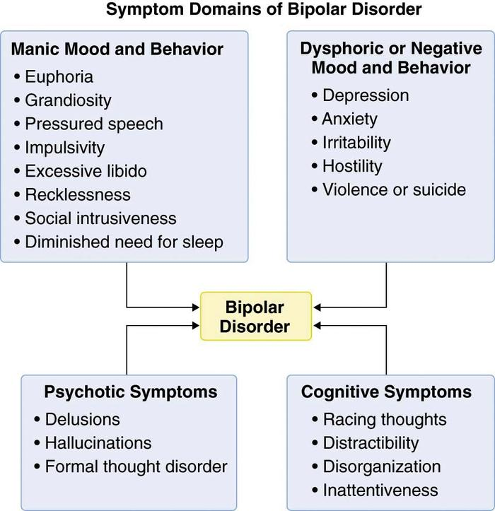

Slide 6
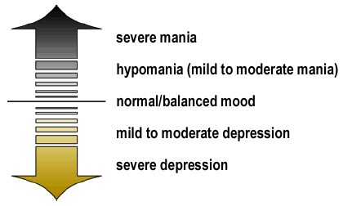
Bipolar spectrum
NIMH 2007

Slide 7
DSM-5 Diagnosis
Diagnostic Classifications
Bipolar I Disorder
One or more Manic Episode or Mixed Manic Episode
Minor or Major Depressive Episodes often present
May have psychotic symptoms
Specifies: anxious distress, mixed features, rapid cycling, melancholic features, atypical features, mood-congruent psychotic features, mood incongruent psychotic features, catatonia, peri-partum onset, seasonal pattern
Severity Ratings: Mild, Moderate, Severe

Slide 8
DSM-5 Diagnosis
Manic Episode Criteria
A distinct period of abnormally and persistently elevated, expansive, or irritable mood.
Lasting at least 1 week.
Three or more (four if the mood is only irritable) of the following symptoms:
Inflated self-esteem or grandiosity
Decreased need for sleep
Pressured speech or more talkative than usual
Flight of ideas or racing thoughts
Distractibility
Psychomotor agitation or increase in goal-directed activity
Hedonistic interests
APA (2013)

Slide 9
DSM-5 Diagnosis
Manic Episode Criteria (cont.)
Causes marked impairment in occupational functioning in usual social activities or relationships, or
Necessitates hospitalization to prevent harm to self or others, or
Has psychotic features
Not due to substance use or abuse (e.g., drug abuse, medication, other treatment), or a general medial condition (e.g., hyperthyroidism).
A full manic episode emerging during antidepressant treatment
APA (2013)

Slide 10
DSM-5 Diagnosis
Diagnostic Classifications
Bipolar II Disorder
One or more Major Depressive Episode
One or more Hypomanic Episode
No full Manic or Mixed Manic Episodes
No evidence of psychotic symptoms
Severity Ratings: Mild, Moderate, Severe
APA (2013)

Slide 11
DSM-5 Diagnosis
Hypomanic Criteria
Similarities with Manic Episode
Same symptoms
Differences from Manic Episode
Length of time
Impairment not as severe
Psychotic symptoms not present
May not be viewed by the individual as pathological
However, others may be troubled by erratic behavior
APA (2013)

Slide 12
DSM-5 Diagnosis
Diagnostic Classifications
Cyclothymia
For at least 2 years (1 in children and adolescents), numerous periods with hypomanic symptoms that do not meet the criteria for hypomanic episode
Present at least ½ the time and not without for longer than 2 months
Short periods of depression alternating with short periods of hypomania.
Criteria for major depressive, manic, or hypomanic episode have never been met
APA (2013)
Notes:
1

Slide 13
DSM-5 Diagnosis
Diagnostic Classifications
Unspecified Bipolar and Related Disorder
Bipolar features that do not meet criteria for any specific bipolar disorder.
APA (2013)

Slide 14
Diagnosis
Rapid-Cycling Specifier
Can be applied to Bipolar I or II
Four or more mood episodes (i.e., Major Depressive, Manic, Mixed, or Hypomanic) per 12 months
May occur in any order or combination
Must be demarcated by …
a period of full remission, or
a switch to an episode of the opposite polarity
Manic, Hypomanic, and Mixed are on the same pole
NOTE: This definition is different from that used in some literature, where in cycling refers to mood changes within an episode (Geller et al., 2004).
APA (2013)

Slide 15
Bipolar –ICD-10 criteria
F31 BIPOLAR AFFECTIVE DISORDER
Note: Episodes are demarcated by a switch to an episode of opposite or mixed polarity or by a remission.
F31.0 Bipolar affective disorder, current episode hypomanic
A. The current episode meets the criteria for hypomania (F30.0).
B. There has been at least one other affective episode in the past, meeting the criteria for hypomanic or manic episode (F30.-), depressive episode (F32.-) or mixed affective episode (F38.00).
F31.1 Bipolar affective disorder, current episode manic without psychotic symptoms
A. The current episode meets the criteria for mania without psychotic symptoms (F30.1).
B. There has been at least one other affective episode in the past, meeting the criteria for hypomanic or manic episode (F30.-), depressive episode (F32.-) or mixed affective episode (F38.00).

Slide 16
Bipolar –ICD-10 criteria
F31.2 Bipolar affective disorder, current episode manic with psychotic symptoms
A. The current episode meets the criteria for mania with psychotic symptoms (F30.2).
B. There has been at least one other affective episode in the past, meeting the criteria for hypomanic or manic episode (F30.-), depressive episode (F32.-) or mixed affective episode (F38.00).
A fifth character may be used to specify whether the psychotic symptoms are congruent or incongruent with the mood:
F31.20 with mood congruent psychotic symptoms
F31.21 with mood incongruent psychotic symptoms

Slide 17
Bipolar –ICD-10 criteria
F31.3 Bipolar affective disorder, current episode moderate or mild depression
A. The current episode meets the criteria for a depressive episode of either mild (F32.0) or moderate severity (F32.1).
B. There has been at least one other affective episode in the past, meeting the criteria for hypomanic or manic episode (F30.-), or mixed affective episode (F38.00).
A fifth character may be used to specify the presence of the somatic syndrome as defined in F32, in the current episode of depression:
F31.30 without somatic syndrome
F31.31 with somatic syndrome
F31.4 Bipolar affective disorder, current episode severe depression without psychotic symptoms
A. The current episode meets the criteria for a severe depressive episode without psychotic symptoms (F32.2).
B. There has been at least one well authenticated hypomanic or manic episode (F30.-) or mixed affective episode(F38.00) in the past.

Slide 18
Bipolar –ICD-10 criteria
F31.5 Bipolar affective disorder, current episode severe depression with psychotic symptoms
A. The current episode meets the criteria for a severe depressive episode with psychotic symptoms (F32.3).
B. There has been at least one well authenticated hypomanic or manic episode (F30.-) or mixed affective episode
(F38.00) in the past.
A fifth character may be used to specify whether the psychotic symptoms are congruent or incongruent with
the mood.
F31.50 with mood congruent psychotic symptoms
F31.51 with mood incongruent psychotic symptoms

Slide 19
Bipolar –ICD-10 criteria
F31.6 Bipolar affective disorder, current episode mixed
A. The current episode is characterized by either a mixture or a rapid alternation (i.e. within a few hours) of hypomanic, manic and depressive symptoms.
B. Both manic and depressive symptoms must be prominent most of the time during a period of at least two weeks.
C. There has been at least one well authenticated hypomanic or manic episode (F30.-), depressive (F32.-) or mixed affective episode (F38.00) in the past.
F31.7 Bipolar affective disorder, currently in remission
A. The current state does not meet the criteria for depressive or manic episode in any severity, or for any other mood disorder in F3 (possibly because of treatment to reduce the risk of future episodes).
B. There has been at least one well authenticated hypomanic or manic episode

Slide 20
Deferential Diagnosis

Slide 21
Bipolar I
Alternative Diagnosis | Differential Consideration
Major Depressive Disorder | Person with depressive Sx never had Manic/Hypomanic episodes
Bipolar II | Hypomanic episodes, w/o a full Manic episode
Cyclothymic Disorder | Lesser mood swings of alternating depression -hypomania (never meeting depressive or manic criteria) cause clinically significant distress/impairment
Normal Mood Swings | Alternating periods of sadness and elevated mood, without clinically significant distress/impairment
Schizoaffective Disorder | Sx resemble Bipolar I, severe with psychotic features but psychotic Sx occur absent mood Sx
Schizophrenia or Delusional Disorder | Psychotic symptoms dominate. Occur without prominent mood episodes
Substance Induced Bipolar Disorder | Stimulant drugs can produce bipolar Sx
Source: Francis (2013)

Slide 22
Bipolar II
Alternative Diagnosis | Differential Consideration
Major Depressive Disorder | No Hx of hypomanic (or manic) episodes
Bipolar I | At least 1 manic episode
Cyclothymic Disorder | Mood swings (hypomania to mild depression) cause clinically significant distress/impairment; no history of any Major Depressive Episode
Normal Mood Swings | Alternately feels a bit high and a bit low, but with no clinically significant distress/impairment
Substance Induced Bipolar Disorder | Hypomanic episode caused by antidepressant medication or cocaine
ADHD | Common Sx presentation, but ADHD onset is in early childhood. Course chronic rather than episodic. Does not include features of elevated mood.
Source: Francis (2013)

Slide 23
Cyclothymic Disorder
Alternative Diagnosis | Differential Consideration
Normal Mood Swings | Ups & downs without clinically significant distress/impairment
Major Depressive Disorder | Had a major depressive episode
Bipolar I | At least one Manic episode
Bipolar II | At least one clear Major Depressive episode
Substance Induced Bipolar Disorder | Mood swings caused by antidepressant medication or cocaine. Stimulant drugs can produce bipolar symptoms
Source: Francis (2013)

Slide 24
Diagnostic difficulties of Bipolar
Lack of reliable assessment tools for Bipolar Disorder
Misdiagnosed as unipolar depression
Children, adolescents and young adults are often diagnosed with ADHD
People often do not have clear cut, discrete mood episodes
Mania if often unrecognized or considered irritability/ aggression
Psychotic features are often mistaken for Schizophrenia
Unwillingness of the client to seek treatment
Lack of insight from client in mood episodes
Clinicians missing manic/hypomanic episodes- and reliance on self-reports

Slide 25
PRECIPITATING FACTORS
60% of first episodes precipitated by psychosocial, physical, or drug causes
30% of second episodes-similar causes can be identified
10% of third episodes have a notable cause
None of fourth episodes
Illness starts as exogenous and becomes more endogenous
Concept of kindling
Notes:
The kindling hypothesis (Post, 1992) posits that initial episodes of a mood disorder are more likely to be influenced by psychosocial stressors compared to later episodes, upon which stressors are thought to have less of an effect

Slide 26
Associated Impairments
Suicidal Behaviors
Prevalence of suicide attempts
40-45% in Bipolar vs. 19% in Unipolar
Age of first attempt-tends to be younger than patients with unipolar depression
Multiple attempts-87% vs. 50% of unipolar patients
Severity of attempts
Suicidal ideation-significantly more (72% vs.52% in unipolar)

Slide 27
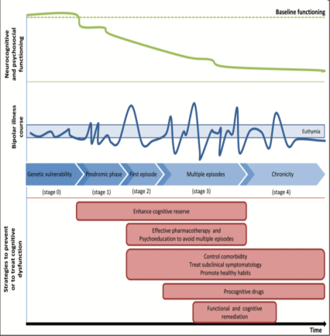
Associated Impairments
Cognitive Deficits
Executive Functions-mainly problem solving, self-monitoring, temporal sequencing of information and impulse control
Attention-mainly selective, sustained and set-shifting
Memory-new learning and recall affected
Sensory-Motor Integration-sequencing of motor acts affected
Nonverbal Problem-Solving
Academic Deficits
Mathematics
Solé 2017
Notes:
Multiple bipolar episodes are associated with increased cognitive decline

Slide 28
Associated Impairments
Psychosocial Deficits
Relationships
Peers
Family members
Recognition and Regulation of Emotion
Social Problem-Solving
Self-Esteem
Impulse Control & Risk taking behavior

Slide 29
COMORBID DISORDERS
Substance Abuse – At least 61%
Alcohol, Cocaine, THC(Cannabis)
Effect – More mixed and rapid cycling, poorer response to Lithium, slower time to recovery, and more lifetime hospitalizations
Narcissistic PD
Borderline PD
20-30% OCD, Panic Disorder
ADHD

Slide 30
Substance Abuse and Bipolar Disorder
BPAD has high rate of comorbid/concurrent substance misuse
21-61% of people with BPAD abuse or are addicted to substances as compared to 3-13% in the general population
BPAD is second to antisocial personality disorder in terms of concurrent substance abuse
Substance use adversely effects medication, predisposes to earlier onset of symptoms and often leads to hospitalization

Slide 31
Bipolar Disorder and Personality Disorders
Approximately 50% of all Bipolar patients also meet criteria for a personality disorder
The most common comorbid conditions are in cluster B and C
The most common Cluster B disorders include Borderline, Histrionic, Narcissistic
The most common Cluster C disorders include Avoidant and Obsessive-Compulsive

Slide 32
References & further reading
American Psychiatric Association. (2013). Diagnostic and statistical manual of mental disorders (5th ed.). Washington, DC: Author.
NIMH. (2007). Bipolar disorder. Bethesda, MD: Author. Retrieved May 28, 2007, from http://www.nimh.nih.gov/publicat/bipolar.cfm
Some of the slides were taken from a PowerPoint presentation freely available online: Assessment and Intervention for Bipolar Disorder: Best Practices for School Psychologists by Stephen Brock, California State University Sacramento.
WORLD HEALTH ORGANIZATION. (1992). The ICD-10 classification of mental and behavioural disorders: clinical descriptions and diagnostic guidelines. Geneva, World Health Organization.

Slide 33
GA Module: Bipolar-2
Questions
Discussion

Slide 34
GA Module: Bipolar- 2
MCQs
1. The experience of numerous periods of hypomanic symptoms (that do not meet the criteria for hypomanic episodes) over 2 years may be diagnosed as:
A. Dysthymic disorder
B. Cyclothymic disorder
C. Rapid Cycling disorder
D. Personality disorder
Bipolar disorder NOS
Notes:
Answer: B Cyclothymia

Slide 35
GA Module: Bipolar- 2
MCQs
Answer: B. Cyclothymic disorder
For at least 2 years (1 in children and adolescents), numerous periods with hypomanic symptoms that do not meet the criteria for hypomanic episode
Present at least ½ the time and not without for longer than 2 months
Short periods of depression alternating with short periods of hypomania.
Criteria for major depressive, manic, or hypomanic episode have never been met
Notes:
Answer: B Cyclothymia

Slide 36
GA Module: Bipolar- 2
MCQs
2. The Cognitive deficits associated with Bipolar Disorder may include:
A. Executive functioning deficits
B. Verbal learning and memory
C. Difficulties in sequencing of motor acts
D. Processing and psychomotor skills including fine motor skills
E. All of the above
Notes:
Answer: E All of the above

Slide 37
GA Module: Bipolar- 2
MCQs
Answer: E. All of the above
Euthymic bipolar patients demonstrate relatively marked impairment in aspects of executive function and verbal memory.
However, In a meta analysis by Bourne et al, findings were inconsistent both across primary studies and previous meta‐analyses.
Notes:
Answer: E All of the above

Slide 38
GA Module: Bipolar- 2
MCQs
Which of the following statements is false?
A. The term 'melancholia' in DSM-IV is equivalent to somatic symptoms in ICD-10
B. Dysthymia is characterized by subthreshold depressive symptoms
C. Bipolar I is characterized by hypomanic episodes only
D. 'Endogenous' depression is characterized by somatic symptoms
E. 'Reactive' depression is characterized by anxiety, irritability, and phobias

Slide 39
GA Module: Bipolar- 2
Answer: B. Bipolar I is characterized by hypomanic episodes only
One or more Manic Episode or Mixed Manic Episode
Minor or Major Depressive Episodes often present
May have psychotic symptoms

Slide 40
GA Module: Bipolar- 2
MCQs
Which of the following statements is FALSE about Rapid Cycling bipolar disorder:
A. History of antidepressant induced hypomania is a risk factor
B. Evidence of low thyroxin levels is found even when not under treatment
C. Lasts less than 2 years in 50% of cases
D. Patients cycle between hypomania and depression each week
E. Is not genetically inherited in families with bipolar disorder
Notes:
Answer: D – patients typically would have at least four distinct episodes per year

Slide 41
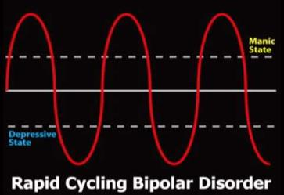
GA Module: Bipolar- 2
MCQs
Answer: D. Patients cycle between hypomania and depression each week
Notes:
Answer: D – patients typically would have at least four distinct episodes per year

Slide 42
GA Module: Bipolar- 2
MCQs
5. Which of the following statements is TRUE regarding Cyclothymia:
A. Is more common in males
B. Prevalence around 5%
C. Usual age of onset is between 35-40 years
D. Results in a diagnosis of bipolar disorder in a third of patients
E. Mood stabilisers are usually ineffective
Notes:
Answer: D – 1/3rd of patients develop bipolar disorder

Slide 43
GA Module: Bipolar- 2
MCQs
Answer: D. Results in a diagnosis of bipolar disorder in a third of patients
Notes:
Answer: D – 1/3rd of patients develop bipolar disorder

Slide 44
GA Module: Bipolar Disorder
Thank you

