Slide 2
Other Neurodegenerative Disorders & Dementias
Aims and Objectives
To overall aim is to gain a basic overview of common dementias including Lewy Body dementia (DLB), Parkinson’s disease dementia (PDD) & related disorders, frontotemporal dementia (FTD), and vascular dementia (VaD).
By the end of the session, the trainee should understand the basic epidemiology, aetiology, clinical presentation and basic management of these forms of dementia.

Slide 3
Other Neurodegenerative Disorders & Dementias
To achieve this
Case Presentation
Journal Club
555 Presentation
Expert-Led Session
MCQs
Please sign the register and complete the feedback

Slide 4
Other Neurodegenerative Disorders & Dementias
Other Neurodegenerative Disorders & Dementias
Dr Mark Worthington
Consultant Older Adult Psychiatrist
Lancashire Care NHS Foundation Trust
Peer reviewed by:
Dr Matt Jones
Expert Led Session

Slide 5
Dementia by Type
Notes:
NB - Differences between later onset and younger onset in terms of diagnostic case mix

Slide 6
Untreatable causes of dementia
Adapted from Hodges JR. Cognitive Assessment for Clinicians
Neurodegenerative | Alzheimer’s disease* Lewy Body dementia (DLB) Huntington’s disease (HD)* Frontotemporal dementias (FTD)* Parkinson’s disease (PD)* | Progressive supranuclear palsy (PSP) Multiple systems atrophy (MSA) Corticobasal degeneration (CBD) Prion diseases (e.g. CJD)* Leucodystrophies*
Vascular | Vascular dementias | CADASIL*
Infective | Progressive multifocal leucoencephalopathy (PML) CJD (prion disease) | Post-encephalitis Sub-acute sclerosing panencephalitis (SSPE)
Traumatic | Dementia pugilistica
Post-anoxic | Post-surgical (e.g. Cardiac bypass) Carbon monoxide poisoning? | Cardiac arrest
Toxic | Alcohol? Heavy metals | Organic solvents Organophosphates
Notes:
(Adapted from Hodges JR. Cognitive Assessment for Clinicians)

Slide 7
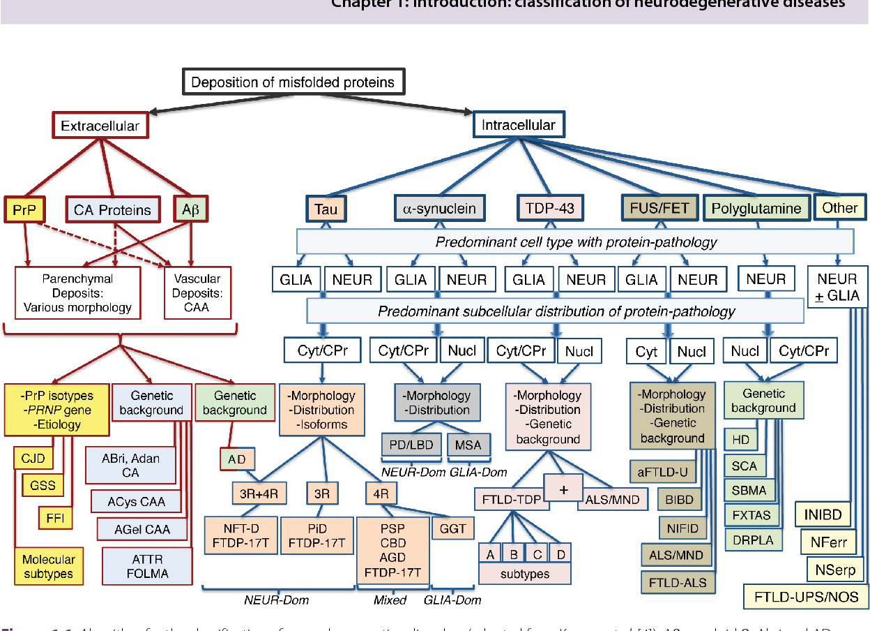
Neurodegenerative diseases - complex pathological overlap!
Kovacs, G.G., 2016. Molecular pathological classification of neurodegenerative diseases: turning towards precision medicine. International journal of molecular sciences, 17(2), p.189.

Slide 8
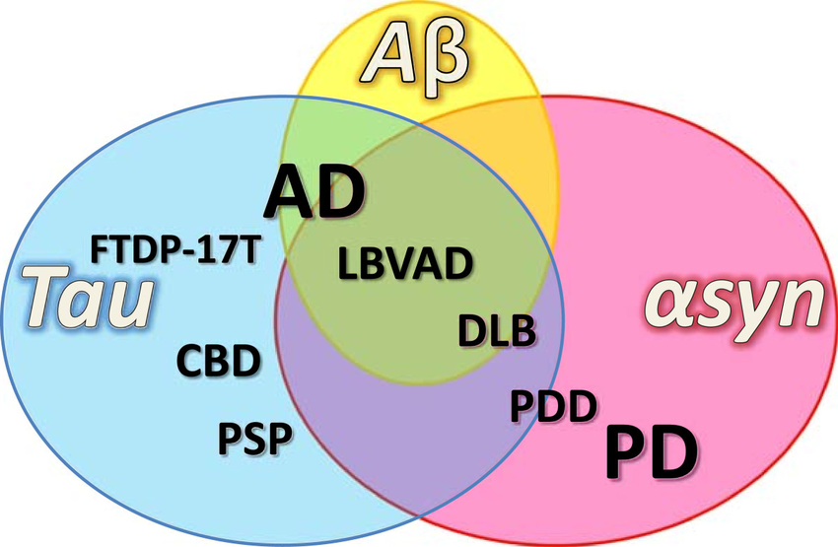
Three main proteinopathies - a little easier to remember!
Moussaud, S., Jones, D.R., Moussaud-Lamodière, E.L., Delenclos, M., Ross, O.A. and McLean, P.J., 2014. Alpha-synuclein and tau: teammates in neurodegeneration?. Molecular neurodegeneration, 9(1), p.43.

Slide 9
Vascular dementia
Syndrome; spectrum of disorders, not a single diagnosis
Heterogeneity within this syndrome
2nd most common cause dementia– 1 in 20 aged over 65 globally
Risk factors

Slide 10
Vascular cognitive impairment/ dementia
Embolic occlusion
Multi-infarct
Strategic infarct
Post stroke
Hypertensive
Small vessel disease
Vasculopathy
CADASIL
CAA
Hypo-perfusion
Local
Global

Slide 11
General findings
Neurological findings: pseudobulbar palsy, brisk tendon reflexes, gait abnormalities, early urinary symptoms
Psychomotor slowing ,abnormal executive functioning, fluctuating confusion
Depression , anxiety ,emotional lability
Relatively preserved personality with insight in mild and moderate cases

Slide 12
Vascular dementia
Multiple or single strategic infarcts
Large vessel infarcts should be bilateral or in dominant hemisphere
Lacunar (small subcortical infarcts 3-20mm) infarcts: strategic infarcts (e.g. thalamus) or multiple lesions required. Can be silent or history of TIA/CVA
NINDS-AIREN criteria

Slide 13
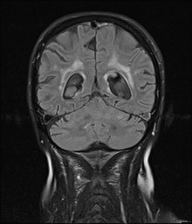
Vascular dementia
Small vessel disease (SVD)
Damage to small subcortical vessels
SVD commonly seen in older individuals
Commonest cause of vascular dementia
WMHs – bright on T2 and FLAIR
NINDS-AIREN: >25% of white matter affected
Román, G.C., Tatemichi, T.K., Erkinjuntti, T., Cummings, J.L., Masdeu, J.C., Garcia, J.H., Amaducci, L., Orgogozo, J.M., Brun, A., Hofman, A. and Moody, D.M., 1993. Vascular dementia: diagnostic criteria for research studies: report of the NINDS‐AIREN International Workshop. Neurology, 43(2), pp.250-250.
Notes:
The vessels affected are small arteries and arterioles that branch from proximal parts of the major cerebral arteries to supply the basal ganglia
and thalamus, and penetrating arterioles from the pial surface that reach through the cerebral cortex to supply the white matter.

Slide 14
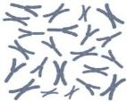
CADASIL
Cerebral autosomal dominant arteriopathy with subcortical infarcts & leucoencephalopathy (CADASIL)
Mutation on NOTCH3 gene
Impairs function and survival of vascular smooth muscle cells
Multiple lacunar infarcts and marked white matter disease (widespread leucoencephalopathy)
Migraine, recurrent strokes, affective disorder, seizures, visual problems
Onset around 35-40
19
Notes:
Rare disorder / form of subcortical small vessel disease
From Taylor & Doody (2008):
CADASIL is a pure form of white matter ischaemic disease. There is a 60–70% reduction in choline acetyltransferase in cortical regions. This is suggestive of significant cholinergic dysfunction (Keverne et al, 2006). There is evidence that axons in the parieto-occipital and dorsal frontal cortex are damaged (Mesulam et al, 2003).

Slide 15
Cerebral amyloid angiopathy (CAA)
Deposition of amyloid within blood vessels
Risk of haemorrhage and CVA
F>M
Pathology occurs in most AD and older adults without AD – contributes to vascular cognitive impairment / dementia (Esiri, 1997)
Microbleeds on MRI (T₂* ) – haemosiderin leakage
Modified Boston Criteria Knudsen, K.A., Rosand, J., Karluk, D. and Greenberg, S.M., 2001. Clinical diagnosis of cerebral amyloid angiopathy: validation of the Boston criteria. Neurology, 56(4), pp.537-539.

Slide 16
Hypo perfusion
Localised
Small arteriovenous malformation (AVM)
Global
Chronic: low output cardiac failure, large AVM, chronic anaemia, bilateral carotid stenosis
Transient: cardiac arrest, carbon monoxide poisoning

Slide 17
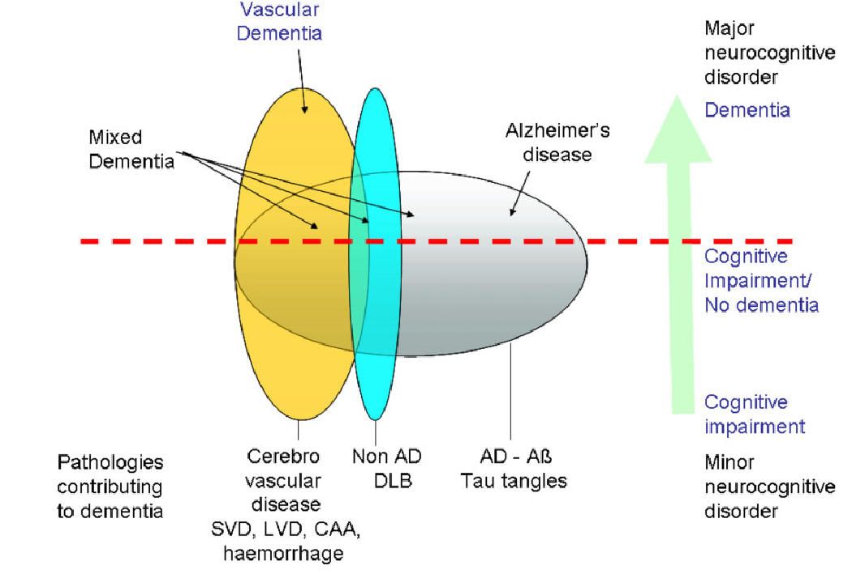

Coexistence of different types of pathology
Khan, A., Kalaria, R.N., Corbett, A. and Ballard, C., 2016. Update on vascular dementia. Journal of geriatric psychiatry and neurology, 29(5), pp.281-301.
©2012 by The Royal College of Psychiatrists
Notes:
Schematic diagram showing the extensive coexistence of different types of pathology in many individuals and the correspondingly low frequency of pure forms of pathology. The degree of cognitive impairment increases from top to bottom of the diagram, and the horizontal line represents the point at which impairments are sufficiently great to be classified as dementia. ‘Alzheimer’s disease’ and ‘Cerebrovascular disease’ indicate pathology, not necessarily with dementia syndrome. ‘Other’ includes many forms of pathology that can give rise to cognitive impairment, such as dementia with Lewy bodies.

Slide 18
Frontotemporal Dementias (FTD)
Epidemiology & aetiology
Pathophysiology
Clinical presentation
Investigations
Treatment
Prognosis

Slide 19
Frontotemporal Dementias
Heterogeneous group of neurodegenerative dementias with selective atrophy of frontal and/or temporal lobes
Insidious course; onset typically in 6th decade (21-85 yrs)
Genetic risk factors / familial in many cases (especially behavioural variant FTD) (Onyike & Diehl-Schmid, 2013)
Prevalence 15-22 per 100 000 (Onyike & Diehl-Schmid, 2013)
M=F
Second most common cause of dementia after AD in people younger than 65 years (Bird, 2003)
Clinical spectrum - behavioural symptoms, progressive aphasia and executive dysfunction, to parkinsonism plus or motor neuron disease

Slide 20
Frontotemporal Dementias - types
Behavioural variant (bvFTD) (~50%)
Personality & behaviour change
Hyperorality, altered eating behaviour
Loss of insight
Emotional blunting
Early preservation of memory, visuospatial function
Primary progressive aphasias (PPA) (~50%)
Exclusively speech and language difficulties for 2 years
Semantic variant (svPPA)
Non-fluent variant (nfPPA)
Logopenic variant (lvPPA) – an atypical Alzheimer’s rather than FTD
(Gorno-Tempini ML, 2011)
Notes:
Can be sub-divided into behavioural and language types dependent on key clinical features

Slide 21
The FTLD syndrome spectrum. (A) Schematic of current diagnostic criteria. (B) Schematic to highlight our hypothesis that FTLD syndromes occur on a spectrum. (C and D) Four-way Venn diagrams of overlap between FTLD syndromes in the study. The numbers in each oval refer to the number of patients who met the diagnostic criteria for those syndromes. Many patients met the diagnostic criteria for two or more syndromes. (C) Overlap between bvFTD, nfvPPA, PSP and CBS. (D) Overlap between bvFTD, nfvPPA, svPPA and lvPPA.
Murley, A.G., Coyle-Gilchrist, I., Rouse, M.A., Jones, P.S., Li, W., Wiggins, J., Lansdall, C., Rodríguez, P.V., Wilcox, A., Tsvetanov, K.A. and Patterson, K., 2020. Redefining the multidimensional clinical phenotypes of frontotemporal lobar degeneration syndromes. Brain, 143(5), pp.1555-1571.

Slide 22
Genetics
MAPT* (Microtubule-associated protein tau) → inclusions of insoluble hyperphosphorylated tau
GRN* (Progranulin gene) → inclusions of TDP43
C9ORF72 (Chromosome 9 open reading frame 72) (associated with FTD-MND) → inclusions of TDP43
VCP (chromosome 9)
CHMP2B (chromosome 3)
17
17
9
9
3
Notes:
*Commonest causes of familial FTD / most associated with bvFTD rather than language types
TDP-43 = transactive response DNA binding protein 43
VCP – valosin containing protein: also found on chromosome 9. Associated with Paget’s disease and inclusion body myopathy
CHMP2B – chromatin modifying protein 2B on chromosome 3.
Upto 10% of FTD cases are autosomal dominant although a greater proportion have a strong family history.
Tau and progranulin are located relatively closely on chromosome 17

Slide 23
Pathophysiology
Intracellular inclusions of:
Tau (MAPT mutation), or
TDP-43 (C9ORF72 / GRN mutations)
FUS
UPS
Associated pathological findings:
Pick bodies (tau-reactive intraneuronal inclusions)
Pick cells (aka balloon cells)(swollen achromatic neurones)
Ubiquitin inclusions (containing TDP-43)
Large neuronal cell loss
Alzheimer’s pathology in lpvPPA
Notes:
Pick bodies and ballooned neurones are only found in minority of FTD
Pick bodies can be found in hippocampus (due to high neuronal density) also amygdala, basal ganglia, and brain stem nuclei. Detection in affected cortex is less reliable. Relationship between pathology and course/degeneration of disease is uncertain.
The pathological changes seen in FTD are varied. A majority of cases have inclusions but mild spongiform change with neuronal loss and gliosis may occur in the absence of inclusions.
The presentation depends on the distribution of pathology rather than the pathology per se.

Slide 24
Clinical presentation bvFTD
For possible bvFTD, three of the following behavioural/cognitive symptoms (A–F) must be present (persistent/recurrent) to meet criteria:
Early behavioural disinhibition (e.g. Socially inappropriate behaviour; loss of manners or decorum; Impulsive, rash or careless actions)
Early apathy or inertia
Early loss of sympathy or empathy (e.g. diminished response to other people’s needs and feelings, diminished social interest, interrelatedness or personal warmth)
Early perseverative, stereotyped or compulsive/ritualistic behaviour
Hyperorality and dietary changes
Neuropsychological profile: executive/generation deficits with relative sparing of memory and visuospatial functions
Rascovsky, K., Hodges, J.R., Knopman, D., Mendez, M.F., Kramer, J.H., Neuhaus, J., Van Swieten, J.C., Seelaar, H., Dopper, E.G., Onyike, C.U. and Hillis, A.E., 2011. Sensitivity of revised diagnostic criteria for the behavioural variant of frontotemporal dementia. Brain, 134(9), pp.2456-2477.
Notes:
bvFTD presents with progressive decline in interpersonal skils.
Executive dysfunction
Obsessionality or rigidity (e.g. excessive clock watching; obsessive about new hobbies – increased religiosity)
Stereotypies
Changes in social circumstances may be the first sign
Embarassing behaviour (e.g. jokes in appropriate places) Change in empathy/sympathy
Altered food preferences
Restriction in dietary preferences
Decline in table manners

Slide 25
Clinical Presentation
Non fluent variant (nfPPA):
Effortful non-fluent speech with speech sound errors (speech apraxia)
Telegraphic; agrammatism
Affects comprehension of complex sentences
Semantic dementia (svPPA):
Fluent empty and circumlocutory speech
Loss of word knowledge; wider agnosias later
Superordinate word substitutions (e.g. animal for penguin)
Impaired confrontation naming
Logopenic primary progressive aphasia (lvPPA):
Word-finding pauses; impaired repetition of phrases
Spared object and word comprehension
Notes:
PNFA:
Many patients with PNFA later develop symptoms suggestive of corticobasal degeneration or PSP. Impulsivity, apathy and preserved insight are associated features.
SD:
Behavioural changes such as bizarre dress-sense, compulsiveness, irritability and rigidity are often seen in SD. Behavioural features develop which overlap with bvFTD.

Slide 26
FTD-Motor Neurone Disease(MND)
MND - Amyotrophic Lateral Sclerosis (ALS), Progressive Muscular Atrophy (PMA), Progressive Bulbar Palsy (PBP), and Primary Lateral Sclerosis (PLS)
Produces progressive weakness, muscular wasting and spasticity, producing death from respiratory failure, median of three years after onset in 50% of patients
ALS most common form
most common symptomatology iscognitive change first, followed by weakness

Slide 27
Summary of Mendelian genetics associated with FTLD and the FTLD-ALS spectrum. Genes circled in red are ‘major-FTLD genes’; genes circled in violet are ‘spectrum-FTLD genes’, i.e. they belong to the FTLD-ALS spectrum. Genes circled in dark-violet and blue are edge/borderline between FTLD and ALS and pure ALS genes, respectively. *=not replicated.
(Ferrari, R., Manzoni, C. and Hardy, J., 2019.)

Slide 28
Psychosis and FTD-MND
FTD, psychosis is a recognized symptom, affecting
32% of patients in the largest autoptically confirmed case series, though psychiatric disturbances are not included in the diagnostic criteria (Landqvist Waldö, M., Gustafson, L., Passant, U., and Englund, E. (2015). Psychotic symptoms in frontotemporal dementia: a diagnostic dilemma? Int. Psychogeriatr. 27, 531–539).
FTD and schizophrenia - differential diagnosis can be a challenge
Late-onset psychosis should always raise concern for familiality with motor neuron disease and thus warrant genetic testing for c9orf72 repeat expansion (Sommerlad, A., Lee, J., Warren, J., and Price, G. (2014). Neurodegenerative disorder masquerading as psychosis in a forensic psychiatry setting. BMJ Case)

Slide 29
Investigations
Brian imaging is essential in all suspected cases!
Neuroimaging:
bvFTD - often asymmetric anterior fronto-temporal atrophy (esp. orbitofrontal)
svFTD – asymmetrical anterior temporal lobe atrophy & hypometabolism (usually left-sided)
nfvPPA – peri-sylvian atrophy (dominant hemisphere)
lvPPA FTD – left-sided temporoparietal atrophy
EEG: not helpful / no specific findings
Notes:
Braing imaging is regarded as mandatory both to confirm diagnosis and also to exclude mimics (e.g. brain tumour)
Brain changes spread with disease duration and later can affect more posterior temporal cortical areas

Slide 30
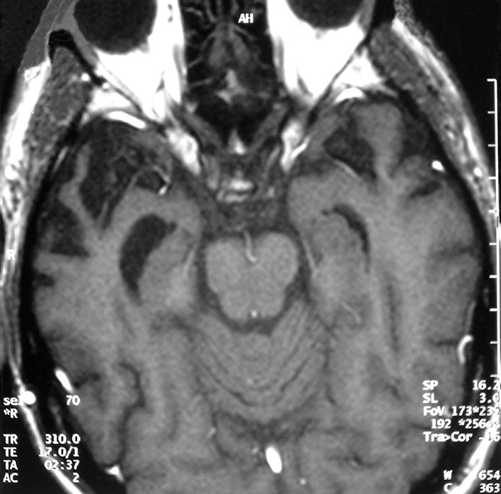
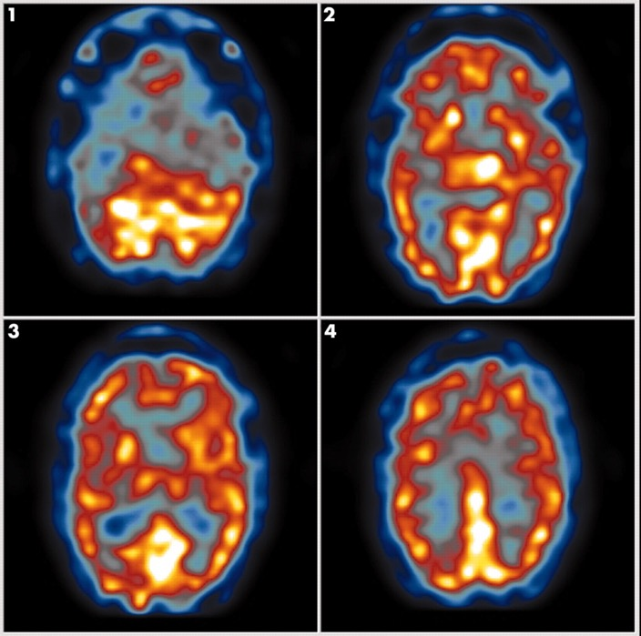

Neuroimaging in FTD
Cooper S , Greene J D W J Neurol Neurosurg Psychiatry 2005;76:v15-v24
©2005 by BMJ Publishing Group Ltd
Notes:
Anterior temporal lobe atrophy in frontotemporal dementia.
Bilateral frontotemporal hypoperfusion on SPECT in frontotemporal dementia.

Slide 31
Treatment
No disease modifying treatments
Treatment is largely supportive and symptomatic
Management can be challenging due to age of onset and early loss of insight
Compulsive behaviours may respond to SSRIs (Warren et al, 2013)

Slide 32
Prognosis
Variable dependent on subtype
Median 7-13 years (Onyike, 2011)
FTD-MND 2-3 years (Hodges et al, 2003)
svPPA longer than bvFTD / nfvPPA

Slide 33
Lewy Body Dementia (DLB)
Epidemiology & aetiology
Pathophysiology
Clinical presentation
Investigations
Treatment
Prognosis

Slide 34
Lewy Body Dementia (DLB)
Neuropsychiatric syndrome with progressive dementia and parkinsonism
2nd most common neurodegenerative dementia
Prevalence 5% in elderly (Karantzoulis & Galvin, 2013)
DLB pathology in up to 30% of dementias (Zaccai et al, 2005; McKeith et al, 2005)
Symptoms often described as lying between AD and PD
Notes:
Synuclein is an intracellular protein involved in axonal transport
Males tended to be affected > F

Slide 35
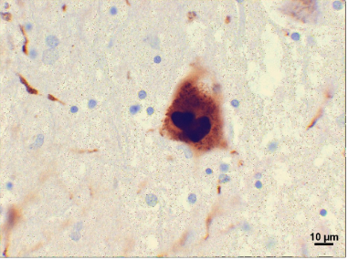
Pathophysiology
Lewy bodies: intracytoplasmic neuronal inclusions of synuclein (as in PD). Characteristic “halo” appearance.
Lewy neurites: abnormal neurites containing granular material and α-synuclein filaments in diseased neurones.
Common to have mix of LB and AD (amyloid) pathology
Notes:
Variants in all three synuclein genes (alpha, beta or gamma) can affect risk.
Lewy bodies – eosinophilic inclusions containing degenerative neurofilaments that stain positive for ubiquitin and alpha-synuclein.
Cortical Lewy Bodies lack the halo appearance.
Many patients also have some AD pathology present.

Slide 36
Presentation / features
Cognitive:
Early deficits on tests of executive and visuospatial domains > memory
Neuropsychiatric:
Visual hallucinations: usually detailed; well formed. Typically animals, people (dysmorphic), body parts or machinery (Karantzoulis & Galvin, 2013)
Delusions (>AD)
Depression / apathy / misidentification
Parasomnias – e.g. RBD
Fluctuations (in cognition/arousal) – similar to delirium
Notes:
Hallucinations and delusions more common in DLB than AD
Hallucinations are linked to cholinergic depletion in the temporal cortex and basal forebrain
RBD = REM sleep behaviour disorder
Constipation - can precede cognitive or motor symptoms

Slide 37
Presentation / features
Autonomic dysfunction
Orthostatic hypotension
Constipation
Severe neuroleptic sensitivity
30-50% of DBL patients
Acute confusion
Can result in NMS or fatality
Notes:
Suddent onset impaired cognition, acute confusion, and marked worsening of EPSEs.

Slide 38
New DLB Consensus Diagnostic Criteria
Essential
Progressive cognitive decline of interferes with normal social or occupational functions, or with usual daily activities
Prominent or persistent memory impairment may not necessarily occur in the early
stages but is usually evident with progression.
Deficits on tests of attention, executive function,
and visuoperceptual ability may be especially prominent and occur early.
Core
Fluctuating cognition with pronounced variations in attention and alertness.
Recurrent visual hallucinations that are typically well formed and detailed.
REM sleep behavior disorder, which may precede cognitive decline.
One or more spontaneous cardinal features of parkinsonism: these are bradykinesia (defined as slowness of movement and decrement in amplitude or speed), rest tremor, or rigidity.
Supportive clinical features
Severe sensitivity to antipsychotic agents; postural instability; repeated falls; syncope or other
transient episodes of unresponsiveness; severe autonomic dysfunction, e.g., constipation,
orthostatic hypotension, urinary incontinence; hypersomnia; hyposmia; hallucinations in other
modalities; systematized delusions; apathy, anxiety, and depression.
Indicative biomarkers
Reduced dopamine transporter uptake in basal ganglia demonstrated by SPECT or PET.
Abnormal (low uptake) 123iodine-MIBG myocardial scintigraphy.
Polysomnographic confirmation of REM sleep without atonia.
Supportive biomarkers
Relative preservation of medial temporal lobe structures on CT/MRI scan.
Generalized low uptake on SPECT/PET perfusion/metabolism scan with reduced occipital
activity 6 the cingulate island sign on FDG-PET imaging.
Prominent posterior slow-wave activity on EEG with periodic fluctuations in the pre-alpha/
theta range.
McKeith, I.G., Boeve, B.F., Dickson, D.W., Halliday, G., Taylor, J.P., Weintraub, D., Aarsland, D., Galvin, J., Attems, J., Ballard, C.G. and Bayston, A., 2017. Diagnosis and management of dementia with Lewy bodies: Fourth consensus report of the DLB Consortium. Neurology, 89(1), pp.88-100.
Notes:
More predictive in pure DLB than in the usual “mixed” cases
Sensitivity in pure DLB 83%; specificity 95%
BUT in mixed cases only 12%

Slide 39
DLB consensus diagnostic criteria
Probable DLB can be diagnosed if:
a. Two or more core clinical features of DLB are present, with or without the presence of
indicative biomarkers, or
b. Only one core clinical feature is present, but with one or more indicative biomarkers.
Probable DLB should not be diagnosed on the basis of biomarkers alone.
Possible DLB can be diagnosed if:
a. Only one core clinical feature of DLB is present, with no indicative biomarker evidence, or
b. One or more indicative biomarkers is present but there are no core clinical features.
DLB is less likely:
a. In the presence of any other physical illness or brain disorder including cerebrovascular
disease, sufficient to account in part or in total for the clinical picture, although these do not
exclude a DLB diagnosis and may serve to indicate mixed or multiple pathologies contributing
to the clinical presentation, or
b. If parkinsonian features are the only core clinical feature and appear for the first time at
a stage of severe dementia.
DLB should be diagnosed when dementia occurs before or concurrently with parkinsonism. The
term Parkinson disease dementia (PDD) should be used to describe dementia that occurs in the
context of well-established Parkinson disease. In a practice setting the term that is most
appropriate to the clinical situation should be used and generic terms such as Lewy body diseaseare often helpful. In research studies in which distinction needs to be made between DLB and PDD, the existing 1-year rule between the onset of dementia and parkinsonism continues to be recommended.
McKeith, I.G., Boeve, B.F., Dickson, D.W., Halliday, G., Taylor, J.P., Weintraub, D., Aarsland, D., Galvin, J., Attems, J., Ballard, C.G. and Bayston, A., 2017. Diagnosis and management of dementia with Lewy bodies: Fourth consensus report of the DLB Consortium. Neurology, 89(1), pp.88-100.

Slide 40
Investigations
Structural:
MRI – relative preservation of MTL (vs AD)
Functional:
DAT Scan – reduced dopamine uptake (Sensitivity 78%; specificity 90%) (McKeith et al, 2007)
Occipital hypo-perfusion (SPECT) / hypometabolism (PET)
EEG:
Prominent slow wave activity
Notes:
Important to remember that DAT doesn’t’ distinguish from other synucleinopathies such as PD

Slide 41
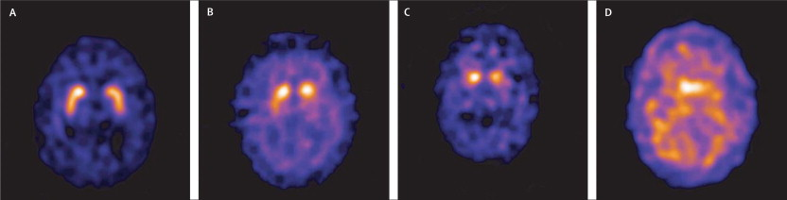
DAT Scan
Normal and abnormal 123I-FP-CIT SPECT images
Sensitivity and specificity of dopamine transporter imaging with 123I-FP-CIT SPECT in dementia with Lewy bodies: a phase III, multicentre study
Ian McKeith, John O'Brien, Zuzana Walker, Klaus Tatsch, Jan Booij, Jacques Darcourt, Alessandro Padovani, Raffaele Giubbini, Ubaldo Bonuccelli, Duccio Volterrani, Clive Holmes, Paul Kemp, Naji Tabet, Ines Meyer, Cornelia Reininger
Volume 6, Issue 4, 2007, 305–313
http://dx.doi.org/10.1016/S1474-4422(07)70057-1
Notes:
A – Normal
Abnormal:
B – type 1 Asymmetrical uptake with normal or almost normal putamen actiity in 1 hemisphere
C – type 2 Marked reduction in uptake bilaterally
D – type 3 Virtually absent uptake

Slide 42
Pharmacological Treatments
AChEIs are the main treatment option
Rivastigmine commonly used but little evidence of difference between drugs (Bhasin et al, 2007)
Cochrane suggests effect of AChEIs is unclear (Rolinski et al, 2012)
Dopaminergic agents not routinely used – variable and limited response (Molloy et al, 2005)

Slide 43
Prognosis
Higher mortality rate (vs AD) (Williams et al, 2006)
Faster cognitive decline (probably) (Rongve et al, 2016)

Slide 44
Parkinson’s Disease Dementia (PDD)
20-50% during course of illness (Leroi et al, 2004)
Often associated with / risk factor for psychosis
M>F
1 year rule:
≤ 12 months of parkinsonism = Lewy Body disease;
if >12 months = Parkinson’s disease dementia

Slide 45
Pathophysiology
Lewy body disease:
Pathology starts in medulla and olfactory bulbs
Braak Stages
Substantia nigra (pars compacta)
Dorsal nucleus of vagus nerve
Nucleus basalis of Meynert (acetylcholine)
Notes:
Pathology spreads from early sites through six Braak stages and later involves rest of brainstem, amygdala, limbic lobe and neocortex.

Slide 46
Clinical Presentation
Early dementia uncommon
Occurs later in around 25%
Early stages some evidence of executive dysfunction
Reduced verbal fluency
Apathy
”Subcortical” presentation

Slide 47
Treatment
Rivastigmine commonly used
Helpful for non-cognitive symptoms
Dopaminergic agents may worsen confusion and/or psychosis

Slide 48
Atypical Parkinsonian Syndromes
Sometimes referred to as Parkinson-Plus Syndromes
Multiple System Atrophy (MSA)
Progressive Supranuclear Palsy Syndrome (PSPS), variant phenutypes are PSP-RS, PSP-parkinsonism
Corticobasal Syndrome (CBS)
PSPS and CBS - same tauopathies as in many cases of FTD Clinical overlap in speech/behaviour problems present in the nfvPPA

Slide 49
Multiple System Atrophy (MSA)
Combination of features:
Parkinsonism
Cerebellar ataxia (e.g. intention tremor*)
Autonomic dysfunction
MSA-P: predominant parkinsonism resembling idiopathic PD (IPD).
Striato-nigral denegeneration
MSA-C: predominant cerebellar signs with UMN signs
Olivopentocerebellar atrophy
Shy-Drager Syndrome (primary autonomic failure)
Notes:
Majority of patients present with parkinsonism – asymmetrical rigidity and bradykinesia (also tremor but less common than IPD). Will complain of clumsiness of hands, stiffness and muscle aches.
Signs of autonomic dysfunction (e.g. postural hypotension and erectile dysfunction) are part of both MSA-P and C.
*intention tremor is not seen in IPD
From Radiopaedia:
In a 2007 consensus paper ⁶ MSA has been divided clinically into two forms according to the dominant non-autonomic symptoms:
MSA-C: predominance of cerebellar symptoms (olivopontocerebellar atrophy).
MSA-P: predominance of Parkinsonian signs and symptoms (striatonigral degeneration).
Some older texts refer to MSA-A to denote Shy-Drager syndrome. In the latest consensus however autonomic symptoms are considered part of both MSA-C and MSA-P and thus the term MSA-A is no longer used.

Slide 50
Multiple System Atrophy
Progresses more rapidly than IPD
Early gait disturbance, falls, marked orthostatic hypotension should raise suspicion of MSA
Often have marked flexed posture with chin on chest (>IPD)
Overt dementia uncommon
May be caused by abnormal synuclein-derived prion (Prusiner et al, 2015)
Notes:
Visual hallucinations and psychosis as seen in LBD are rare in MSA.
Pathology differs from IPD.
Targets striatum, substantia nigra, brainstem nuclei, cerebellum, intermediolateral columns of spinal cord, Onuf’s nucleus (hence bladder/bowel dysfunction).
Lewy bodies are not a feature but cytoplasmic inclusions that stain for α synuclein are pathognomonic.

Slide 51
Progressive Supranuclear Palsy (PSP)
Symmetrical akinetic-rigid syndrome (“tauopathy”)
Sporadic
Onset 6th decade; M=F
Bradykinesia; rigidity (axial>limb)
Vertical gaze palsy
Postural and gait instability / falls
Dystonic posture – flexion of trunk; neck extension (retrocollis)
Notes:
Vertical supranuclear gaze palsy is characteristic especially for downgaze.
May see wide-eye stare with reduced blink frequency
Impairment of executive function is common
Symmetrical limb apraxia – ideomotor (imitation) and pantomiming (ideational) impairments – not seen in normal idiopathic PD (but can in PDD).
Pathology affects:
Pallidum / substantia nigra (pars compacta and reticulata) / PAG matter / oculomotor, vestibular and cerebellar dentate nuclei, and the superior colliculi.

Slide 52
Progressive supranuclear palsy
Early cognitive changes:
Apathy
Reduced fluency
Impairment in abstract thinking
Utilisation/imitation behaviours
Personality change
May also see language changes
Speech apraxia / non-fluent aphasia
Frontal release signs
Notes:
Personality changes common
Emotional lability (often with pathological laughter and crying)
Later in the disorder frontal release signs are noted such as grasp and pout reflex
Disorder progresses slowly with retention of insight.

Slide 53
Corticobasal syndrome (CBS)
Usually sporadic; onset typically early 60s
M=F
Tauopathy
Asymmetrical degeneration of number of brain areas – frontoparietal cortical & basal ganglia and other sub-cortical nuclei
Swollen achromatic tau-positive Pick cells are characteristics
Notes:
Another tauopathy
Frontal and parietal atrophy / Striatopallidal atrophy
Sparing of temporal and occipital cortex
The asymmetrical features are of important diagnostic significance
Cortical sensory loss – e.g. agraphaesthesia / astereognosis
Patients may describe not doing what they want it to do or feeling as if it belongs to someone else
In extreme cases they may develop an alien limb where it involuntarily performs activities such as grabbing door handles or opposes the contralateral limb.

Slide 54
Corticobasal syndrome
Diverse presentations
Asymmetric rigidity & apraxia
Dystonia / myoclonus
“Alien limb” / cortical sensory loss
Visuospatial dysfunction (inc. Balint’s syndrome)
Executive dysfunction
Supranuclear gaze palsy
Notes:
L-Dopa not helpful

Slide 55
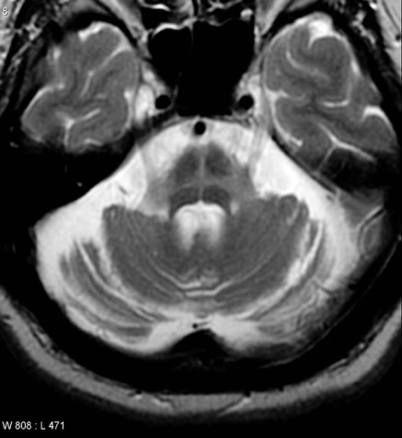
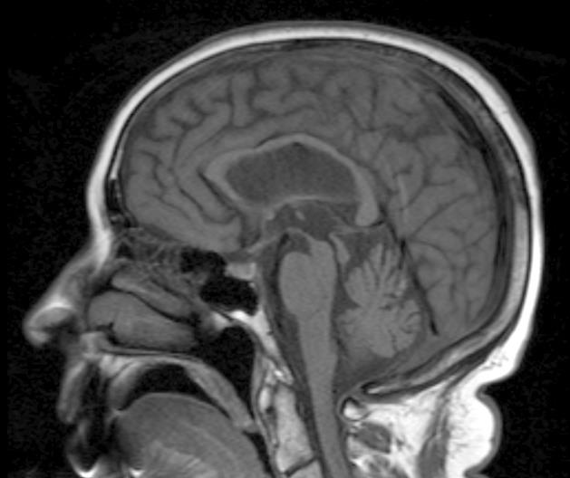
Neuroimaging (MRI)
Multiple system atrophy
The hot-cross bun sign (Increased signal in tegmentum on T2)
Cerebellar atrophy
Progressive supranuclear palsy
Midbrain atrophy
The “Hummingbird Sign”
Corticobasal degeneration
Asymmetric cortical atrophy (late finding)
Case courtesy of A.Prof Frank Gaillard, Radiopaedia.org, rID: 5465
By Dr Laughlin Dawes - radpod.org, CC BY 3.0,
https://commons.wikimedia.org/w/index.php?curid=3713329

Slide 56
Huntington’s Disease
Epidemiology & aetiology
Pathophysiology
Clinical presentation
Investigations
Treatment
Prognosis

Slide 57
Huntington’s Disease
Motor
Psychiatric
Cognitive
Impaired concentration
Anxiety
Depression
Psychosis
Chorea
Clumsiness
Executive
Behavioural
Suicidal ideation
Gait changes
Speech changes
Neuropsychiatric disorder
Triad of symptoms
Worldwide variation in prevalence
Europe 4-12 per 100 000
(Harper, 1992; Paulsen, 2001; Spinney 2010)
Autosomal dominant disorder (M=F)
Expansion in CAG repeat (≥36 codons) (Huntingtin gene; short-arm chromosome 4)
Anticipation (esp. paternal transmission)
Notes:
High prevalence in Tasmania; rare in parts of Japan.
CAG codes for glutamine – HD is a polyglutamine disorder
Normal repeat length in HTT gene is ≤36
Larger expansions result in earlier disease manifestation
Anticipation occurs in paternal transmission as during spermatogenesis repeat expansion may occur; resulting in most juvenile cases.
Incomplete penetrance (may or may not develop) happens with 36–40 repeats, and 35 or less are not associated with the disorder. The number of CAG repeats accounts for about 60% of the variation in age of onset.
Other trinucleotide repeat disorders include spinocerebellar ataxias, fragile X, Friedrich’s ataxia and myotonic dystrophy.

Slide 58
Pathophysiology
Aggregation of huntingtin protein
Reduced GABA in basal ganglia (Perry et al, 1973)
Reduced striatal acetylcholine
Relative excess of dopamine
striatal – movement disorder
mesolimbic - psychosis

Slide 59
Huntington’s Disease
Typically 4th or 5th decade
Symptom cluster can vary with age of onset
Neurological or psychiatric features can be first presentation
Neurological:
Choreiform movements
Dysarthria
Motor impersistence / “Milkmaid’s Grip”
Psychiatric:
Mood disorder 38% (depression>mania) (Jauhar & Ritchie, 2010)
Anxiety
Psychotic features (often with increasing cognitive impairment)
Irritability & changes in behaviour
Apathy
Notes:
Symptom cluster can vary with age of onset – younger people having more striate rigidity; chorea in middle age; intention tremor after age 60
About 10% of cases occur before age 20
Early movements are random and irregular
Often manifest in hands, face and shoulders or changes in gait.
Speech tends to be affected early with slight dysarthria (volume of speech is also effected)
As disease progresses the motor disturbances are more obvious.
Abrupt, jerky, rapid and repetitive.
Obvious facial movements.
More chorea & athetosis
Other physical changes include changes in spatial awareness and effects on voluntary movements –resulting in slamming of cups/doors etc.
Weight loss
Incontinence
Other causes of chorea: Wilson’s disease / Sydenham’s chorea / basal ganglia damage / hereditary / cerebral palsy.

Slide 60
Cognitive changes
Insidious decline
“Subcortical” pattern of impairment
Apathy and inefficiency
Poor attention / distractibility
Early executive changes (esp. planning; rigidity; impulsivity)
No early language changes
Visuospatial function largely intact
Memory impairment (2⁰ to attentional deficits)
Notes:
Most of the changes in behaviour in HD are due to cognitive changes and these significantly.
Frontostriatal circuitry changes result in executive dysfunction:
Problems with planning and judgement with poor self monitoring
Difficulty in switching focus
Impulsive behaviour with failure to consider consequences
Problems with planning
Harder to switch from 1 task to another
Prefer set routines
Lack of initiation
Loss of insight “I’m fine”
Reduced ability to read facial expressions
Don’t ask repeated questions – they need time to process and answer a question.

Slide 61
Other considerations
Elevated suicide risk in HD (4-6x) (Rosenblatt et al, 2000)
Behavioural changes: (Craufurd et al, 2001, cited in Jauhar & Ritchie, 2010)
Apathy
Irritability (up to 50%)
Depression

Slide 62
Huntington’s Disease - investigations
Genetic testing (symptomatic individuals only outside genetic centres)
Neuroimaging:
Atrophy & dilated ventricles (predominantly frontal)
Caudate atrophy
Functional imaging:
PET ⁽¹⁸FDG) early caudate hypometabolism (Kuhl, et al, 1982)
EEG:
Reduced or absent alpha
Can be normal (unusual)
Case courtesy of A.Prof Frank Gaillard, Radiopaedia.org, rID: 8052

Slide 63
Huntington’s Disease - Treatment
Symptomatic only (always consider if symptom needs treating)
Chorea
Tetrabenazine (dopamine depletion)
Low-dose antipsychotic
Rigidity
PD medication; may precipitate/worsen psychosis & chorea
Benzodiazepines can be useful
Depression /anxiety / psychosis
Largely as per usual treatment
Caution re increased risk of EPSEs
ECT well tolerated
Notes:
Chorea – antipsychotics usually first choice
Tetrabenazine increases rates of depression and suicidality / parkinsonism and dystonia
Depression – SSRIs first line
Irritability – multiple aetiological factors (loss of impulse control / hunger / fatigue / noise etc)
Psychoeducation / High dose SSRIs / mood stabilisers / propranolol (80mg bd) or antipsychotics (last resort)
Disorders of sleep respond very poorly to hypnotics. Sedative ADs probably better or melatonin may be worth a trial.

Slide 64
Huntington’s Disease - Prognosis
Mean duration 15-20 years (Lovestone, 2009)

Slide 65
Selected Reading
Ferrari, R., Manzoni, C. and Hardy, J., 2019. Genetics and molecular mechanisms of frontotemporal lobar degeneration: an update and future avenues. Neurobiology of aging, 78, pp.98-110.
Rascovsky, K., Hodges, J.R., Knopman, D., Mendez, M.F., Kramer, J.H., Neuhaus, J., Van Swieten, J.C., Seelaar, H., Dopper, E.G., Onyike, C.U. and Hillis, A.E., 2011. Sensitivity of revised diagnostic criteria for the behavioural variant of frontotemporal dementia. Brain, 134(9), pp.2456-2477.
Román, G.C., Tatemichi, T.K., Erkinjuntti, T., Cummings, J.L., Masdeu, J.C., Garcia, J.H., Amaducci, L., Orgogozo, J.M., Brun, A., Hofman, A. and Moody, D.M., 1993. Vascular dementia: diagnostic criteria for research studies: report of the NINDS‐AIREN International Workshop. Neurology, 43(2), pp.250-250.
Gorno-Tempini, M.L., Hillis, A.E., Weintraub, S., Kertesz, A., Mendez, M., Cappa, S.F., Ogar, J.M., Rohrer, J.D., Black, S., Boeve, B.F. and Manes, F., 2011. Classification of primary progressive aphasia and its variants. Neurology, 76(11), pp.1006-1014.

Slide 66
Please provide feedback/suggestions on this presentation to the module lead mark.worthington@lancashirecare.nhs.uk

Slide 67
Old Age Module
MCQs
A 38 year old man presents with a seizure on a background of increasing memory impairment, migraines, apathy and unsteady gait.
Which genetic mutation is most likely?
NOTCH3
MAPT
Presenilin-1
C9ORF72
SNCA

Slide 68
Old Age Module
MCQs
A 38 year old man presents with a seizure on a background of increasing memory impairment, migraines, apathy and unsteady gait.
Which genetic mutation is most likely?
NOTCH3
MAPT
Presenilin-1
C9ORF72
SNCA

Slide 69
Old Age Module
MCQs
A 62 year old woman is struggling with poor balance and muscle spasms. She has difficulty controlling her left hand which she descries as feeling ‘out of control’. MRI brain shows asymmetrical atrophy of the superior parietal lobe. Which of the following is most closely associated with the primary diagnosis?
Logopenic PPA
Semantic PPA
Posterior cortical atrophy
Non-fluent PPA
Cerebral amyloid angiopathy

Slide 70
Old Age Module
MCQs
A 62 year old woman is struggling with poor balance and muscle spasms. She has difficulty controlling her left hand which she descries as feeling ‘out of control’. MRI brain shows asymmetrical atrophy of the superior parietal lobe. Which of the following is most closely associated with the primary diagnosis?
Logopenic PPA
Semantic PPA
Posterior cortical atrophy
Non-fluent PPA
Cerebral amyloid angiopathy

Slide 71
Old Age Module
MCQs
A man with Parkinson’s Disease develops psychotic symptoms. Which antipsychotic drug treatment has the best evidence base?
Quetiapine
Amisulpride
Haloperidol
Risperidone
Clozapine
Notes:
The Maudsley guidelines states that Quetipaine should be used first line, with Clozapine a second line

Slide 72
Old Age Module
MCQs
A man with Parkinson’s Disease develops psychotic symptoms. Which antipsychotic drug treatment has the best evidence base?
Quetiapine
Amisulpride
Haloperidol
Risperidone
Clozapine
Zhang, H., Wang, L., Fan, Y., Yang, L., Wen, X., Liu, Y. and Liu, Z., 2019. Atypical antipsychotics for Parkinson’s disease psychosis: a systematic review and meta-analysis. Neuropsychiatric Disease and Treatment, 15, p.2137.
Notes:
The Maudsley guidelines states that Quetipaine should be used first line, with Clozapine a second line

Slide 73
Old Age Module
MCQs
A 43 year old gentleman presents with unwanted movements that started in his hands and now involve his limbs and face. He is also struggling with low mood and obsessional thoughts. Genetic analysis reveal multiple CAG repeats on chromosome 4. A brain MRI is most likely to show:
Caudate atrophy
Cerebellar atrophy
Multiple white matter intensities
Putaminal infarct
Lacunar infarct

Slide 74
Old Age Module
MCQs
A 43 year old gentleman presents with unwanted movements that started in his hands and now involve his limbs and face. He is also struggling with low mood and obsessional thoughts. Genetic analysis reveal multiple CAG repeats on chromosome 4. A brain MRI is most likely to show:
Caudate atrophy
Cerebellar atrophy
Multiple white matter intensities
Putaminal infarct
Lacunar infarct

Slide 75
Old Age Module
MCQs
A 70 year old man has been given a diagnosis of Lewy Body Dementia. According to recognised criteria, which of these is a core clinical feature?
Hyposmia
REM sleep disorder
Severe sensitivity to antipsychotic agents
Postural instability
Orthostatic hypotension

Slide 76
Old Age Module
MCQs
A 70 year old man has been given a diagnosis of Lewy Body Dementia. According to recognised criteria, which of these is a core clinical feature?
Hyposmia
REM sleep disorder
Severe sensitivity to antipsychotic agents
Postural instability
Orthostatic hypotension

Slide 77
Old Age Module
Any Questions?
Thank you

