Slide 1


Attachment
Dr Anne Shortall
Consultant Child and Adolescent Psychiatrist
Updated 2020 by Dr Meenaka Williams and Brendan Hore

Slide 2
Learning Outcomes
Awareness of principles of interventions
To understand different classifications of attachment, conditions that promote healthy attachment and the clinical relevance of failure to develop selective attachments.
Basic understanding of assessment of attachment across the lifespan
To understand the relevance of attachment theory to emotional development, affect regulation and relationships across the lifespan

Slide 3
Why should adult psychiatrists care about attachment
Understand underlying aetiological factors in adults who present with mental health disorders
Understand how adults patients’ early attachment patterns could explain aspects of how that patient presents and uses services, and how it can impact on their parenting
we need to consider what strengths, blocks, blind spots, unresolved issues, assumptions, vulnerabilities, ‘hot buttons’ and ‘no go’ areas we may each bring into the room with our patients

Slide 4
Definitions of attachment
An affectionate bond between two people that endures through time and space and serves to join them emotionally
An affectionate bond between two people that endures through time and space and serves to join them emotionally
An affectionate bond between two people that endures through time and space and serves to join them emotionally

Slide 5
Why do we need Attachment?
Life is dangerous
Parents not always comforting and protective
Basis for physical and psychological survival
Child and adult use the best adaptive strategy for their unique context

Slide 6
Purpose of attachment behaviours
It is through important attachment relationships that the child makes sense of herself, her emotions, other people and relationships
Underlying information processing patterns (particularly non-verbal) will be robust – how we see the world, others and ourselves
Early attachments affect the course of psychological and social development and mental health

Slide 7
What a ‘good enough’ attachment figure does
Empathically receive and regulate infants communications
Predictable, consistent, emotionally available
Let children take developmentally appropriate responsibility for themselves – parents can do too much or too little
Protect and comfort children when children cannot do this for themselves
Visual contact, touch, tone of voice important

Slide 8
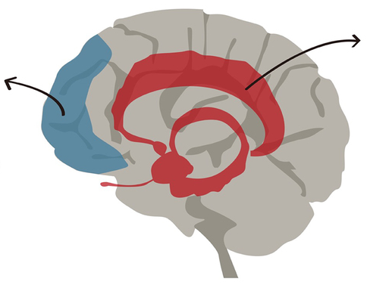
Brain Development
Limbic System –(‘Emotional Brain’)
First parts of the brain to mature; intact at birth
Fight/Flight/Freeze (Arousal) Response – cascade response leading to physical reactions)
The amygdala stores (pre-verbal) anger and anxiety experiences
Prefrontal Cortex (‘Thinking Brain’)
Develops postnatally; does not mature till toddlerhood
Involved in higher cognitive functions
(e.g. logical thinking, consequences, etc)
Control centre for managing arousal
Entirely experience dependent; develops within relationships
Need to consider how cognitive ability and neurodevelopmental conditions interact with development trauma.

Slide 9
Neural Integration
Integrative communication between caregiver & child stimulates activation & growth of integrative fibres (Schore, ’94)
Integrative fibres enable co-ordination & balance of self-regulation – attention, behaviour, emotion & thinking
Repeated neglect, adversity or abuse can result in underdevelopment of some areas of the brain and in over-sensitivity of others. It can also result in poor integration between brain areas
Brain develops regulatory circuits during 1st five years of life

Slide 10
Sensitive
Acceptance
Cooperation
Accessibility
Insensitive
Rejection
Interference
Ignoring

Slide 11
Sensitive
parent meshes their response to infant’s signals and communication to form a cyclical turn taking pattern of interaction
Insensitive
Parent intervenes in an arbitrary way, these intrusions reflecting their own mood and wishes
Acceptance
parent generally accepts the responsibility of child care, demonstrating few examples of irritation with the child.
Rejection
Parent has feelings of anger and resentment that eclipse their affection for the child, often finding the child irritating and resorting to punitive control

Slide 12
Cooperation
parent respects the child's autonomy and rarely exerts direct control
Interference
parent imposes their own wishes on the child with little concern for the child’s mood or current preoccupations
Accessibility
parent is familiar with their child's communication and notices them at some distance. Easily distracted by the child
Ignoring
parent is preoccupied with their own activities and thoughts They often fail to notice child’s communication unless they become very obvious through intensification

Slide 13
Theoretical basis
Attachment theory (Bowlby 1951,1969,1988)
Research and practice have confirmed its position as a most powerful and influential account of social and emotional development.
Bowlby asserted:
children are biologically prepared to contribute to attachment relationships,
a secure emotional base facilitates the development of self-esteem, empathy and independence,
attachment behaviours most obviously occur within the relationship between infants and parents between 6 months and 3 years.
Ainsworth et al (1978)
Provided scientific evidence to support Bowlby’s theory
Used the Strange Situation procedure to research child-parent interactions.
Identified three patterns of attachment: insecure-avoidant, insecure-ambivalent and secure.

Slide 14
Theoretical basis ctd…
Main and Solomon ( 1986 and 1990)
Used strange situation test to add further category- disorganized
Main and Goldwyn ( 1990)
Suggested that parents’ mental representations of their own childhood experiences determine their sensitivity to their child’s attachment needs and influence the quality of their parenting.
Developed the Adult Attachment Interview to assess an adult’s attachment experiences, the meaning to the adult of these experiences and their current internal working model.
Crittenden (1985 – present)
Also Ainsworth student –alternative model of attachment (Dynamic Maturational Model (DMM) to ABCD model, no disorganization, patterns extend into adulthood, range of assessment tools across the lifespan

Slide 15
Strange Situation Test
Developed to assess attachment relationships between caregiver and child between 9 and 18 months
Child is observed playing for 20 minutes, during which time a sequence of events occur involving the carer and a stranger entering and leaving the room
The purpose is to raise the child’s stress and so observe the activation of their attachment behaviour
Developed by Mary Ainsworth
The amount of exploration - i.e. how much the child plays throughout is also observed

Slide 16
Categories of attachment behaviour on SST
Ainsworth developed the following categories of attachment:
Rates in non clinical populations
Secure ( type B) -55-60%
Insecure –avoidant- ( type A)-20%
Insecure- ambivalent /anxious ( type C)- 10%
Disorganized – ( type D)- later added by Main and Solomon -up to 15%
These proportion are remarkable similar across cultures- secure is usually 55%-60% although rates of other types can vary slightly

Slide 17
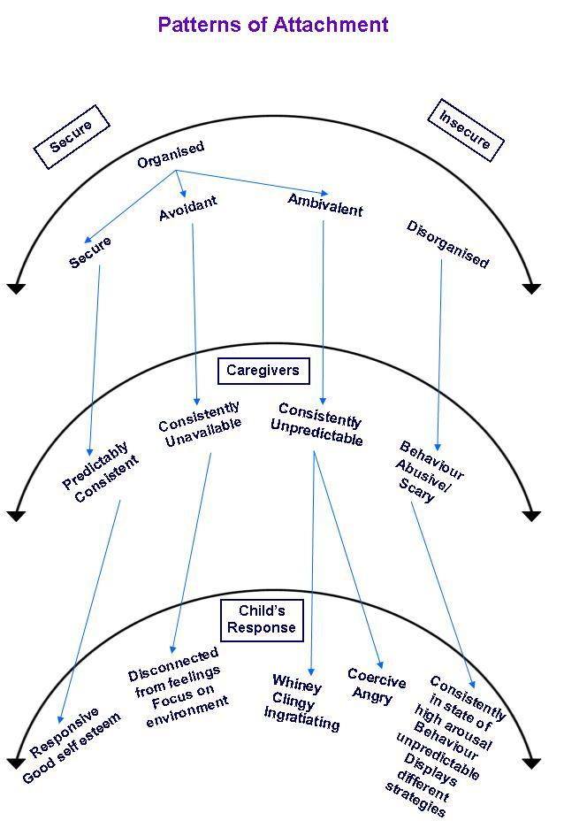
Patterns of Attachment
Attachment can be classified into patterns of behaviour:
Secure attachment pattern
Insecure attachment patterns (3 types)
Ambivalent
Avoidant
Disorganised

Slide 18
Secure Attachment
Parent/Carer: available, protective, sensitive, responsive, accepting, consistent and predictable
Internal working model: I am lovable, others are caring & dependable
As young child: learns through play; begins to understand own and others’ mental states
values relationships; independent and secure.
older child: has sense of self-efficacy, self confidence and social competence; has some skills for coping effectively with frustration and stress
consistent, responsive and predictable; able to promote secure attachment in own children

Slide 19
Insecure attachment
Carer: consistently unresponsive to child’s needs: resentful and rejecting or intrusive and controlling
Internal working model:
I’m unlovable
As infant/young child:
inhibits emotional expression; undemanding, self-sufficient uncomfortable with closeness
As older child: self-reliant, independent; achievement orientated
As adult: avoids emotional intimacy; intellectualizes emotions; task orientated; may appear cold and detached
As parent: child’s distress leads to anxiety; dismissive of child’s distress and likely to view it as attention-seeking.

Slide 20
Insecure attachment-ambivalent
Carer: inconsistent (sometimes available and responsive, sometimes not)
Internal working model: I’m unlovable, others are unreliable
As infant/young child:
amplifies attachment behaviours to ensure they are noticed; high but angry dependency (fretful, whingy, clingy)
As parent: uncertain and ambivalent; needs child to have closeness and to feel accepted but insensitive to child; treats children as entirely wonderful or entirely awful
As older child: pre-occupied with the availability of others; crave attention and approval
As adult: pre-occupied with relationships but generally unhappy in them; jealous, possessive

Slide 21
Disorganised Attachment
Carer: frightening to child
Internal working model: I’m am unworthy of care
As infant/young child: Confused since wants to approach carer for care but is frightened of them and so wants to avoid them; fearful and helpless
As parent: very significant difficulty acknowledging and meeting needs of own children; look to children to meet some of their own needs
As older child: fearful; and inattentive; highly controlling; avoids intimacy; relationships cause distress with little provocation; violent anger
As adult: disturbance and disorganisation remains high

Slide 22
Features of disordered attachment
Emotions
Poor recognition of internal emotional states
Relationships
clinging
Labile
Anxiety
Angry outbursts
Detached
lack of discrimination; over friendly, or withdrawal
Poor maintenance of relationships
Need to be in control
Aggressive interactions
Ambivalence
Poor eye contact
Problems regulating physical closeness

Slide 23
Behaviour
Inattentive
Poor concentration
Cognitive
Fail to learn from mistakes
Executive functioning problems
Physical
Enuresis
Sleep difficulties
Impulsive
Poor cause and effect thinking
Encopresis
Problems regulating food intake

Slide 24
Disorganized attachment
Infants with disorganized attachment on the strange situation test are more likely to show high levels of aggression in middle childhood
This is likely to be a long lasting trait
Rates of disorganised attachment are much higher in children who are looked after; or where there is a history of abuse/ trauma- possibly as high as 90%
There may be an overlap between the concept of disorganised attachment and the diagnostic category of Reactive Attachment Disorder. ( although some dispute that they are the same)

Slide 25
Differential diagnosis of attachment difficulties
ASD
ADHD
Bipolar
Depression

Slide 26
ASD vs Attachment
Play
Relationships
Communication
ASD tends to be related to intense interests, involve collecting/ordering; have high cognitive content. Children with attachment disorders may lack play skills but interests tend to be more usual.
Children with ASD may show one sided interaction, unaware of other’s perspective. Children with attachment disorders- might lack social skills but do not have unusual types of interaction; can be highly attuned to other’s reactions.
specific communication deficits of ASD, e.g. echolalia, literal understanding, unusual voice tone not usually seen in attachment disorder.

Slide 27
Assessment in children
Focused observations of child and carer. Strange situation test. Adaptations have been developed for slightly older children
Structured assessment may be used, e.g. Story Stems, MCAST-play based methods designed to access attachment representations
Structured interviews for older children (7 upwards ) and adolescents.- e.g. School aged Assessment of Attachment (SAA)
Most of the above are predominately used in research; clinical assessment tends to rely on history taking and general observations

Slide 28
Assessment in adults
Mainly structured interviews-self report questionnaires also exist
Most widely used- Adult Attachment Interview AAI- ( George, Kaplan and Main 1984)
Semi structured interview- lot of research validity both with ABCD and DMM methods
Aims to elicit adult representations of their attachment experiences.
Interview codes content and coherence of discourse, and underlying information processing
Categories are autonomous; dismissing; preoccupied; unresolved

Slide 29
AAI Categories
Autonomous
value attachment relationships, describe them in a balanced way
Dismissing
memory lapses.
Preoccupied
Have continuing preoccupation with own parents
Discourse is coherent and internally consistent
Minimize negative experiences
deny impact on relationships
Positive descriptions may be contradicted.
Incoherent discourse.
Have angry or ambivalent representations of the past
Unresolved
evidence of trauma or unresolved loss or abuse

Slide 30
Therapeutic interventions for children
A range of approaches have been developed.
None are, or attempt to be, a substitute for good quality care at home. They can only be an extra.
All professional attachment interventions emphasize the central importance of carers and largely describe therapeutic work with, and through parents, long-term substitute carers or adoptive families.

Slide 31
Principles of care giving for children with disrupted attachments: Looked after children
Information giving
Co regulation of emotions
Limit setting, discipline with empathy
Claiming behaviours
Help child build narrative about their experiences
Carer coping and self care

Slide 32
Care giving for children with disrupted attachments: Looked after children
Information giving
Co regulation of emotions
Limit setting, discipline with empathy
Claiming behaviours
Help child build narrative about their experiences
Carer coping and self care

Slide 33
Carer characteristics: Looked after children
Managing extreme behaviours
Maintaining positivity
Calm reflective Stance
Avoid being drawn into negative cycle
Need for realistic expectations and flexible approach

Slide 34
Therapeutic Interventions
Parent-Child Game
Adapted Webster Stratton groups
Video interaction guidance
Attachment groups for carers
Relationship Play Therapy-theraplay
Parenting Education-understanding about effects of early disrupted attachment on current behavior
Dyadic Developmental Psychotherapy

Slide 35
Evidence for interventions
Not a lot of clear evidence about therapeutic interventions.
Some evidence to suggest that behavioural based interventions can increase parental sensitivity especially with young children
But harder to address parents' own attachment representations
In older children, a range of CAMHS interventions may be useful for addressing problem areas such as increased arousal, social problem solving, coping with frustration, closer family relationships- but studies do not generally show a change in attachment status of the child
Studies favour- short term interventions with clear focus.

Slide 36
Prognosis
insecure attachment patterns are best thought of as risk/ vulnerability factors for later problems, rather than predictive factors
Little evidence about links between infant attachment patterns and later adult psychopathology
Some studies have shown that those adults with preoccupied/ ambivalent attachment-have higher rates of mood disorder, anxiety and borderline personality disorder
Disorganized attachments in young children- associated with later high levels of aggression in middle childhood/adolescence, and possibly predict a higher level of mental health difficulties in later life.
Studies have shown link with more hostility in later adult relationships

Slide 37
Prognosis
Psychiatric in patients- shown to have higher rates of disorganized attachment than controls
Extreme disturbances of attachment are like be associated with history of abuse and /or trauma as children as well
We do know that attachment patterns in parents- closely mirror those of their infants (or can get reversal patterns)
consequences are broader than mental health difficulties but can affect quality of adult relationships, parenting, employment, criminality, drug use, etc.
Difficult to know if continuity of problems is due to continuity of environment

Slide 38
Changes to Attachment: ICD 11
ICD10
Categorised under: ‘Disorders of social functioning with onset specific to childhood and adolescence’
Two main subcategories: ‘Reactive attachment disorder’ and ‘Disinhibited attachment disorder of childhood’
ICD11
Categorised under: ‘Disorders specifically associated with stress’
Two main subcategories: Reactive attachment disorder’ and ‘Disinhibited social engagement disorder’
RAD: fearfulness and hypervigilance, poor social interaction with peers, aggression towards self and others, misery, and growth failure in some cases
RAD: doesn’t offer specific symptoms, just that it occurs in context of grossly inadequate childcare

Slide 39
MCQ 1
The biological basis of attachment behaviour is:
A. The child developing relationships with other children
B. The mother wanting to protect her child from any harm
C. The child seeking proximity to the attachment figure
D. The mother’s instinct to rear children
E. All of the above

Slide 40
Answer
E

Slide 41
MCQ 2
Attachment theory has been developed by:
A. Freud
B. Bowlby
C. Skinner
D. Piaget
E. Klein

Slide 42
Answer
B

Slide 43
MCQ 3
‘Institutional deprivation” occur in the context of which ICD 11 diagnosis?:
A. Generalised anxiety disorder
B. Phobic anxiety disorder
C. PTSD
D. Reactive attachment disorder
E. Paranoid personality disorder

Slide 44
Answer
D

Slide 45
MCQ 4
Select a feature that does NOT form part of Reactive Attachment Disorder (ICD 11) but points towards Pervasive Developmental Disorders:
A. Abnormal pattern of social responsiveness that improves if child is placed in normal rearing environment
B. Aggressive responses towards their own or other’s distress
C. Restricted, repetitive interests and behaviours
D. Strongly contradictory social responses
E. None of the above

Slide 46
Answer
C

Slide 47
MCQ 5
Reactive Attachment Disorder of early infancy and childhood (DSM V) and Reactive Attachment Disorder of (ICD 11) share common diagnostic criteria. Which of the following is NOT a diagnostic feature in ICD 11:
A. Developed before age of 5 years
B. Does not turn to primary caregiver for comfort
C. Does not display security seeking behaviour
D. Does not respond when comfort is offered
E. None of the above

Slide 48
Answer
E

Slide 49
MCQ 6
Which of the following features is NOT part of Disinhibited Social engagement Disorder (ICD11):
A. Approaches adults indiscriminately
B. Exhibits over familiar behaviour with strangers
C. Features develop within first 5 years of life
D. Occurs in context of grossly inadequate childcare
E. Abnormal speech development including echolalia

Slide 50
Answer
E

Slide 51
MCQ 7
Which of the following cognitive age ranges must a child reach to develop an attachment relationship:
A. 2-5 months
B. 7-9 months
C. 2 years
D. 5 years
E. 7 years

Slide 52
Answer
B

Slide 53
MCQ 8
What is the procedure called that assesses a child’s attachment behaviour:
A. Novel Situation Test
B. Attachment Assessment Procedure
C. Strange Situation Procedure
D. Mother - Infant Attachment Battery
E. None of the above

Slide 54
Answer
C

Slide 55
MCQ 9
Symptoms of Reactive Attachment Disorder have to be present before which age:
A. 3 years
B. 9 months
C. 18 months
D. 8 years
E. 5 years

Slide 56
Answer
E

Slide 57
MCQ 10
The current hypothesis is that Attachment Disorders develop as a result of:
A. Children having been brought up by a single parent
B. Children having had limited opportunities to form selected attachments
C. Children having received a vegetarian diet
D. Children having intrinsic difficulties in forming secure attachments
E. Children having a specific gene mutation

Slide 58
Answer
B

