Slide 1

Forensic Psychiatry 3
Mental Disorders and Offending

Slide 2
Mental Disorders and Offending
Aims and Objectives (from handbook)
To develop an understanding of
  The role of mental disorder in offending
  The frequency of and types of offences committed by those with serious mental illness (SMI)
  The role of special syndromes in offences
  Vulnerability and suggestibility in mentally-disordered offenders

Slide 3
Mental Disorders and Offending
To achieve this
Case Presentation
Journal Club
555 Presentation
Expert-Led Session
MCQs
Please sign the register and complete the feedback

Slide 4
Mental Disorders and Offending
Expert Led Session
Mental disorder and offending
Author: Dr Victoria Sullivan

Slide 5
Offending in patients with SMI
Psychosis – brief overview
Affective Disorders
Personality disorder
Substance Misuse
Notes:
The particular focus today will be looking at offending in patients with
Psychosis – brief overview as most covered in 2nd lecture
Affective disorders
Personality Disorder
Substance Misuse
Epilepsy, neurodevelopmental disorders covered in the ID lectures and on the full day

Slide 6
Psychosis and offending
Notes:
Much of this is covered in first session – so mainly a recap of this.

Slide 7


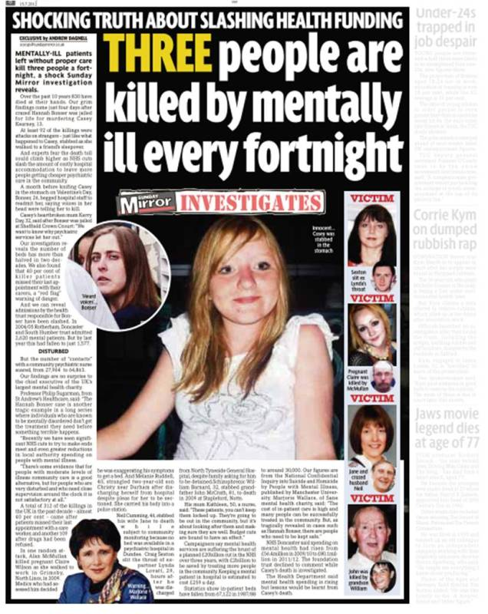

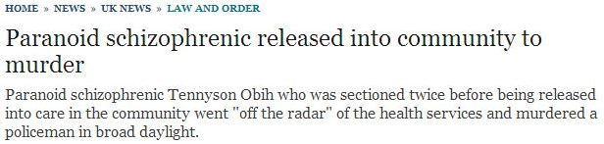

Slide 8
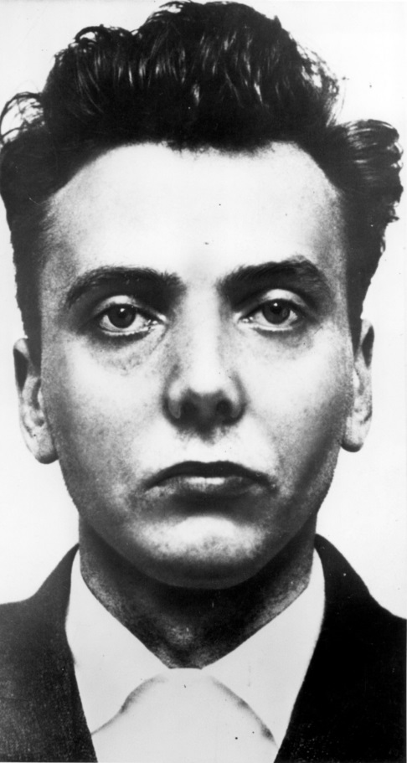
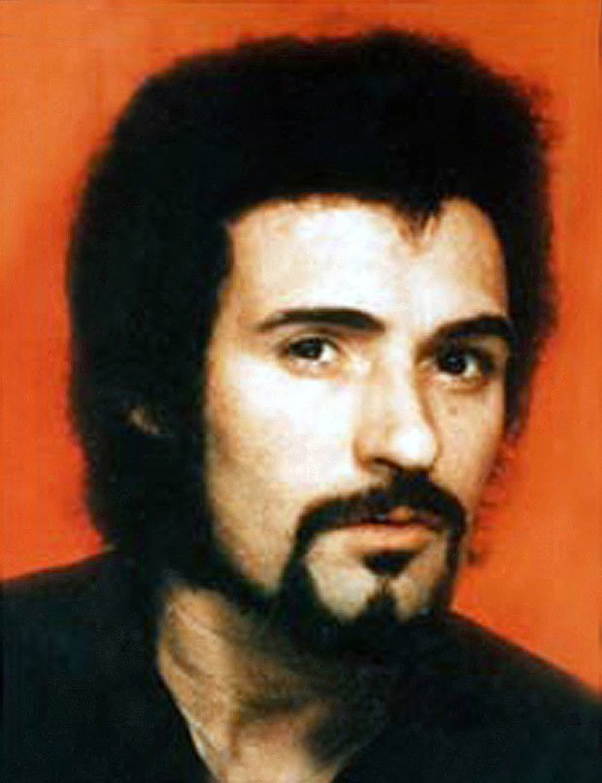
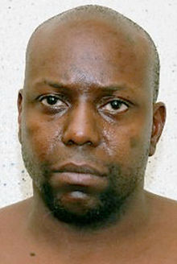
Peter Bryan Ian Brady Peter Sutcliffe
Notes:
Peter Bryan
Paranoid Schizophrenia
H/o carrying weapons for protection, paranoia – believed police were following him and cameras were watching him, practiced voodoo (? Cultural), reported that the warheads were turning and he knew this because of a feeling in his veins and was related to pains, delusions of reference (reported that watching cooking programmes on TV –”men had died to try and eat that food…the way he cooked it, it has substance in it…it has punch in it, it has substance in it,” believed that dead souls were listening to him, thought insertion
First detained in Rampton in 1994 after he killed a shop assistant (in 1993) by beating her about the head with a hammer. Reported to have heard a voice of the victim saying “rape me, rape me”, possible erotomanic delusions- believed that victim was in love with him,
Released on trial leave in 2001
In February 2004 he killed his friend Brian Cherry by hitting him over the head with a claw hammer. Police were alerted by neighbours who reported hearing screams and when they found him he had dismembered the body and was cooking some of his friend’s brain in a frying pan. He was remanded to Broadmoor.
Two months after his admission he killed a fellow patient, Richard Loudwell, by beating him to the head and tying a ligature around his neck.
Independent Inquiry into the care and treatment of Peter Bryan and Richard Loudwell
Ian Brady
Moors murderer with Myra Hindley
Convicted of 3 counts of murder in May 1996 and sentenced to life imprisonment
Diagnoses include paranoid schizophrenia and antisocial and narcissistic personality disorders
Reported to have head noises in prison, which persisted on moving cells; appeared paranoid in prison about staff and other prisoners; some suggestions of passivity (believing he was not controlling his own body); excessive use of salt on food (? Due to concerns about the food); swearing at himself and having lengthy conversations with himself in his room in hospital, believed patients smearing honey on chairs
Food refusal
He reports feigning mental illness
Some debate about diagnosis – read tribunal decision January 2014 which upheld diagnosis of chronic psychotic disorder
Peter Sutcliffe
The Yorkshire Ripper
Convicted of murdering 13 women and attempting to murder 7 others
He reported that the voice of God sent him on a mission to kill prostitutes
Defence of manslaughter on grounds of DR was rejected – he was convicted of murder and is serving 20 concurrent life sentences
Diagnosis of paranoid schizophrenia

Slide 9
Are schizophrenic patients more violent?
ECA survey re-examined (Swanson et al 1990)
  Increased violent offences in SZ
Elbogen & Johnson (2009)
  SMI alone does not predict violence
  Other factors for violence reported more frequently in SMI
Fazel et al (2009)
  Substance use is biggest contributory factor
Notes:
General belief that people with SZ are convicted of more criminal offences than those without but there is very little evidence to support this. Studies have been inconsistent. Generally it is likely that the greater burden of socioeconomic burden in those with SZ more likely to account for any increase in offending.
Offending may be direct or indirect – so direct would be acting as a result of paranoid persecutory beliefs, or indirect may be for economic reasons etc
Are SZ patients more violent?
Swanson et al reanalysed the data form the Epidemiological Catchment Area Survey (this was a study commenced in 1977 in order to look at the prevalence and incidence of mental disorders and the use of / need for mental health services. This was conducted over 5 sites in America.)
SZ in 19.6% non-violent offenders
SZ in 55.5% violent offenders
Elbogen & Johnson (2009)
US national survey about alcohol use, nearly 35000 subjects interviewed twice 2 – 3 years apart, relating data from SMI to self-reported violence
SMI alone didn’t predict violence
Other factors – historical, clinical, dispositional and contextual factors were associated with violence and were reported more frequently in those with SMI
Fazel et al (2009b) consisted of a meta-analysis of 20 studies that compared the risk of violence in those with SZ and psychosis with the general population.
Pooled OR 4.7 for men and 8.2 for women (adjusted for socio-economic factors)
Co-morbid substance use massively increased risk
Risk for SZ + Subst use was not different from those with Subst Use alone

Slide 10
Are schizophrenic patients more violent?
Steadman et al (1998)
  Data from MacArthur Study
  ‘Major mental disorder’ (MMD) not specific for SZ / psychosis
  Overall rate of violence 27.5%
Notes:
Discharge follow-up studies
Steadman et al used data from MacArthur Study – followed up 1136 people discharged from MH hospitals in USA for 1 year
Compared rate of violence (self-report, collateral info and police records) with 519 controls matched for neighbourhood of residence
Used board group of ‘major mental disorder’ including psychosis, depression, dysthymia, mania and cyclothymia
No significant difference between prevalence of violence among patients without substance use and community controls
Substance use increased rate of violence in all groups
Among all patients – overall rate of violence 27.5%
Other mental disorders = PD, adjustment disorder and suicidality

Slide 11
 | Rate of violence (%)
MMD and no substance use | 17.9 %
MMD and substance use | 31.1 %
Other mental disorder and substance use | 43 %
Table from ‘Practical Forensic Psychiatry,’ by Clark T & Rooprai DS chapter 7

Slide 12
Homicide and psychosis
Nielssen et al (2010)
Annual rate homicide by SZ patients 1 in 3000
Increased risk of homicide in FEP
Annual rate homicide before treatment is 15 times higher than after treatment
Shaw et al (2006)
34% homicides – lifetime mental disorder
5 – 7% schizophrenia
9 – 11% personality disorder
5 – 6% psychotic at time of offence
Notes:
Nielssen et al (2010)
Increased risk of homicide in first episode psychosis
Annual rate homicide by SZ patients 1 in 3000
4 in 10 homicides by SMI patients BEFORE treatment
1 in 700 people with psychosis commit homicide before treatment each year
1 in 10000 people with psychosis who have received treatment commit homicide each year
Annual rate of homicide before treatment is 15 times higher than after treatment
Possible explanations
? Higher rates of FEP than previously thought
Dangerous patients in FEP who don’t actually commit murder may have intensive treatment so don’t go on to murder
Do antipsychotics reduce violence
Shaw et al (2006)
UK survey of 1594 homicides over 3 years
34% lifetime mental disorder (based on diagnoses in psych court reports or by current psychiatrist)
5 – 7% SZ
7 – 10% affective disorder
9 – 11% PD
7 – 10% alcohol dependence
6 – 8% drug dependence
DoH (2001)
Of people with SZ who committed homicide
72% known to services
51% in contact with services within past year
Mean age 31
78% not currently married
68% unemployed / long-term sick
25% living alone
37% h/o alcohol use
51% h/o drug use
32% h/o violent convictions

Slide 13
Psychotic symptoms and violence
Delusions
  50% psychotic violent offenders attributed it to delusions
  MacArthur study found no such association
Hallucinations
  Rudrick (1999)- no association between command hallucinations and violence
  But may add to risk with congruent delusions
Threat / control over-ride symptoms
  MacArthur study found no association (Appelbaum 2000)
  Various studies show this is a critical factor
Notes:
Psychotic offenders are more likely to make external attributions for negative events than those without psychosis, regardless of the delusion type (Carlin et al 2005)
Delusions
Common for patients to report that they acted violently as a result of a delusional belief
Approx 50% psychotic violent offenders attributed the offence to delusions (Taylor 1985)
MacArthur Study (Appelbaum et al 2000) did not find an association between delusions and risk of violence
Persecutory delusions more likely to be acted on
Hallucinations
Little evidence that auditory hallucinations are associated with an increased risk of violence
Rudnick (1999) – no association between command hallucinations and dangerous behaviour
Threat / control over-ride symptoms
TCO symptoms
Feeling that one’s mind is dominated by forces beyond one’s own control
Feeling that thoughts are being put into one’s mind that are not one’s own
Feeling that there are people who wish to do one harm
Hypothesis is that psychotic symptoms lead to violence if the individual believes that others pose a threat or if they intrude and override internal violence-inhibiting controls
MacArthur study found no association between violence and TCO symptoms

Slide 14
Delusional content and violence
Delusional jealousy
Erotomania
Delusional misidentification
Delusions of passivity
Querulous delusions
Notes:
INTERACATION – what kind of delusional content may be related to violence?
Delusional jealousy
Risk of violence to spouse (generally)
OTHELLO SYNDROME
Delusions / overvalued ideas about spouse’s fidelity
Often accompanied by intensive seeking of evidence to support the belief
In general treatment depends on underlying cause (many psychiatric causes)
Important to consider confidentiality and sharing of info
Erotomania
De Clerambault’s syndrome
Usually females
Belief that someone of importance is in love with her
Nuisance behaviour / stalking
Series of 29 cases – violence predicted by previous antisocial behaviour (Menzies et al 1995)
Delusional misidentification
Capgras most commonly associated with violence
Victim usually close family member (Silva et al 1996)
Delusions of passivity
Common for patients to report they weren’t themselves or not in control
Querulous delusions
Beliefs that give ground for complaint against the victim

Slide 15
Offending in affective disorders
Notes:
Infanticide / Filicide covered in part 1

Slide 16
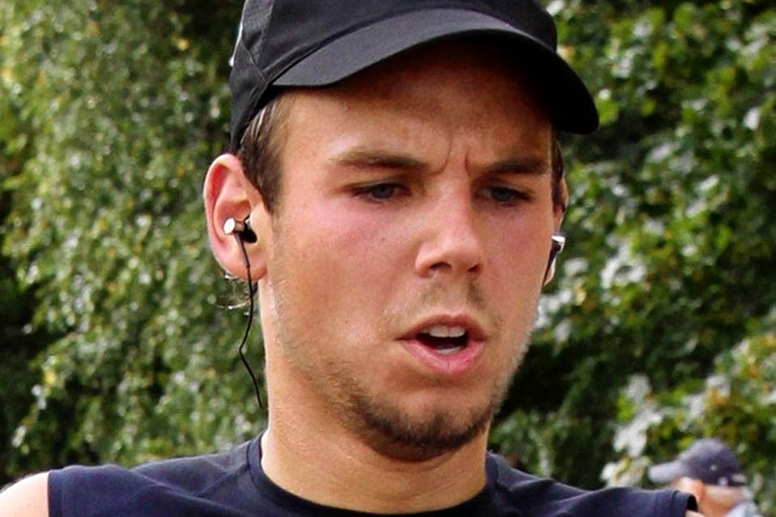
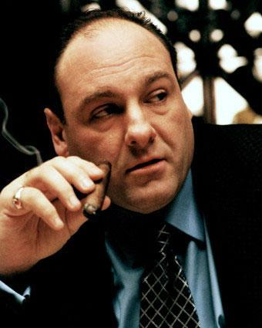
Andreas Lubitz ‘Tony Soprano’
Notes:
Andreas Lubitz
27 year old pilot of Germanwings 9525 that crashed in the Alps in March 2015, killing himself and all 150 passengers
Past h/o depression – had been under the care of drs in weeks / days leading up to the crash
It is believed that he deliberately crashed the plane – unclear motivation for this / to what extent if any his mental health contributed
Tony Soprano
Fictional head of mafia
Suffered anxiety and panic attacks – difficulty controlling his emotions and anger → violence

Slide 17
Mood disorders & violence
MacArthur Study (Monahan et al 2001)
  Rate of violence 1 year post-discharge
    Depression 28.5%
    BPD 22%
    SZ 14.8%
Manic patients more likely to show violence on admission
  AESOP study (Dean et al 2007)
  3 x more likely to be aggressive than SZ
Notes:
As heard in part 1 – higher prevalence of mood disorders in prisoners than in the general population
Dunedin birth cohort (Arsenault et al 2000) by age 21 for both depression and violence and mania and violence, the risk did not persist controlling for substance misuse. Low numbers in study though.
Graz et al (2009) 5.6% those with manic disorder and 1% with major depression committed violent crimes in 7 – 12 years post discharge
AESOP study
Aetiology and ethnicity of schizophrenia and other psychosis – nearly 2/3 patients with mania were aggressive at first contact with services
3 times more likely to be aggressive on admission than those with SZ

Slide 18
Mood disorder & homicide
National Confidential Inquiry (Hunt et al (2010) Shaw et al (2006))
  7% homicide offenders have lifetime mood disorder
    Less likely to have had contact with MH services
Homicide-Suicide
  Rare – 30 / year
  Offenders usually male
  Men kill partners, women kill children
  Mood disorder and PD
  Flynn et al (2009)
Notes:
National Confidential Inquiry into suicide and Homicide by people with mental illness
7% homicide perpetrators have a lifetime diagnosis of mood disorder (5% have SZ)
Those with depressive symptoms at time of offence unlikely to have had previous contact with MH services
Proportion of homicide perpetrators with symptoms of MI at time of offence increased with increasing age
>65 years – 50% depressed at time of offence, and almost 50% have a past h/o mood disorder
Older homicide offenders less likely to have previous violent convictions
Conclusions
Need for greater awareness of potential risk posed to others by elderly patients with mood disorders
Homicide-suicide
Rare
Rosenbaum (1990) – case series found that 75% perpetrators were depressed at time
National Confidential Inquiry (Flynn et al 2009) shows
30 incidents of homicide followed by suicide in England and Wales each year
Most perpetrators male
Men more often killed a partner
Women more often killed children
10% had previous contact with MH services
Most common diagnoses were mood disorder and PDs
Elderly homicide perpetrators more likely than younger to kill a female partner and more likely to die by suicide after – sometimes they are mercy killings to end an ailing partner’s suffering

Slide 19
Mood disorders & sex offending
No clear evidence / studies
Mania
  Sexual disinhibition
  Increased libido
Depression
  Weaken internal controls
Notes:
Mania – associated with sexual disinhibition, an increase in libido and enhanced sense of confidence / attractiveness.
Depression may present with sex offending in middle-aged men. Breakdown of psychological defences.
Often find indirect sex offending such as downloading child pornography – inadequate personality style
Depression and alcohol may weaken internal controls

Slide 20
Offending in personality disorders

Slide 21

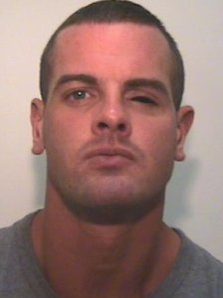
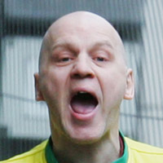
B
A
Dale Cregan
Theresa Riggi
Michael Stone
C
Notes:
Dale Cregan
32-year old drug-dealer and murderer who was sentenced to a whole life tariff for four counts of murder, including killing 2 police officers; and 3 counts of attempted murder
In May 2012 he shot dead Mark Short in a pub in Droylsden and attempted to kill 3 others in the same incident. In August 2012 he shot dead Mark Short’s father and threw a hand grenade at him. In September 2012 he made a hoax phone call to the police and when officers attended he shot the two officers (Nicola Hughes and Fiona Bone) and threw a hand grenade at them.
Reported to have gone on hunger strike in prison and then admitted to Ashworth Hospital
Likely to have antisocial PD / ? Psychopathy
Theresa Riggi
A 50 year old American woman who killed her 3 children in Edinburgh in August 2010
She was sentenced to 16 years in prison after she pleaded guilty to culpable homicide on the grounds of DR (Scottish Law)
She killed her 3 children (8 year old twins and a 5 year old girl) by stabbing each of them 8 times and then tried to cover this up with a gas explosion before attempting to kill herself by jumping from a second floor flat.
A report found that she had narcisstic, histrionic and paranoid personality disorders.
She committed suicide at Rampton Hospital in March 2014
Michael Stone
Convicted of the murders of Lin and Megan Russell in 1996, 9 year old Josie Russell survived attack
Had previous convictions for violence
Is reported to be a psychopath / ASPD, but was not admitted to hospital at the time of the offence and on subsequent re-trials because of the treatability test (previously a disorder had to be treatable, which psychopathy isn’t). Now appropriate treatment has to be available to alleviate of prevent deterioration of the disorder – there is no requirement that the person has to engage / comply

Slide 22
Personality Disorder
No gold standard test for diagnosing PD
  NICE (QS88) – structured clinical assessment
Prevalence of any PD ranges from 4 – 6%
  54% have one PD only
All PDs (except schizotypal) more common in men
Notes:
ICD – 10 definition – “a severe disturbance in the characterological condition and behavioural tendencies of the individual, usually involving several areas of personality, and nearly always associated with considerable personal and social disruption.”
DSM definition – “an enduring pattern of inner experience and behaviour that deviates markedly from the expectations of the individual’s culture.”
New NICE guidance (QS88) states that a structured clinical assessment using a recognised clinical tool is essential for diagnosis (i.e. can’t rely on clinical diagnosis alone)
MOST LITERATURE REFERS TO DSM-IV DIAGNOSES OF PD

Slide 23
Antisocial PD & Offending
40 – 70% conduct disorders convert into ASPD
Substance Use
  Most common comorbidity
  Men 3-5 times more likely to have substance use
  Increases risk of violence
Notes:
DSM- Antisocial PD
Failure to conform to social norms with respect to lawful behaviour
Impulsivity or inability to plan ahead
Irritability and aggressiveness
Deceitfulness
Reckless disregard for safety of self or others
Consistent irresponsibility
Lack of remorse
Individual must have had conduct disorder with onset before age of 15
ICD -10 – Dissocial PD
Callous unconcern for the feelings of others
Gross and persistent attitude of irresponsibility and disregard for social norms, rules and obligations
Incapacity to maintain enduring relationships, though having no difficulty establishing them
Very low tolerance to frustration and a low threshold for discharge of aggression, including violence
Incapacity to experience guilt or to profit from experience, particularly punishment
Marked proneness to blame others, or to offer plausible rationalisations for the behaviour that has brought the patient into conflict with society
May be persistent irritability as an associated feature
Conduct disorder may support diagnosis
Conduct Disorder
Childhood onset (before 10) or adolescent onset
Key characteristics
Aggression towards people or animals
Destruction of property
Deceitfulness or theft
Serious violations of rules
Callous-unemotional traits
Callous-unemotional traits (Frick & Petitclerc 2009)
Associated with conduct disorder
Persistent antisocial behaviour in adulthood
Childhood-onset CD may be more likely to have callous-unemotional traits
Children with these traits show more severe aggression which is more likely to be pre-meditated and for instrumental gain
?strong genetic basis
Persistent antisocial behaviour into adulthood
Conversion rate for CD into adult dissocial / antisocial PD 40 – 70%
Interventions for conduct disorder
Cognitive problem solving skills
Anger control groups
Group-based parent training / education programmes
Functional family therapy
Substance Misuse
90% ASPD have comorbidity – most common is substance misuse
Men 3 – 5 x more likely to misuse alcohol and / or drugs
Females (ASPD less common) have higher prevalence of substance use than men
Alcohol use associated with violence in ASPD

Slide 24
ASPD & Offending
Come into contact with CJS commonly
50 – 60% male prisoners have ASPD
  More criminal versatility
  10 – 20 times more likely to commit homicide
  Violent offences more likely
  (Roberts & Coid 2010)
Brain changes - ? Genetic component
Notes:
47% of those with ASPD in community have an arrest record
50 – 60% male prisoners have ASPD
Relatively small number of persistent offenders commit 50 – 70% all violent offences (Odgers 2009)
Prisoners with ASPD (Roberts & Coid 2010)
More criminal versatility
10 – 20 x more likely to commit homicide than gen population
More likely to commit violent offences
More likely to commit robbery, theft, burglary, blackmail, fraud and firearms offences
Neurobiological basis of AS behaviour
Increased evidence for neurobiological / genetic component to AS behaviour
Evidence linking following genes with violence (Ferguson & beaver 2009)
DA transporter gene
Serotonin transporter gene
MAO-A gene
COMT gene
AS individuals have
Reduced prefrontal structures
Larger volumes in posterior brain areas
Psychopaths have
White matter abnormalities
Reduced volume in amygdala

Slide 25
ASPD & Offending
Very little evidence-based effective treatment
NICE
  Cognitive / behavioural interventions
  Medication not used routinely
  Treat alcohol and substance use
Notes:
Treatment of ASPD
Very little evidence-based effective treatment
NICE (2010)
h/o offending behaviour – group-based cognitive and behavioural interventions to address problems such as impulsivity, interpersonal difficulties and AS behaviour
Similar groups for non-offenders with ASPD
Medication not recommended for routine use
Treat alcohol and substance use

Slide 26
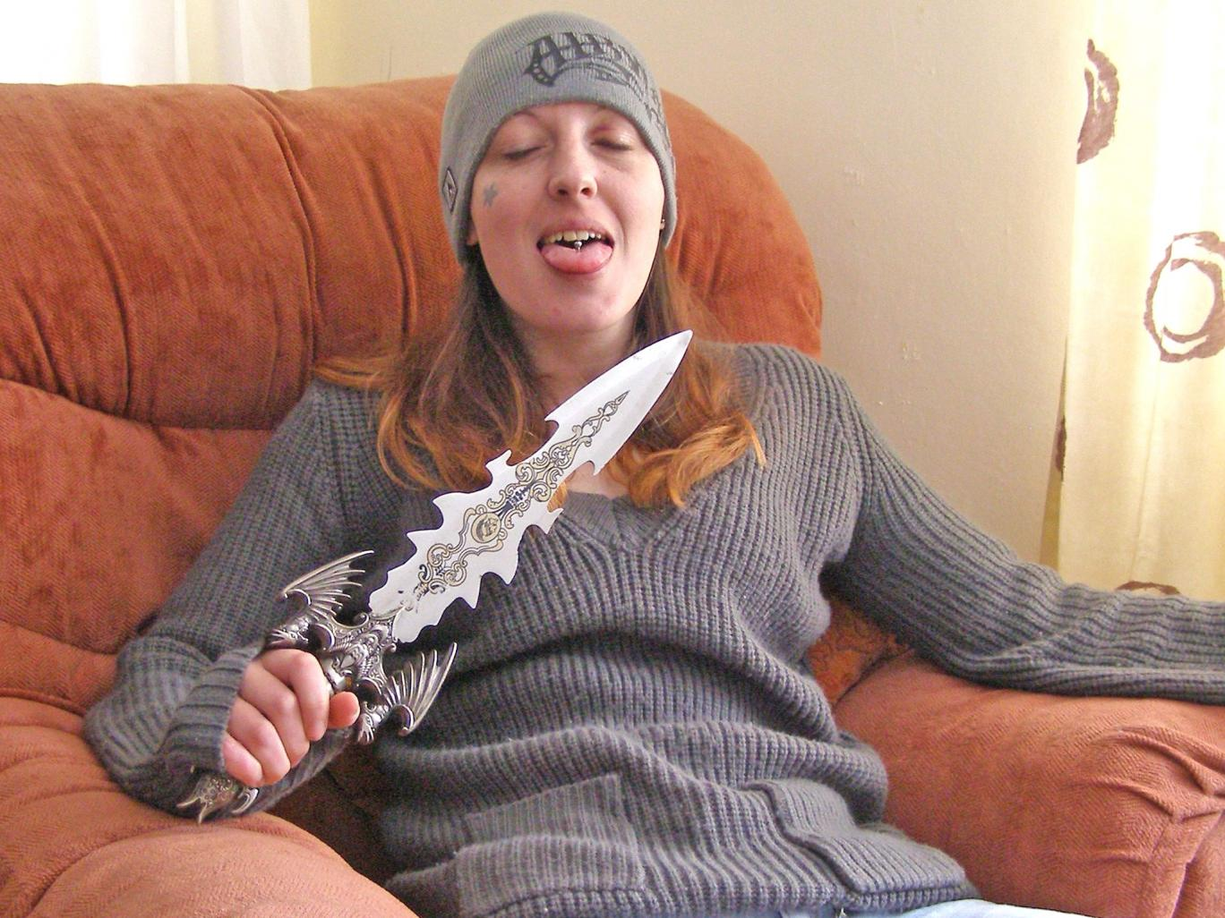
Joanna Dennehy
Notes:
Joanna Dennehy
Convicted of killing 3 men and seriously wounding 2 others during a 2 week spree
Reported to have come from a loving home
Killed first victim – 31 year old Lukasz Slabosezewski in March 2014. His body was dumped in a wheelie bin and had been stabbed through the heart. She showed the corpse to a 14 year old girl
Ten days later she killed 56 year old John Chapman in his bedsit at the block of flats that she also lived in. She had accused him of seeing her in the bath and had taken a photograph of his body. She stabbed him 6 times and then rang a friend singing ‘oops I’ve done it again.’
Later that day she killed 48 year old Kevin Lee who was her landlord. She dressed him in a black dress and dumped his body in a ditch, arranging it into suggestive poses
In April there were two incidnets of attempted murder when she stabbed strangers in the street
She wrote a letter to the Judge which showed that she had no remorse for her actions
She was sentenced to a whole life sentence in February 2014

Slide 27
Psychopathy
PCL-R – 20 items (Hare 1991)
≥ 30 (USA) or ≥ 25 (UK) → psychopathy
Notes:
Psychopathy is not used in current diagnostic manuals
Core characteristics of psychopathy
Interpersonal – superficially charming, grandiose, egocentric, manipulative
Affective – shallow labile emotions, lack of empathy, lack of guilt, little subjective distress
Behavioural – impulsive, irresponsible, prone to boredom, lack of long-term goals, prone to breaking rules
Most psychopaths, but not all, have ASPD
10% patients with ASPD have psychopathy
PCL-R is standard method for diagnosing psychopathy (Hare, 1991)
Each item score between 0 and 2 – 0= not present, 1 = maybe, 2 = definitely present
Score =/> 30 in USA or =/> 25 in UK diagnostic of psychopathy

Slide 28
Psychopathy
Glibness & superficial charm | Promiscuous sexual behaviour
Grandiose sense of self-worth | Early behavioural problems
Need for stimulation / prone to boredom | Lack of realistic long-term goals
Pathological lying | Impulsivity
Conning and manipulative | Irresponsibility
Lack of remorse or guilt | Failure to accept responsibility for actions
Shallow affect | Many short-term relationships
Callous / lack of empathy | Juvenile delinquency
Parasitic lifestyle | Revocation of conditional release
Poor behavioural controls | Criminal versatility
Notes:
Those in bold are linked to offending
Lack of guilt / empathy – no inhibitor to antisocial behaviour
Conning linked to fraud
THINK ABOUT JOANNA DENNEHY CASE – WHICH OF THESE CHARACTERISTICS DOES SHE SCORE ON / WHAT WOULD HER SCORE BE?
Glibness and superficical charm (2) she appeared to be able to make relationships easily and charm men in particular
Grandiose sense of self-worth (1 / 2) she is reported to have become excited by police hunting for her
Need for stimulation / prone to boredom (2) evidence that she completed a number of risky activities / adrenaline activities / needed stimulation
Pathological lying (2) no evidence that she tried to conceal her crimes. But she reported told people that she had served time for murdering her father who had sexually abused her. Whereas he is alive and well and there is no suggestion of any truth in this
Conning and manipulative (2) able to con several men and manipulate them to her own needs
Lack of remorse or guilt (2) judge commented on her lack of remorse
Shallow affect (2) Need more information?
Callous / lack of empathy (2) Lots of evidence of this
Parasitic lifestyle (2) frequently moved between partners, used men and women
Poor behavioural controls (2) impulsive, explosive anger
Promiscuous sexual behaviour (2) lots of evidence
Early behavioural problems (0) all reports are that she had a very normal, loving upbringing. Intelligent, calm and well behaved. Problems began around age 15 when she was in relationship with an older male
Lack of realistic long-term goals (0) need more information
Impulsivity (2) lots of evidence
Irresponsibility (2) lots of evidence
Failure to accept responsibility for actions (1) pleaded guilty
Many short-term relationships (2) lots of evidence
Juvenile delinquency (0) no evidence of any behavioural problems / delinquency until late teens
Revocation of conditional release (2) had previously spent time in prison for various offences
Criminial versatility (2) drugs, theft, prostitution, assault, murder, attempted murder
Tentative score - 32

Slide 29
Psychopathy & offending
Loss of inhibition to antisocial behaviour
May be a desire to control, demean and humiliate
Impulsive and risky behaviour
Argued that many may function well in corporate life
Notes:
5% prisoners in England and Wales are psychopaths (compared to 1% general population)

Slide 30
Other PDs and offending
Borderline PD
  Female violent prisoners 4 x more likely to have borderline PD (Logan & Blackburn 2009)
  MacArthur study data (Newhill et al 2009)
    Borderline PD more likely to commit violent acts
Paranoid PD
  Linked to morbid jealousy
  Increased risk of violence (Carroll 2009)
Notes:
Borderline PD
Less known about prevalence and characteristics of violence in borderline PD – may be because seen as a disorder of women and violence is underestimated in women, may be diagnosed with ASPD instead
Logan and Blackburn – women imprisoned for a major violent offence are 4 times more likely to have a diagnosis of borderline PD than women whose index offence is of less severe violence
Newhill et al (2009) – MacArthur study data of male and female patients with borderline PD
73% violent during 1 year period
Those with borderline PD more likely to commit seriously violent and aggressive acts than those without (even when controlled for confounding factors such as substance use)
Those with co-morbid ASPD 3.5 times more likely to be violent
Paranoid PD
Jealous overvalued ideas are a diagnostic criterion of paranoid PD – linked to morbid jealousy
Very resistant to change
Increased risk of violence (Carroll 2009)
Associated with stalking, making threats, complaints and litigation

Slide 31
Offending in substance misuse

Slide 32
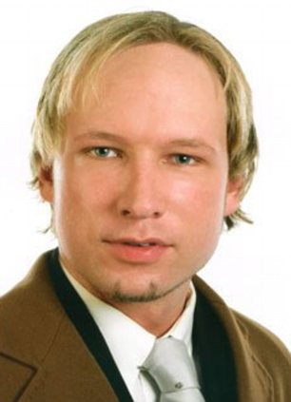
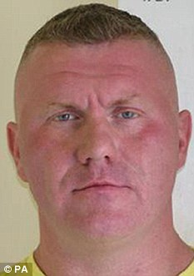
Anders Breivik Raoul Moat
Notes:
Anders Breivik
36 year Norwegian who carried out terrorist attacks in July 2011, killing 8 people with a bomb in central Oslo and then 69 teenagers at a summer camp on the island of Utoya.
He was found to have a narcissitic personality disorder and was found to be sane at the time of the offences
It is reported that he was under the influence of a variety of drugs at the time of the offence
Raoul Moat
37 year old man who was subject to a police manhunt in 2010 after he had shot 3 people
One of the victims was PC David Rathband who he blinded. Rathband later committed suicide
Believed that he was a prolific abuser of steroids → ? ‘Roid rage’
It is reported that he had asked to see a psychiatrist in the months leading up to the incidents

Slide 33
Association with violence
Intoxication directly increases risk of violence
Exacerbation of mental illness
Other characteristics
Socio-economic
Notes:
4 possible relationships between substance use and risk of violence in those with mental disorder:
Intoxication with drugs leads directly to an increased risk of violence
Stimulants are associated with increased violence risk
Both mentally-disordered and non mentally-disordered offenders
Substance use leads to more symptoms of mental illness, which leads to an increased risk of violence
Cannabis & stimulants lead to increased psychotic symptoms
Long-term use of alcohol and opiates may exacerbate psychosis
Drug use and violence are associated through other characteristics
Use of drugs leads to involvement in a social environment where violence is common

Slide 34
Offending & Substance misuse
Remember Fazel et al (2009) looking at psychosis and violence
  Substance use is biggest contributory factor
Steadman et al (1998) looked at MacArthur study for violence and SMI
  Substance use increased rate of violence in all groups

Slide 35
Offending in epilepsy & neurodevelopmental disorders

Slide 36
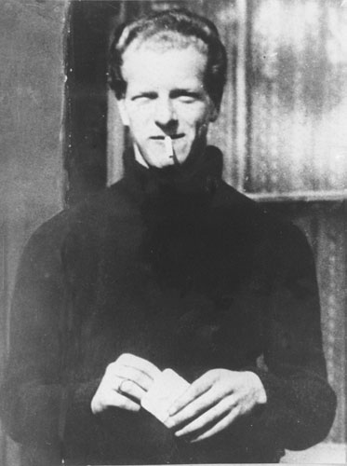
Derek Bentley
Notes:
Derek Bentley
Hanged in 1953 for mentally aiding the murder of a policeman during the commission of an attempted burglary in November 1952
The murder is said to have been committed by his friend, Christopher Craig who was 16 at the time
He was found guilty on the basis of saying “let him have it Chris“ – at the time of conviction it was found that he was encouraging Christopher to shoot the police officer, but his conviction was later quashed in 1993 (by Royal Pardon) as it was agreed that he had been telling him to hand over the gun
It was a mandatory death sentence at the time of his conviction
An IQ test at the age of 15 / 16 gave him an IQ of 66 and a reading age of 4
EEGs suggested that he was epileptic and he was refused national service on the grounds that he was ‘mentally substandard’
Film – Let Him Have It

Slide 37
Learning-disabled offenders
0.8% all adult LD have contact with CJS
Characteristics include:
  Young men
  Borderline / mild LD (as opposed to severe) [62%]
  Psychosocial deprivation
  Co-morbid psychiatric disorders [44%]
  Family h/o offending
Notes:
Prevalence of LD
General population 1.5%
Prisoners 10% (up to 60% male prisoners have learning difficulties)
LD offenders in prison have longest duration of stay and are most difficult to discharge due to lack of community provision
Holland et al (2002) – reviewed prevalence studies of offending in LD patients
Up to 5% had had contact with CJS
Of those LD patients awaiting interview in police stations
9% had IQ ≤ 70
34% had IQ ≤ 75
Also found following factors to be common among LD-offenders
Young men
Borderline / mild LD
Psychosocial deprivation
Childhood behavioural problems
Co-morbid psychiatric disorders
Family h/o offending
Low socio-economic status
h/o behavioural problems / previous offending
Homelessness
Prison Reform Trust (Talbot 2008)
20 – 30% offenders have LD or impairments in ADLs
20% prison population has a hidden disability that will affect and undermine their performance in education and work settings

Slide 38
Learning-disabled offenders
Range of behaviours
  Physical aggression (52%)
  Verbal aggression (40%)
  Damage to property (24%)
  Inappropriate sexual behaviour (18%)
  Cruelty and neglect to children (11%)
  Fire-setting (1%)
Notes:
Wheeler et al (2009) reviewed 237 referrals to LD team due to AS / offending behaviour

Slide 39
Challenging behaviour
Behaviour can be described as challenging when it is of such an intensity, frequency or duration as to threaten the quality of life and / or the physical safety of the individual or others and is likely to lead to responses that are restrictive, aversive or result in exclusion.
Challenging behaviour in LD populations
  10 – 60%
  9.8% point prevalence for aggression
  4.9% point prevalence for self-injurious behaviour
  Tsiouris (2010)
Notes:
Royal college psychiatrists definition of challenging behaviour (2007)
RCPsych emphasises following factors in assessing challenging behaviour:
Factors unique to the individual
Degree and nature of LD
Communication difficulties
Sensory or motor difficulties
Co-morbid mental health problems
Physical health problems
Emotional needs and strength
Social competency
Insight
Strengths and coping strategies
Environmental factors
Geographical location of placement and its perceived importance to the patient
Physical structure of the placement (e.g. room sizes, communal spaces, time out etc)
Environmental adaptations to the needs of the person for their sensory and physical health needs
Other patients
Staff, support and intervention
Training and experience
Constancy of staff group
Consistent approach
Activities and sessions
Individualised care plans
Functional analysis of challenging behaviour

Slide 40
Management of challenging behaviour
CBT / behavioural modification
Environmental modification
Specialist placements
Medication
  Antipsychotics ONLY for underlying mental disorder
  ? Risperidone for autism
  SSRIs
Notes:
Very limited evidence base
Focus on individual strengths and weaknesses
CBT / behavioural modification
Environmental modification
Supportive, well-staffed
Specialist placements
Antipsychotics are not anti-aggressive and should only be used to treat underlying mental disorder
Autism patients – do show improvement in irritability and aggression with risperidone
SSRIs may reduce aggression in 50%

Slide 41
Offending & LD
Borderline LD over-represented in offender populations
  Lack of abstract thinking
  Reduced capacity to delay gratification
  Reduced capacity to modify behaviour
  Socio-economic stressors
  ? More likely to get caught
  Skills deficits
  Social naivety / vulnerability
Notes:
No firm evidence that LD in itself is a risk factor for offending – but borderline LD individuals are over-represented in offender populations.
Possible explanations
Lack of abstract thinking – lack of empathy and unable to foresee consequences of their actions
Operating at delayed developmental stage
Reduced capacity to delay gratification / resist temptation
Reduced capacity to modify behaviour according to experience
Social naivety
Greater socio-economic stressors – more likely to be rejected by peer group
Increased likelihood of getting caught
Skills deficits – verbal skills, memory and visual-motor integration are all related to offending, independent of socio-economic status
Poor problem-solving skills
Sexual offending and Arson discussed in part 1

Slide 42
ASD & Offending
Offences that may suggest ASD
  Stalking / obsessive harassment
  Inexplicable violence
  Computer crime
  Offences due to misjudged social relationships
Management
  Setting
  Psychological
  Pharmacological
  Environmental
Notes:
Following offence types might indicate presence of ASD (Berney 2004)
Obsessive harassment / stalking
Inexplicable violence
Computer crime
Offences arising from misjudged social relationships
Characteristics of ASD that may lead to offending
Lack of concern for / awareness of likely outcomes
Lack of empathy
Impulsive violence arising from anxiety
Social naivety leading to exploitation by others
Misinterpretation of social norms may lead to sexual offending
Obsessive interests → stalking / theft
Management of ASD
Evidence-base is weak
Setting – outpatient / mainstream secure unit / specialist ASD unit
Psychological
CBT
Role-playing
Mind reading
Social skills training
Specific interventions for the offending behaviour
Support for carers
Pharmacological – for co-morbid conditions only
Environmental to avoid sensory overload, predictable and consistent regimes

Slide 43
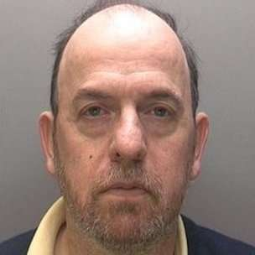
Nigel Constable
Notes:
Nigel Constable
Killed his mother during an epileptic automatism
Diagnosed with TLE at age of 9
Unwitnessed assault in which she sustained head injuries, but his behaviour afterwards suggested he was post-ictal
Found NGRI
M’Naghten rules
Everyone presumed to be sane
Must be proved that at the time of the offence, the accused was suffering from a defect of reason as a result of disease of the mind, as to not know the nature and quality of the act, or if he did know he did not know that it was wrong
Hospital order
Automatism = unconscious, automatic behaviour

Slide 44
Epilepsy & offending
Rarely associated with violence but may be raised in defences (Part 4)
Prevalence: gen pop < prisoners < forensic pts
Co-morbid psychiatric conditions 20 – 30%
5 possible causes of violence in epilepsy
  Violent automatism
  Prodromal irritability
  Post-ictal confusion
  Lower socioeconomic status
  Brain damage
Notes:
Rarely associated with violence
Prevalence of epilepsy
0.5 – 1% general population
Prisoners 1 – 2%
Forensic psychiatric patients 5%
However it can be difficult to account for the high rates of epilepsy in prisoners. Possible explanations include:
Epileptic patients more likely to have been institutionalised
Brain damage – cause of epilepsy and cause of offending behaviour
Low self-esteem in people with epilepsy as a risk factor for offending
Increased risk of mental disorder
Poor environments cause of epilepsy and offending
Behavioural disorders causing accidents, leading to brain injuries leading to epilepsy
20 – 30% patients with epilepsy have a co-morbid psychiatric condition
2 – 9% psychosis
20 – 60% depression
20 – 50% substance abuse
No general increase in violence with epilepsy
BUT
Epilepsy can be associated with complex behaviours (outside of conscious control) which may result in violence
Violence in epilepsy usually due to other risk factors (e.g. substance use)

Slide 45
Epileptic offending / post-ictal
Criteria to suspect criminal act due to epilepsy
  Evidence of epilepsy
  Crime sudden with no obvious motive / no planning
  Crime senseless & no attempt at concealment / escape
  Short duration
  Witness descriptions
  Amnesia
  Lishman (1998)
Notes:
LINK TO CASE OF NIGEL CONSTABLE
Criteria to suspect a criminal act may be due to a person’s epilepsy:
Unequivocal evidence of epilepsy, but not necessary to have history of automatic behaviour
Crime will have been sudden with no obvious motive and no evidence of planning or premeditation
Crime will appear senseless and typically there will have been little or no attempt at concealment or escape
Abnormal behaviour will have usually been of short duration, lasting minutes rather than hours and never entirely appropriate to the circumstances
Witnesses may have noticed impairment of awareness, e.g. inappropriate actions / gestures, stereotypic movements, unresponsiveness or irrelevant replies to questions, aimless wandering or dazed or vacant expression
Amnesia for the act is the rule, but there should be no anterograde amnesia for events following resumption of conscious awareness
No evidence that sex offending is commoner in people with epilepsy
Ictal violence is rare
Committed during a seizure
Usually complex partial seizures
Offending more likely post- or inter-ictal period where person may be more vulnerable to external influences (suggestions from others)
Need to involve neurologist in assessing an epileptic person who has committed a violent offence

Slide 46

Brian Thomas
Notes:
Brian Thomas
Brian Thomas had a history of sleepwalking.
In 2008 he was caravanning with his wife, when a group of youths made them feel uncomfortable. So they moved their caravan
While sleeping Mr Thomas believed that the youths had broken into the caravan. He thought he was fighting them off when in actual fact he was strangling his wife
When he finally realised what he was doing, his wife was already dead
Mr Thomas had sleep studies in prison which confirmed the presence of sleepwalking
He pleaded automatism and was acquitted in November 2009

Slide 47
Parasomnias & violence
Rarely associated with violence
Disorders of arousal from sleep:
  Sleep drunkenness
  Violence associated with sleepwalking
  Violence associated with night terrors
  REM sleep behaviour disorder
Notes:
Where violence does occur in sleep disorders
More common in males
Childhood h/o parasomnias (incl nocturnal enuresis)
Victims usually known to perpetrator
Sleep deprivation, alcohol, cannabis and caffeine may all provoke sleep walking
Disorders of arousal from sleep
Violence associated with confusion on sudden awakening (Sleep drunkenness)
Confusion, disorientation and misinterpretation of reality on sudden arousal from deep (stage 3 or 4) slow wave sleep
Sufferer may perform complex actions, generally without leaving the bed and may apparently defend themselves against attack
No recall
Case reports suggest violence triggered by external cause – touch or noise with victim being close by
Violence associated with sleep walking
Complex coordinated actions – destruction of surrounding objects, self-injury or injury to others may occur
Victim commonly a spouse
Very little evidence of ‘provocation’
Violence associated with night terrors
Night terrors differ from nightmares in terms of physiological arousal and presentation
Walking from slow wave sleep (nightmares occur in REM sleep)
Highly arousing image (when observed the individual is terrified)
REM sleep behaviour disorder
Normal REM sleep – paralysis of all skeletal muscles. There is an absence of this in REM sleep behaviour disorder
Often other neuro abnormalities
Older men
No evidence of violence when awake
Other elaborate behaviours can occur when asleep including atypical sexual behaviour

Slide 48
Parasomnias & violence
History is vital – patient & bed partner
  Onset
  Action
  Victim
  Level of consciousness
  After the action
  (Bournemann et al 2006)
Physiological measures of sleep and muscular activity – Sleep lab
Notes:
History to include details on
Onset (generally at least an hour after falling asleep, often with attempts to waken, may be brought on by sleep deprivation or alcohol ingestion)
Action (duration generally brief, onset abrupt and apparently senseless)
Victim (known / unknown, may have precipitated arousal)
Level of consciousness (impaired during action)
After the action (perplexity, horror where there has been violence, partial / full amnesia)

Slide 49
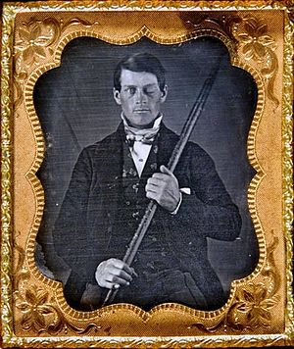
Phineas Gage
Notes:
Phineas Gage
Railroad construction foreman known for his survival of an accident in 1848 during which a large iron rod was driven through his head destroying most of his left frontal lobe
Gage displayed significant changes to his personality and behaviour
Became unreliable
Prone to swearing and inappropriate remarks

Slide 50
Acquired Brain Injury
Link between ABI and offending
Increased prevalence ABI in prisoners / forensic patients
ABI predisposition to violence
  PFC lesions → disinhibition
  Temporal lobe lesions → aggression
  Substance use
  Self-directed violence
Notes:
Several studies show link between ABI and offending – may not be causal – people likely to offend may also be more likely to suffer head injury
Prevalence of ABI
General population 5 – 15%
General psychiatric patients 17 – 43%
Prisoners 50% non-violent offender
100% those on death row
Forensic psychiatric patients 22% in high security, 23 – 50% other services
Features of ABI that predispose to violence
Prefrontal cortex (Frontal lobe) lesions → personality changes, impaired executive function, defective social and moral reasoning → disinhibition
Temporal lobe lesions (amygdala and hippocampus) may lead to aggression
Other factors – poor premorbid social function, alcohol and / or substance use increase risk of head injury AND violence independently
AS behaviour increases risk of head injury → increased risk of violence
Self-directed violence including suicide
Post-concussion syndrome
Transient symptoms that occur in 30 – 80% concussions (mild head injury) and many cases of moderate – severe TBI
Abates within 6 months
Can predispose to violence (independent of permanent brain injury)
Comprises
Physical symptoms – headache, dizziness, photosensitivity, tinnitus, double vision, insomnia
Psychological symptoms – irritability, anxiety, depression, restlessness, aggression, mood lability, impulsivity and loss of tolerance to alcohol / drugs
Cognitive symptoms – poor concentration, confusion, impaired judgement, amnesia and poor memory

Slide 51
ABI & offending
Cognitive impairment
Impulse control deficit
Personality change / irritability / aggression
Poor social judgement
Vulnerability
Comorbidity
Disinhibition
Notes:
ABI and offending
Cognitive impairment affecting recognition of legal boundaries
Impulse control deficits
Increased aggression, irritability and personality change
Poor social judgement
Increased vulnerability to involvement in criminal activity
Comorbid ASPD
disinhibition

Slide 52
MCQs

Slide 53
Mental Disorders and Offending
MCQs
1. Which is the biggest risk factor for violence in psychosis?
    A. Non-compliance with medication
    B. Co-morbid personality disorder
    C. Homelessness
    D. Unemployment
    E. Co-morbid substance misuse

Slide 54
Mental Disorders and Offending
MCQs
1. Which is the biggest risk factor for violence in psychosis?
    A. Non-compliance with medication
    B. Co-morbid personality disorder
    C. Homelessness
    D. Unemployment
    E. Co-morbid substance misuse

Slide 55
Mental Disorders and Offending
MCQs
2. With respect to Munchausen’s by Proxy, which of the following is incorrect?
  A. More common in mothers
  B. The annual incidence of fabricated or induced illness in children under 16 is 0.5 per 100,000
  C. There is no clear relationship with any specific mental disorder
  D. 50% perpetrators had a personality disorder
  E. 21% have a history of alcohol and / or drug misuse

Slide 56
Mental Disorders and Offending
MCQs
2. With respect to Munchausen’s by Proxy, which of the following is incorrect?
  A. More common in mothers
  B. The annual incidence of fabricated or induced illness in children under 16 is 0.5 per 100,000
  C. There is no clear relationship with any specific mental disorder
  D. 50% perpetrators had a personality disorder
  E. 21% have a history of alcohol and / or drug misuse
Notes:
89%

Slide 57
Mental Disorders and Offending
MCQs
3. Which of the following regarding mood disorder and violence is incorrect?
    A. The prevalence of depression in male prisoners is 10%
    B. The prevalence of depression in female prisoners is 25%
    C. Manic patients are likely to show aggression and violence associated with admission to hospital
    D. 7% homicide perpetrators have a lifetime diagnosis of mood disorder
    E. Most perpetrators of homicide-suicide are male

Slide 58
Mental Disorders and Offending
MCQs
3. Which of the following regarding mood disorder and violence is incorrect?
    A. The prevalence of depression in male prisoners is 10%
    B. The prevalence of depression in female prisoners is 25%
    C. Manic patients are likely to show aggression and violence associated with admission to hospital
    D. 7% homicide perpetrators have a lifetime diagnosis of mood disorder
    E. Most perpetrators of homicide-suicide are male
Notes:
The prevalence of depression is 12% in female prisoners

Slide 59
Mental Disorders and Offending
MCQs
4. Which is the correct statement relating to substance use and the MacArthur Violence Study?
    A. Substance use increases the rate of violence among both those with and without mental illness
    B. The rate of violence for those with a mental disorder and no substance use is 25%
    C. The rate of violence for those with a mental disorder and substance use is 50%
    D. Substance use is a protective factor for violence
    E. The highest rate of violence was for those with mood disorder and substance use

Slide 60
Mental Disorders and Offending
MCQs
4. Which is the correct statement relating to substance use and the MacArthur Violence Study?
    A. Substance use increases the rate of violence among both those with and without mental illness
    B. The rate of violence for those with a mental disorder and no substance use is 25%
    C. The rate of violence for those with a mental disorder and substance use is 50%
    D. Substance use is a protective factor for violence
    E. The highest rate of violence was for those with mood disorder and substance use
Notes:
MMD and no substance use – rate of violence 17.9%
MMD and substance use – rate of violence 31.1%
Highest rate of violence in those with ‘other mental disorders’ (PD, adjustment disorder and suicidality) and substance use

Slide 61
Mental Disorders and Offending
MCQs
5. Which is the incorrect statement about epilepsy and offending?
  A. Ictal violence is more likely in complex partial seizures
  B. Most offending occurs in post-ictal or inter-ictal period
  C. Violence in epilepsy is usually a feature of the disease
  D. The prevalence of epilepsy in prisoners is 1 – 2%
  E. The prevalence of epilepsy in the general population is 0.5 – 1%

Slide 62
Mental Disorders and Offending
MCQs
5. Which is the incorrect statement about epilepsy and offending?
  A. Ictal violence is more likely in complex partial seizures
  B. Most offending occurs in post-ictal or inter-ictal period
  C. Violence in epilepsy is usually a feature of the disease
  D. The prevalence of epilepsy in prisoners is 1 – 2%
  E. The prevalence of epilepsy in the general population is 0.5 – 1%
Notes:
Violence in epilepsy is usually due to other factors

Slide 63
Mental Disorders and Offending
EMI 1.1 – Fire Setting
Wayne is a 14 year old who whilst truanting from school with a gang of boys sets fire to an abandoned warehouse. He waits around for the fire service to arrive and watches from a safe distance as they put the fire out.
A. Crime concealment
B. Financial compensation
C. Suicidal
D. Extremism
E. Vandalism
F. Psychosis
H. Pyromania

Slide 64
Mental Disorders and Offending
EMI 1.1 – Fire Setting
Wayne is a 14 year old who whilst truanting from school with a gang of boys sets fire to an abandoned warehouse. He waits around for the fire service to arrive and watches from a safe distance as they put the fire out.
A. Crime concealment
B. Financial compensation
C. Suicidal
D. Extremism
E. Vandalism
F. Psychosis
H. Pyromania

Slide 65
Mental Disorders and Offending
EMI 1.2 –
Vincent is a 48 year old man with Asperger’s Disorder. He has a history of setting fires when he is angry. He enjoys looking at how things burn. He is upset by another resident shouting at him and so set a fire. He feels an inner tension that is relieved when he has set the fire. He calls the fire brigade and becomes excited when they arrive.
A. Crime concealment
B. Financial compensation
C. Suicidal
D. Extremism
E. Vandalism
F. Psychosis
H. Pyromania

Slide 66
Mental Disorders and Offending
EMI 1.2 –
Vincent is a 48 year old man with Asperger’s Disorder. He has a history of setting fires when he is angry. He enjoys looking at how things burn. He is upset by another resident shouting at him and so set a fire. He feels an inner tension that is relieved when he has set the fire. He calls the fire brigade and becomes excited when they arrive.
A. Crime concealment
B. Financial compensation
C. Suicidal
D. Extremism
E. Vandalism
F. Psychosis
H. Pyromania

Slide 67
Mental Disorders and Offending
EMI 1.3 –
Stephanie sets fire to a university research laboratory, where she believes the researchers are carrying out experiments on elephants. Two weeks ago she suddenly realised that the University were dissecting elephant trunks in order to test the effects of snorting cocaine so that the Government could develop a synthetic drug to distribute in the community.
A. Crime concealment
B. Financial compensation
C. Suicidal
D. Extremism
E. Vandalism
F. Psychosis
H. Pyromania

Slide 68
Mental Disorders and Offending
EMI 1.3 –
Stephanie sets fire to a university research laboratory, where she believes the researchers are carrying out experiments on elephants. Two weeks ago she suddenly realised that the University were dissecting elephant trunks in order to test the effects of snorting cocaine so that the Government could develop a synthetic drug to distribute in the community.
A. Crime concealment
B. Financial compensation
C. Suicidal
D. Extremism
E. Vandalism
F. Psychosis
H. Pyromania

Slide 69
Mental Disorders and Offending
EMI 1.4 –
Alison is a 50 year old woman who has recently separated from her husband after he left her for another woman. Divorce proceedings have begun and she is concerned that she may have to leave the family home because she can’t afford to pay the mortgage. She is depressed with low mood, poor sleep, anhedonia and poor concentration. She feels that if she loses her home she won’t have anything to live for. She sets fire to her house using petrol in 3 seats in the living room, hallway and upstairs bedroom. She calls the fire brigade from her mobile phone in the garden.
A. Crime concealment
B. Financial compensation
C. Suicidal
D. Extremism
E. Vandalism
F. Psychosis
H. Pyromania

Slide 70
Mental Disorders and Offending
EMI 1.4 –
Alison is a 50 year old woman who has recently separated from her husband after he left her for another woman. Divorce proceedings have begun and she is concerned that she may have to leave the family home because she can’t afford to pay the mortgage. She is depressed with low mood, poor sleep, anhedonia and poor concentration. She feels that if she loses her home she won’t have anything to live for. She sets fire to her house using petrol in 3 seats in the living room, hallway and upstairs bedroom. She calls the fire brigade from her mobile phone in the garden.
A. Crime concealment
B. Financial compensation
C. Suicidal
D. Extremism
E. Vandalism
F. Psychosis
H. Pyromania

Slide 71
Mental Disorders and Offending
EMI 2 – Human Rights
Right to respect for private and family life
Prohibition of torture
Right to marry
Right to life
Right to liberty and security
Freedom of thought, conscience and religion
Right to a fair trial
A. Article 2
B. Article 3
C. Article 5
D. Article 6
F. Article 8
G. Article 9
H. Article 12

Slide 72
Mental Disorders and Offending
EMI 2 – Human Rights
Right to respect for private and family life | F. Article 8
Prohibition of torture | B. Article 3
Right to marry | H. Article 12
Right to life | A. Article 2
Right to liberty and security | C. Article 5
Freedom of thought, conscience and religion | G. Article 9
Right to a fair trial | D. Article 6

Slide 73
Mental Disorders and Offending
Any Questions?
Thank you.

