Slide 1

MRCPsych General Adult Module
Biopsychosocial management of GAD, phobic anxiety disorders and panic disorder

Slide 2
GA Module: Anxiety Disorders
Aims and Objectives
The overall aim is for the trainee to gain an overview of the biopsychosocial management of anxiety
By the end of the session trainees should:
Develop an understanding of anxiety disorders and their management (pharmacological, psychological, social).

Slide 3
GA Module: Anxiety Disorders
Expert Led Session
Biopsychosocial management of GAD, phobic anxiety disorders and panic disorder

Slide 4
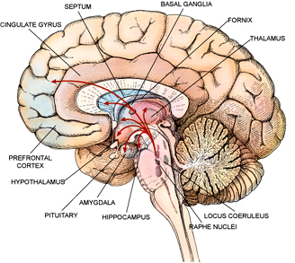
Outline
Assessment
Stepped care model
Psychological treatments
Drug treatments
Course
Relapse prevention

Slide 5
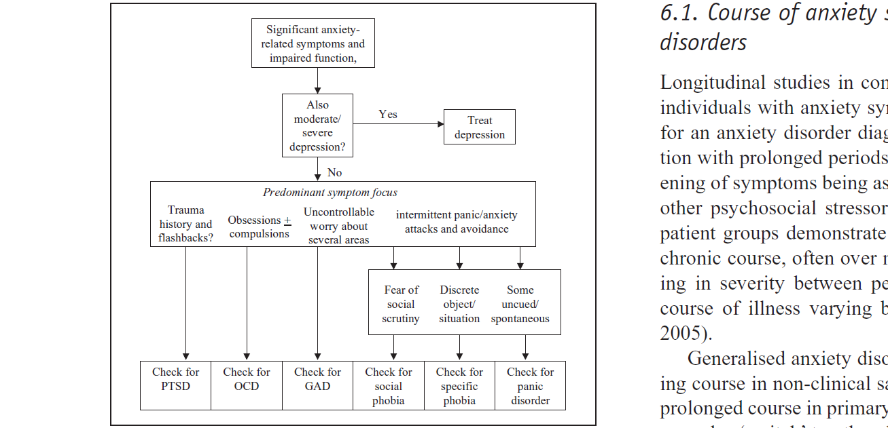
Assessment of anxiety symptoms

Slide 6
Management principles
Correct diagnosis
Co-morbidities
Rule out organic e.g. thyroid etc.
Effect of alcohol, substances and caffeine
Over the counter and prescribed medications
Psychoeducation, self-help
Psychological interventions
Medications

Slide 7
Stepped care approach (GAD) NICE 2015
Step4
inpatient/
CRHTT
CBT +drug
Treatment-refractory
Step 3:
High intensity CBT or drug
Inadequate response to step 2
Step 2:
Low intensity CBT, self-help and psychoeducational group
If no improvement after education
Step 1:
Identification and diagnosis
Education about treatment option

Slide 8
Step 1
Identification and Assessment :number, severity and duration of symptoms, the degree of distress and functional impairment
Education: over-the-counter medications, preparations and their potential problems.

Slide 9
Step 2
Low-intensity psychological interventions:
individual non-facilitated self-help
individual guided self-help
psychoeducational groups

Slide 10
Step 3
Individual high-intensity psychological intervention (HIPI): should be used as first line
Drug treatment – (discussed later)

Slide 11
Individual high-intensity psychological intervention (HIPI)
Offer either CBT or applied relaxation
CBT:
based on the treatment manuals used in the clinical trials for CBT or applied relaxation for GAD
delivered by trained and competent practitioners
consist of 12–15 weekly sessions

Slide 12
General principles of prescribing in Anxiety disorders
Severity of symptoms
Co-morbidities
SSRI - 1st line
12 weeks
Additional medications

Slide 13
Drug treatment for GAD
Antidepressants: SSRIs, SNRIs
Pregabalin
Other treatments: not licensed, weak evidence
Antipsychotics (like Quetiapine): monotherapy/augmentation
Beta blockers
Imipramine and Trazadone
Buspirone
Agomelatine

Slide 14
Drug treatment
Offer Sertraline first: cost-effective
If sertraline is ineffective, offer an alternative SSRI or
SNRI

Slide 15
Drug treatment
Cannot tolerate SSRIs or SNRIs, consider offering Pregabalin (Caution: Street value around addiction)
Benzodiazepine: during crises
Not to offer antipsychotic in primary care

Slide 16
Secondary Care
Marked functional impairment in conjunction with:
risk of self-harm or suicide or
significant comorbidity or
physical health problems or
self-neglect or
an inadequate response to step 3 interventions

Slide 17
Step 4
Specialist assessment of needs and risks
Treatments:
Combinations of psychological and drug treatments
Combinations of antidepressants
Augmentation of antidepressants with other drugs
Cautions: side effects, interaction

Slide 18
Panic Disorder
Thoughts-Images
I am having heart attack
Feelings
Anxiety terror ..etc
Thoughts-Images
That is confirm it- I really am dying”
Behaviour
Escape the situation
Avoid future trigger
Trigger
Physical sensation of anxiety

Slide 19
Panic Disorder
Step 1
Step 5
Care in specialist mental health services: review of medication, CBT by experienced therapist , support to carer. Referral to tertiary centre
Step 2
Step 3
Step 4
Recognition and diagnosis: differentiate from panic attack
Treatment in primary care: CBT/SSRI OR TCAs / Self help. Bibilotherapy based-CBT
Review and consideration of alternative treatments
Review and referral to specialist mental health services: combination of CBT and medication

Slide 20
Psychological Interventions
CBT should be used
Briefer CBT: around 7 hours in total with structured self-help materials

Slide 21
Drug treatment for Panic Disorder
SSRIs: first line.
Venlafaxine
TCAs: imipramine or clomipramine
Valproate (off license)
Avoid Benzos, propranalol and buspirone

Slide 22
Phobic Disorder
Psychological interventions:
Individual CBT
CBT-based supported self-help
Medication:
escitalopram or sertraline
deluxetine
phenelzine is of proven efficacy
(Social phobia : Most SSRI and Venlafaxine, moclobemide, pregabaline and gabapentin and olanzapine)
Short-term psychodynamic psychotherapy: if decline CBT and medications

Slide 23
Social Phobia : The Heimberg Model
Individual CBT
education about social anxiety
cognitive restructuring
graduated exposure
examination and modification of core beliefs
relapse prevention

Slide 24
Social Phobia : Short-Term Psychodynamic Psychotherapy
modify insecure attachments
focus on a core conflictual relationship theme
focus on shame
encouraging exposure to feared social situations
self-affirming inner dialogue
improve social skills.

Slide 25
Social Phobia : Treatment Resistance
Individual CBT in combination with antidepressant
Escitalopram or sertraline
There is emerging evidence for the efficacy of venlafaxine
phenelzine

Slide 26
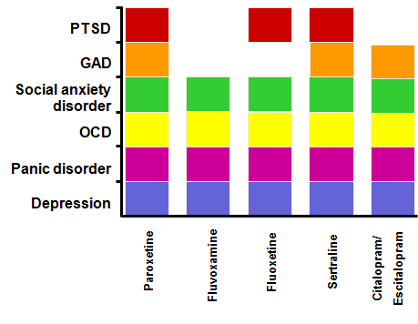
Evidence Base for SSRIs in Anxiety Disorders

Slide 27
Other Medications
Benzodiazepines: Acute treatment
Pregabaline: Acute treatment and relapse prevention of GAD and social anxiety.
Role of Augmentation of SSRI/SNRI in GAD
Agomelatine: Depression and GAD
Buspirone: Acute treat of GAD and more effective in patients not exposed to BDZs, safe.

Slide 28
Continuation of Medication for Relapse Prevention
GAD: 6-12 months
Social phobia: At least 6 months
PTSD: Up to 12 months
OCD: At least 12 months
Notes:
In GAD continue treatment for 6-12 months after response to acute treatment.
Continue treatment for at least 6 months beyond response in Social phobia.
In OCD treatment should be continued for at least 12 months but longer term treatment might be required to protect against relapse in most cases and treatment should not be routinely discontinued.

Slide 29
Factors Predicting a Good Outcome
Having a stable, supportive family life
Being young male
Having no co-morbid physical illness
Not receiving any psychotropic medication earlier in the course of illness

Slide 30
References
Baldwin DS, Anderson IM, Nutt DJ, Allgulander C et al, Evidence-based pharmacological treatment of anxiety disorders, post-traumatic stress disorder and obsessive-compulsive disorder: A revision of the 2005 guidelines from the British Association for Psychopharmacology Journal of Psychopharmacology 2014; 1–37.
British Association for Psychopharmacology - treatment of Anxiety disorders guidelineshttp://www.bap.org.uk/pdfs/Anxiety_Disorder_Guidelines.pdf5.
Bruce SE, Yonkers KA, Otto MW et al. Influence of Psychiatric Comorbidity on Recovery and Recurrence in Generalized Anxiety Disorder, Social Phobia, and Panic Disorder: A 12-Year Prospective Study Am J Psychiatry 2005;162:1179-1187
Christmas D, Davies S, Nutt D. Psychopharmacology of anxiety disorder, Ebrainjnc.cpm
Naomi A. Fineberg , Brigitte Tonnoir , Ole Lemming , Dan J. Stein. Escitalopram prevents relapse of obsessive-compulsive disorder. European Neuropsychopharmacology (2007)
NICE Guidelines- GAD and panic disorder (Quick reference) http://www.nice.org.uk/nicemedia/live/13314/52601/52601.pdf3.
Taylor, Paton, Kapur (2009). The Maudsley Prescribing guidelines, 10th Edition, Informa Healthcare.

Slide 31
GA Module: Anxiety Disorders
MCQ
1. Venlafaxine is not licenced for which of the following indications?
A Social anxiety
B PTSD
C Panic disorder
D Depression +/- Anxiety
E GAD
Notes:
Answer: E- all of the above

Slide 32
GA Module: Anxiety Disorders
MCQ
1. Venlafaxine is not licenced for which of the following indications?
A Social anxiety
B PTSD
C Panic disorder
D Depression +/- Anxiety
E GAD
Notes:
Answer: E- all of the above

Slide 33
GA Module: Anxiety Disorders
MCQ
2. The following are TRUE of the pharmacokinetics of benzodiazepines:
A When long-acting they have long elimination half-life.
B When short-acting they have a small distribution volume.
C When long-acting they have no active metabolites
D When short-acting they have high accumulation
E Benzodiazepines with a half-life of 12 hours tend to be used as anxiolytics.
Notes:
Answer: E- all of the above

Slide 34
GA Module: Anxiety Disorders
MCQ
2. The following are TRUE of the pharmacokinetics of benzodiazepines:
A When long-acting they have long elimination half-life.
B When short-acting they have a small distribution volume.
C When long-acting they have no active metabolites
D When short-acting they have high accumulation
E Benzodiazepines with a half-life of 12 hours tend to be used as anxiolytics.
Notes:
Answer: E- all of the above

Slide 35
GA Module: Anxiety Disorders
MCQ
3. Which of the following statements is FALSE about the effects of hypnotics on sleep?
A Benzodiazepines supress stage IV sleep.
B With chronic Benzodiazepines use suppression of REM sleep in the early part of the night occurs
C On withdrawal of Benzodiazepines a rebound increase above the ‘normal’ amount of REM sleep occurs.
D It may take up to 6 weeks to see a return to a normal sleep pattern on Benzodiazepine withdrawal.
E Barbiturates are more likely to suppress REM sleep than are Benzodiazepines.
Notes:
Answer: E- all of the above

Slide 36
GA Module: Anxiety Disorders
MCQ
3. Which of the following statements is FALSE about the effects of hypnotics on sleep?
A Benzodiazepines supress stage IV sleep.
B With chronic Benzodiazepines use suppression of REM sleep in the early part of the night occurs
C On withdrawal of Benzodiazepines a rebound increase above the ‘normal’ amount of REM sleep occurs.
D It may take up to 6 weeks to see a return to a normal sleep pattern on Benzodiazepine withdrawal.
E Barbiturates are more likely to suppress REM sleep than are Benzodiazepines.
Notes:
Answer: E- all of the above

Slide 37
GA Module: Anxiety Disorders
MCQ
4. With regards to the NICE guidelines for GAD, which of the following is FALSE?
A SSRIs (particularly Sertraline) are the first line medications.
B SNRIs are second line.
C If the patient cannot tolerate SSRI or SNRI, offer Pregabalin.
D Antipsychotic should be offered for the treatment of GAD in primary care.
E Do not offer a benzodiazepine for the treatment of GAD in primary or secondary care except as a short-term measure during crises
Notes:
Answer: E- all of the above

Slide 38
GA Module: Anxiety Disorders
MCQ
4. With regards to the NICE guidelines for GAD, which of the following is FALSE?
A SSRIs (particularly Sertraline) are the first line medications.
B SNRIs are second line.
C If the patient cannot tolerate SSRI or SNRI, offer Pregabalin.
D Antipsychotics should be offered for the treatment of GAD in primary care.
E Do not offer a benzodiazepine for the treatment of GAD in primary or secondary care except as a short-term measure during crises
Notes:
Answer: E- all of the above

Slide 39
5. With respect to the NICE guidelines for psychological intervention for GAD, which of the following is FALSE?
A CBT for people with GAD should be based on the treatment manuals used in the clinical trials of CBT for GAD.
B CBT for GAD usually consist of 12–15 weekly sessions (fewer if the person recovers sooner; more if clinically required), each lasting 1 hour.
C Practitioners providing high-intensity psychological interventions for GAD need not have regular supervision to monitor fidelity to the treatment model.
D If a person with GAD chooses a high-intensity psychological intervention, offer either CBT or applied relaxation.
E Consider providing all interventions in the preferred language of the person with GAD if possible.
Notes:
Answer: E- all of the above

Slide 40
5. With respect to the NICE guidelines for psychological intervention for GAD, which of the following is FALSE?
A CBT for people with GAD should be based on the treatment manuals used in the clinical trials of CBT for GAD.
B CBT for GAD usually consist of 12–15 weekly sessions (fewer if the person recovers sooner; more if clinically required), each lasting 1 hour.
C Practitioners providing high-intensity psychological interventions for GAD need not have regular supervision to monitor fidelity to the treatment model.
D If a person with GAD chooses a high-intensity psychological intervention, offer either CBT or applied relaxation.
E Consider providing all interventions in the preferred language of the person with GAD if possible.
Notes:
Answer: E- all of the above

Slide 41
GA Module: Anxiety Disorders
Any Questions?
Thank you.

