Slide 1

Perinatal Psychiatry
Evidence-based recommendations for psychotropic medications
in pregnancy and breastfeeding

Slide 2
Perinatal Psychiatry
Aims and Objectives
To develop an understanding of Evidence-based recommendations for psychotropic medication in pregnancy and lactation

Slide 3
Perinatal Psychiatry
Evidence-based recommendations for psychotropic medications
in pregnancy and lactation
With thanks to Dr Angelika Wieck and Dr Aaron McMeekin

Slide 4
Transfer of psychotropic medication to the fetus
All psychotropic drugs pass through placenta and are present in the amniotic fluid
The degree varies between drugs but little as yet known
Surveys estimate psychotropic medications taken in 21 – 33 percent of established pregnancies¹
¹ACOG Practice Bulletin: Clinical management guidelines for obstetrician-gynecologists number 92, April 2008 (replaces practice bulletin number 87, November 2007). Use of psychiatric medications during pregnancy and lactation.

Slide 5
Timing of exposure & potential adverse outcomes
Early pregnancy Major structural defects
Later pregnancy Minor structural defects
Functional defects (e.g. Valproate linked to developmental delay / Autism Spectrum Disorder)
Preterm delivery
Abnormal fetal growth
At delivery Neonatal toxicity
Neonatal withdrawal
Postnatal Cognitive and Behavioural effects

Slide 6
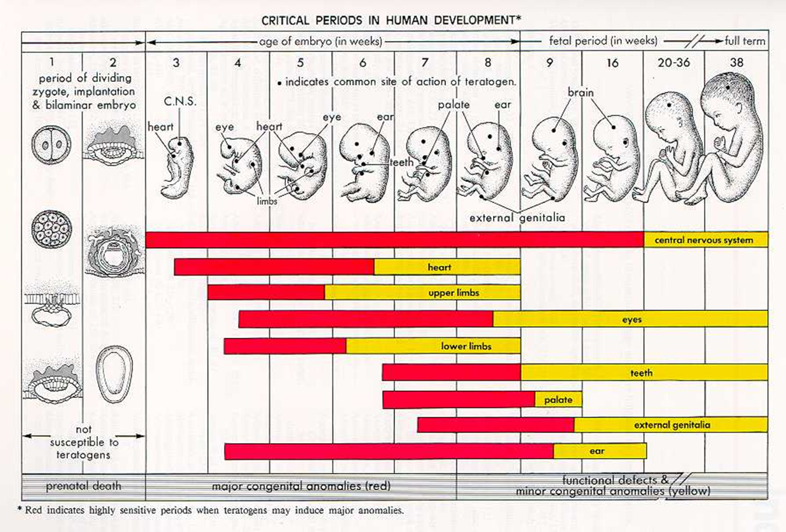
From http://www.cerebral-palsy.net/update2001/fetal.html

Slide 7
Investigating whether a drug is harmful to the developing child
Randomised, double-blind controlled trials not ethical
Next best levels of evidence:
pregnancy registers, population studies, cohort studies,
case series and control studies
There are a lack of well designed prospective comparative studies for psychotropic use in pregnancy¹
¹Einarson A1, Boskovic R. (2009). Use and safety of antipsychotic drugs during pregnancy. J Psychiatr Pract. 15(3):183-92.

Slide 8
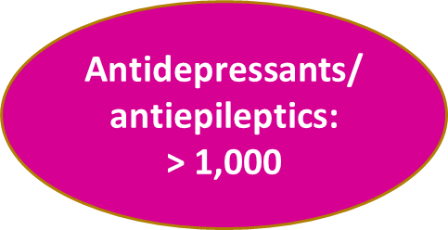

Sample Sizes Needed to test for congenital anomalies
Depends on outcome in question and what risk increases are assumed
Major congenital malformation rate is 3 % in general population:
1,000 exposed cases needed to test for doubling of risk¹
Specific malformation with a 0.1 % occurrence in general population (e.g. cleft palate):
even when including 4 controls for each exposure, almost 11,000 exposed cases are needed to test for a doubling of the effect².
Sample sizes in studies of first trimester exposure to individual psychotropic agents:
Sample sizes for studies of later pregnancy exposure are also often inadequate
¹European Medicines Agency (2008) http://www.ema.europa.eu/docs/en_GB/document_library/Scientific_guideline/2009/09/WC500003307.pdf
²Dellicour S, ter Kuile FO, Stergachis A (2008). PLoS Med 5(9): e187. doi:10.1371/journal.pmed.0050187

Slide 9
Quality of evidence
Many other factors confound pregnancy and infant outcomes
Little as yet known about untreated maternal mental illness, but preliminary insights point to an adverse effect (stress, life style, physical health, sleep, illness itself)
Conversely women with SMI (serious mental illness) are more likely to smoke, drink alcohol or use illicit substances in pregnancy¹
Studies control for different confounding factors – hampers comparison between studies
Epidemiological studies have the advantage of large numbers but lack accuracy of infant diagnoses and diagnostic bias
Research difficult to do !
¹McAllister-Williams et al (2017). British Association for Psychopharmacology consensus guidance on the use of psychotropic medication preconception, in pregnancy and postpartum 2017. Journal of Psychopharmacology, 31(5), pp.519-552.

Slide 10

WHO Lactation Strategy
WHO, 2003¹:
‘Infants should be exclusively breastfed for the first six months of life. Thereafter, to meet their evolving nutritional requirements, infants should receive nutritionally adequate and safe complementary foods while breastfeeding continues for up to two years of age or beyond.’
RCM (2018) have advised new mothers who formula feed to receive as much support as breastfeeding mothers
World Health Organization. Global strategy for infant and young child feeding. Geneva, 2003, World Health Organization.
Available at: http://www.who.int/child_adolescent_health/documents/9241562218/en/index.html.

Slide 11
Lactation
All psychotropic drugs are transferred into breast milk
Exposure during breastfeeding is usually much less than during pregnancy
Few data for most psychotropics.
Measure of exposure : relative infant dose (RID):
infant dose/kg bw : maternal dose/ kg bw
RID < 10% regarded as ‘relatively safe’ – Hale (2014) ¹
Most psychotropics are well below 10 %, but some exceptions
(Lithium levels range from 10 – 60% of maternal serum concentrations)
¹1Hale T Medications & Mother’s Milk. Hale Publishing. http://www.medsmilk.com/

Slide 12
Principles of treatment
There are no risk free options !
Optimize non-pharmacological treatments
Addressing substance misuse, unhealthy lifestyle and physical illness as important as minimising medication effects for infant outcome
Treatment decisions are highly individual – there is no right answer for everyone!
When choosing medication with the patient take into account:
Past response to treatment
Side effect profile
Individual preferences

Slide 13
Principles of treatment
Include partner / significant other in discussion
Always record discussion in patient data file !

Slide 14
Women with childbearing potential
Discuss with patient once a year –
How safe are the prescribed drugs in pregnancy ?
What are your plans for childbearing ?
Are you using contraception ?
Do you require family planning advice ?
Consider the patient’s ability to parent

Slide 15
Women with childbearing potential
2007: Less than a quarter of psychiatrists prescribing antiepileptic drugs or lithium ask women of childbearing potential whether they are pregnant or use adequate contraception^{1,2}
2015: Audits from Manchester and London shows only a small improvement³.
¹ Wieck et al Arch Womens Ment Health 2007; 10: 83-5
² James et al J Psychopharmacol 2007; 21: 815-9
³ Harper et al, Annual Scientific Meeting (Poster), Perinatal Faculty, London, November 2015

Slide 16
Principles of prescribing
(Preconception and in Pregnancy)
Avoid drugs with higher teratogenic risk
Avoid drugs with the least safety data
Avoid abrupt discontinuation on confirmation of pregnancy (unless it is valproate)
Avoid polypharmacy, if possible
Use lowest but still effective dose
Women who are obese or have poor diet should take folic acid (folate) at a high dose (5 mg)
Folic acid, at best, provides only partial protection re Valproate effects¹
¹Wieck, A. and Jones, S. (2018). Dangers of valproate in pregnancy. BMJ, p.k1609.

Slide 17
Principles of prescribing
(Preconception and in Pregnancy)
Teratogenic Risk
Estimated risk of major congenital malformations (greatest to least teratogenic)
  Valproate
  Carbamazepine
  Lithium
  Lamotrigine
  Antipsychotics
  Antidepressants

Slide 18
Pregnant women with a previous mental illness
Start perinatal care planning as early in pregnancy as possible
Refer to perinatal psychiatry specialist if available
Safety data change all the time – perinatal specialist
is up to date and can integrate new data with
specific clinical situation

Slide 19
Pregnant women with a previous mental illness
Identify risk factors for postnatal recurrence
Discuss stress reduction, sleep optimisation
Maximise postnatal support
Formulate detailed perinatal plan and distribute among all involved professionals
Pregnant women should be seen by psychiatrist
within two weeks of referral (NICE, antenatal
postnatal mental health guidelines, 2014)

Slide 20
Pregnant women with a previous mental illness
Inform obstetric team of psychotropic medication
Inform community midwife and health visitor of maternal medication – neonatal withdrawal may commence after discharge

Slide 21
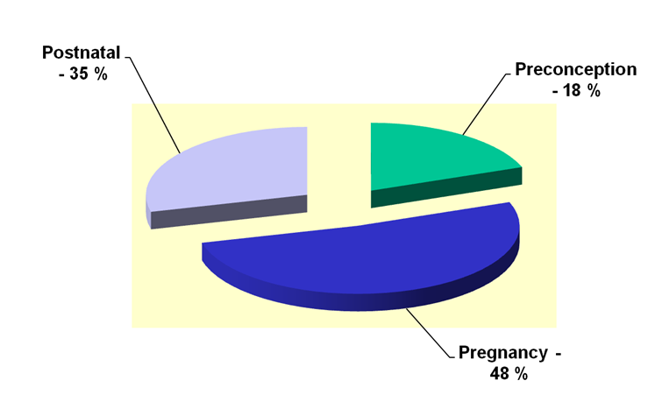
Childbearing status at first presentation in Manchester Perinatal Psychiatry Clinic

Slide 22
Evidence for reproductive safety of psychotropic drugs
Evidence changes evolve continually
Therefore prescribing practice must evolve in tandem to avoid evidence that can become quickly outdated
In UK 3 main bodies produce sets of guidelines
  National Institute for Health and Care Excellence (NICE)
  Scottish Intercollegiate Guidelines Network (SIGN)
  British Association for Psychopharmacology (BAP)
However Google Scholar may provide the latest papers

Slide 23
Neurodevelopment
Peng et al, 2013¹
Well-designed prospective study of 76 infants exposed to FGAs or SGAs in pregnancy, matched to 76 control children
Scores indicate delay in several cognitive domains (Bayley Scale of infant and toddler development) in early postnatal months
Scores normalized by 12 months postnatal
No difference at 12 months is consistent with findings in earlier studies^{2,3,4}
¹Peng et al. Psychopharmacology (Berl). 2013 Apr 5. [Epub ahead of print); ²Gentile S, Schizophr Bull 2010; 36: 518-44; ³Kris 1965, Curr Ther Res Clin Exp; 7: 785-9; ⁴Slone et al 1977, Am J Obstet Gynecol; 128: 486-8

Slide 24
Summary
Current evidence does not suggest that antipsychotics are major teratogens.
Small increase in major congenital anomalies (mostly cardiovascular, esp. septal defects) may be due to confounding factors. Larger samples and control for confounders is needed
Association with a small increase in babies small for gestational age and pre-term birth may also be associated with confounding factors
Possible association with 2X fold increase of gestational diabetes, possibly related to early pregnancy BMI. Further research needed.
NICE (2014)¹ recommends screening for gestational diabetes in all women taking antipsychotics in pregnancy
Possible association with 2X fold increase in stillbirth Requires further research
¹National Institute of Health and Care Excellence (2014) Clinical Practice Guideline 192

Slide 25
Antiepileptic drugs and congenital anomalies¹
Anomalies are more common at higher doses. Threshold uncertain
The teratogenic effect is independent
of seizure activity in pregnancy²
%
20
*
*
10
*
0
Valproate
Lamotrigine
Polytherapy
Unexposed controls
Any Anti-epileptic
Carbamazepine
¹Meador et al, Neurology 2008; 71(14):1109-17
²Fried et al, Drug Saf 2004; 27(3):197-202
(* = significant difference to non-epileptic controls)

Slide 26
 | Significant associations with | Risk of spina bifida
Valproate¹ | Spina bifida Hypospadias Cleft palate Atrial septal defects Polydactyly Craniosynostosis | OR: 12.7 (CI : 7.7 to 20.7)
Carbamazepine² | Spina bifida Cardiovascular anomalies ? | OR: 2.6 (CI : 1.2 to 5.3)
Lamotrigine³⁻⁷ | 1 study found increase in oral clefts from 7 : 10,000 to 7 : 1,000, subsequent studies did not confirm. Low teratogenicity compared with valproate but few comparisons with untreated infants yet
1. Jentink et al, N Engl J Med 2010 ; 362;23 2. Jentink et al, BMJ 2010;341:c6581; doi:10.1136/bmj.c6581 3. Holmes
et al , Neurology 2008; 70(22 Pt 2):2152-8. 4. Hunt et al, Neurology 2009; 72(12):1108. 5. Dolk et al, Neurology 2008;
71(10):714-22 6. Cunnington et al, Neurology 2011;76;1817-1823; 7. Tomson et al, Lancet Neurol 2011; 10: 609–17

Slide 27
Valproate: other neurodevelopmental disorders
Several earlier studies suggest association¹
Christensen et al (2013)² - Population study from Denmark
14 year follow up
Childhood autism : 2.50 % (adjusted hazard ratio: 5.2; 2.7-10.0)
Autism spectrum disorder: 4.42 % (adjusted hazard ratio: 2.9; 1.7-4.9)
Cohen et al (2013)³
At increased risk of ADHD diagnosis at age 6
Dose-relationships not yet sufficiently clarified^{4,5}
1.Bromley et al, J Neurol Neurosurg Psychiatry, 2013: 1-7. 2. Christensen et al, JAMA, 2013: 309(16): 1696-1704. 3. Cohen et al, Epilepsy Behav. , 2013 ; 29(2): 308–315 4. Perucca et al, Neurobiol. Dis. ,2014, http://dx.doi.org/10.1016/j.nbd.2014.05.011, 5. Wood et al , Epilepsia, 2015: 58 (7): 1047-55

Slide 28
Dietary folate supplementation– is it preventative ?
400 microgram daily recommended at general population level
for 3 months before and after conception to prevent congenital
anomalies, particularly neural tube defects
High doses (5mg daily) recommended for high risk families
NICE (2004, 2007) recommends 5mg folic acid in periconceptual period for women taking antiepileptic drugs.
Data from pregnancy registers and reviews:^{1,2,3,4}
Folate’s preventative effect of anomalies in women taking AEDs is at best uncertain. No protection seen in some studies.
Preventative effect of neurodevelopmental impairments unknown.
1. Wyszynski et al, Neurology 2005; 64(6):961-5 2. Morrow et al, J Neurol Neurosurg Psychiatry 2009; 80:506-511
3. Jentink et al, Pharmacoepidemiol Drug Saf 2010; 19: 803–807, 4. Bogdan et al, American Journal of Medical Genetics 2012, Part A, 2071-2090

Slide 29
Lithium
‘Lithium baby register’ (N=225) ¹
      18 (8%) babies had cardiovascular defects compared to
      1 % in general population
      6 (2.7 %) had Ebstein anomaly compared to 1 : 20,000 in
      general population
      Poor design
Recent reviews ^{2,3} :
      Still small body of subsequent data
      Original observations were most likely a significant
      overestimation
      But actual risk remains uncertain
      Evidence lithium causes the anomaly is uncertain⁴
1 Weinstein ,1980, Handbook of lithium therapy, pp. 421-9. MTP Press, Lancaster.
2 Yacobi and Ornoy. Isr J Psychiatry Relat Sci 2008; 45: 95–106,
³McKnight et al, Lancet. 2012 Feb 25;379(9817):721-8
⁴ Jones, I., Chandra, P., Dazzan, P. and Howard, L. (2014). Bipolar disorder, affective psychosis, and schizophrenia in pregnancy and the post-partum period. The Lancet, 384(9956), pp.1789-1799.

Slide 30
Lithium
Fetal or neonatal effects – case reports of ¹
      Cardiac arrhythmias, hypoglycaemia, diabetes insipidus, polyhydramnios, thyroid dysfunction, goitre, floppiness, lethargy, hepatic anomalies and respiratory difficulties
      Cases reported of maternal and neonatal toxicity
Neurobehavioural outcome² :
      5 year prospective study of 60 children showed no adverse effects when compared with their unexposed siblings
1 American College of Obstetricians and Gynecologists 2007, Practice Bullletin Number 87
2 Schou, Acta Psychyiatr Scan 1976; 54: 193-7

Slide 31
Summary for mood – stabilizers and recommendations
Valproate:
The concerns about the use of valproate in pregnancy have increased.
The administration of folate can only partially prevent harm to children
Valproate should not be used during the whole of pregnancy
European Medicines Agency (2018)¹ recommends that:
Valproate should not be used in pregnancy unless the women has a form of epilepsy that is unresponsive to other epileptic drugs
Valproate should not be prescribed to women of childbearing potential unless they follow a comprehensive pregnancy prevention programme (assessment of potential to become pregnant, pregnancy tests before and during treatment and counselling on risks and contraception
Patients may be required to have specialist reviews and complete a risk acknowledgement form every year
Valproate packing may carry a visual warning of the pregnancy risks and women will receive a warning card with each prescription
¹Wieck, A. and Jones, S. (2018). Dangers of valproate in pregnancy. BMJ, p.k1609.

Slide 32
Summary for mood stabilizers and recommendations
NICE ¹ :
Valproate must not be used in women and girls of childbearing potential (including young girls who are likely to need treatment into their childbearing years), unless other options are unsuitable and the pregnancy prevention programme is in place
Valproate and Carbamazepine should not be offered in pregnancy¹.
Lamotrigine: no recommendations regarding its use. If used, monitor serum levels frequently in pregnancy (tend to fall) and into the postpartum period
(increase again)
Lithium:
Only continue lithium in first trimester if switch to a safer drug
results in high risk of relapse
Otherwise replace lithium with an antipsychotic agent until
after delivery or until the 2nd trimester
Measure serum levels frequently, particularly in month before expected delivery date (for details see NICE guidance¹)
¹National Institute of Health and Care Excellence (2014) Clinical Practice Guideline 192

Slide 33
Antidepressants – neonatal issues
Persistent pulmonary hypertension of the newborn
SSRI exposure: odds ratio 2.50 (1.32 to 4.73) – meta-analysis by Grigoriadis et al, 2013¹
Effect seen after late pregnancy exposure only
Rare condition: number needed to harm : 286-351 for 1 additional case
¹ Grigoriadis et al (2013), BMJ, doi: 10.1136/bmj.f6932

Slide 34
Antidepressants – First trimester exposure
Little known about tricyclics, clomipramine has been associated with
a small increase in cardiovascular malformations
SSRIs – much more data, mostly from epidemiological studies
SSSRIs associated with small increase of cardiovascular anomalies
(relative risk for cardiovascular malformations 1.36, septal heart defects 1.40)¹
Data concerning small risks of other malformations is less consistent
Differences between SSRIs – inconsistent evidence except for paroxetine being probable the SSRI with the highest risks (may be associated with small absolute increase in congenital heart defects but results across other studies inconsistent with some finding no association)
¹Grigoriadis et al (2013) J Clin Psychiatry 74: e293-308

Slide 35
Antidepressants – pregnancy outcomes
Premature delivery
Inconsistent findings about association between antidepressants and pre-term delivery
Preterm delivery may be associated with timing of exposure (>3rd trimester)
Depression is also associated with preterm delivery

Slide 36
Antidepressants – poor neonatal adaptation
All antidepressants – (meta-analysis by Grigoriadis et al, 2013)
Poor neonatal adaptation symptoms (OR 5.07)
Neonatal respiratory distress (OR 2.20)
Neonatal tremors (OR 7.89)
Affects 1:3 babies, but mild and transient, rarely needs more than monitoring
¹ Grigoriadis et al (2013) J Clin Psychiatry, 74(4): e309-e320

Slide 37
SSRIs – autism spectrum disorder
Meta-analysis by Man et al (2014)
Small increase (Odds ratio 1.81, CI 1.47-2.24)
Role of confounding factors unknown, 1 study found higher rate in untreated siblings²
Observational studies suggest risk of ASD secondary to SSRIs and SNRIs is small to negligble
Confounding factor may be that women with SMI have higher risk of children with ASD (Unipolar major depression may confer genetic risk for ASD)
¹ Man et al (2014) Neurosic Biobehav Rev 75: 1088-95, ²Sorensen et al (2013) Clinical Epidemiology, 5: 449-459

Slide 38
Antidepressants – other neurobehavioural development after intra-uterine exposure
No effects seen with tricyclic antidepressants, SSRIs and venlafaxine in early childhood^{1,2}
1 study: weak association of SSRI exposure with delayed motor development at age 3 but not clinically significant³
¹ Nulman et al (2012) Am J Psychiatry, 169: 1165-74
^{,2}Santucci et al (2014) J Clin Psychiatry 75(10):1088-95
³Handal et al (2015) BJOG, doi: 10.1111/1471-0528.13582

Slide 39
Prescribing to breastfeeding mothers
Antipsychotics:
  Avoid clozapine (agranulocytosis)
Mood stabilizers:
  Don’t use lithium
  Don’t use valproate or carbamazepine
Antidepressants
  NICE (2014) no longer recommends sertraline and paroxetine
  Differences between drugs appear to be small
Advise mother to monitor baby for side effects (sedation, muscle tone, other side-effects) – discuss with community midwife/health visitor/ GP if in doubt

Slide 40
GA Module: Perinatal
MCQ
1. During pregnancy the following physiological changes occur
Plasma volume markedly increases and eGFR increases
Plasma volume markedly decreases and eGFR increases
Plasma volume markedly increases and eGFR decreases
Plasma volume markedly decreases and eGFR decreases
There is no change in either plasma volume or eGFR

Slide 41
GA Module: Perinatal
MCQ
1. During pregnancy the following physiological changes occur
Plasma volume markedly increases and eGFR increases
Plasma volume markedly decreases and eGFR increases
Plasma volume markedly increases and eGFR decreases
Plasma volume markedly decreases and eGFR decreases
There is no change in either plasma volume or eGFR
Notes:
Plasma vol increases by 10-15% at 6-12 weeks then expands rapidly until 30-34 weeks. Renal blood flow increases by 30-50% and results in increased eGFR causing a decrease in plasma levels of urea and creatinine

Slide 42
GA Module: Perinatal
MCQ
2. Which of the following is NOT associated with exposure to SSRIs in the Perinatal period?
Perinatal Death
Persistent Pulmonary Hypertension of the Newborn
Postpartum haemorrhage
Poor neonatal adaptation syndrome
Preterm birth

Slide 43
GA Module: Perinatal
MCQ
2. Which of the following is NOT associated with exposure to SSRIs in the Perinatal period?
Perinatal Death
Persistent Pulmonary Hypertension of the Newborn
Postpartum haemorrhage
Poor neonatal adaptation syndrome
Preterm birth

Slide 44
GA Module: Perinatal
MCQ
3. Which of the following statements is TRUE regarding NICE guidelines?
Benzodiazepines can be offered in pregnancy for medium term treatment of anxiety
Consideration of medication dose changes do not have to be made during pregnancy
If this is a first pregnancy a women’s previous response to medication should not influence the choice of antidepressant (being pregnant dictates the choice)
Lithium can be continued if the women is at high risk of relapse and an antipsychotic is unlikely to be effective
Measure prolactin levels in women planning pregnancy who are taking a prolactin raising antipsychotic as raised prolactin increases the chances of conception
Notes:
Benzodiazepines for short term only / Physiological changes may mean medication changes in pregnancy / Previous response should be a central indicator of choice of medication / Prolactin decreases the chances of conception

Slide 45
GA Module: Perinatal
MCQ
3. Which of the following statements is TRUE regarding NICE guidelines?
Benzodiazepines can be offered in pregnancy for medium term treatment of anxiety
Consideration of medication dose changes do not have to be made during pregnancy
If this is a first pregnancy a women’s previous response to medication should not influence the choice of antidepressant (being pregnant dictates the choice)
Lithium can be continued if the women is at high risk of relapse and an antipsychotic is unlikely to be effective
Measure prolactin levels in women planning pregnancy who are taking a prolactin raising antipsychotic as raised prolactin increases the chances of conception

Slide 46
GA Module: Perinatal
MCQ
4. Which of the following statements is TRUE?
Valproate is associated with reduced fertility in women and men
Taking Folic acid 5mg with Valproate will reduce teratogenicity
Valproate monotherapy is not associated with an increased risk of Attention Deficit Hyperactivity Disorder
Valproate monotherapy only affects the child in the 1st and 3rd trimester
Valproate passes in higher concentrations than Lamotrigine in breastmilk
Notes:
Answer: D- Amisulpride

Slide 47
GA Module: Perinatal
MCQ
4. Which of the following statements is TRUE?
Valproate is associated with reduced fertility in women and men
Taking Folic acid 5mg with Valproate will reduce teratogenicity
Valproate monotherapy is not associated with an increased risk of Attention Deficit Hyperactivity Disorder
Valproate monotherapy only affects the child in the 1st and 3rd trimester
Valproate passes in higher concentrations than Lamotrigine in breastmilk

Slide 48
GA Module: Perinatal
MCQ
5. Which of the following is TRUE regarding breastfeeding?
Patients with postpartum mental health disorders who require pharmacotherapy should generally be discouraged from breastfeeding
All psychotropic medications are transferred to breast milk in varying amounts
Psychotropics should be chosen with regard to longer half life and less protein binding
Mothers should change their pregnancy medication for breastfeeding
Methadone and Nicotine Replacement Therapy are incompatible with breastfeeding

Slide 49
GA Module: Perinatal
MCQ
5. Which of the following is TRUE regarding breastfeeding?
Patients with postpartum mental health disorders who require pharmacotherapy should generally be discouraged from breastfeeding
All psychotropic medications are transferred to breast milk in varying amounts
Psychotropics should be chosen with regard to longer half life and less protein binding
Mothers should change their pregnancy medication for breastfeeding
Methadone and Nicotine Replacement therapy are incompatible with breastfeeding

Slide 50
Thank you

