Slide 2
Mood Disorders in Older Adults
Aims and Objectives
Understand the epidemiology, aetiology and the classification of mood disorders in the elderly.
Understand how mood disorders present in the elderly (including psychotic features), the assessment process including neuroimaging and the use of rating scales and the principles of treatment/management including treatment resistance.
Understand more about the risk of suicide in the elderly

Slide 3
Mood Disorders in Older Adults
To achieve this
Case Presentation
Journal Club
555 Presentation
Expert-Led Session
MCQs
Regional academic day for bipolar affective disorder in later life
Please sign the register and complete the feedback

Slide 4
Old Age Module
Expert Led Session
Depression in Older Adults
Dr Cathy Symonds
Consultant Older Adult Psychiatrist
Greater Manchester West MH Foundation Trust

Slide 5
Topics covered in this presentation
Epidemiology of affective disorders and suicide
Classifications/ presentations mood disorders in later life
Neuroimaging
Use of rating scales
Treatment including in treatment resistant depression
Suicide in elderly

Slide 6
Epidemiology
Older adults - likely to report symptoms and co-morbid conditions make diagnosis difficult
In 2011, point prevalence of DSM-IV major depression in those >75 in the UK was between 4.6% and 9.3% (Luppa, Sikorski, Luck, et al. 2012).
Rates for sub-threshold depressive symptoms 4.5% to 37.4% (Meeks, Vahia, Lavretsky, et al. 2011).
Female incidence typically higher than male.
Combined suicide rate for over 60s is 15 per 100,000 (Office for National Statistics, 2016)

Slide 7
Risk factors -Late life depression
Divorced or widowed marital status
Low educational level
Poor self-rated health status
Functional impairment
Multi-domain Mild Cognitive Impairment (but beware of mistaking apathy with depression)
Stressful life events and poor social network
Carer role
Bereavement
Social isolation / loneliness
(Luppa M et al 2012)

Slide 8
Personality attributes in late life depression
Obsessional traits related to late life depression (Post 1972)
Avoidant and dependent personalities more prone to late life depression (Abrams et al 1987)
Cluster C personalities (Avoidant / Dependent / Obsessional Personalities) – experience more dysfunction and likely to respond to treatment in late life depression
(Morse and Robins -2005)

Slide 9
Classification Diagnostic Criteria (ICD-10/ DSM-V)
ICD-10 at least 4 out of 10 and DSM-V 5 out of 9 symptoms
ICD-10 at least 2 and DSM-V at least 1 of low mood, loss of interest/pleasure, loss of energy
Two week history of consistent symptoms, sufficient severity, most of everyday.
NICE guidelines use DSM-V
‘Dysthymic disorder’ removed - now included under ‘persistent mood disorder with chronic depression’.
Bereavement exclusion removed from major depressive disorder DSM-V

Slide 10
Key differences in presentations
Core symptoms of major depression (low mood, anhedonia and loss of energy) are similar across the lifespan.
Somatic concerns (hypochondriasis) may predominate, which can be challenging in older patients at risk of serious illness and/or with co-morbid physical problems. Hypochondriacal delusions are often prominent and easily overlooked.
Psychotic symptoms in late-life depression are more common than at younger ages.
Biological symptoms may be also be explained by co-morbid diseases eg chronic pain, making diagnosis more challenging

Slide 11
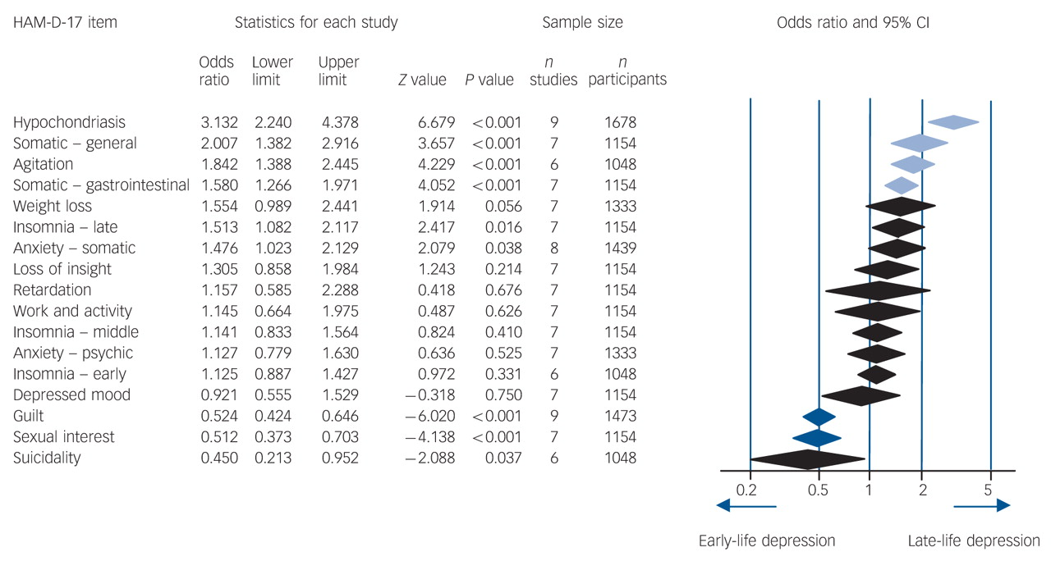

Hegeman, J.M., Kok, R.M., Van der Mast, R.C. and Giltay, E.J., 2012. Phenomenology of depression in older compared with younger adults: meta-analysis. The British Journal of Psychiatry, 200(4), pp.275-281.
Notes:
Forest plot of overall odds ratios (and their 95% confidence intervals as the extremes of the diamonds) comparing early-life and late-life occurrence of every item of the 17-item Hamilton Rating Scale for Depression (HAM-D-17)
Forest plot of overall odds ratios (and their 95% confidence intervals as the extremes of the diamonds) comparing early-life and late-life occurrence of every item of the 17-item Hamilton Rating Scale for Depression (HAM-D-17). Darker blue diamonds indicate the items are more prevalent and/or severe in younger patients, and the lighter blue diamonds that the items are more prevalent and/or severe in older patients.

Slide 12
Memory and mood
Subjective memory complaints are:
common
sometimes hypochondriacal
often labelled ‘pseudodementia’.
The current preferred term for pseudodementia is ‘depression-executive dysfunction syndrome’ (Alexopoulos et al 2012)
Depressive cognitive biases, e.g. minimisation or selective abstraction can also cause clinical problems.

Slide 13
Late Life Depression- Pathophysiology
Biogenic amines hypothesis
Dopamine pathways
CRF,TRH, GHRH, HPA axis abnormalities
Immune and inflammatory responses-prolonged exposure to glucocorticoids.
Structural brain changes: cortical atrophy, frontal lobe atrophy.
White matter changes and small vessel disease (vascular depression)
Other structural brain diseases can cause depressive symptoms (eg Parkinson’s disease, stroke disease, PSP etc). Cerebral autosomal dominant arteriopathy with subcortical infarcts and leukoencephalopathy (CADASIL) initially presents with depression, as can most other dementias
Myocardial infarctions linked to depression but unclear mechanism (SADHART study)

Slide 14
Vascular Depression
Vascular depression hypothesis states that depression may be caused by ischaemic lesions especially in limbic/ prefrontal region
(Alexopoulos 1997)
Presentation
Psychomotor retardation
Less guilt
Poorer insight
Limited depressive symptoms
More cognitive impairment and disability
Fluency and naming impaired
Homocysteine depression hypothesis.
Elevated levels of homocysteine lead to cerebral vascular disease and neurotransmitter deficiency, which then cause depressed mood

Slide 15
Management - history
Full history, mental state, social history, drug and substance history
“The hidden addict” (RCPsych report) reports that many older patients labelled as depressed actually have a primary substance misuse problem, usually alcohol but also prescribed medications plus street drugs.
Prescribed medication (eg beta-blockers, steroids, tamoxifen) can cause depression
Full medical history and focussed examination.
Cognitive screening tool such as mini-ACE, MMSE, MoCA, ACE-III etc
Consider frontal lobe tests

Slide 16
Management - investigations
Suggested ‘routine’ tests (in addition to a physical examination) for depression include:
FBC
U&Es; bone profile
TFTs
erythrocyte sedimentation rate (ESR) and/or C-reactive protein (CRP) (ESR can be raised in vasculitis with a minimally raised or normal CRP).
If indicated:
Gamma-GT
B12 & folate
LFTs
autoantibody screen
HIV antibodies
Neuroimaging
EEG.

Slide 17
Rating scales
NICE recommends - objective and allow for progress over time (NICE, 2009)
The Geriatric Depression Scale (GDS) has many formats and translations
The Montgomery Äsberg Depression Rating Scale (MADRS) can guide treatment by helping to indicate severity. It is observer rated.
The Cornell Scale for detecting depression in dementia uses observational data and is administered to a caregiver (Alexopoulos, Abrams, Young, et al. 1988). It takes a little longer (15–20 minutes) than the GDS, but is more specific.
Mottram, Wilson, Ashworth et al (2002) showed that a score of 16 and above on the Hamilton Rating scale for Depression (HDRS) or 21 on the MADRS were associated with a depressive disorder likely to benefit from medication.
Other scales are available and a popular in MCQ questions!

Slide 18
Depression-Neuroimaging
Areas of the brain implicated in late-life depression.
Anterior cingulate cortex (ACC) – small volume
Orbitofrontal cortex (OFC) – smaller volumes related to late life depression (includes limbic and basal ganglia areas)
Hippocampus – reduction in volume found in depressed elderly
Severity of WM hyperintensities – more in LOD compared to early onset depression suggesting varying aetiologies – controversial?

Slide 19
Depression: functional neuroimaging
Dorsal cingulate gyrus, middle and dorsolateral prefrontal cortex (DLPFC), insula, and superior temporal gyrus
Hypoactive at rest during negative mood states
Activity increases with SSRI treatment.
Cortical-limbic network-the medial and inferior frontal cortex and basal ganglia
Overactive at rest and during induction of negative mood states.
Activity reduces with antidepressant treatment.

Slide 20
Treatment of late life depression
MDT and patient centred approach
Well informed patient - wishes and choices about treatment considered at all stages.
Reviewing medication and physical illnesses contributing to presentation.
Explaining treatment modalities in detail.
Comprehensive Care plan provided to patients & carers
Avoid excluding a cause (e.g. HIV, alcohol) or a treatment (e.g. psychotherapy) based on age alone.

Slide 21
Aim of treatment
No different to younger adults
Minimise risks
Achieve remission in acute phase
Assist in functioning to pre-morbid level
Treatment of co-morbid physical health issues
Maintain remission and prevent future relapses

Slide 22
Psychosocial interventions
No evidence that psychotherapy less effective in cognitively intact later life patients
Remains first line in mild-moderate depression as per NICE
Less side effects than medication
Less rigorous and/or behavioural approaches should be tried together with medication eg befriending schemes, reducing loneliness, day centres etc.

Slide 23
Psychosocial interventions
Physical activity with antidepressants -more efficacious for MD compared to medication alone.
(Mura G.2013),(Pereira D.S. 2013),(Tony G. 2013)
Exercise shown to help with depression in long term care. (OPERA TRIAL-Underwood M 2011)
Listening to music can help older people to reduce their depression level.(Chan M.F. 2012)

Slide 24
Pharmacological Intervention
Consideration to be given to current physical health issues which can affect pharmaco-kinetic response
Ensuring safe prescribing-noting drug interactions.
Minimising polypharmacy.
Monitor risk of delirium with medication (esp tricyclics) and hyponatraemia (SSRI’s most likely to cause; mirtazapine, duloxetine & moclobemide least likely to cause)
SSRIs – upper GI bleed and spinal fractures

Slide 25
Pharmacological Intervention
Sertraline does not effect QTc (SADHART) but reduce dose of citalopram in elderly (max 20mg; max dose of escitalopram 10mg)
Sedatives increase risk of falls.
Consider stopping co-prescribed medication that may cause depression (eg beta-blockers, opiates, etc )if safe to do so

Slide 26
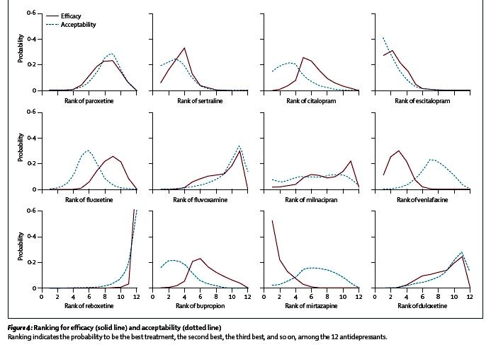
Ranking of efficacy and dropouts – network meta-analysis
Cipriani et al 2009
4: Sertraline
2: Escitalopram
3: Venlafaxine
1: Mirtazapine
Notes:
Summary
Background Conventional meta-analyses have shown inconsistent results for effi cacy of second-generation
antidepressants. We therefore did a multiple-treatments meta-analysis, which accounts for both direct and indirect
comparisons, to assess the eff ects of 12 new-generation antidepressants on major depression.
Methods We systematically reviewed 117 randomised controlled trials (25 928 participants) from 1991 up to
Nov 30, 2007, which compared any of the following antidepressants at therapeutic dose range for the acute treatment
of unipolar major depression in adults: bupropion, citalopram, duloxetine, escitalopram, fl uoxetine, fl uvoxamine,
milnacipran, mirtazapine, paroxetine, reboxetine, sertraline, and venlafaxine. The main outcomes were the proportion
of patients who responded to or dropped out of the allocated treatment. Analysis was done on an intention-to-treat
basis.
Findings Mirtazapine, escitalopram, venlafaxine, and sertraline were signifi cantly more effi cacious than duloxetine
(odds ratios [OR] 1·39, 1·33, 1·30 and 1·27, respectively), fl uoxetine (1·37, 1·32, 1·28, and 1·25, respectively),
fl uvoxamine (1·41, 1·35, 1·30, and 1·27, respectively), paroxetine (1·35, 1·30, 1·27, and 1·22, respectively), and
reboxetine (2·03, 1·95, 1·89, and 1·85, respectively). Reboxetine was signifi cantly less effi cacious than all the other
antidepressants tested. Escitalopram and sertraline showed the best profi le of acceptability, leading to signifi cantly
fewer discontinuations than did duloxetine, fl uvoxamine, paroxetine, reboxetine, and venlafaxine.
Interpretation Clinically important diff erences exist between commonly prescribed antidepressants for both effi cacy
and acceptability in favour of escitalopram and sertraline. Sertraline might be the best choice when starting treatment
for moderate to severe major depression in adults because it has the most favourable balance between benefi ts,
acceptability, and acquisition cost.

Slide 27
Treatment phases
Acute phase-initial phase with signs of improvement and remission –usually weeks and tends to be longer in elderly
Continuation phase-second phase to prevent relapse-usually months. At least 6 months after remission (NICE)
Maintenance Treatment-prevention of future episodes –usually years. At least 2 years after remission in recurrent depresion (NICE)
Beware of under-treating patients e.g. patients ‘stuck’ in partial remission, poor compliance, suboptimal dosing etc
Have a step wise plan (see STAR*D study) and approach your treatment in a logical, holistic and evidence based way

Slide 28
Augmentation options
SSRI with Lithium
SSRI with Mirtazapine
SSRI with Venlafaxine
SSRI with TCA
Mirtazapine with Venlafaxine

Slide 29
Augmentation strategies
Antidepressants + antipsychotics - evidence limited in elderly. Reserve for psychotic depression, anxious or agitated depression.
Acetylcholinesterase inhibitors- not shown to be efficacious in combination with anti-depressants. (McDermott C.L.2012)
Lithium augmentation shown to be the most useful in systematic review in refractory depression.(Cooper et al 2011)
Caution with lithium in elderly as lower end of treatment range is safer (0.4-0.6).

Slide 30
ECT
Highly effective, safe and well tolerated (Geduldig, E.T., Kellner, C.H.2016)
Effective in acute phase with high risk
Rapidly acting to achieve remission (H. P. Spaans et al. (2015)
Bilateral ECT more effective than unilateral treatment (Bjolseth T.M. 2015)
Continuation/maintenance ECT an option for some

Slide 31
ECT
More cognitive impairment evident with bilateral.
Right unilateral ultra brief (RUL-UB) ECT with venlafaxine is relatively cognitively safe (Lisanby et al 2020)
Prone to high relapse rate after initial remission.
Continued use of antidepressant recommended to achieve long term remission.
ECT remains a standard and vital treatment for their most seriously ill in the geriatric age group (Kellner etal 2015)

Slide 32
Social interventions
Psychosocial interventions have a small but statistically significant effect in reducing depressive symptoms among older adults (Forsman AK 2011)
A three-month outdoor activity intervention shown to improve mood among older people with severe mobility limitations. (Rantakokko etal 2015)

Slide 33
Prognosis
Greater risk of relapse compared to young population.
Poor prognosis indicated by
Slow initial recovery
Chronic depression
Medical comorbidity
Cerebrovascular disease
Dementia
Poor social support

Slide 34
Suicide Risk - Late Life Depression
Among those who attempt suicide, elderly are the most likely to die.
In adolescence, risk of attempted to completed suicides 200:1
Risk for the general population -from 8:1 to 33:1.
Risk for elderly 4:1
4 times increased risk of self harm controlling for age, sex, and physical health than controls
Higher score on Geriatric Depression Scale associated with early death by suicide

Slide 35
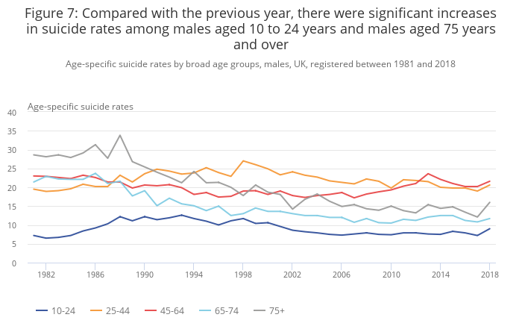
Suicide across the ages (Office for National Statistics, 2018)

Slide 36
Suicide and late life depression
Increased suicide risk and non-suicide mortality.
Elderly with suicidal thoughts -more likely to act on them and successfully commit suicide than their younger counterparts.
Older age is significantly associated with more determined and planned self-destructive acts and with fewer warnings of suicidal intent.
Most common methods
firearms
hanging
self-poisoning
falls from height

Slide 37
Take home messages
Physical comorbidity and psychosocial stressors are key factors in later life depression, making diagnosis more challenging.
Cognitive impairments, dementia and ‘pseudo-dementia’ are important considerations.
Treatment should be logical, holistic and stepwise.
Suicide is declining in the elderly but is still a major preventable cause of death.

Slide 38
Old Age Module
MCQs
The features suggestive of depression-executive dysfunction syndrome would include all except:
There is a long history of memory impairment and difficulty with ADLs
The patient complains of poor memory
Assessment of cognitive function often results in 'don't know answers'
The onset is fast
There is often a history of depression or an identifiable precipitant

Slide 39
Old Age Module
MCQs
The features suggestive of depression-executive dysfunction syndrome would include all except:
There is a long history of memory impairment and difficulty with ADLs
The patient complains of poor memory
Assessment of cognitive function often results in 'don't know answers'
The onset is fast
There is often a history of depression or an identifiable precipitant

Slide 40
Old Age Module
MCQs
An 84 year old lady presents with severe depression. She had a myocardial infarction 3 months ago and her QTc is 490ms. Which antidepressant would be the safest option?
Sertraline
Mirtazapine
Paroxetine
Citalopram
Duloxetine

Slide 41
Old Age Module
MCQs
An 84 year old lady presents with severe depression. She had a myocardial infarction 3 months ago and her QTc is 490ms. Which antidepressant would be the safest option?
Sertraline
Mirtazapine
Paroxetine
Citalopram
Duloxetine

Slide 42
Old Age Module
MCQs
An 87 year old man has lost his wife recently. Which of the following clinical features would most suggest that this was an abnormal grief reaction?
Loss of sleep
Loss of appetite
Laying the dining table for the deceased at meal times
Anxiety
Suicidal ideation

Slide 43
Old Age Module
MCQs
An 87 year old man has lost his wife recently. Which of the following clinical features would most suggest that this was an abnormal grief reaction?
Loss of sleep
Loss of appetite
Laying the dining table for the deceased at meal times
Anxiety
Suicidal ideation

Slide 44
Old Age Module
MCQs
Which is the not a feature of serotonin syndrome?
Blurred vision
Confusion
Akathisia
Elevated white cells
Hypomimia

Slide 45
Old Age Module
MCQs
Which is not a feature of serotonin syndrome?
Blurred vision
Confusion
Akathisia
Elevated white cells
Hypomimia

Slide 46
Old Age Module
MCQs
Which rating scale is most helpful in detecting depression in people with moderate dementia?
Cornell
MMSE
GDS
AMTS
Hamilton Rating Scale

Slide 47
Old Age Module
MCQs
Which rating scale is most helpful in detecting depression in people with moderate dementia?
Cornell
MMSE
GDS
AMTS
Hamilton Rating Scale

Slide 48
Old Age Module
MCQs
You have a patient on lithium with a consistently elevated blood pressure. What is your most appropriate action?
Start amiloride
Lithium must be stopped
Start furosemide
Start lisonopril
Start candesartan

Slide 49
Old Age Module
MCQs
You have a patient on lithium with a consistently elevated blood pressure. What is your most appropriate action?
Start amiloride
Lithium must be stopped
Start furosemide
Start lisonopril
Start candesartan

Slide 50
Any Questions?
Thank you
If you have any feedback on the content of this presentation please email Dr Anthony Peter, Older Adult Module Lead
Anthony.Peter@lancashirecare.nhs.uk

