Slide 1

Eating Disorders
Dr Katharina Junejo and Dr Hilary Strachan: Consultant Child and Adolescent Psychiatrists
Updated by Dr Rachel Elvins, Consultant Child and Adolescent Psychiatrist

Slide 2
Aims
Diagnostic criteria for eating disorders, in particular Anorexia and Bulimia Nervosa
Psychopathology of eating disorders
Medical management including re-feeding syndrome

Slide 3
Changes in DSM V classification: 2013
The merging of feeding and eating disorders into a single grouping with categories applicable across age groups
Diagnosis can be made on the basis of behaviours (e.g. parental report of excessive exercise) that indicate fear of weight gain or other underlying fears or beliefs
Broadening of the criteria for the diagnosis of anorexia nervosa and removing the requirement for amenorrhoea
Inclusion of binge eating disorder as a specific category defined by subjective or objective binge eating in the absence of regular compensatory behaviour
Introduction of a newer term, ‘avoidant/restrictive food intake disorder’ (ARFID), to classify restricted food intake in children or adults that is not accompanied by psychopathology related to body weight and shape (Bryant-Waugh 2010).

Slide 4
Anorexia Nervosa: ICD 10
Weight loss or in children lack of weight gain, body weight 15% below expected BMI
Self induced weight loss by avoiding fattening food
Body image distortion with dread of fatness as intrusive, overvalued idea and patient imposes a low weight threshold
Endocrine disorder involving hypothalamic-pituitary-gonadal axis: amenorrhoea, in men: loss of sexual interest. Exception: if taking the pill
If prepupertal: delayed development
Notes:
Diagnosis based on maintenance of low weight as results of over evaluation of the self in terms of weight and shape. Weight loss attained and sustained by insufficient food intake and increase in activity.
However, BMI limited utility as changes in young people. Useful in tracking changes over time, useful median BMI (dividing actual BMI by 50th BMI for age/sex).
2 different types: binging/purging type (vomiting, laxatives), restricting type

Slide 5
AN: characteristics
The discrepancy between weight and perceived body image is key to the diagnosis of anorexia; anorexic patients delight in their weight loss and express a fear of gaining weight
Have changes in hormone levels which, in females, result in amenorrhea (if the weight loss occurs before puberty begins, sexual development will be delayed and growth might cease)
Feel driven to lose weight because they experience themselves as fat, even when at a subnormal weight
Intensely afraid of becoming fat and preoccupied with worries about their body size and shape
Direct all their efforts towards controlling their weight by restricting their food intake, may self induce vomiting, misuse laxatives or diuretics (purging behaviors), exercises excessively or misuse appetite suppressants
Notes:
Patients may deny AN cognitions and express a desire to regain weight.

Slide 6
Epidemiology
Lifetime prevalence (adolescent girls) by age 20 was 0.8% for anorexia nervosa, 2.6% for bulimia nervosa, 3.0% for binge eating disorder, 2.8% for atypical anorexia nervosa (Stice et al 2013)
1:200 girls at age 16
Common age of onset at age 15 (range 9-24)
Females ten times more often affected than males
Highest mortality (cardiac arrhythmias and suicide) of any adolescent psychiatric disorder and standardised mortality rate ten times of normal population

Slide 7
Aetiology: 1
Cultural factors: western culture fostering ideal of thinness and self- discontent. Tension may arise between fearing consequences of eating and easy available and appealing food
Specific environmental risk factors: teasing about weight/shape by peers/family may moderate susceptibility; reinforcing cultural body ideals; loss of social connectivity during meal times
Perinatal risk factors : Hx of obstetric complications
Life events and precipitants
Cognitive vulnerabilities: problems with decision making, rigid thought processes, difficulties with self regulatory control, enhanced skill in processing details, perfectionistic and inability to tolerate anxiety / uncertainty

Slide 8
Aetiology: 2
Eating Disorders are familial
The risk of AN among mothers and sisters of probands is estimated at 4% or about eight times the rate among the general population (Strober et al, 2000)
A large twin registry study appears to confirm that BN and AN are related. This study found that the co-twin of a child with AN was 2.6 times more likely to have a diagnosis of BN than were co-twins of children without an Eating Disorder (Walters and Kendler, 1995)
Twin studies confirm a genetic link. Studies of identical or monozygotic twins show concordance of up to 90% for AN and 83% for BN (Kaye et al, 2000)
Nearly all women in Western society diet at some point in adolescence or young adulthood, yet fewer than 1% develop AN

Slide 9
Differential diagnoses: Medical
Endocrine: diabetes mellitus, hyperthyroidism, glucocorticoid insufficiency
Gastrointestinal: coeliac disease, inflammatory bowel disease, peptic ulcer
Oncological: lymphoma, leukaemia, intracerebral tumour
Chronic infection: tuberculosis, HIV, viral, other
Rare -Kleine-Levin Syndrome (hyperphagia, hypersomnia, and irritability seen in adolescents with a self limiting course);
Rare- Kluver-Bucy Syndrome (limbic system dysfunction with visual and auditory agnosia, placidity, hyperorality, hypersexuality, hyperphagia, seen in Pick’s Disease, HIV Encephalopathy, Herpes Encephalitis, Brain Tumors, etc.)

Slide 10
Differential diagnosis: Psychiatric
Schizophrenia, MDD, OCD (ritualistic eating behaviors)
The majority of patients with an eating disorder will also meet criteria for another psychiatric disorder, most commonly MDD or a PD such as EUPD
Rates of OCD in anorexia is about 5x the general population; OCPD found in 30% of parents of anorexics

Slide 11
Prognosis
Prognosis: average duration 5-6 years
Severe illness markers:
long duration
severe weight loss
purging type
psychological problems
difficulty gaining weight
inability to restore normal weight as inpatient
high expressed emotions within family

Slide 12
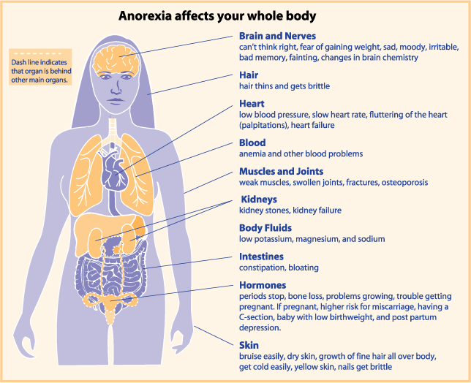

Slide 13
Clinical management of AN
Comprehensive approach: dietician, paediatrician, psychiatrist, psychologist, family therapist
Manage immediate physical risk
Weight restoration
Normalise eating patterns, re-establish normal perceptions of hunger and satiety, and correct the biological and psychological sequelae of malnutrition.
Malnourished patient may have single (e.g. protein-calorie malnutrition) or multiple deficiencies
Nutrients have highly variable stores in body and blood levels usually poor indicator of body store
Malnourished patients have low metabolic rate which goes up quickly during re-feeding

Slide 14
Physical Assessment
Weight
Height
Plot on centile charts
%age weight for height or BMI centile rather than BMI
Rapidity of change in weight – previous ht/weight
BP and P - Lying and standing
Physical assessment – dehydration, temp, peripheries
Full respiratory, cardiovascular, abdominal and neurological examination
Squat test – demonstrate and get them to copy
Episodes of collapse/dizziness fainting/chest pain/ shortness of breath/weakness – ask again
Having periods?

Slide 15
What do you need to know immediately?
Physical risk
What are they actually eating and drinking Breakfast/Lunch/Tea ?
How long for
Rate of weight loss
Vomiting/pills /laxatives
Bingeing
Exercise
Physical symptoms – though many deny/minimise
Psychiatric risk
Self harm/suicidality – likely to increase as meal plan goes up
Likely adherence to treatment
Capacity/competence – will they agree to being refed on the ward?

Slide 16
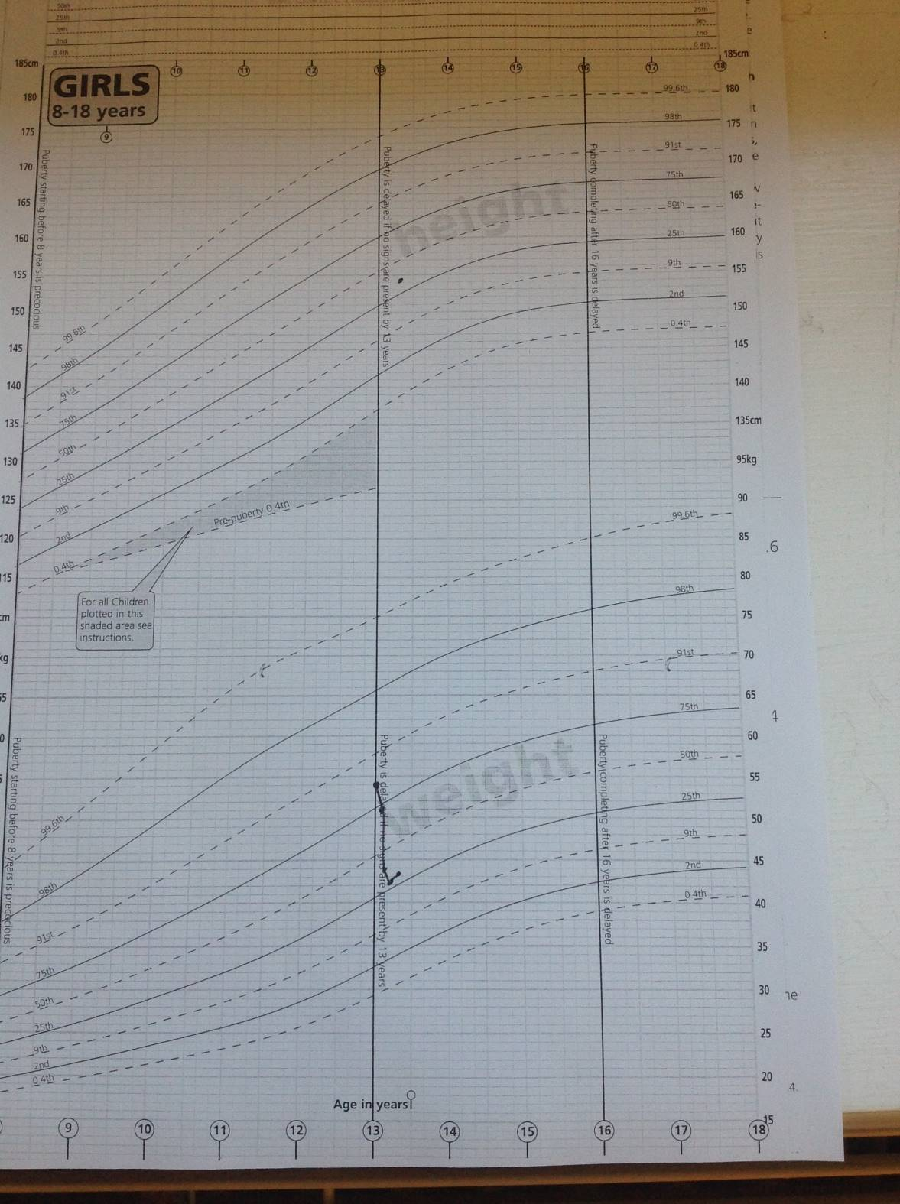
Notes:
More than two centiles difference between height and weight=unhealthy weight zone
Beware the overweight patient who has significant weight loss and has just dropped into the healthy weight zone. Their RATE of weight loss makes them risky even though they are in a healthy weight zone.

Slide 17
Weight for height
Notes:
WFH programme enables easy calculation and monitoring. Also allows sharing between professionals eg paeds/dietetics
We don’t use the BMI in children but use a weight for height measure – in this case the last column using %median BMI
Look at the trends - refeeding aiming for 0.5-1kg/week

Slide 18
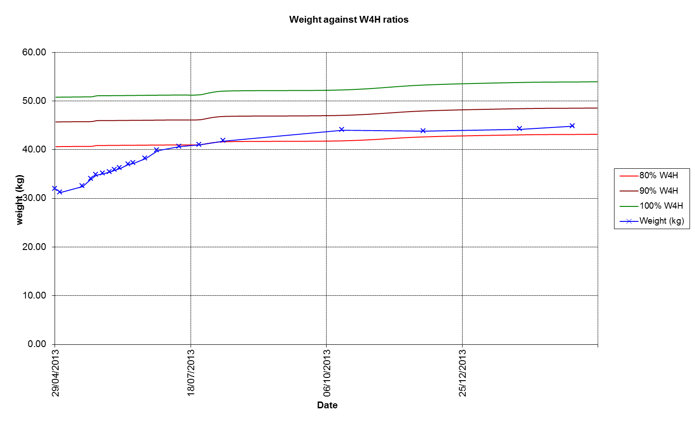
Notes:
Chart generated by WFH programme
Patient refed on paeds ward then discharged
Initial weight loss due to gradually increasing refeeding plan – not enough initially to cause weight regain, then building to steady gain
Aiming for >90% wfh (over purple line) in most patients. 96% of females will restart periods at this weight.
This patient refed well but did not achieve this. They disengaged and relapsed.

Slide 19
Management of Really Sick Patients under 18 with Anorexia Nervosa Junior Marsipan guidelines (CR168)
Risk assessment, physical examination and associated action
Location of care and transition between services
Compulsory treatment
Paediatric admission and local protocols
Management of re-feeding
Management of compensatory behaviours associated with an eating disorder in a paediatric setting
Management in primary care and paediatric out-patient settings
Discharge from paediatric settings
Management in specialist CAMHS in-patient settings

Slide 20
Notes:
MARSIPAN risk tracker. We use in all patients to enable ongoing physical and psychiatric risk monitoring.
Use of BP centile charts is essential

Slide 22
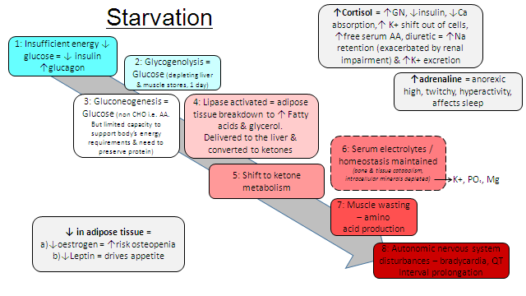
Notes:
Physiological changes that occur in starvation. Progressive shift from glucose to ketone metabolism. The important point is that generally electrolyte homeostasis is maintained by depleting body reserves. Body enters starvation mode and metabolism is slowed.

Slide 23
Percieved risks for refeeding syndrome
Rate of weight loss prior to refeeding* (Crook, Hally et al. 2001; Boateng, Sriram et al.2010; Raj, Keane-Miller et al. 2012)
The extent of malnutrition* (Ornstein, Golden et al. 2003; Raj, Keane-Miller et al. 2012)
Method of refeeding (enteral verse Parenteral) (Weinsier and Krumdieck 1981; Diamanti, Basso et al. 2008)
Carbohydrate load (Kohn, Madden et al. 2011; O'Connor and Goldin 2011);
Rate at which nutrition is introduced (Kohn, Golden et al. 1998; Whitelaw, Gilbertson et al. 2010)
*Jnr MARSIPAN defines this as: < 70% WfH or 70-80% WfH, or faster rates of wt loss of 500-999g for 2 consecutive weeks. Minimal or no feeding prior to admission, or commencing re-feeding – estimated intake c. 400-600kcals/day or severe restriction (less than 50% of required intake).

Slide 24
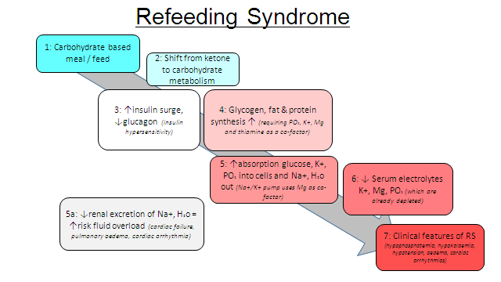
Notes:
In refeeding syndrome the body is struggling to cope with the shift back from ketone to glucose metabolism. Electrolytes and co-factors such as thiamine are depleted and the body cannot cope with rapid intracellular uptake as cells utilise glucose. Checking Calcium Phosphate and magnesium are critical. Falls in these can precipitate fatal cardiac arrythmia therefore prompt electrolyte replacement and consideration of slowing refeeding rate is critical.

Slide 25
Why admit to Paediatrics/medical wards?
High risk according to MARSIPAN
Risky physical state
Severe weight loss
Rapid weight loss – beware “normal weight”
Dehydration – restricting fluid intake
Physical complications – electrolyte imbalances, slow heart rate, refeeding syndrome
Refeeding admission – 2 weeks

Slide 26
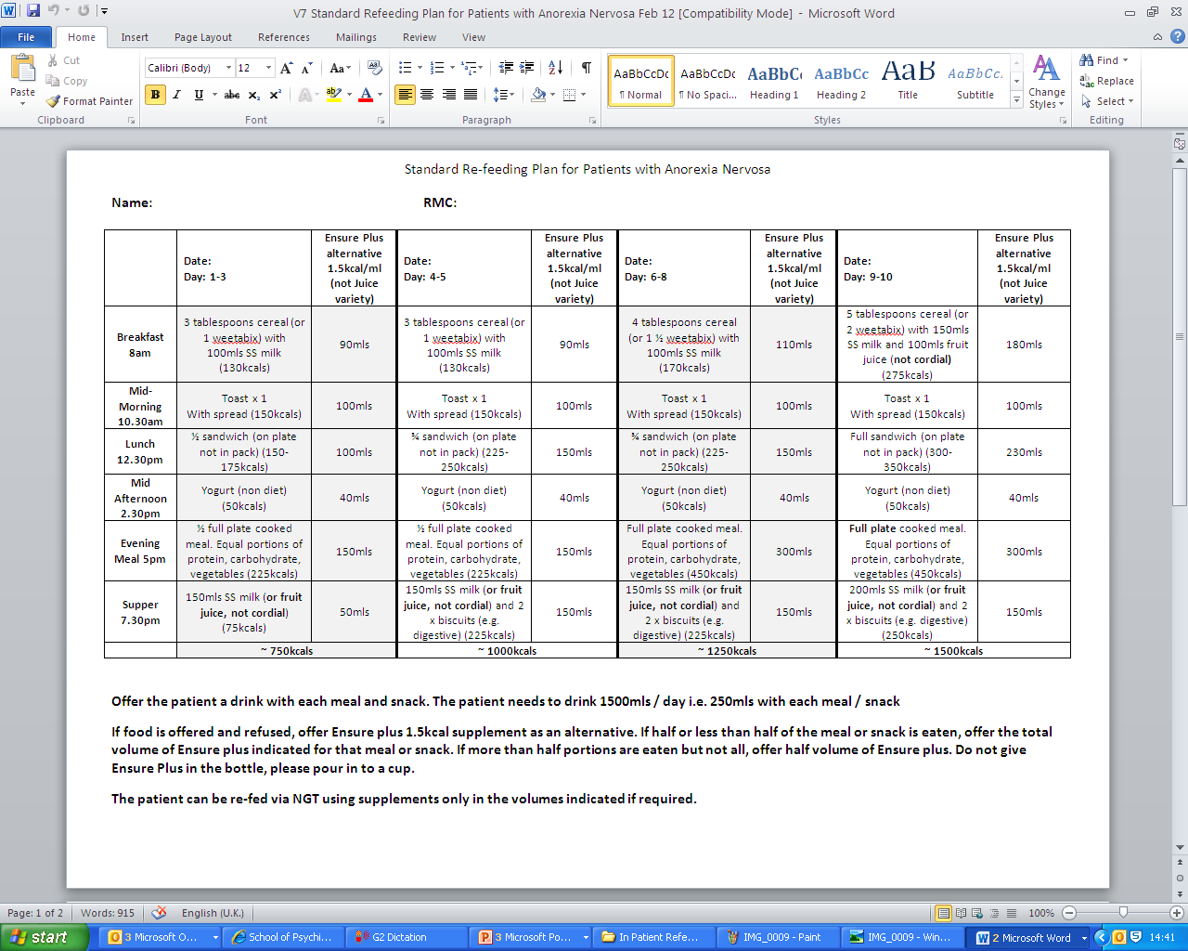
Notes:
Refeeding the patient is the key to treating AN it corrects physical complications which may be life threatening
Refeeds the starved brain and reducing AN cognitions and improving mood (though these may worsten initially). This is a standard inpatient refeeding plan starting at 750Kcal. Recent studies suggest it may be safe to start at 1250Kcal but patients may not manage this. At each meal patient is offered the food then ensure if refused. After 24-48 hours of refusal consideration is given to giving supplement via NG tube. This may be considered sooner if paeds are concerned re life threatening complications. This is made very clear to patients at the beginning of their admission.

Slide 27
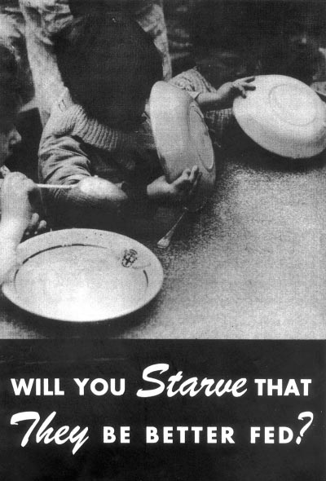
Minnesota Starvation Experiment (Ancel Keys)
An experiment which ran from November 1944 until December 1945 that studied the physiologic and psychological effects of malnutrition and semi-starvation and the effectiveness of dietary rehabilitation on 36 healthy male “volunteers” (conscientious objectors from historic peace churches), as part of the American effort to re-feed populations that suffered malnutrition during the war.
Notes:
Volunteers behaved like anorexics - obsession with food (men looking at cookbooks in 1940’s america) rigid, mood changes, struggled to re-establish eating – looked much like anorexics helping prove that a significant part of the anorexic psychopathology is due to brain starvation

Slide 28
Factors maintaining under-eating
Safety behaviour, Compensation e.g.. exercise, vomiting
Alienation of social norms
Focus on detail of food rigidity
Rule driven eating, avoidance
Lack of variety and sufficiency: starvation effects
High anxiety
Homeostatic and hedonistic control fight back e.g. food more salient
Appetite driven eating
Others enforce eating
Physically unpleasant, Appetite regulation disrupted, Violation of rules, neg. emotions

Slide 29
Psychological therapies
Engagement with patient and family
Motivational interviewing-assess readiness for change
Support Step by Step recovery: relearn how to eat sufficient, flexibly with variety, socially with food set in context of bigger picture
Family based therapy (Maudsley / Lock models)
Individual therapies: CBT-ED, psychodynamic psychotherapy, cognitive analytic therapy
Manage psychiatric comorbidities
Notes:
Eating safely is a core feature of FBT and CBT-E. You cannot “therap” a starved brain and success of individual psychological therapy in v low weight is poor as the brain is unable to think flexibly, and develop new neural pathways.

Slide 30
Family based therapy: 1
Family-Based Therapy (FBT) grew out of the work of Minuchin and has been developed at the Maudsley Institute in London
A problem-focused therapy that aims to change behavior through unified parental action.
The family in FBT is not viewed as the cause of the disorder but rather as a positive resource in the adolescent’s weight restoration and return to normal eating and health.
FBT takes no stance on disease etiology and tries instead to separate the pathology of AN from the adolescent herself.

Slide 31
Family based therapy:2
FBT focuses on family strengths
The first phase of treatment - “Yp is too ill to make safe decisions about eating, parents are taking responsibility for this”
The second phase begins when the child has reached 90% of ideal body weight and is eating without much resistance; at this point the parents are supported in returning the responsibility for their child’s eating back to the child.
The final phase generally begins when the adolescent has achieved a healthy weight for age and height and focuses on the general issues of adolescent development and how the Eating Disorder affected this process.
FBT, or the so-called “Maudsley Method,” has been shown effective in 50 – 75% of adolescents, who in randomized trials achieved weight restoration by the end of treatment and maintained it for up to five years. In one trial of adolescents with a short history of illness, the response rate reached 90% (Eisler et al, 1997).

Slide 32
Medication
Evidence mainly comes from studies in adults
The evidence for use of medication in the treatment of childhood-onset eating disorders is limited, and the evidence for effectiveness is weak across the age range:
Atypical antipsychotics – beware cardiovascular risk. Used in high risk AN eg aggressively refusing refeeding requiring restraint
Selective serotonin reuptake inhibitors (SSRIs) – not effective at low weight

Slide 33
Bulimia Nervosa
An episode of binge-eating is characterized by both of the following: eating, in a discrete period of time, an amount of food that is definitely larger than most people would eat during a similar period of time and under similar circumstances
Sense of lack of control over eating during the episode (e.g. a feeling that one cannot stop eating or control what or how much one is eating).
Taking extreme measures for controlling shape or weight (e.g. self-induced vomiting, misuse of laxatives or diuretics, over-exercising and intense dieting or fasting).
Extremely concerned about their shape or weight.
The binge eating and inappropriate compensatory behaviors both occur, on average, at least twice a week for 3 months.

Slide 34
BN: characteristics
Frequent episodes of binge eating, during which they consume a large amount of food within a short period of time
Feels overwhelmed by the urge to binge and can only stop eating once it becomes too uncomfortable to eat any more
Feels guilty, anxious and depressed, because they have been unable to control their appetite any they fear weight gain
Tries to regain control by getting rid of the calories consumed ( the most common method is vomiting, but they might misuse laxatives, diuretics or appetite suppressants, fast or excessively exercise)

Slide 35
Anorexia vs. Bulimia
Denies abnormal eating behavior
Introverted
Turns away food in order to cope
Preoccupation with losing more and more weight
Recognizes abnormal eating behavior
Extroverted
Turns to food in order to cope
Preoccupation with attaining an “ideal” but often unrealistic weight

Slide 36
Epidemiology
The prevalence rate of bulimia is 3-8% in females 12 – 40 y; incidence <0.1%
Bulimics face an increased risk of depression; anxiety disorders may also be increased
The lifetime prevalence of substance abuse/dependence among bulimics (particularly alcohol and stimulants) is at least 30% (25% among all patients with an eating disorder)
The diagnosis of a personality disorder among bulimics is not uncommon (especially Borderline PD)

Slide 37
Aetiology
Aetiology of eating disorders in line with most other psychiatric disorders is generally considered to be multi-factorial
If young person develops an ED will depend on individual vulnerability, consequent on the presence of biological or other predisposing factors, their exposure to particular provoking risk factors and on the operation of protective factors.
Eating disorders form a spectrum of clinical severity in which there is a continuum of familial liability

Slide 38
Genetic factors
Female relatives of those with bulimia nervosa were 3.7 times as likely to suffer with bulimia
Fifty-four per cent to 83 per cent of the variance in liability has been thought to be due to common genetic factors (Bulik et al., 2000), but again the confidence intervals around the estimation of heritability are broad, thus the relative contribution of genetic to other factors is unclear

Slide 39
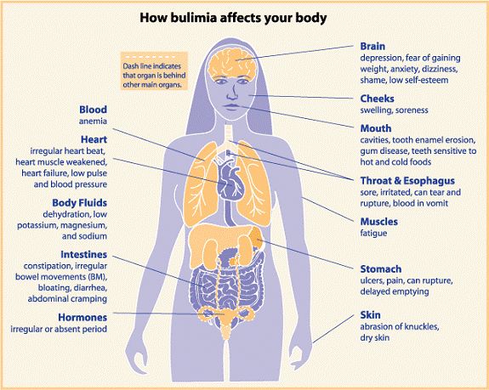

Slide 40
Treatment
NICE recommends stepped care approach: as first line treatment to offer an evidence based self help programme, then CBT-BN adapted to need and development, as alternative to CBT offer interpersonal psychotherapy
Open label study, which treated adolescents for eight weeks with 60 mg of Fluoxetine per day, along with supportive psychotherapy. The study found decreases in binge and purge episodes, and 70% of subjects were rated as improved or much-improved by study’s end (Kotler et al, 2003).

Slide 41
ARFID (Avoidant / restrictive food intake disorder)
No weight loss or persistent low weight when food is available i.e. should not be diagnosed in the presence of neglect
No disturbed thinking regarding weight and body shape/size and no desire to lose weight
There is no underlying physical cause
Psychosocial functioning is impaired

Slide 42
ARFID
Tend to be younger than those with either AN or BN, are more likely to be male, often have a longer duration of illness and a greater likelihood of comorbid medical and/or psychiatric symptoms
Little evidence to guide clinicians treating children and adolescents with this condition
Young people are often treated pragmatically using a combination of medical monitoring, family therapy, medication, and cognitive behavioural therapy

Slide 43
MCQ 1
When a child with anorexia nervosa refuses treatment that is deemed essential what do the National Institute of Clinical Excellence recommend?
A. The Mental Health Act should not be used where parents give their consent
B. Parental consent should be relied upon in cases of persistent refusal
C. A second opinion from an eating disorders specialist should be considered only as a last resort
D. If parents also refuse the treatment, the Mental Health Act should be applied
E. The Children’s Act should be considered under circumstances where parents also refuse treatment

Slide 44
MCQ 2
What is the approximate ratio of girls to boys with a diagnosis of any Eating Disorder in the UK?
A. 5:1
B.10:1
C.15:1
D.20:1
E. 25:1

Slide 45
MCQ 3
Which of the following is true?
A. In children, BMI is a stable measure of severity of Anorexia Nervosa
B. Children with Anorexia Nervosa can present with healthy weight
C. NICE recommend low dose fluoxetine for the treatment of BN
D. During treatment patients with Anorexia nervosa should be aiming for weight gain of more than 2 kg per week
E. Oestrogen administration should not be used to treat bone density problems in children

Slide 46
MCQ 4
What medication do NICE recommend for Bulimia Nervosa?
A. Fluoxetine
B. Olanzapine
C. Venlafaxine
D. Methylphenidate
E. Mirtazepine

Slide 47
MCQ 5
Which of the following is not a criterion for diagnosis of Anorexia Nervosa according to ICD10?
A. Endocrine dysfunction
B. Fear of fatness
C. Over-exercise
D. Food restriction
E. Weight more than 15% below expected weight for age and height

Slide 48
MCQ 6
All of the following are often present in both Bulimia Nervosa and Anorexia Nervosa except:
A. Food restriction
B. Self induced vomiting
C. Low weight
D. Purging
E. Episodes of overeating

Slide 49
MCQ 7
Which of the following is a necessary early treatment for life threatening low weight in a young person with an eating disorder?
A. Feeding high calorie meals
B. Thiamine replacement
C. NG tube feeding
D. CBT
E. Psychotropic medication

Slide 50
MCQ 8
Which of the following are features of anorexia nervosa (1 or more)?
A. Low FSH, LH an Oestradiol
B. Shortened QT
C. Delayed gastric emptying
D. Reduced Growth Hormone
E. Low T3, normal TSH
F. Normocytic, normochromic anaemia

Slide 51
MCQ 9
Which of the following are true about the long term complications of Anorexia Nervosa?
A. Pubertal delay is common
B. Osteopenia and osteoporosis are less frequent in children and adolescents than in adults
C. Catch up growth can occur with nutritional restoration
D. Hormone replacement is recommended for teenagers with Anorexia
E. Weight gain and the establishment of healthy eating habits usually results in restoration of menstruation

Slide 52
MCQ 10
Which of the following are true regarding the prognosis of Eating Disorders:
A. Bulimia has a worse prognosis than anorexia nervosa
B. Vomiting in Anorexia Nervosa is a predictor if poor prognosis
C. The 30 year mortality rate in women with Eating Disorders has been found to be 20%
D. The mortality rate for Eating Disorders is greater than for psychiatric in patients
E. Some bone loss experienced in Anorexia Nervosa is irreversible

Slide 53
Answers
D
B
B
A
C
C
B
ACEF
ACDE
BDE

