Slide 1
Legal Aspects in Child & Adolescent Psychiatry
Dr Paramel: ST6 Child and Adolescent Psychiatry
Dr Kenny Ross, Dr Karl Coldman: CAMHS Consultant

Slide 2
Learning Objectives
Develop an understanding of legal frameworks with respect to children
Understand how the law interacts with children.

Slide 3
Topics Covered
Basic Principles
Assessment of competence
Children and Families Act (2014)
Mental Health Act (1983, as amended 2007)
Mental Capacity Act (2005)

Slide 4
Basic Principles
Children and young people can expect:
to be kept as fully informed as they wish, and as is possible, about their care and treatment
health professionals to act as their advocates
to have their views and wishes sought and taken into account as part of promoting their welfare in the widest sense
to be the individual who consents to treatment when they are competent to do so
to be encouraged to take decisions in collaboration with other family members, especially parents, if this is feasible
that age-appropriate information will be provided
confidentiality unless there are exceptional reasons that require confidentiality to be breached.

Slide 5
Legal Frameworks
Doctors should be familiar with ethical and legal obligations which are outlined in best practice guidance, statute and case law
The Gillick case
Children Acts 1989 and 2004
The Children (Scotland) Act 1995
Children (Northern Ireland) Order 1995
Age of Legal Capacity (Scotland) Act 1991
Mental Capacity Act 2005 (England & Wales)
Family Law Reform Act 1969
Human Rights Act 1998
United Nations Convention on the Rights of the Child

Slide 6
Legal Concepts
Basic Principles
Assessment of competence
Parental Responsibility
Children and Families Act (2014)
Mental Health Act (1983, as amended 2007)
Mental Capacity Act (2005)

Slide 7
Assessment of competence: Over 16s
All people aged 16 and over are presumed in law to be competent to give their consent to medical treatment and to the release of information in the United Kingdom

Slide 8
Assessment of competence: Under 16s
Needs to be assessed in each case on a continual basis
Involve all children and young people in decisions relating to their medical treatment
Recognise when a young person is able to make a valid choice about a proposed medical intervention or disclosure of personal medical data and is therefore competent to make a personal decision
Do not judge the ability of a particular child or young person solely on the basis of his or her age

Slide 9
Assessment of competence: Under 16s
For a young person under the age of 16 to be competent, s/he should have:
The ability to understand that there is a choice and that choices have consequences
The ability to weigh the information and arrive at a decision
A willingness to make a choice (including the choice that someone else should make the decision)

Slide 10
Assessment of competence: Under 16s
For a young person under the age of 16 to be competent, s/he should have:
An understanding of the nature and purpose of the proposed intervention
an understanding of the proposed intervention’s risks and side-effects
an understanding of the alternatives to the proposed intervention, and the risks attached to them
Freedom from undue pressure

Slide 11
Assessment of competence: Under 16s
Competent under 16 year olds are sometimes referred to as being “Gillick” competent
In England, Wales and NI children who are aged 12 or over are generally expected to have competence to give or withhold their consent to the release of information

Slide 12
Who should assess competence?
GPs who have known the young person for a long time
The treating doctor may be the most appropriate person
Other members of the health care team who have a close rapport with the patient may also have a valuable contribution to make
It is unwise to rely on any assessment that is not contemporaneous
Outcome must be recorded in case notes.

Slide 13
Legal Concepts
Basic Principles
Assessment of competence
Parental Responsibility
Children and Families Act (2014)
Mental Health Act (1983, as amended 2007)
Mental Capacity Act (2005)

Slide 14
Parental responsibility
PR may be exercised until a young person reaches 18 years in England Wales and NI
Mothers automatically acquire parental responsibility at birth
For births registered in England, Wales or NI a father acquires PR if he is married to the mother at the time of the child’s birth or subsequently
An unmarried father will acquire PR if he is recorded on the child’s birth certificate from 1 December 2003 in England or Wales and from 15 April 2002 in NI

Slide 15
Parental responsibility
An unmarried father, whose child’s birth was registered before the dates mentioned above, or afterwards if he is not recorded on the child’s birth certificate, does not have PR even if he has lived with the mother for a long time
Father can acquire PR by way of a Court registered PR-agreement with the mother or by obtaining a PR Order or a Residence Order from the Courts
PR awarded by a Court can only be removed by a Court

Slide 16
What if the parents are divorced?
Parents do not lose PR
A separated or divorced parent cannot relinquish PR
Applies even if the parent without custody does not have contact with the child and does not make any financial contribution

Slide 17
Disagreement between people with PR
Law requires doctors to have consent from only one person in order lawfully to provide treatment
Decision must be made by the clinician in charge
If the dispute is over an irreversible, controversial, elective procedure doctors should not proceed without the authority of a Court

Slide 18
Legal Concepts
Basic Principles
Assessment of competence
Parental Responsibility
Children and Families Act (2014)
Mental Health Act (1983, as amended 2007)
Mental Capacity Act (2005)

Slide 19
Children and Families Act-Adoption
Helps some children to move in sooner with the families who might adopt them (fostering for adoption)
Makes it easier to find new parents for children who need to be adopted
Helps to find more people to adopt children
Gives families a real choice in exactly who gives them help after the adoption
Makes it easier for people who want to adopt a child to look for the right child for them to adopt

Slide 20
Children and Families Act Family Courts Going into care
Family Court can decide when a child needs to go into care to stay safe
The Act sets a new time limit of 26 weeks for the Court to decide whether or not a child is to go into care
The Act tells the Court to look at what the child’s care plan says about where they are going to live and who they are going to have contact with
The judge can decide whether the child should stay in care until the final decisions are made about their future
An expert must have the Court’s permission before they can write a report for the Court or come to the Court to give their opinions

Slide 21
Children and Families Act Family Courts Parents splitting up
Helps parents to see if they can sort things out without having to go to Court
It is usually best for both parents to stay involved with their children, even if they have split up
Courts should help parents to do what is right for their child, not what they might want to do for themselves
Courts can send parents on a course or special activities to help them learn how to keep in contact with their child (Courts can’t send the children on any of these courses or activities, only their parents)

Slide 22
Children and Families Act New Laws
The Act gives young carers more rights to ask for help
Gets more help for parents who are looking after a disabled child
Lets foster children carry on living with their former foster carers until they are 21

Slide 23
Children and Families Act New Laws
Helps children who are looked after by their Local Authorities to do well at school
Schools should give more help to pupils who have medical problems
Makes sure the Government can sort things out for children if their Local Authority is not doing what it should be doing
The Act says the Government can set new rules for children’s homes, fostering services and adoption agencies (regulations and standards)
The Act says that every school and academy which is paid for by the state must give free school lunches to every child who wants one in their reception classes, year one and year two.

Slide 24
The Children Act 1989 Statutory assessments
Referrals received by Local Authority:
Decision on course of action within one working day
May proceed to Assessment under Section17 or 47 of the Act
See Appendix for information and example flow charts of process

Slide 25
Legal Concepts
Informed consent
Assessment of competence
Parental Responsibility
Children and Families Act (2014)
The Mental Health Act (1983, as amended 2007)
The Mental Capacity Act (2005)

Slide 26
The Mental Health Act and Under 18s
Identifying persons with PR
For LAC establish whether they are subject to a Care Order or are being voluntarily accommodated by LA
If a young person is voluntarily accommodated by the LA, parents or others with PR have the same rights and responsibilities in relation to treatment as they would otherwise.
If the child or young person is subject to a Care Order, the person with PR shares parental responsibility with the Local Authority

Slide 27
Mental Health Act and Under 18s
There is no minimum age for detention in hospital under The Act
The valid consent of a capacitous child or young person will be sufficient authority for their admission to hospital and/or treatment for mental disorder; additional consent by a person with parental responsibility will not be required
Consent should be sought for each aspect of the child or young person’s admission, care and treatment as it arises
A young person must have the capacity to make the particular decision in question
Unlike adults, the refusal by a young person with capacity under the age of 18 may in certain circumstances, be overridden by a Court

Slide 28
Mental Health Act and Under 18s
At least one of the people involved in assessing whether a child or young person should be admitted to hospital, and if so whether they should be detained under The Act (ie one of the two medical practitioners or the AMHP), should ideally be a CAMHS professional
The AMHP should employ their best efforts to identify those who have PR, and who would be the Nearest Relative

Slide 29
16 and 17 year olds with capacity to consent Informal admission
Where a young person aged 16 or 17 has capacity to consent to being admitted to hospital for treatment for mental disorder, they may either consent, or refuse to consent
If a young person has the capacity to consent to informal admission and gives such consent, they can be admitted, irrespective of the views of a person with PR
If the young person with capacity does not consent to the admission, then a person with PR cannot consent on their behalf
Where the young person does not consent to their admission to hospital, but the admission is thought to be necessary, consideration should be given to whether the criteria for admission under The Mental Health Act are met

Slide 30
16 and 17 year olds who lack capacity to consent Informal admission
Where a young person aged 16 or 17 lacks capacity it may be possible for them to be admitted informally, in accordance with the MCA, unless the admission and treatment amounts to a Deprivation of Liberty
However, recent case law makes it clear that any inpatient treatment is restrictive, so better framework for care is The Mental Health Act

Slide 31
16 and 17 year olds with capacity to consent Informal treatment
Young people aged 16 or 17 can consent to their medical treatment and to any ancillary procedures involved in that treatment, such as an anaesthetic
Where a young person has the capacity to consent to proposed medical treatment but refuses to consent, it would not be advisable to rely on the consent of a person with parental responsibility in order to treat the young person
Consideration should be given to whether admission under The Mental Health Act for the purposes of treatment is necessary, and if so, whether the criteria are met
If The Mental Health Act is not applicable, legal advice should be sought

Slide 32
16 and 17 year olds who lack capacity to consent Informal treatment
Where the young person lacks capacity, the MCA may apply in the same way as it does to those aged 18 and over, and treatment may be given in accordance with the MCA, unless it amounts to a deprivation of liberty
Recent case law makes it clear that any inpatient treatment is restrictive and can amount to deprivation of liberty.
If it is not possible to provide treatment relying on the MCA, consideration should be given to whether admission under The Mental Health Act for the purposes of treatment is necessary, and if so, whether the criteria are met
If The Mental Health Act is not applicable, legal advice should be sought on the need to seek authorisation from the Court before further action is taken.

Slide 33
Under 16s who are Gillick competent Informal admission and treatment
Where a child who is Gillick competent to decide about their admission to hospital for assessment and/or treatment of their mental disorder consents to this, they may be admitted to hospital as an informal patient
A child who is Gillick competent and has consented to being admitted informally, may also be given treatment if they are competent to consent to the proposed treatment, and do consent
Consent will be required for each aspect of the child’s care and treatment as it arises. This will involve an assessment of the child’s competence to make the particular decision and, where the child is competent to do so, confirmation that they have given their consent

Slide 34
Under 16s who are Gillick competent Informal admission and treatment
Where a child who is Gillick competent refuses to be admitted for treatment it may be inadvisable to rely on the consent of a person with parental responsibility
Consideration should be given to whether admission under The Mental Health Act is necessary, and if so, whether the criteria are met
If The Mental Health Act is not applicable, legal advice should be sought on the need to seek authorisation from the Court before further action is taken

Slide 35
Under 16s who are not Gillick competent Informal admission and treatment
It may be possible for a person with parental responsibility to consent, on their behalf, to their informal admission to hospital for treatment for mental disorder
If parental consent can be relied upon and consent is given by a person with parental responsibility, then the child may be admitted and treated as an informal patient.

Slide 36
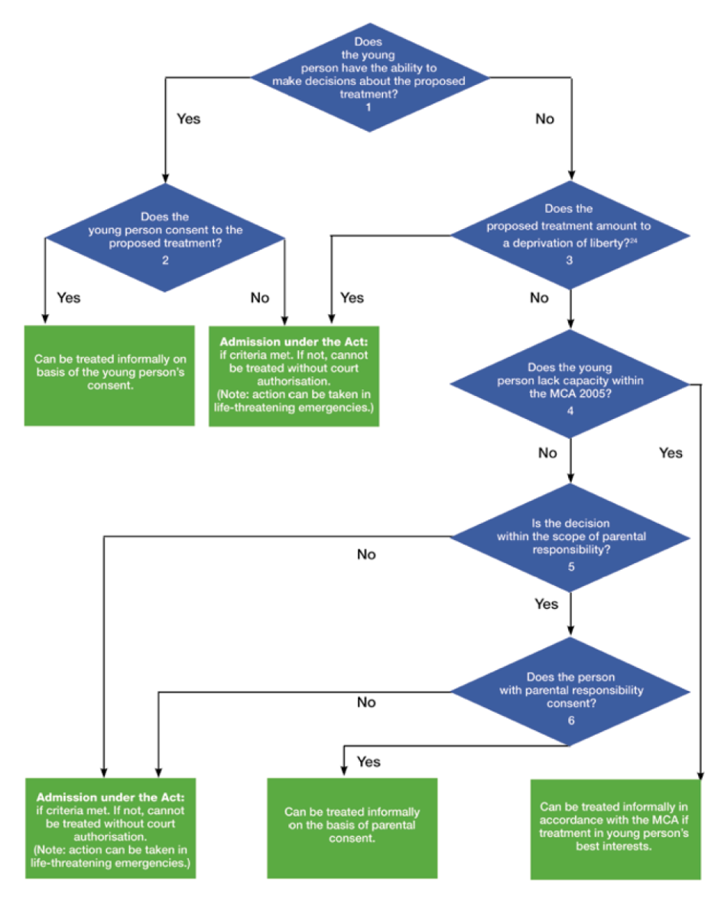
Informal treatment of 16 and 17 year olds

Slide 37
Exercise A
A 13 year old child is assessed as not being Gillick competent. The primary purpose of the intervention is to provide medical treatment for mental disorder. The child has been in hospital before and is happy to return there. However, neither of the parents (both of whom have parental responsibility) consents.

Slide 38
Exercise A
Given that it is not possible to rely on the child’s consent (the child is not Gillick competent) or parental consent (the parents do not consent and no other person has parental responsibility) the child cannot be admitted informally in accordance with section 131(1) of The Mental Health Act. If the child meets the relevant criteria, the child could be admitted to hospital for assessment (section 2) or for treatment (section 3) under The Mental Health Act. If the criteria for detention under The Mental Health Act are not met, legal advice should be sought on the need to seek authorisation from the Court before further action is taken.

Slide 39
Exercise B
A 14 year old girl is assessed as not being Gillick competent. The primary purpose of the intervention is to provide medical treatment for mental disorder. She is severely anorexic and the proposed treatment is that she is fed by naso-gastric tube. The naso-gastric tube may need to be in place for several weeks in order to restore the child to a safe BMI (body mass index)

Slide 40
Exercise B
The care team conclude that as this is a particularly invasive form of treatment and the girl is likely to resist the insertion of the tube, it would not be appropriate to rely on parental consent to authorise this intervention. Accordingly, even though a person with parental responsibility consents, the child is not admitted and treated informally under section 131(1) of the Act. If the child meets the relevant criteria, she could be admitted to hospital for assessment (Section 2) or for treatment (Section 3) under the Act. If the criteria for detention under the Act are not met, legal advice should be sought on the need to seek authorisation from the Court before further action is taken

Slide 41
MCQ 1
Until what age can parental responsibility be exercised?
A) Until 14
B)Until 16 in England, Wales and NI
C)Until 18 in England, Wales and NI
D)Until 14 in Scotland

Slide 42
Answer 1
In England, Wales and Northern Ireland, parental responsibility may be exercised until a young person reaches 18 years.
In Scotland, only the aspect of parental responsibility concerned with the giving of ‘guidance’ endures until 18 years – guidance meaning the provision of advice. The rest is lost when the young person reaches 16 years, although some may be lost before this if the child attains legal capacity to act on his or her own behalf

Slide 43
MCQ 2
A Court can do all the following except
A) give consent to treatment on behalf of competent patients aged under 18 if necessary
B) give consent to treatment on behalf of incompetent patients aged under 18 if necessary
C) can override a child’s refusal or parents’ refusal of a particular treatment if there is evidence that it would be in the child or young person’s best interests
D) require doctors to treat contrary to their professional judgment

Slide 44
Answer 2
Answer D

Slide 45
MCQ 3
When is a young person competent to consent to the disclosure of his/her personal information?
A) Never, a person with PR can override the consent of young person
B) At 12
C) At 14
D) At 16
E) At 18

Slide 46
Answer 3
In England, Wales and Northern Ireland children who are aged 12 or over are generally expected to have competence to give or withhold their consent to the release of information
In Scotland, anyone aged 12 or over is legally presumed to have such competence

Slide 47
MCQ 4
Can someone with parental responsibility refuse disclosure of a child’s or young person’s personal information?
A) Never
B) Yes, but professionals can override it
C) Yes, but only a Court can override this
D) PR and disclosure of information are unrelated

Slide 48
Answer 4
Anyone with parental responsibility can give or withhold consent to the release of information where the child lacks competence
Where an individual who has parental responsibility refuses to share relevant information with other health professionals or agencies and the health professional considers that it is not in the best interests of the child, (for example, it puts the child at risk of significant harm), disclosure may take place in the public interest without consent

Slide 49
MCQ 5
Who can access a child’s or young person’s health record?
A) Access is never given to under 18s
B) Access can never be given to non-professionals
C) A competent child if they give a valid reason
D) A competent 15 year old

Slide 50
Answer 5
D
Competent children and young people may apply for access to their own records, or may authorise others to do so on their behalf.
It is not necessary for competent patients to give reasons as to why they wish to access their records
Anyone with parental responsibility has a statutory right to apply for access to their child’s health records. If the child is capable of giving consent, access may only be given with his or her consent

Slide 51
MCQ 6
Which of the following provisions in the Mental Capacity Act do not apply to 16-17 year olds
A) they cannot make a Lasting Power of Attorney
B)they cannot make an advance decision to refuse medical treatment
C)the Court of Protection cannot make a statutory will
D)none of the above

Slide 52
Answer 6
A, B and C

Slide 53
MCQ 7
Which of the following statements is true regarding participation of children and young person in research and innovative treatment
A)Only consent from a competent child is required in all situations
B)Parents can never refuse participation
C)Even when parents agree a child can refuse participation
D) Children can never take part in emergency care trials

Slide 54
Answer 7
C
Children can take part in emergency care trials, when there would be no time to seek initial consent before administering the medicine, if certain criteria are met
In 2008, the Medicines for Human Use (Clinical Trials) and Blood Safety and Quality Amendment was passed. As well as amending the Blood Safety and Quality Regulations 2005, this amended the regulations to enable children to be involved in emergency trials in certain circumstances.

Slide 55
MCQ 8
The following factors undermine the validity of parental consent except
A) The parent lacks capacity as defined in the MCA
B) The parent puts their interest first
C) Where 1 parent agrees and the other parent with PR disagrees
D) Parent has a history of mental illness

Slide 56
Answer 8
D

Slide 57
MCQ 9
Section 131A of The Mental Health Act states that children and young people admitted to hospital for the treatment of mental disorder should be accommodated in an environment that is suitable for their age.Which of the following statements is true
A) Only applies to detained patients
B) A young person under 18 can be admitted to an adult ward if they choose
C)CTO recall of a young person to adult ward is acceptable
D) Admission of a young person to adult ward is acceptable if s/he is on a depot

Slide 58
Answer 9
B

Slide 59
Any Questions?

Slide 60
Appendix
Statutory assessments under The Children Act 1989
Referrals received by Local Authority:
Decision on course of action within one working day
May proceed to Assessment under Section17 or 47 of the Act
See following slides containing flow charts, outlining different stages in assessments

Slide 61
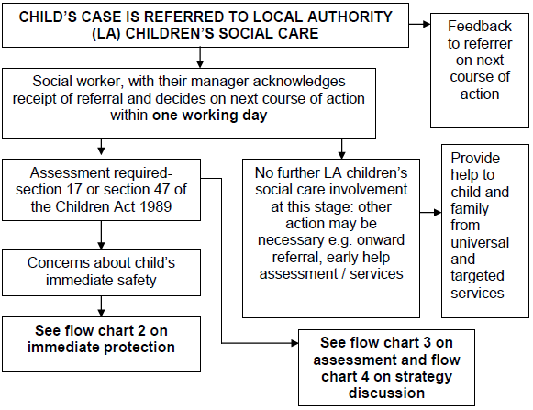
Flowchart 1

Slide 62
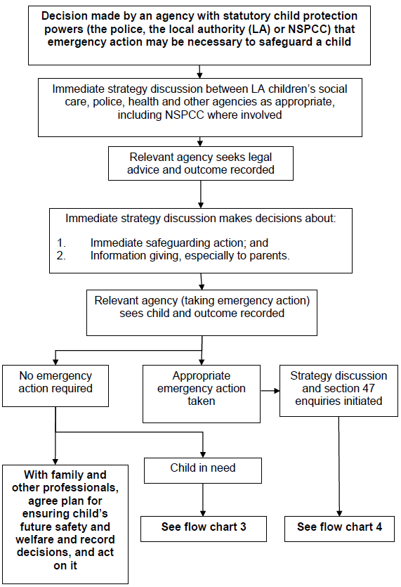
Flowchart 2

Slide 63
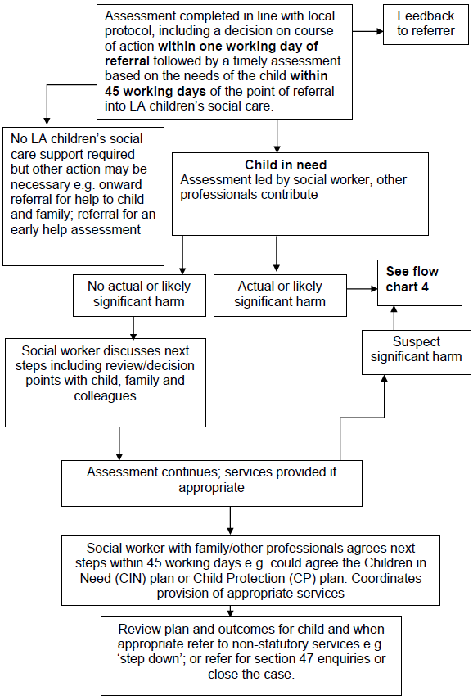
Flowchart 3

Slide 64
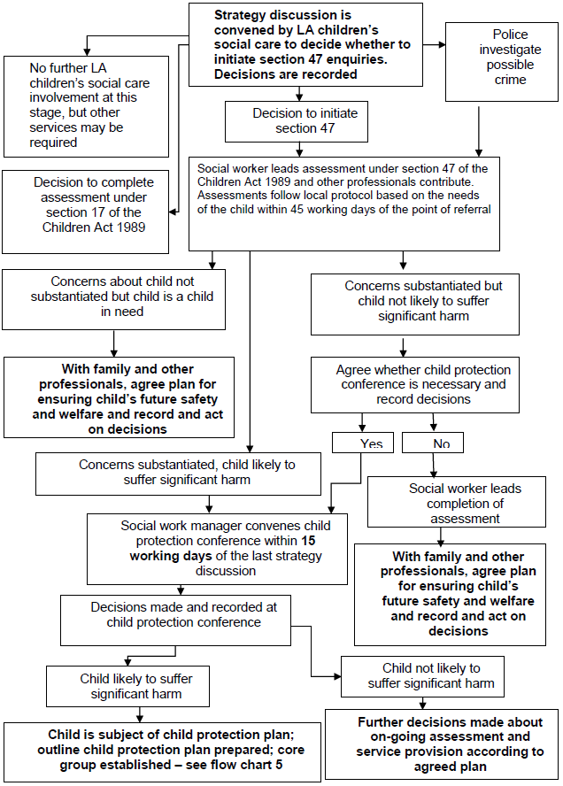
Flowchart 4

Slide 65
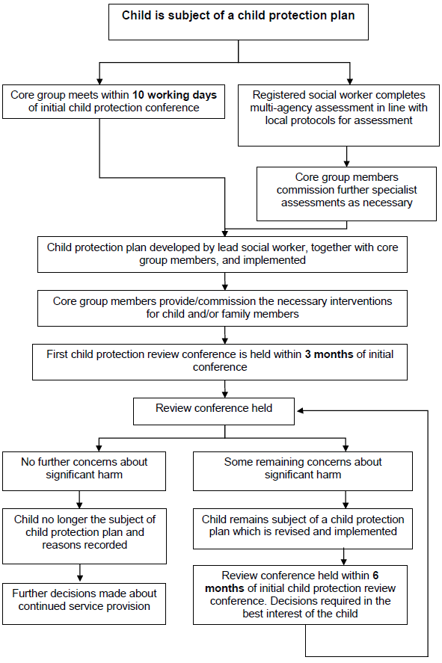
Flowchart 5

Slide 66
Reference
General Medical Council. 0-18 years: guidance for all doctors. Available at www.gmc-uk.org
Department of Health. Seeking consent: working with children. Available at www.dh.gov.uk
General Medical Council. 0-18 years: guidance for all doctors – sections 12 and 13. Available at www.gmc-uk.org
Mental Capacity Act 2005.
http://www.legislation.gov.uk/ukpga/2005/9/contents
Mental Capacity Act 2005: Code of Practice. Department for Constitutional Affairs (now Ministry of Justice). 2007. https://www.gov.uk/government/publications/mental-capacity-act-code-of-practice
Mental Capacity Act 2005: Deprivation of Liberty Safeguards – Code of Practice to supplement the main Mental Capacity Act 2005 Code of Practice. 2008.
http://webarchive.nationalarchives.gov.uk/20130107105354/http:/www.dh.gov.uk/en/Publicationsandstatistics/Publications/PublicationsPolicyAndGuidance/ DH_085476

Slide 67
MCQ 1
The Mental Health Act (1983, amended 2007) applies to which of the following age groups:
A. 16 and over
B. 18 and over
C. 16 – 65
D. 18 – 65
E. All age groups

Slide 68
MCQ 2
A 15 year old boy, with a full understanding of the risks/benefits of treatment, consents to treatment for ADHD. This can be offered under the framework of:
A. The Mental Health Act
B. The Children’ Act
C. Gillick competence
D. The Mental Capacity Act
E. The Family Reform Act

Slide 69
MCQ 3
What is the definition of a child in UK child protection guidance?
A. Anyone under the age of 18
B. Anyone under the age of 16
C. Anyone under the age of 14
D. Anyone under the age of 18 in full-time education
E. Anyone under the age of 16 in full-time education

Slide 70
MCQ 4
Which of these groups of people would not automatically qualify for Parental Responsibility (PR) under The Children Act (1989)?
A. Mothers
B. Fathers
C. Adoptive parents
D. People with special guardianship
E. An individual with an order from a Family Court

Slide 71
MCQ 5
A 14 year old girl has delirium secondary to a urinary tract infection, and has refused IV antibiotics although has allowed nurses to site a cannula. She does not have capacity to make decisions regarding this treatment, with her delirium interfering with her ability to understand information. What would be the most likely legal framework used to treat her in this situation?
A. The Mental Capacity Act
B. The Mental Health Act
C. Gillick competence
D. The Family Reform Act
E. Consent from an individual with Parental Responsibility

Slide 72
MCQ 6
Which of the following difficulties experienced by young people does NOT count as a mental disorder under the terms of the Mental Health Act?
A. Anorexia Nervosa
B. Learning Disability
C. Autism Spectrum Disorder
D. Alcohol dependence
E. Personality Disorder

Slide 73
MCQ 7
What age group can be treated under the Mental Capacity Act:
A. Any age group
B. Any age group if the person with Parental Responsibility is unavailable
C. 14 and over
D. 16 and over
E. 18 and over

Slide 74
MCQ 8
Which of the following is NOT relevant when considering the compulsory treatment of 16-18 year olds?
A. Deprivation of liberty
B. The zone of parental control
C. Consent of the person with parental responsibility
D. Gillick competence
E. The Mental Health Act

Slide 75
MCQ 9
Which of the following would NOT be used when considering IV rehydration for a 14 year old with Anorexia Nervosa?
A. The Mental Health Act
B. Treatment with consent from the person with Parental Responsibility
C. Consent from a child with Gillick competence
D. The Mental Capacity Act
E. Emergency treatment under common law

Slide 76
MCQ 10
There are circumstances in which the confidentiality young people can expect may have to be breached, to the extent of informing those with parental responsibility.
Which of the following is NOT an important factor in making this decision?
A. The young person’s age and developmental level
B. The severity of any mental disorder
C. The closeness of the relationship with the parents
D. The presence of an Autism Spectrum Disorder
E. The degree of care and protection required

Slide 77
Answers
E
C
A
B
E
D
D
A
D
CD

