Slide 1

MRCPsych General Adult Psychiatry
General Hospital Psychiatry

Slide 2
General Hospital Psychiatry
Objectives
To develop an understanding of:
psychiatric assessment of patients with physical illness, liaising with colleagues in other specialties, psychiatric consequences and aspects of brain pathology; and clinical and theoretical psychiatric aspects of chronic fatigue and pain, including management.

Slide 3
General Hospital Psychiatry
Expert Led Session
General Hospital Psychiatry

Slide 4
This lecture complements material covered during the liaison psychiatry academic day:
Assessment of sequelae associated with diseases of brain and body- a case example
Somatoform pain disorders
Chronic fatigue and Fibromyalgia

Slide 5
Objectives for Case
Review collateral history taking framework for patients with catastrophic injuries in a general hospital setting
Discuss communication strategies in challenging situations
Outline an example of reading around a case to separate primary neurological from psychiatric diagnoses
The patient as teacher – 4 clinical pearls

Slide 6
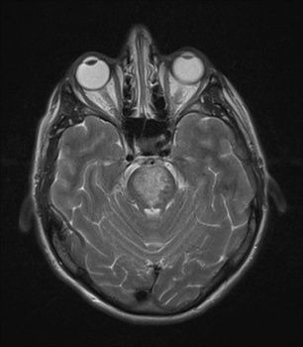
Case
James is 62. He was admitted after having a pontine stroke. He is quadriparetic, has a tracheostomy in situ and is currently fed via NG tube. Nursing staff are concerned he is depressed.
What collateral history do you want to obtain from staff and relatives – questions?
Discuss in small groups

Slide 7
Collateral from nursing staff, allied healthcare practitioners and relatives:
What triggered concerns - acute or cumulative changes?
Levels of lucidity, engagement, co-operation with care interventions, communication strategies, visible enjoyment when receiving visits?
Concerns regarding pain, pressure areas, nutrition and fluid balance, constipation, sleep-wake cycle

Slide 8
Collateral from nursing staff, allied healthcare practitioners and relatives:
History of mental health problems?
Premorbid personality, coping style, cognitive status, functional ability, major pastimes and pleasures (potential losses, role changes but also what can still be enjoyed)
Any recent or ongoing stressors at home / work?
Social circumstances and support mechanisms at home
How are partner and family coping?

Slide 9
Collateral from medical colleagues
Extent of injury
Prognosis – mobility, airway and feeding
Acute, superimposed concerns (physical observations, infection, electrolyte imbalance, renal failure etc – think DELIRIUM)
Ongoing concerns - past medical history
Current medications
Management plan

Slide 10
Assessment
James is alert and it is apparent he has a good range of eye movement as you enter the room.
You introduce yourself and explain the purpose of the assessment
What strategies might you use to ascertain his level of orientation, and what types of questions are you going to ask about his mood?
Discuss in small groups

Slide 11
Communicating - bridging the gap
There are no right answers here. Explore what is easiest for the patient. It might not be immediately obvious.
Head movements for yes/no or gently squeezing your hand, tapping a hand on the bed, eye movements could be used but would be further down the list in terms of simplicity
Writing is also an option for patients with focal oro-laryngeal problems (post op etc)
James is quadriparetic, not quadriplegic. He was able to use his right hand to communicate by squeezing the interviewers hand

Slide 12
Treatment and follow up
James finds himself crying for no apparent reason. He is devastated about the stroke, but does enjoy visits from his family. Sleep is poor. He cannot think about the future but is clear he has not had any thoughts of ending his life. A major preoccupation is shoulder pain.
Plan – Physio input and analgesia. Mirtazepine and/or pause while further reading occurs?

Slide 13
Read around your patients
Brainstem compression from a trigeminal schwannoma presenting with pathological crying. J Clin Neurosci. 2008 Mar;15(3):322-4
Neuroimaging of serotonin transporters in post-stroke pathological crying. Psychiatry Res. 2003 Jul 30;123(3):207-11.
Serotonin 5HT1A receptor availability and pathological crying after stroke. Acta Neurol Scand. 2007 Aug;116(2):83-90.
Involuntary motor phenomena in the locked-in syndrome. J Neurol. 1980;223(3):191-8.
Pathological crying as a manifestation of spontaneous haemorrhage in a pontine cavernous haemangioma. J Clin Neurosci. 2010 May;17(5):662-3
We diagnosed pathological crying secondary to the pontine lesion and kept the Mirtazepine to boost serotonin and aid sleep. He responded well.

Slide 14
Stroke – Exam notes
Comorbid depression in 35% patients
Comorbid anxiety in 25 % patients (cortical infarcts)
Apathy, catastrophic reactions and undue lability (esp frontal CVA) in 20% patients
Delirium occurs in up to a third of patients experiencing haemorrhagic CVA (can respond to small doses of haloperidol)
Mania and psychoses are rare
Left sided basal ganglia infarcts have been associated with increased risk of post CVA depression
SSRI’s first line for mood, anxiety, lability

Slide 15
Outcome & Summary
James was able to use a speaking tube 6 weeks after we met him. He gave me these teaching points for this session:
Don’t be scared to ask difficult questions
Take the time to find a way to communicate properly
Don’t underestimate the effect of pain on mood and outlook on life. Its not always where you expect to find it.
Keep coming even when you think there’s nothing much more to do. Explaining the crying to me and the wife was a big relief.

Slide 16
Further Themes in GHP
Somatoform pain disorders
Chronic fatigue
Fibromyalgia
Huge topics – all will require further reading for the interested

Slide 17
Somatoform Pain Disorders
Pain in one or more anatomical sites – pain is the predominant focus of presentation and severe enough to request a clinical opinion
Pain causes significant distress or impairment in social, occupational or other important areas of function
Psychological factors are thought to contribute to onset, severity, maintenance, exacerbation of pain

Slide 18
Somatoform Pain Disorders
Pain is not intentionally produced or feigned (factitious disorder or malingering)
Pain is not better accounted for by mood, anxiety or psychotic disorder
Note that a co-existing medical condition may be present (common conditions include rheumatoid and osteo arthritis, disc herniation, osteoporosis, neuropathies, metastatic disease)

Slide 19
Somatoform Pain Disorders
Acute = less than 6 months
Chronic = greater than 6 months
Differential diagnosis
Organic condition
Somatisation
Depression
Anxiety disorder
Psychosis (coenestopathic states)
Factitious disorder
Malingering

Slide 20
A few organic considerations
Fractures,including compression fractures
Sprains and strains, Tendinitis
Rheumatoid and osteoarthritis
Polymyalgia rheumatica, Polymyositis
Herniae causing compression (obturator, sciatic, inguinal , femoral etc)
Disc herniation
Radiculopathy / neuropathy / neuralgias
Neoplasia
Each organ system has its own pain differential (angina, nephrolithiasis, reflux etc)

Slide 21
Common syndromes
Tension headache
Temporomandibular pain
Atypical facial pain
Non cardiac chest pain
Non ulcer dyspepsia
Irritable bowel syndrome
Chronic pelvic pain
Irritable bladder syndrome
Proctalgia fugax
Fibromyalgia

Slide 22
A few facts and figures (Grabe 2003, Katz 2015)
Lifetime prevalence of chronic pain syndromes 12.3%
Female: male ratio: 2:1
Odds ratio for comorbid depression : 2.5
Odds ratio for comorbid anxiety disorder : 2.3

Slide 23
Associated Features
Search for precipitants and maintaining factors (emotional conflict, psychosocial stressors, potential gains from adopting sick role)
Comorbid mood and anxiety disorders (may precede, co-occur or result from pain syndrome)
Sleep - initial insomnia, fragmentation, reduced sleep time
Alcohol and substance misuse, including analgesics
Social isolation, reduced activity levels
Explore possibility of doctor shopping, over investigation, iatrogenic analgesic dependence

Slide 24
Using a multi-axial system
International association for the study of pain propose a five axis system to characterise pain syndromes:
I - site
II - organ system
III - temporal characteristics
IV - severity and duration (since onset)
V - aetiology

Slide 25
Assessment Framework
Quality of pain (affective and sensory dimensions e.g. vicious, exhausting, crushing, burning)
Location and distribution
Duration and timing of first onset
Relapses and remissions
Related life events and difficulties
Personal and Family history of severe, chronic or disabling physical disorders
Adverse childhood experiences
Collateral history is often vital (chronicle of distressing events and also attitudes, knowledge and beliefs of carers)

Slide 26
Treating Somatoform Pain Disorders
Pharmacological strategies include TCA’s, SSRI’s, Pregabalin and Gabapentin
Psychological therapies centre on CBT and tackle perceived locus of control, attributional style, cognitive distortions and coping strategies
Relaxation techniques, physiotherapy, graded exercise therapy and biofeedback (increasing awareness of autonomic changes and stress) are also used

Slide 27
Further Reading
Katz J, Rosenbloom BN, Fashler S.(2015). Chronic Pain, Psychopathology, and DSM-5 Somatic Symptom Disorder. Can J Psychiatry. Apr;60(4):160-7.
Burke AL^{1,2}, Mathias JL², Denson LA². Psychological function of people living with chronic pain. Br J Clin Psychol. 2015 Sep;54(3):345-60

Slide 28
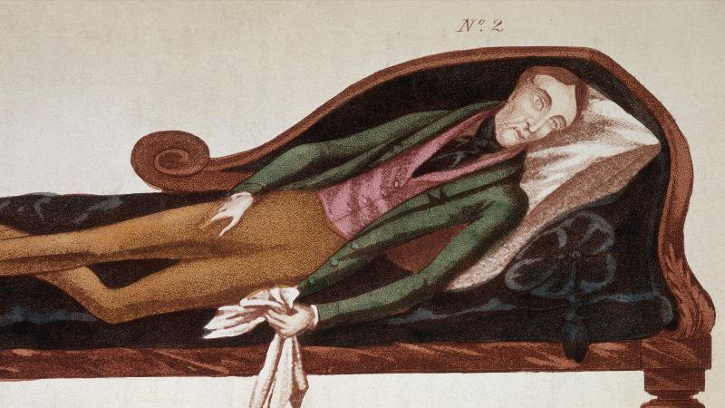
Chronic Fatigue Syndrome
A perpetually controversial
condition
0.4% European population
have it
F:M = 4:1
Bimodal age at onset: 13-15 yrs - early 20’s- peaks at mid 40’s
(online exam notes age at onset 29-35yrs, M:F 1:3, duration 3-9 years)

Slide 29
Diagnostic Frameworks
Not easy to find at first glance. Chronic fatigue is not listed in either ICD-10 or DSM but..
ICD-10 : G93.3 (Benign Myalgic Encephalomyelitis)
ICD-10 : F48.0 (Neurasthenia)
DSM-IV : Undifferentiated somatic symptom disorder

Slide 30
CDC Consensus Definition
New onset fatigue, not relieved by rest and lasting at least 6 months
4 of
subjective memory impairment, sore throat, tender lymph nodes, muscle and joint pain, unrefreshing sleep, post exertional malaise lasting >24h
Impaired functioning
Other conditions that may explain fatigue have been excluded

Slide 31
ICD-10
Persistent and distressing complaints of increased bodily fatigue after mental effort, or persistent and distressing complaints of bodily weakness and exhaustion after minimal effort
2 or more of : muscle aches and pains, dizziness, tension headaches, sleep disturbance, inability to relax, irritability, dyspepsia
Any autonomic or depressive symptoms are not persistent and severe enough to fulfil criteria for another diagnosis
Post viral – G93.3, cause unknown – F48!..

Slide 32
DSM
One or more physical complaints
Investigations have not revealed a medical or substance related cause OR
Where there is a medical condition, the physical complaints and related impairment is in excess of what would be expected from history, examination and investigations
Clinically significant distress or functional impairment
Duration at least 6 months
Not intentionally produced or feigned
Not better accounted for by another mental disorder

Slide 33
Controversy
Patients present with persistent relapses of fatigue, musculoskeletal pain, sluggish mentation and memory difficulties, disturbed sleep-wake cycle which collectively impair functioning.
Precipitant – infection or other environmental trigger causes fatigue in predisposed individuals.
Perpetuators – are psychiatric symptoms primary, secondary or occurring in parallel with underlying physiological, immunological or inflammatory causes?

Slide 34
Psychologically based Treatments
Exercise therapy for chronic fatigue syndrome. Cochrane Database Syst Rev. 2015 Feb 10;2
General benefits from CBT and GET (Graded Exercise Therapy)
Positive effects - sleep, physical function and self-perceived general health
Equivocal for the outcomes of pain, quality of life, anxiety, depression, drop-out rate and health service resources

Slide 35
Biology & Pharmacotherapy
Markers of altered NK, B and T cell function, raised cytokine levels, reduced ATP levels have been found in CFS/ME patients
Results using Galantamine and hydrocortisone have been published but outcomes are poor (J R Soc Med. 2006 Oct; 99(10): 506–520)
Clinical impact of B-cell depletion with the anti-CD20 antibody rituximab in chronic fatigue syndrome: a preliminary case series. BMC Neurol. 2009 Jul 1;9:28. N=3 study with positive results.

Slide 36
Summary
Reasonable consensus on possibility of a biological trigger such as a viral infection, (though some argue psychological stressors could also act as triggers)
Huge controversy regarding maintaining factors (Inflammatory mediators, Endocrine changes, Psychological mechanisms or possibly a combination)
The only treatments so far with a reasonable evidence base are CBT and GET
How far should efforts go with immunosuppressive therapy? (Steroids, methotrexate, monoclonal antibodies, plasma exchange?..)

Slide 37
Fibromyalgia
Chronic pain disorder
Prevalence of 2-3% worldwide
Second most common disorder in rheumatology clinics
F:M = 7:1
x8 increase in risk in first degree relatives
Thought to arise from central amplification of pain perception

Slide 38
Diagnosis
ACR criteria - Sensitivity 88.4, Specificity 81.1%
3 months or more of:
Widespread pain including axial regions
Tenderness in 18 or more designated palpation points
Fatigue and sleep disturbance are also common and form a core triad with pain

Slide 39
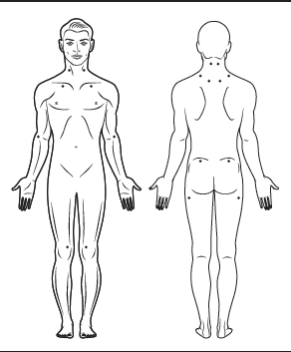
Mood and anxiety disorders are highly comorbid (up to 75%)
Regional pain syndromes also highly comorbid – IBS, headache, pelvic pain

Slide 40
Differential
Culprit medications – Statin related pain or opioid induced hyperalgesia?
Hypothyroidism
Inflammatory rheumatic diseases (RA, polymyalgia rheumatica, SLE, polymyositis)
Osteoarthritis
Neuropathies

Slide 41
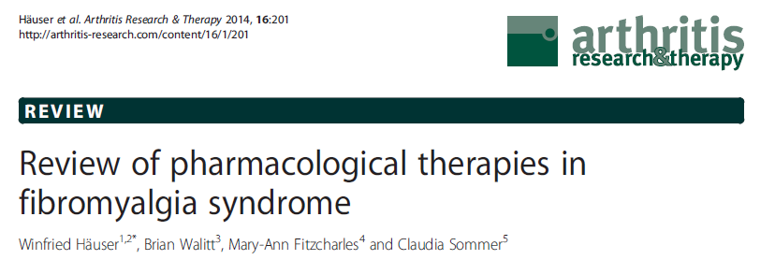
Amitryptyline starting at 10mg nocte
Duloxetine starting at 30mg daily
Milnacipran starting at 50mg mane
Pregabalin starting at 50-100mg nocte
Mostly unlicensed treatments but some efficacy demonstrated across studies

Slide 42

Questions or Comments?

Slide 43
MCQs

Slide 44
General Hospital Psychiatry
MCQs
1. Lesions in the following structure have been associated with pathological crying:
A. Temporal pole
B. Pineal gland
C. Caudate nucleus
D. Pons
E. Tegmentum

Slide 45
General Hospital Psychiatry
MCQs
1. Lesions in the following structure have been associated with pathological crying:
A. Temporal pole
B. Pineal gland
C. Caudate nucleus
D. Pons
E. Tegmentum

Slide 46
General Hospital Psychiatry
MCQs
2. The following theoretical model is commonly applied to somatoform pain disorders:
A. Central demyelination theory
B. Central sensitisation theory
C. Operant sensitisation theory
D. Central operant theory
E. Operant receptive field theory

Slide 47
General Hospital Psychiatry
MCQs
2. The following theoretical model is commonly applied to somatoform pain disorders:
A. Central demyelination theory
B. Central sensitisation theory
C. Operant sensitisation theory
D. Central operant theory
E. Operant receptive field theory

Slide 48
General Hospital Psychiatry
MCQs
3. Diagnostic criteria for Chronic fatigue syndrome requires a duration of symptoms for at least
A. 4 weeks
B. 3 months
C. 4 months
D. 6 months
E. 12 months

Slide 49
General Hospital Psychiatry
MCQs
3. Diagnostic criteria for Chronic fatigue syndrome requires a duration of symptoms for at least
A. 4 weeks
B. 3 months
C. 4 months
D. 6 months
E. 12 months

Slide 50
General Hospital Psychiatry
MCQs
4. Diagnostic criteria for Fibromyalgia requires a duration of symptoms for at least
A. 4 weeks
B. 3 months
C. 4 months
D. 6 months
E. 12 months

Slide 51
General Hospital Psychiatry
MCQs
4. Diagnostic criteria for Fibromyalgia requires a duration of symptoms for at least
A. 4 weeks
B. 3 months
C. 4 months
D. 6 months
E. 12 months

Slide 52
General Hospital Psychiatry
MCQs
5. The following medication is routinely used for treating Fibromyalgia:
A. Carbamazepine
B. Vigabatrin
C. Pregabalin
D. Mirtazepine
E. Mianserin

Slide 53
General Hospital Psychiatry
MCQs
5. The following medication is routinely used for treating Fibromyalgia:
A. Carbamazepine
B. Vigabatrin
C. Pregabalin
D. Mirtazepine
E. Mianserin

Slide 54
Any Questions?
Thank you

